Slide 1
Object-Oriented Programming OOP

Slide 2
OUTLINES
What is OOP
Why OOP
Class and object
Create a class
Create an object

Slide 3
Why Do We Need Object-Oriented Programming?
Object-Oriented Programming was developed because limitations were discovered in earlier approaches to programming.
To appreciate what OOP does, we need to understand what these limitations are and how they arose from traditional programming languages

Slide 4
Procedural Languages
C, Pascal, FORTRAN, and similar languages are procedural languages
A program in a procedural language is a list of instructions
For very small programs, no other organizing principle is needed

Slide 5
Procedural Languages
When programs become larger
A procedural program is divided into functions, each function has
a clearly defined purpose and
a clearly defined interface to the other functions in the program.

Slide 6
Problems with Structured Programming
As programs grow ever larger and more complex many problems may occur
The project is too complex
more programmers are added
complexity increases
……..

Slide 7
Problems with Structured Programming
There are two related problems.
First, functions have unrestricted access to global data.
Second, unrelated functions and data provide a poor model of the real world.

Slide 8
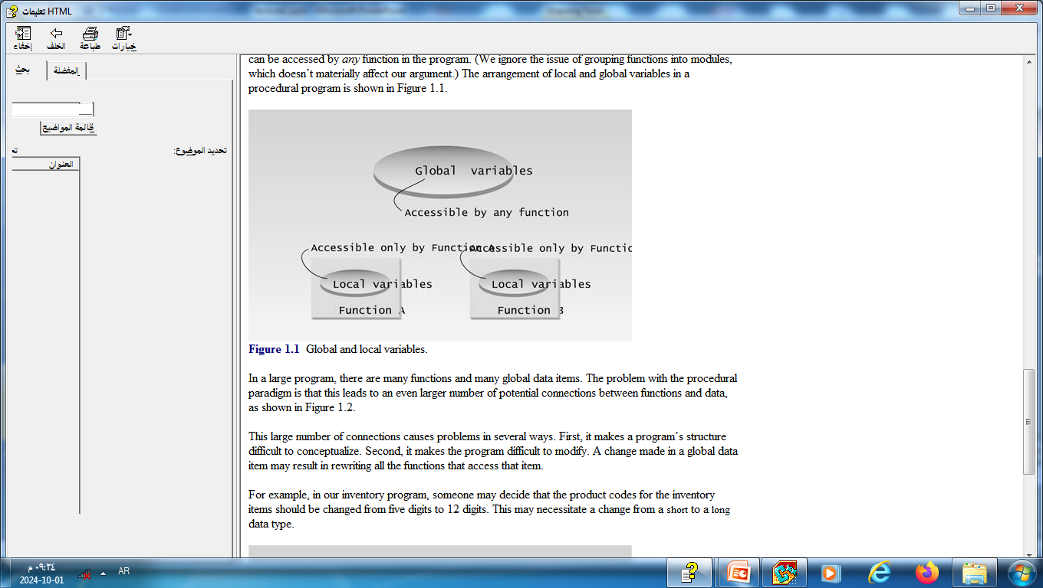
Problems with Structured Programming
Unrestricted Access: Global data can be accessed by any function in the program

Slide 9
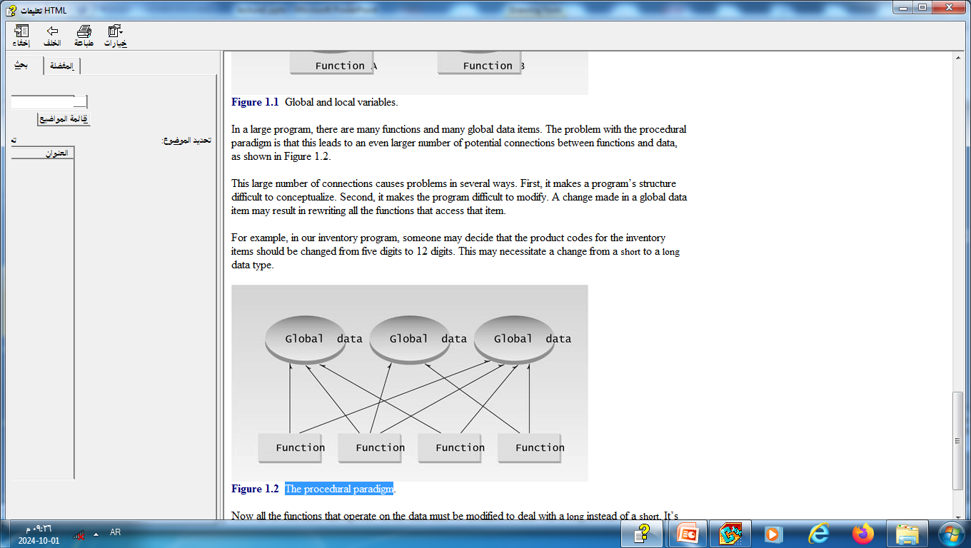
Problems with Structured Programming
The procedural paradigm

Slide 10
Problems with Structured Programming
Real-World Modeling
The third problem with the procedural paradigm is that its arrangement of separate data and functions does a poor job of modeling things in the real world
In the physical world we deal with objects such as people and cars.
Such objects aren’t like data and they aren’t like functions.
Complex real-world objects have both attributes and behavior.

Slide 11
The Object-Oriented Approach
The idea in OOP is to combine into a single unit both data and the functions that operate on that data.
Such a unit is called an object.
These are often referred to as "class members".
Attributes =➔ variables
Methods =➔ functions

Slide 12
If you want to read a data item in an object, you call a member function in the object.
It will access the data and return the value to you.
You can’t access the data directly.
The data is hidden, so it is safe from accidental alteration.
Data and its functions are said to be encapsulated into a single entity.
Data encapsulation and data hiding are key terms in the description of object-oriented languages.

Slide 13
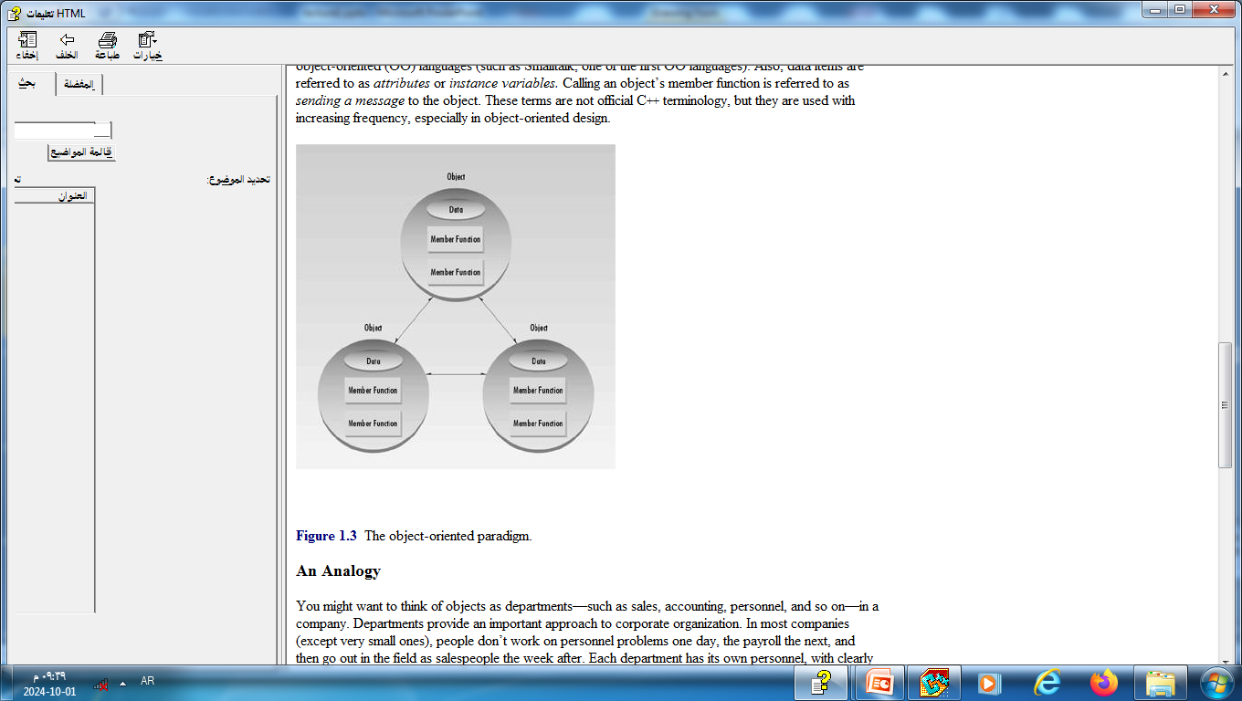

Slide 14
Classes and objects are the two main aspects of object-oriented programming:
A class is a template for objects
An object is an instance of a class

Slide 15
Example: in real life, a car is an object.
The car has attributes, such as
weight
color
and methods, such as
drive
brake

Slide 16
Why OOP
OOP provides a clear structure for the programs
OOP helps to make the code easier to maintain, modify and debug
OOP makes it possible to create full reusable applications with less code and shorter development time

Slide 17
Almost all computer languages have built-in data types
int
char
float
A class is a user-defined data type
We can define many objects of the same class

Slide 18
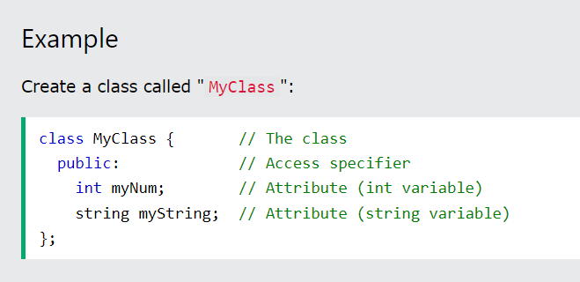
Create a Class
To create a class, use the class keyword
Example

Slide 19
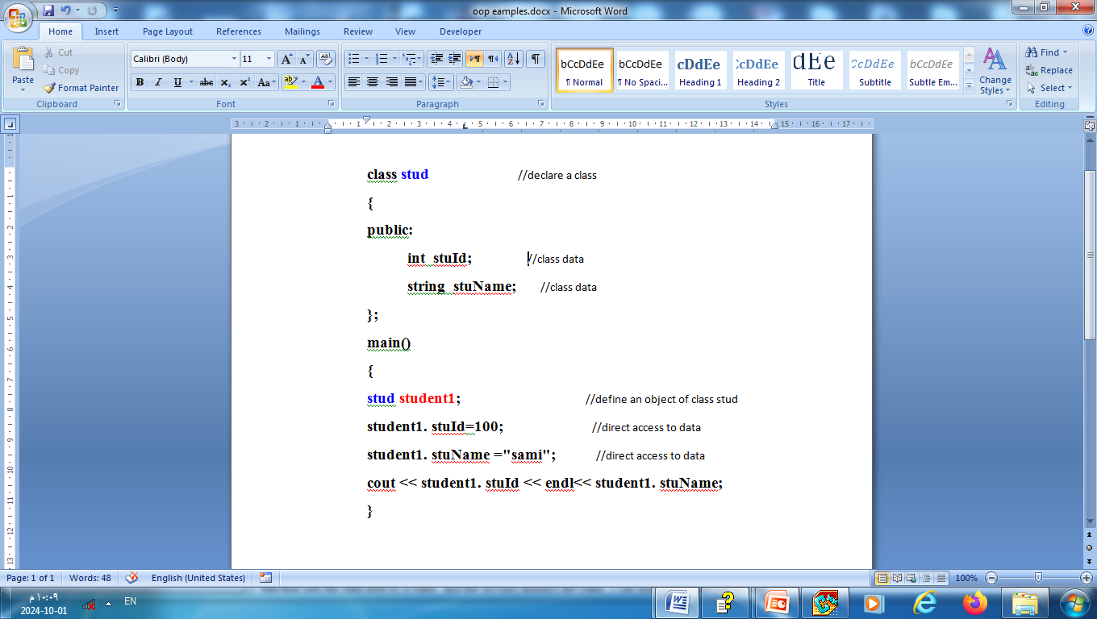

Slide 20
Class Methods
Methods are functions that belongs to the class.
There are two ways to define functions that belongs to a class:
Inside class definition.
Outside class definition

Slide 21
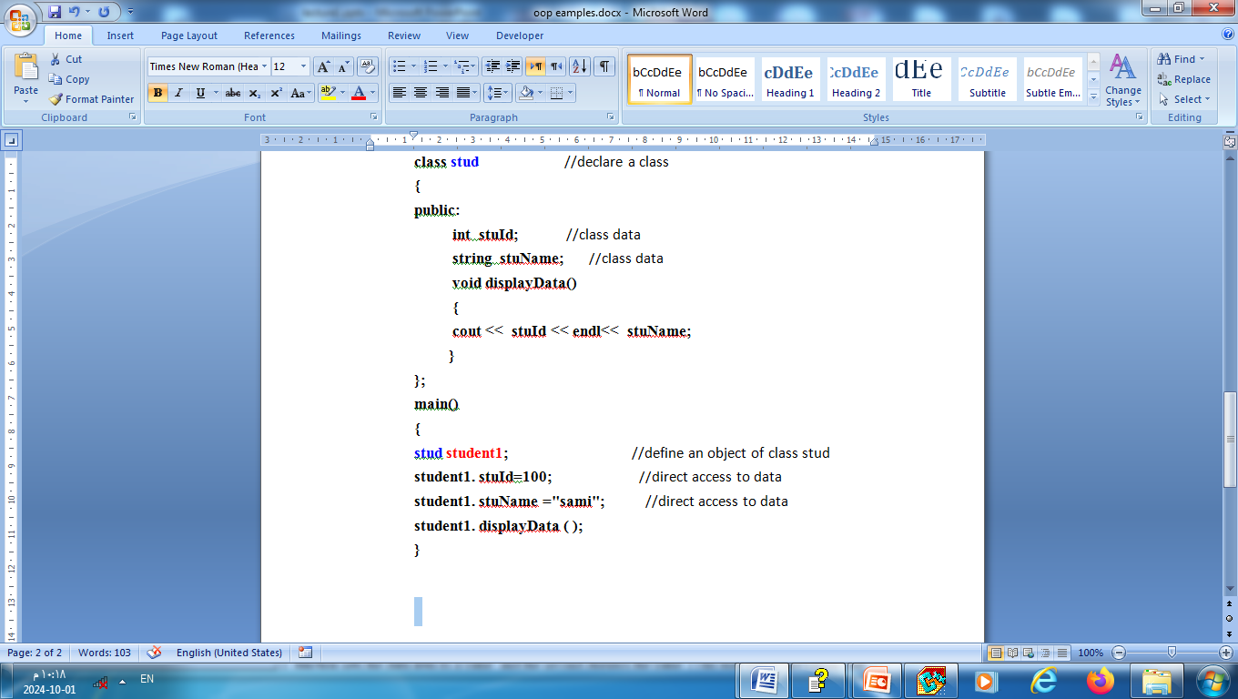
Inside class definition

Slide 22
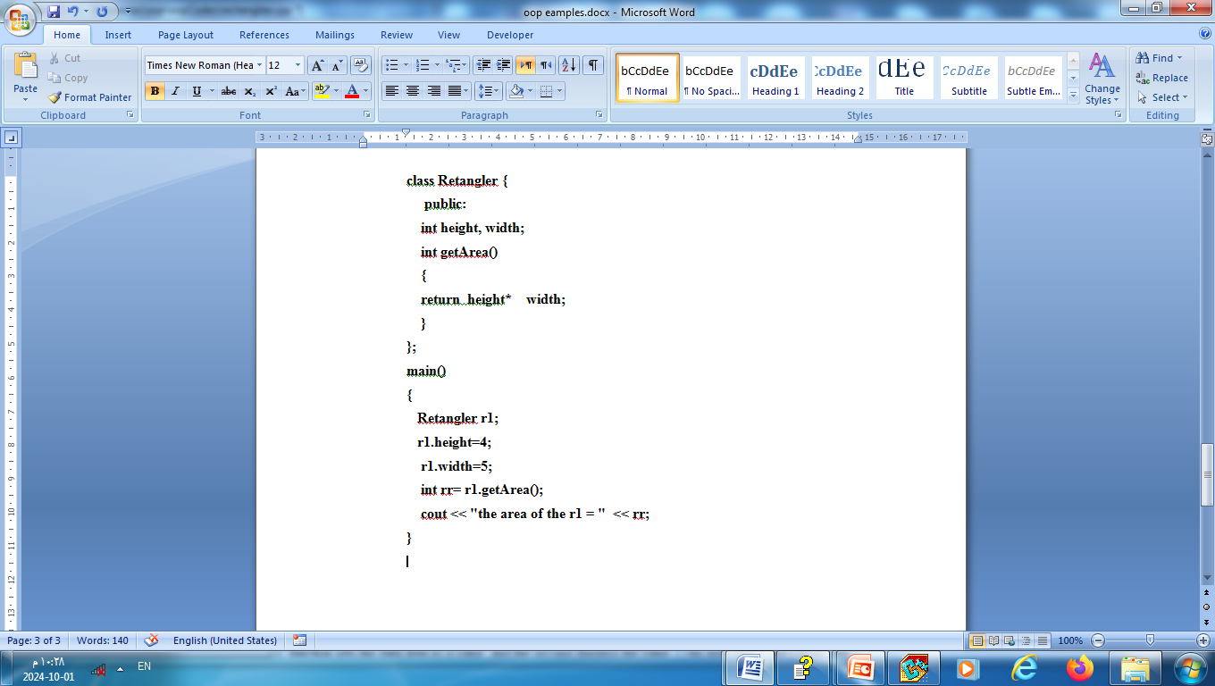
Inside class definition

Slide 23
Outside class definition
To define a function outside the class:
Declare it inside the class
Define it outside of the class.
This is done by specifiying the name of the class, followed the scope resolution :: operator, followed by the name of the function:

Slide 24
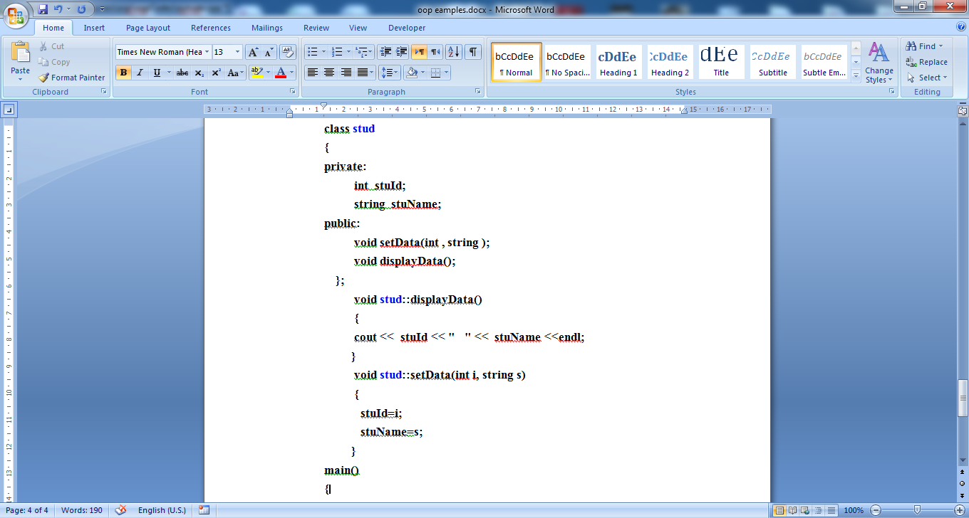
Outside class definition

Slide 25
Function Inside class
Function Outside class
class Sum {
public:
int x, y;
int Result()
{
return x + y;
}
};
class Sum {
public:
int x, y;
int Result();
};
int Sum::Result()
{
return x + y;
}

