Slide 1
Computer Architecture and Organization
Introduction
Lecture 1
Dr.Monia Al_hobishi

Slide 2
What is a Architecture?
The interface between a computers hardware and its software is its Architecture .
The architecture is describe by what the computers instructions do , and how they are specified .

Slide 3
Why study Computer Architecture and Computer Organization?
Computer architecture is a key component of computer engineering and the practicing computer engineer should have a practical understanding of this topic.
It is concerned with all aspects of the design and organization of the central processing unit and the integration of the CPU into the computer system itself.

Slide 4
Definition
Computer Architecture : Computer architecture is defined as the attributes of a system visible to a programmer.
This definition includes the instruction set, instruction formats, operation codes, techniques for addressing memory , the number of bits used to represent data type (number ,characters) , I/O mechanisms.
The computer architecture deals with how to design a circuit for such hardware ,how I design a computer? How dose the computer work ?

Slide 5
Definition
Computer Organization refers to the operational units and their interconnections that realize the architectural specifications.
This definition includes the those hardware details transparent to the programmer, such as control signals; interfaces between the computer and peripherals; and the memory technology used.
The Computer organization deals with how particular hardware works in a computer.

Slide 6
Computer architecture is concerned with structure and behavior of computer as seen by the user .the architectural design of a computer system concerned with the specification of the various functional modules ,such as processors and memories ,and structuring them together in to a computer system .
Computer organization is concerned with the way the hardware components operate and the way they are connected together to from computer system .

Slide 7
Structure and Function
A computer is a complex system; contemporary computers contain millions of elementary electronic components .
• Structure: The way in which the components are interrelated .
• Function: The operation of each individual component as part of the structure

Slide 8
Function
In general terms, there are only four basic functions that a computer can perform :
• Data processing
• Data storage
• Data movement(transfer data)
• Control

Slide 9
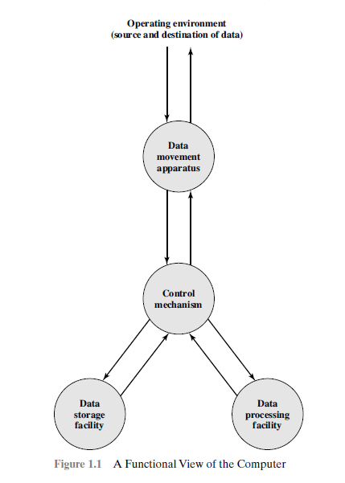
Function of computer

Slide 10
Possible Computer Operation
The computer, of course, must be able to process data.The data may take a wide variety of forms, and the range of processing requirements is broad .
It is also essential that a computer store data.If the computer is processing data on the fly (i.e., data come in and get processed, and the results go out immediately),the computer must temporarily store at least those pieces of data that are being worked on at any given moment.

Slide 11
Possible Computer Operation
The computer must be able to move data between itself and the outside world.
The computer’s operating environment consists of devices that serve as either sources or destinations of data.When data are received from or delivered to a device that is directly connected to the computer, the process is known as( input– output I/O), and the device is referred to as a peripheral. When data are moved over longer distances, to or from a remote device, the process is known as data communications.

Slide 12
Possible Computer Operation
Finally, there must be control of these three functions.
Within the computer , a control unit manages the computer’s resources and orchestrates the performance of its functional parts in response to instructions.

Slide 13
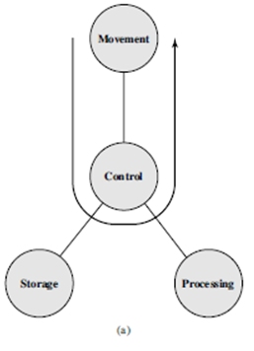
Possible Computer Operation
Data movement device
simply transferring data
From one peripheral
or communications
line to another.

Slide 14
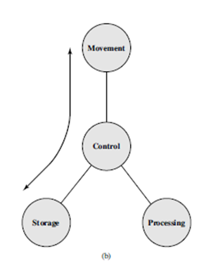
Possible Computer Operation
function as a Data storage device.
with data transferred from
the external environment
to computer storage
(read) &(write).

Slide 15
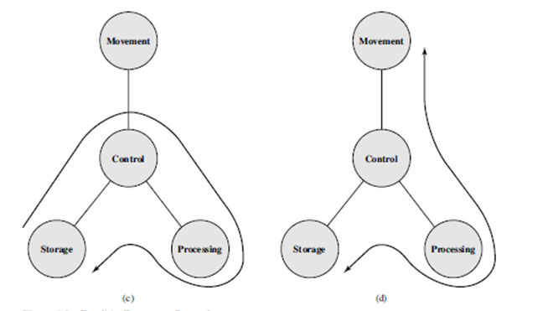
Possible Computer Operation
The final two diagrams show operations involving data processing,
on data either
in storage
(Figure c)
or en route
between
storage and
the
external
environment (Figure d)

Slide 16
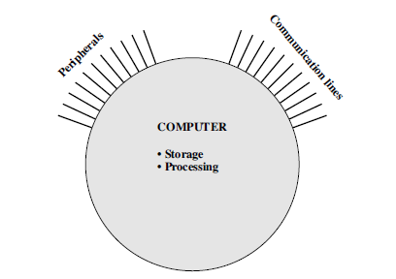
STRUCTURE
Simplest possible depiction of a Computer .
All of its linkages to the external environment can be classified as peripheral devices or communication lines .

Slide 17
Structure of the Computer
1- Simple Single-Processor Computer : there are four main structural components :
Central Processing Unit (CPU):Controls the operation of the computer and performs its data processing functions- processor.
Main Memory: Stores data.
I/O: Moves data between the computer and its external environment.
System interconnection: Some mechanism that provides for communication among CPU, main memory, and I/O.

Slide 18
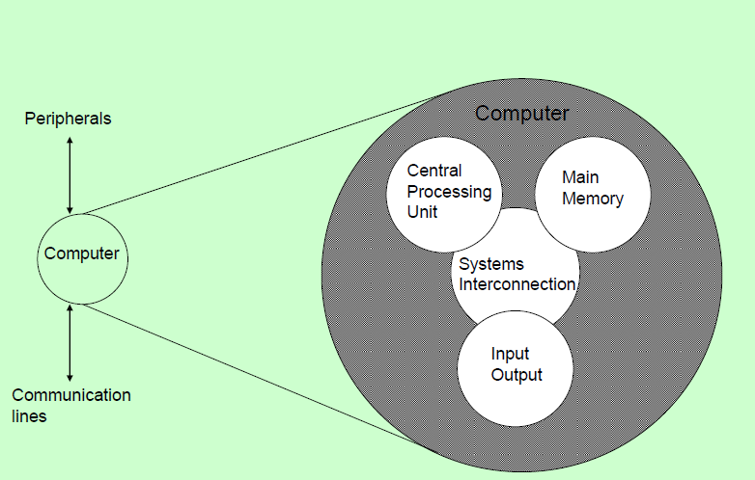
Structure- Top Level

Slide 19
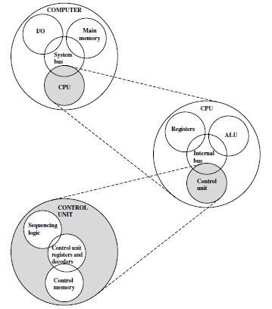
Internal Structure of the Computer
Four main structure component

Slide 20
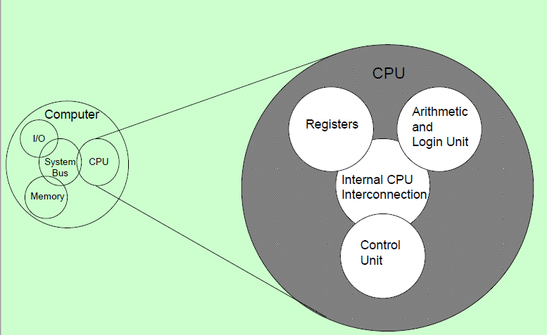
Structure -The CPU

Slide 21
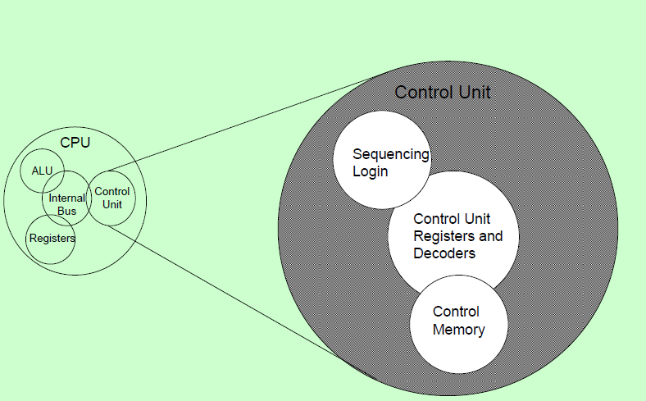
Structure -The Control Unit

Slide 22
Internal structure of the computer
CPU - Its major structural components are as follows:
Control unit: Controls the operation of the CPU and hence the computer .
Arithmetic and logic unit (ALU): Performs the computer’s data processing functions .
Registers: Provides storage internal to the CPU .
CPU interconnection: Some mechanism that provides for communication among the control unit , ALU, and registers .

Slide 23
Structure of the Computer
2- Multicore Computer Structure
As was mentioned, contemporary computers generally have multiple processors.
When these processors all reside on a single chip, the term multicore computer is used, and each processing unit (consisting of a control unit, ALU, registers, and perhaps cache) is called a core.

Slide 24
Structure of the Computer
Central processing unit (CPU): That portion of a computer that fetches and executes instructions.
It consists of an ALU, a control unit, and registers.
In a system with a single processing unit, it is often simply
referred to as a processor .
Core: An individual processing unit on a processor chip.
A core is equivalent in functionality to a CPU on a single-CPU
system.
Processor: A physical piece of silicon containing one or more cores. The processor is the computer component that interprets and executes instructions. If a processor contains multiple cores, it is referred to as a multicore processor.

Slide 25
Elements of a Multicore Computer

Slide 26
Elements of a Multicore Computer

Slide 27
Structure of the Computer
The most prominent elements on the motherboard are the chips.
A chip is a single piece of semiconducting material, typically silicon, upon which electronic circuits and logic gates are fabricated.
The resulting product is referred to as a Integrated Circuit ( IC) .
The motherboard contains a slot or socket for the processor chip, which typically contains multiple individual cores, in what is known as a multicore processor.
There are also slots for memory chips, I/O controller chips, and other key computer components

