Slide 1
CLOUD-BASED WEB SYSTEM DESIGN — MASTER'S PROJECT
PoultryConnect
Connecting poultry farmers directly with wholesale buyers
[Your Full Name] · [Student ID] · [Programme Name] · September 2026
Notes:
[0:00-0:30] Hello, my name is [Your Name] and this is PoultryConnect, my cloud-based web system design project. PoultryConnect is a marketplace that connects poultry farmers directly with wholesale buyers, cutting out the middlemen who usually sit between them. Over the next ten minutes I'll walk through the problem, the architecture, the build, and a short live demo.

Slide 2
THE PROBLEM
Farmers lose margin to middlemen. Buyers lose visibility into supply.
Farmer
Middleman #1
Middleman #2
Wholesale buyer
Raises broilers, layers, eggs — has stock ready to sell
→
Aggregates from several farms, takes a mark-up
→
Transports / resells again, takes another mark-up
→
Finally receives stock — at a marked-up price, with little visibility into where it came from
Research on smallholder market access across Sub-Saharan Africa consistently finds that farm-gate sale to an intermediary remains the dominant channel — not because it's the best price, but because farmers lack storage, transport, and direct buyer information.
PoultryConnect
2
Notes:
[0:30-1:45] The underlying problem is a long, opaque supply chain. A farmer with birds or eggs ready to sell usually goes through one or two layers of middlemen before reaching an actual wholesale buyer — a hotel, a distributor, a market trader. Each layer takes a cut. Agricultural market-access research across Sub-Saharan Africa backs this up: farm-gate sale to an intermediary is the dominant channel, not because it pays best, but because farmers lack storage, transport, and — critically — direct information about who wants to buy. That's the gap PoultryConnect targets.

Slide 3
RESEARCH JUSTIFICATION
Poultry specifically shows the same pattern
Technical value-chain studies describe fragmented small-scale broiler and indigenous-chicken supply chains running through several intermediaries before reaching urban markets.
The large majority of birds in many developing-market poultry sectors are still raised in small, backyard-type operations — precisely the population a low-cost digital channel would help most.
Government and NGO responses — national market-information hotlines, SMS/voice commodity-price services — confirm that information asymmetry, not lack of produce, is the recognised barrier.
PoultryConnect
3
Notes:
[1:45-2:45] This isn't a niche issue in poultry either. Value-chain assessments of poultry markets describe the same fragmented, multi-layered supply chain, and note that limited information about both input and output markets is one of the persistent constraints smallholder poultry producers face. Most birds in many of these markets are still raised in small backyard operations, which is exactly the population a simple digital marketplace can help. And we know digital information tools are seen as a credible remedy, because governments and NGOs already run SMS and hotline services for exactly this reason.

Slide 4
THE SOLUTION
A narrow, two-sided marketplace — not a bloated e-commerce platform
Farmers
Wholesale buyers
Register and list available stock
Browse and filter live listings
Set poultry type, quantity, price, location
View farmer contact details directly
Manage orders: accept, reject, complete
Place an order and track its status
Deliberately excluded from this version: payments, logistics, reviews — kept out so engineering effort stays on the cloud-architecture fundamentals the module assesses.
PoultryConnect
4
Notes:
[2:45-3:30] So the solution is deliberately narrow: a two-sided marketplace with two roles. Farmers register, list stock with quantity, price and location, and manage incoming orders. Buyers browse and filter that live marketplace, see the farmer's contact details, and place orders they can then track. I left out payments, logistics and reviews on purpose — the goal was to spend the engineering effort on the cloud architecture itself, not a full e-commerce build.

Slide 5
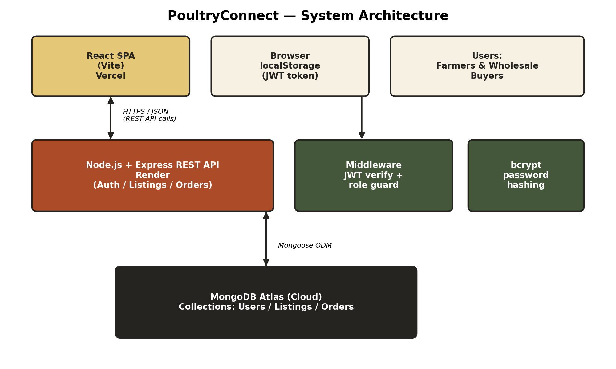
SYSTEM ARCHITECTURE
Three tiers, deployed and scaled independently
PoultryConnect
5
Notes:
[3:30-4:30] Here's the architecture. A React single-page app on Vercel is the presentation layer. It talks over HTTPS to a stateless Node and Express REST API hosted on Render, which handles authentication, listings and orders. That API talks to MongoDB Atlas, a managed cloud database, through Mongoose. Authentication is stateless — a signed JWT sits in the browser and is attached to every request — which means the API tier can scale horizontally without needing shared session storage. Every tier can be redeployed or scaled on its own.

Slide 6
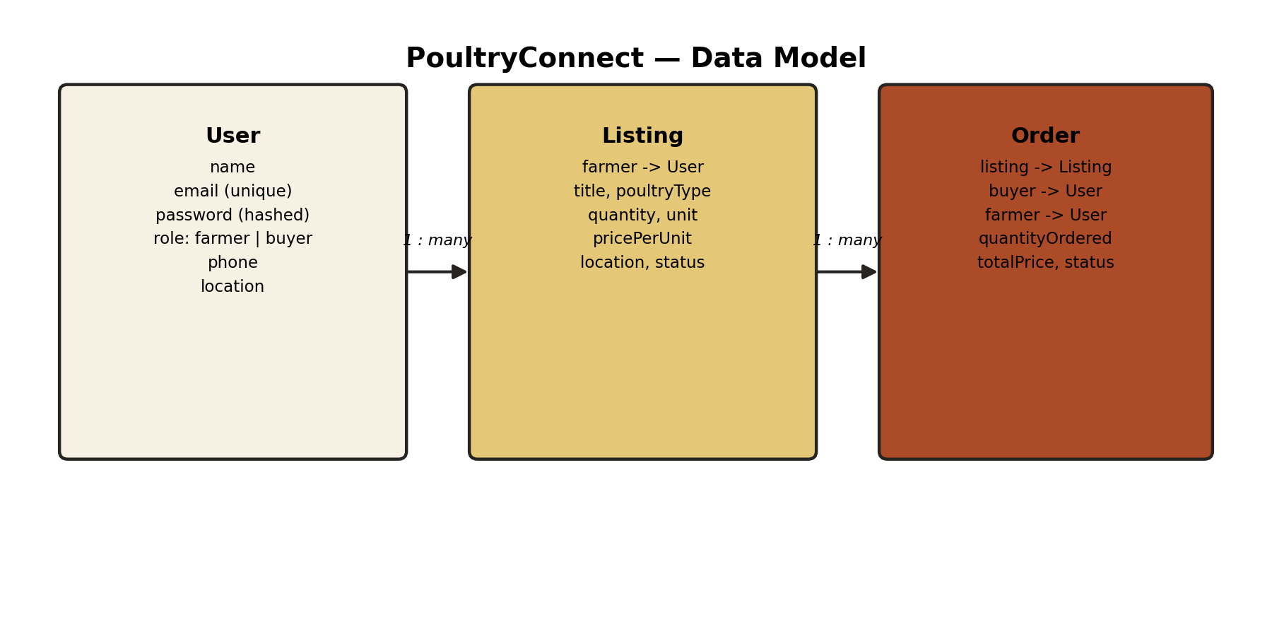
DATA MODEL
Three MongoDB collections, referenced not embedded
Listings and orders are queried and updated independently of the user record, and grow far faster than the user collection — so relationships use referenced ObjectIds, populated at query time with Mongoose's .populate().
PoultryConnect
6
Notes:
[4:30-5:15] The data model has three collections. A User is either a farmer or a buyer, with a hashed password and a role flag the API uses for authorisation. A Listing belongs to one farmer. An Order links a listing, the buyer who placed it, and the farmer who owns it, and carries its own status — pending, accepted, rejected, or completed — independent of the listing's own availability. Because listings and orders are updated far more often than user records, I used referenced IDs rather than embedding, which is the more scalable choice in a document database.

Slide 7
TECHNOLOGY STACK
Every choice was made for a reason, not a default
1
React + Vite
Component-based UI for two very different dashboards; fast solo-dev workflow
2
Node.js + Express
One language across the stack; lightweight, unopinionated REST API
3
MongoDB Atlas
Managed cloud database — flexible schema, zero infrastructure to operate
4
JWT + bcrypt
Stateless auth suited to a decoupled SPA/API; industry-standard password hashing
5
Vercel + Render
Git-push continuous deployment to real public cloud infrastructure
PoultryConnect
7
Notes:
[5:15-6:15] Quickly on the stack, and why: React and Vite for a fast, component-based front end that suits two quite different dashboards. Node and Express so I'm writing one language across the whole stack. MongoDB Atlas because it's a managed, free-tier cloud database — no infrastructure to run myself, and a flexible schema that suits optional listing fields. JWT and bcrypt for stateless, industry-standard authentication. And Vercel and Render because both give git-push continuous deployment to genuine public cloud infrastructure, which satisfies the CI/CD requirement without hand-building a pipeline.

Slide 8
LIVE DEMONSTRATION
What I'll show you now, on the live deployed site
1
Register a farmer account and a buyer account
2
Farmer: publish a new poultry listing
3
Buyer: filter the marketplace and open a listing
4
Buyer: place an order
5
Farmer: accept the order from the dashboard
6
Buyer: see the order status update to "accepted"
Live link: [your-app.vercel.app] GitHub: [github.com/your-username/poultryconnect]
PoultryConnect
8
Notes:
[6:15-8:45] Now let me switch over and show this running live. I'll register a farmer account and a buyer account, publish a listing as the farmer, switch to the buyer account to filter the marketplace and place an order, then switch back to the farmer dashboard to accept that order, and finally show the buyer seeing the status update. [Switch screen share to the live Vercel URL and narrate each step as you click through it.]

Slide 9
SECURITY & DEPLOYMENT
Baseline production practice, not an afterthought
Security
Deployment pipeline
Passwords salted and hashed with bcrypt — never stored in plain text
Single GitHub repo, backend + frontend directories
Stateless JWT authentication with a server-only signing secret
Push to main → Render auto-builds and redeploys the API
Role-based + ownership-checked authorisation on every write
Push to main → Vercel auto-builds and redeploys the SPA
CORS restricted to the known frontend origin
Environment variables injected per-platform, never hard-coded
Secrets in environment variables, excluded from Git via .gitignore
Live within minutes of every accepted change
PoultryConnect
9
Notes:
[8:45-9:30] Briefly on security and deployment. Passwords are salted and hashed with bcrypt and never stored in plain text. Authentication is a stateless, signed JWT. Every write endpoint checks both role and ownership, so a farmer can only edit their own listings. CORS is locked to my known frontend origin, and every secret lives in environment variables, never in the Git repository. On deployment, it's fully git-based continuous delivery: a push to main auto-builds and redeploys both Render and Vercel within minutes, with secrets injected per platform.

Slide 10
LIMITATIONS & NEXT STEPS
Where this goes next
Add payment integration (currently arranged off-platform)
Add listing photos via cloud object storage (S3 / Cloudinary)
SMS/USSD channel for farmers without smartphones
Automated test suite (Jest/Supertest) + dedicated CI workflow
Ratings and trust mechanism for repeat usage at scale
PoultryConnect delivers, at coursework scale, a full cloud-native lifecycle: an evidenced real-world problem, a scalable three-tier architecture, secure implementation, and continuous cloud deployment — a credible foundation for a real pilot with farmers and buyers.
PoultryConnect
10
Notes:
[9:30-10:00] A few honest limitations: there's no payment integration yet, no photo upload for listings, no offline or SMS channel for farmers without smartphones, and no automated test suite beyond the hosting platforms' own build checks. Those are my clear next steps. To close: PoultryConnect takes a genuine, evidenced real-world problem and delivers a working, secure, cloud-deployed solution to it — a solid foundation to build on. Thank you — happy to answer any questions.

