Slide 1

CORPORATE PROFILE
Managed by El Banan

Slide 2


Slide 3

Perspectives

Slide 4

Perspectives

Slide 5

Perspectives

Slide 6


Slide 7


Slide 8
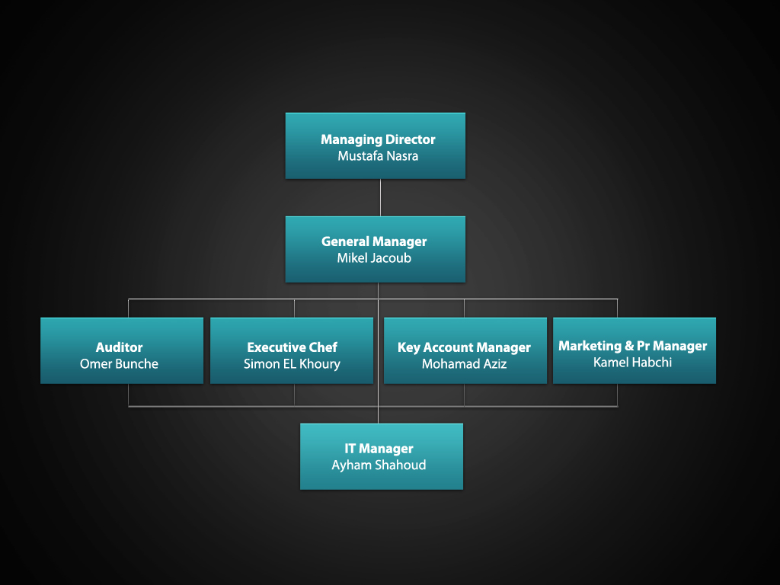

Slide 9


Slide 10


Slide 11


Slide 12


Slide 13


