Slide 1

Data Science with Apache Spark

Slide 2

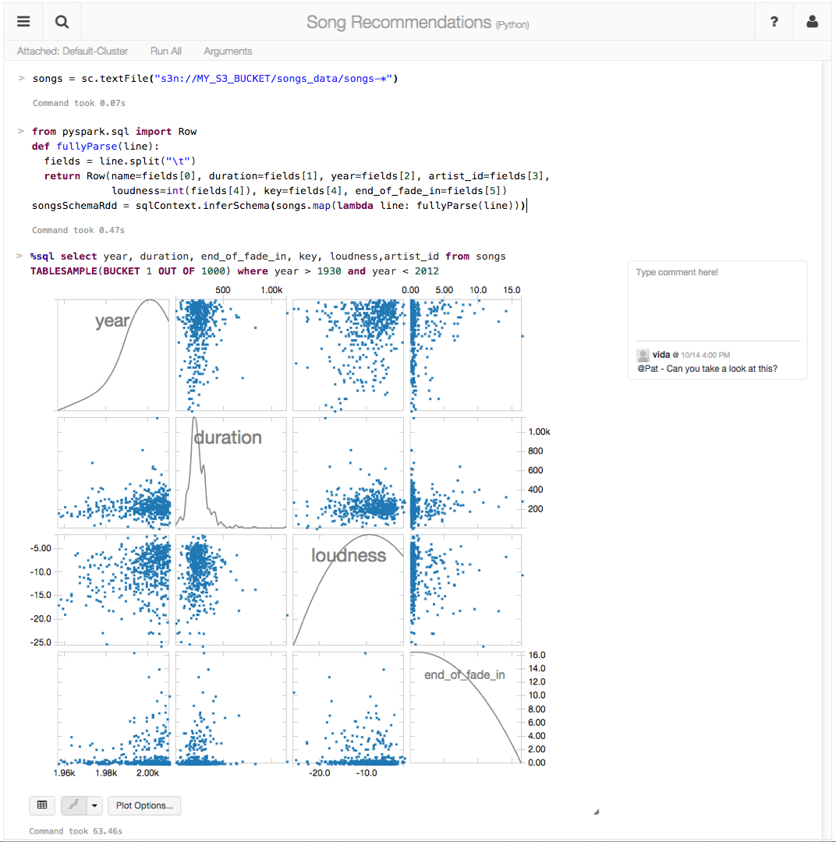
making big data simple
Founded in late 2013
by the creators of Apache Spark
Original team from UC Berkeley AMPLab
Raised $47 Million in 2 rounds
~65 employees
We’re hiring!
Level 2/3 support partnerships with
Hortonworks
MapR
DataStax
Databricks Cloud:
“A unified platform for building Big Data pipelines – from ETL to Exploration and Dashboards, to Advanced Analytics and Data Products.”
Notes:
Databricks is a company that was founded by the creators of the Spark project in 2013.
And one of the first things the founders did after starting the company was donating Spark to the Apache Software Foundation and they remain the largest contributor to Spark’s code base.
Databricks Cloud is a end-to-end hosted service. The goal of our product is to be the easiest place to be up and running with Spark with little or no up-front hardware or cost investment, since it’s a cloud service. We want to help our customers quickly pull out insights via visualization from your data… without worrying about the intricacies of installing and configuring large Hadoop cluster.

Slide 3
The Databricks team contributed more than 75% of the code added to Spark in the past year

Slide 4









About Me
For Fun
Sailing
Rock climbing
Snowboarding
Engineer, Architect & Instructor
Developing with Java since 1995 (Java 1.0)
+15yrs as software developer, architect, and consultant.
Director of Training at Databricks

Slide 5
About Me
For Fun
Sailing
Rock climbing
Snowboarding
For Fun
Sailing
Rock climbing
Snowboarding
Chess

Slide 6
Schedule
Imperial B, Floor 2, 9 a.m. – 5 p.m.
Welcome, Login
TOPIC 1
10:45 – 11 a.m. Coffee Break
TOPIC 2
12 p.m. – 1 p.m. Lunch
TOPIC 3
2:15 p.m. – 2:30 p.m. Soda Break
TOPIC 4
4:00 p.m. – 4:15 p.m. Coffee Break
TOPIC 5

Slide 7
Files and Resources
Documents
Slides and files available at http://tinyurl.com/Spark-DS-Files
Class Notes: http://tinyurl.com/Spark-DataScience-TD1
Databricks
Databricks login at: https://ssw2016.cloud.databricks.com
Username distributed by email prior to class
Password is BigDataSimple#01
Please let us know ASAP if there is a problem
Use a laptop with Firefox or Chrome
Internet Explorer / MS Edge not supported

Slide 8
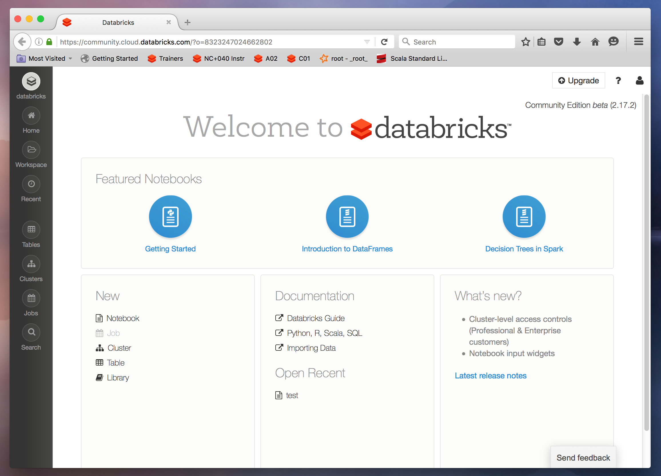
Go Ahead and Log in to Databricks!

Slide 9
End of Intro

