Slide 1

SPIM SUITE
A Web-Based Business Management ERP for Field Operations
Expenses • Income • Attendance • Salary • Projects • Reports
Designed & Developed by Aboorvan | Python / Django Full-Stack Project

Slide 2




What is SPIM Suite?
SPIM Suite is a centralized ERP web application built to help small and mid-size service businesses manage their day-to-day operations — from tracking site-wise income and expenses, to staff attendance and salary cycles, to client projects and invoices.
Built end-to-end with Django and PostgreSQL, the platform replaces scattered spreadsheets and manual registers with one connected, real-time system accessible from any device.
6+
1
PWA
Core Modules
Unified Dashboard
Cross-Device Access
Built For
Construction & maintenance contractors
Multi-site businesses tracking income/expense per location
Teams needing attendance + payroll in one place
Owners who want real-time financial visibility
Site-wise Finance
Attendance & Payroll
Projects & Clients
Reports & Exports

Slide 3


Core Modules
Every operational area of the business, in one connected platform
Expense Manager
Income Tracker
Attendance Registry
Site-wise debit tracking with category breakdowns, inline Excel-style editing & exportable reports
Record income per site/source, linked directly to expense balances for accurate net positions
Daily attendance with bulk entry, auto Sunday holidays, and row locking for past dates
Salary Management
Projects & Clients
Dashboard & Reports
Automated salary cycle calculations with downloadable payslips (PDF/Excel)
Track active projects, client details and invoices alongside financials
Daily / monthly / yearly income vs. expense views with branch-wise filters

Slide 4
Feature Spotlight
Excel-Style Expense Manager
Site-Based Cards
Every branch/site gets its own color-coded card showing live credit, debit and balance.
Inline Editable Rows
Click to edit category-wise debit amounts directly in a spreadsheet-style table — no popups.
Category Breakdown
Food, Room, Diesel, Travel, Ticket, Misc. — every rupee categorized for clarity.
Linked to Income
Credit values flow read-only from the Income module, keeping balances always accurate.
Monthly Views & Reports
Filter any site by month and download a complete report on demand.

Slide 5
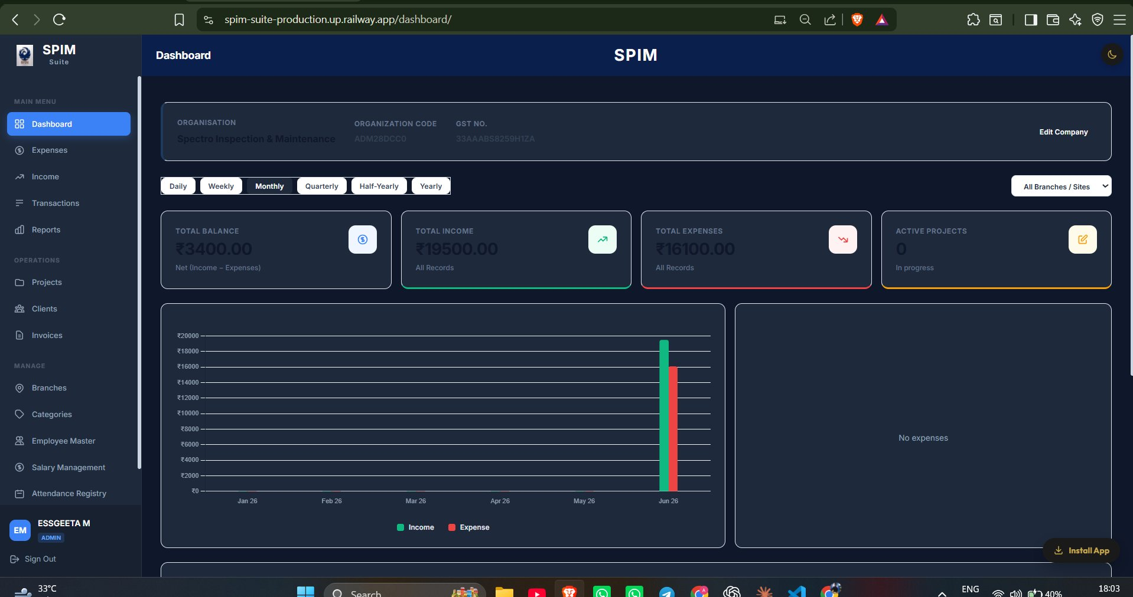
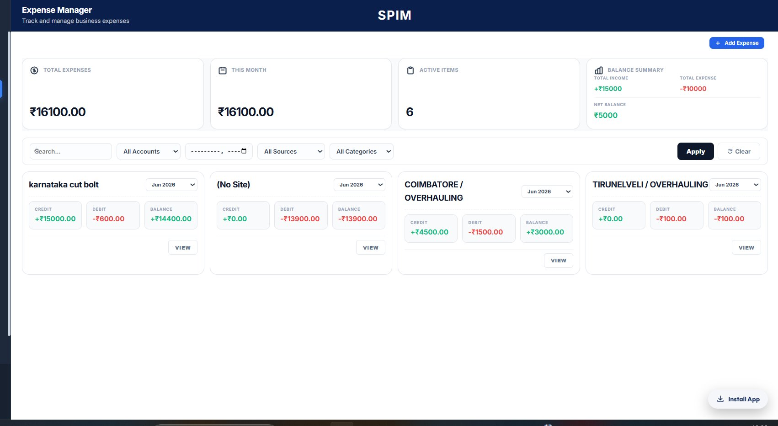
Product in Action
Live dashboard and expense management views from the deployed application
Real-time financial dashboard with income vs. expense charts
Color-coded, site-wise expense cards

Slide 6






Technology Stack
A modern, production-ready full-stack toolkit
Python
Django
PostgreSQL
Core application logic
Web framework & ORM
Production database
HTML / CSS / JS
Railway
Vercel (PWA)
Responsive front-end UI
Backend & DB hosting
Installable web front-end

Slide 7



Architecture & Deployment
Cloud-hosted, connected, and accessible across devices
Backend + Database
Web App (PWA)
SPIM Lite (Mobile)
Railway — Django + PostgreSQL
Vercel — Installable PWA
React Native / Expo
Hosts the core application, REST API and persistent data store. Single source of truth for all modules.
Fast, installable progressive web app for desktop & iOS, with offline-friendly service worker and Apple meta tags.
Companion mobile app for attendance & salary, syncing via the same Railway REST API as APK on Android.
Live Deployments
Web App (Railway): spim-suite-production.up.railway.app
PWA (Vercel): spim-lite.vercel.app

Slide 8



What This Project Demonstrates
End-to-End Ownership
Production Engineering
Business-Centric Thinking
Requirements gathering directly from business owners
Full schema design & Django ORM modeling
UI/UX iteration based on real user feedback
Cloud deployment on Railway with PostgreSQL
CORS-secured API for multi-platform clients
Iterative bug fixing on live production data
Site-wise financial tracking matching real workflows
Automated salary cycles & attendance rules
Exportable reports for offline business use

Slide 9

Let's Connect
Open to full-time roles, freelance projects & collaborations
in Python / Django full-stack development.
Aboorvan | Software Developer (Python / Django / Full-Stack)
Thank you for viewing!

