Slide 1
Symfony and Twig
Small Introduction

Slide 2
Why
Talk request
Somebody has no idea about Symfony
People eager to start
Symfony pros around
Talk in English

Slide 3


Disclaimer
It was late and I was drunk This talk was prepared overnight
Critics and proposals are highly welcome
I’m not affiliated with

Slide 4
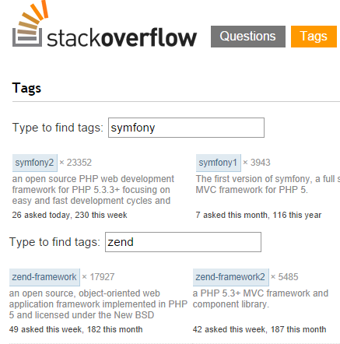

Why Symfony?
State of the art technology
Widespread buzz-word
Easy to find help
Good docs
Great community
Notes:
- phpBB, Drupal and Shopware using Symfony or its modules

Slide 5
Symfony essentials
Models and Doctrine ORM
View rendering and Twig
Controllers and routing
Reusable code, Bundles and Services

Slide 7

What is Twig?
, which is:
A template engine
Fast
Secure
Flexible
?
A circle of life: Smarty > … > Jinja > Django > Twig
Notes:
Fast: Twig compiles templates down to plain optimized PHP code. The overhead compared to regular PHP code was reduced to the very minimum.
Secure: Twig has a sandbox mode to evaluate untrusted template code. This allows Twig to be used as a template language for applications where users may modify the template design.
Flexible: Twig is powered by a flexible lexer and parser. This allows the developer to define its own custom tags and filters, and create its own DSL.

Slide 9
How about performance?
xially 30 november 2011
Plain variable
 | Compiling | Execution
Smarty 3.1.1 | 16.320 seconds | 0.058 seconds
Twig 1.2.0 | 9.757 seconds | 0.083 seconds
Accessing arrays in a loop
 | Compiling | Execution
Smarty 3.1.1 | 0.065 seconds | 0.009 seconds
Twig 1.2.0 | 0.131 seconds | 0.082 seconds
Template inheritance
 | Compiling | Execution
Smarty 3.1.1 | 1.329 seconds | 0.002 seconds
Twig 1.2.0 | 2.641 seconds | 0.121 seconds
http://umumble.com/blogs/php/smarty-vs-twig%3A-performance/
http://upstatement.com/blog/2013/10/comparing-php-template-languages-for-wordpresss/
http://fabien.potencier.org/article/34/templating-engines-in-php
https://github.com/jbroadway/template-bench

Slide 10

Questions?

Slide 11

Brought to you by
Anton Boritskiy
email: anton.boritskiy@gmail.com
github: aboritskiy

