Slide 1

Partiu Project progress report
Ivaldo de Souza
Alex Borjas
18-02-2019

Slide 2
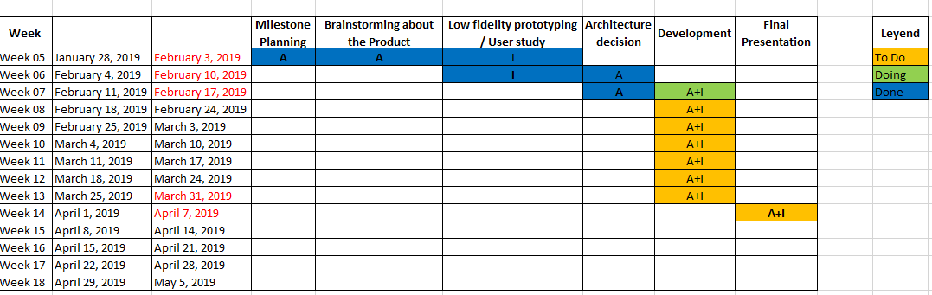
Project progress

Slide 3
Questionnaire - Secuence
Personal
Additional
Travel
Considerations
Age
Gender
Status
Use to travel
Interests
Activities
Reasons
Before choosing destination
Type of holidays
Time to spend
Time of year
Who would you go with ?
Price per night
Type of transportation
Related to: Benchmarking-TravellingSites.xlsx -> Questionnaire-Parameters

Slide 4
Solution Architecture – Software components
Mobile Device
User Interface
App Layer
Core Library
Business Layer
Service Access Layer
Data Access Layer
Database
Data modeling
Firebase Engine

Slide 5
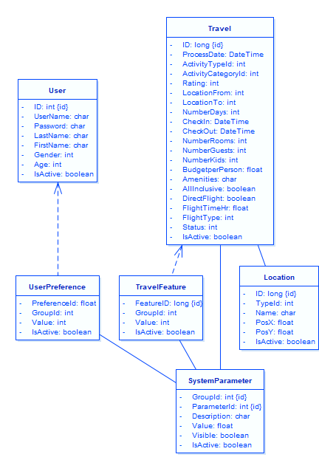
Solution Architecture – Data modeling

