Slide 1
Vehicle Registration System
Cayman Islands (2015-2016)

Slide 2
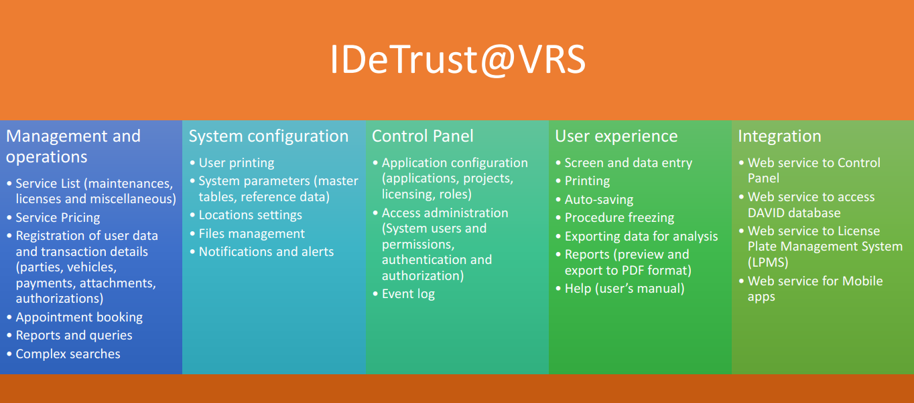
Vehicle Registration System (Business Requirements)

Slide 3
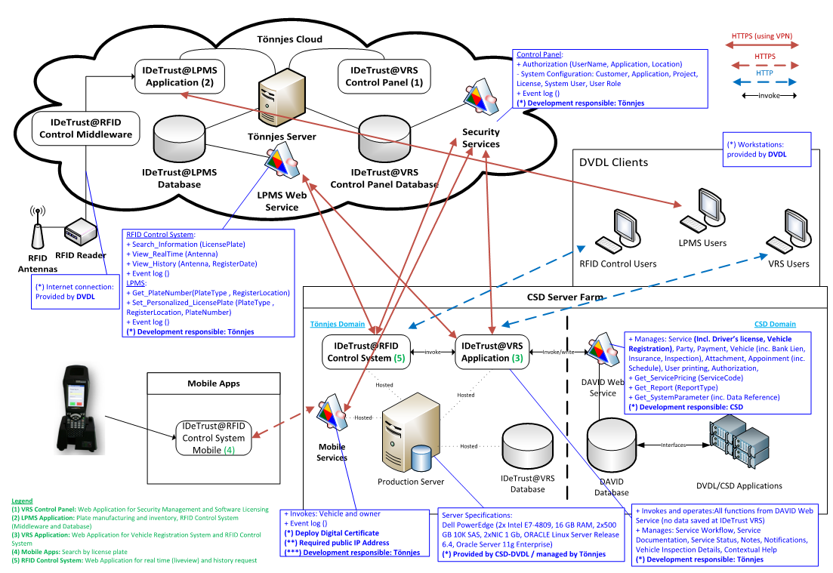
Vehicle Registration System (Solution Architecture)

Slide 4
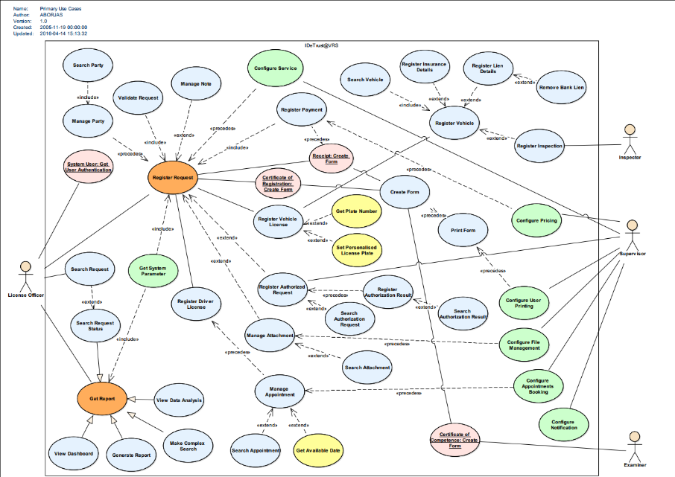
Vehicle Registration System (Primary Use Case)

Slide 5
Vehicle Registration System (Web site – Menu)
Party
Register/Search Person/Company/Signatory
Register/Search Insurance/Bank/Institution
Merge/demerge
Vehicle
Register
Suspend/terminate/reactivate
Configuration
Reasons
Queries
Active licenses
Overdue licenses
Request
Service list
Customer services
Administrative services
Register
Authorizations
Cancellation
Search/View
Appointment booking
Register
Request
Result
Configuration
Schedule
Location
Inspectors
Instructors
Reports and queries
Stationary Inventory
Settings
System users (location/printer)
Register/Search
Configuration
Articles
Cash transaction
Register
Transaction
Adjustment
Configuration
Account
Exchange rate
Locations and Printers
System parameters
Countries
Service management
Quotation
Payment Plan
Reports from DAVID
Payment Report
Statistics
Party’s queries
Reminder’s queries
AMANDA
Event log

Slide 6
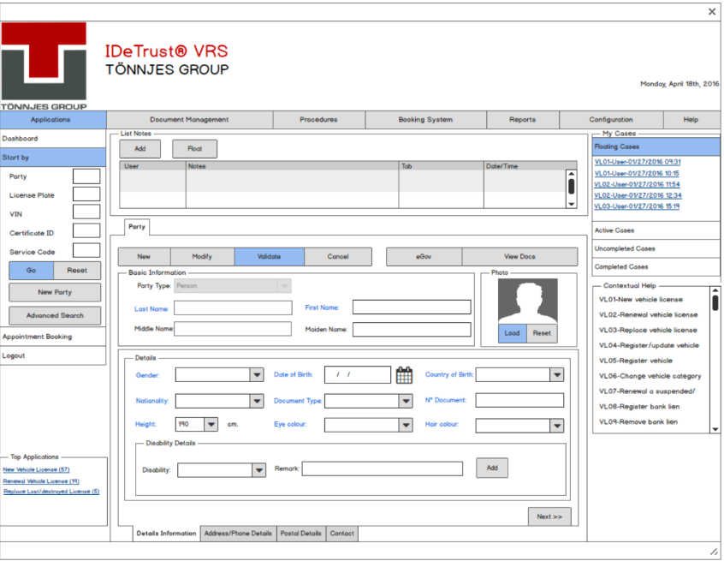
Vehicle Registration System (Prototypes)

Slide 7
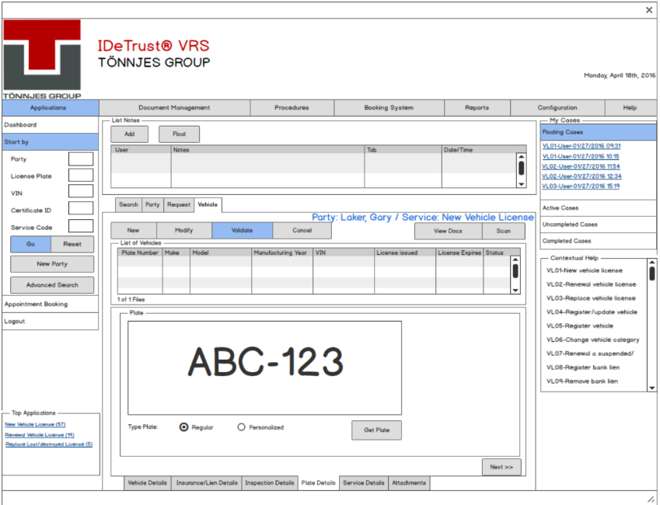
Vehicle Registration System (Prototypes)

Slide 8
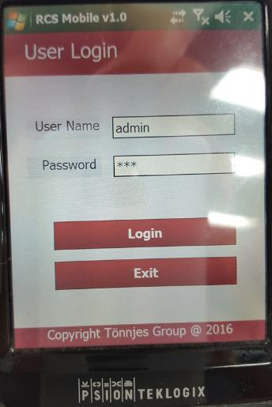
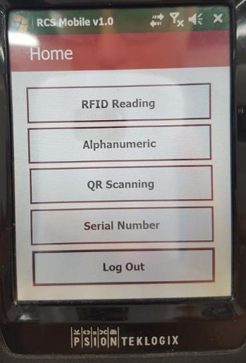
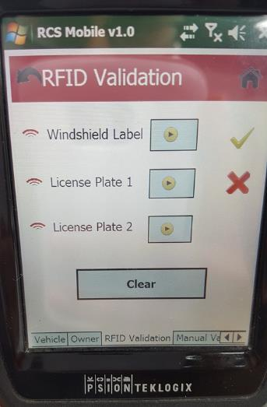
Vehicle Registration System (Mobile App)

