Slide 1
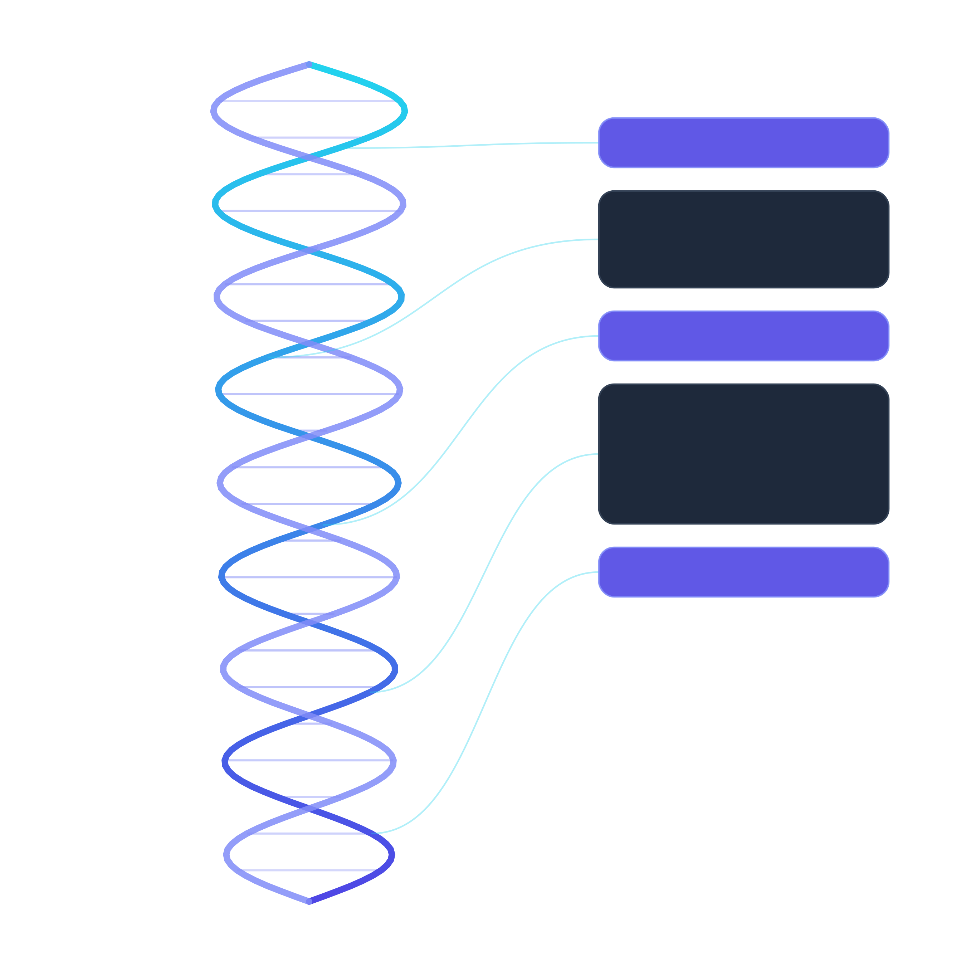
InterfaceDNA
Goal-adaptive AI-powered interfaces for complex digital systems
Instead of making users learn the system,
what if the system understood the goal first?
IS 492 • Checkpoint 1
Aabha Borle • Anisha Kango • Sakshi Katolkar
Fall 2026

Slide 2






The problem: one goal, five different pages
One simple question forces a student to visit five different systems.
A student asks:
Degree Audit
Registration
Advising
Policies
Account Holds
“What do I still need
to graduate?”
requirements
courses
next steps
rules
blocks
The hard part is not clicking around, it is combining information from all five, reading the rules, and figuring out the correct next step.
IS 492 • Checkpoint 1
InterfaceDNA 2

Slide 3




What we learned from 8 papers
We grouped the papers into four themes, each of which tells us something InterfaceDNA needs.
1
2
3
4
- Anisha
- Aabha
- Aabha
- Sakshi
Web agents
Generative UI
Adaptive UI
Human control
Mind2Web • WebArena
WorkArena • WebVoyager
Chen et al., 2026
SUPPLE • Gajos et al.
Amershi et al., 2019
AI can understand a goal and use a website, but long, multi-step tasks are still unreliable.
LLMs can go beyond chat and build an interface that fits the task.
Adaptive UIs existed before LLMs and help, but only when changes stay stable and predictable.
AI should show uncertainty, let users correct it, and ask before doing anything important.
The gap: existing work teaches AI to operate a fixed interface. Nobody asks whether the interface itself can adapt around the user's goal.
IS 492 • Checkpoint 1
InterfaceDNA 3

Slide 4

Our idea: AI adapts the interface, not just navigates it
Same user, same goal - two very different approaches.
TODAY
INTERFACEDNA
AI navigates a fixed portal
AI builds the screen around the goal
“Can I drop
CS 411?”
Registration
Billing
Advising
Records
AI learns where
to click
one focused
task view
Policies
Central question: can GenAI turn a plain-English goal + the student's current data into a screen that is more direct, understandable, and actionable?
IS 492 • Checkpoint 1
InterfaceDNA 4

Slide 5







How InterfaceDNA works
Five steps. The AI understands and plans regular software checks and executes them.
1
2
3
4
5
Goal
Interpret
Retrieve
Plan
Compose
Student types a
plain-English request
AI turns it into a
structured intent
Pull the student's
data + relevant policies
Steps, warnings,
and valid actions
Assemble one
focused task screen
GenAI handles
Regular software handles
understanding the goal • planning the task • composing the screen
permissions • validation • actually executing the action
The AI never changes student data directly. Important actions always need the student to confirm.
IS 492 • Checkpoint 1
InterfaceDNA 5

Slide 6

Example: “Can I drop CS 411?”
The output is not a chat answer; it is a small workspace built for this one task.
Course Drop - CS 411
Eligible
STUDENT GOAL
“Can I drop CS 411?”
Deadline
Holds
Impact
Behind the scenes it checks:
Sept. 30 • 11:59 PM
None blocking
May affect full-time status
drop deadline
holds on the account
Relevant policy
Dropping after the deadline requires an exception. Review financial and enrollment consequences before confirming.
impact on full-time status
the policy that applies
Review drop action
Keep course
what the student can do next
IS 492 • Checkpoint 1
InterfaceDNA 6

Slide 7



Checkpoint 2: how we will test it
Two questions: does the pipeline get things right, and is it actually easier than chat?
25-30
Did the AI get it right?
Is it easier than chat?
Understood the goal correctly
Steps to finish the task
test scenarios
fewer
Gathered all required information
Each one has a known correct answer: the goal, the data needed, the policy, the valid actions, and when to ask for confirmation.
Cited the correct policy
Picked the correct next action
more often
Offered only valid actions
Screen was complete
Effort felt by the user
lower
simulated university portal
Asked for confirmation when required
Success = the adaptive screen helps students finish the task faster and more correctly than a chat-only assistant.
IS 492 • Checkpoint 1
InterfaceDNA 7

Slide 8




Risks, how we handle them, and what comes next
We are deliberately keeping the first prototype small and testable.
AI makes up a policy
AI takes an unsafe action
Only use a fixed, approved set of policy documents
Only pre-approved backend functions + the student must confirm
Student privacy
Prompt injection / bias
Use synthetic (fake) student data while building
Adversarial testing + the system says “I'm not sure” when confidence is low
Roadmap
CP2
Oct. 8
test the pipeline
CP3
Nov. 5
build the prototype
CP4
Dec. 3
final evaluation
Can GenAI make complex systems feel simple - by shaping the interface around what the user is actually trying to do?
IS 492 • Checkpoint 1
InterfaceDNA 8

Slide 9
Thank You!

