Slide 1
: Introduction To Cloud Computing**
LearnLift - AI

Slide 2
Benefits of Cloud Computing
Reduced costs: Payasyougo pricing model eliminates the need for upfront capital expenditures.
Increased flexibility: Scalable resources can be quickly provisioned to meet changing business needs.
Enhanced collaboration: Secure and reliable access to data and applications from anywhere, at any time.

Slide 3
Cloud Computing Models
Public Cloud: Ondemand access to shared resources, managed by a thirdparty provider.
Private Cloud: Dedicated resources for a single organization, managed internally or by a thirdparty provider.
Hybrid Cloud: Combination of public and private clouds, allowing for seamless integration and data transfer.

Slide 4
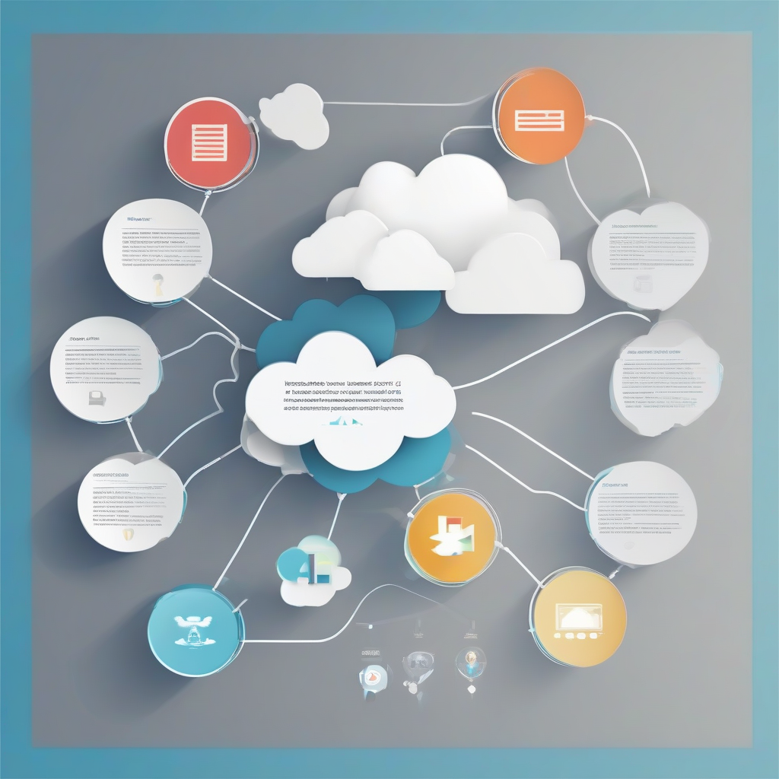
Key Cloud Computing Technologies
Virtualization: Allows multiple virtual machines to run on a single physical server.
Containerization: Packages applications and their dependencies into a single container for easy deployment.
Serverless Computing: Enables applications to run without provisioning or managing servers.

