Slide 1

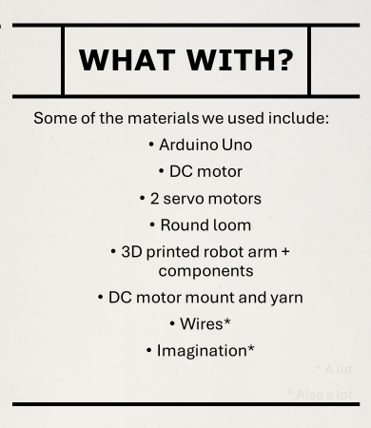
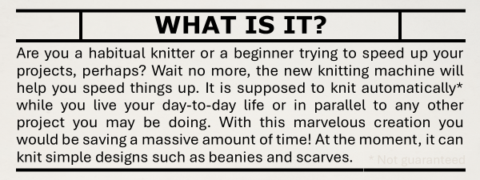
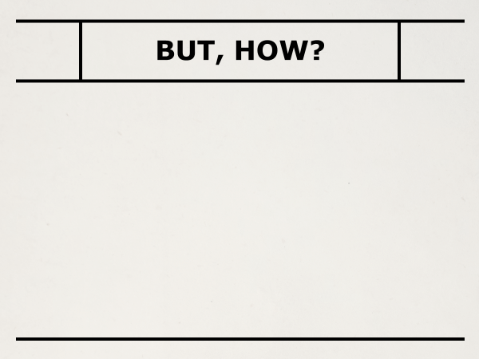
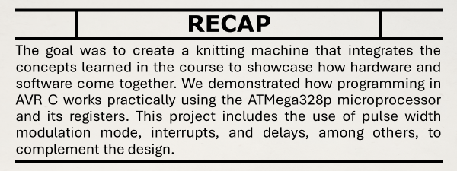
Start - - - - - - v
value of button is 1
v - - - - - - - |
- - > DC motor function start/check button status
| | true
| - - - - - - - - - - - -
| false | |
| v |
| Servo motor function start/check button status |
| | true v - - - -
| - - > Button is pressed
| false | program paused
- - - - - - - - - - - - - - -

