Slide 1
C++ STL Vector Container
And C++ STL Array container,
A few STL algorithms

Slide 2
STL Vector Container
Header file <vector>
Important member functions
begin() and end(): return iterators
clear(): delete all elements
push_back(): insert at end
pop_back(): delete last element
size(): number of elements
empty(): if vector is empty
resize(): change vector size

Slide 3
Maximum and Average Values
See max_avg.txt and max_avg.cpp
To compile: make max_avg.x
In general, in order to compile a program with name.cpp, you can type: make name.x, due to the way we write our makefile

Slide 4
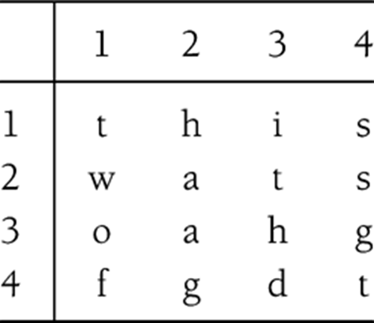
Word Puzzle
Problem description
word_puzzle.pdf
Section 1.1 in textbook
Key question
How to maintain word list (dictionary)
Throughout the semester, we will show a number of different solutions using different containers
Find the words in the puzzle, given a 2-D array and a word-list.

Slide 5
Word Puzzle
Explaining the source code
word_puzzle_vector.h, word_puzzle_vector.cpp
Pay attention to the use of I/O streams, stringstreams, strings, and vector
To compile: make

Slide 6
C++ STL Array Container
New in C++11
Similar to array in C/C++ in that Array has fixed size memory
Will not grow or shrink like other containers such as Vector
Support similar interfaces as other containers
But with notable difference (see next slide)
Likely more efficient than Vector
Use vector if you need to grow or shrink container
Use vector if you are not sure
Notes:
We do not want to over-emphasize the efficiency of array over vector. Despite the efficiency of array over vector, it is likely that you should still prefer to use vector whenever you are not sure which one (array or vector) to use.

Slide 7
STL Array Container
Header file <array>
template < class T, size_t N > class array;
Important member functions
begin(), end(), for iterator support
size(), max_size(), size of array
empty(), test if size of array is zero
Index operator[], at(), access element at specified position
front(), back(), refer to first and last element, respectively
data(), return a pointer to internal data (C/C++ pointer)
fill(), set all elements in array to the specified value

Slide 8
STL Array Container
See array_sort.cpp
To compile: make array_sort.x
Copy is an STL algorithm in <algorithm>
http://www.cplusplus.com/reference/algorithm/copy/
Similarly, sort is an STL algorithm
http://www.cplusplus.com/reference/algorithm/sort/
Note also the behavior of size(), max_size(), and fill()

Slide 9
STL Algorithm sort()
Function signature
void sort(RandomAccessIterator first, RandomAccessIterator last);
void sort(RandomAccessIterator first, RandomAccessIterator last, Compare comp);
Sort elements in the range [first, last)
Note that containers must be random access containers
The first version using operator<() overloaded for the corresponding data type
The second version using function object of type Compare
You can also use function or lambda function
Function objects and lambda functions discussed in next few slides
http://www.cplusplus.com/reference/algorithm/sort/

Slide 10
Using Regular Function with Sort()
You can use regular function to compare elements in container to be sorted
See r3/example5.c

Slide 11
Function Objects (Functors)
Objects whose primary purpose is to define a function
To be passed into another function, such as sort()
Read Section 1.6.4 in the textbook
Review lecture notes ch1_cpptemplate.pptx
http://www.cplusplus.com/reference/functional/
Compared to function (and lambda function), functors have the advantages that you can “configure” the comparison, for example, you only want to compare elements within certain range, which can be specified by the member variables of functors

Slide 12
Function Objects
Using function objects with the sort() function
See r3/example2.cpp

Slide 13
Lambda or Unnamed Functions
Since C++2011
Similar to regular function, but you do not pre-define it, instead, you specify it on the function call (for example, sort())
It does not have a function name
https://msdn.microsoft.com/en-us/library/dd293608.aspx
See r3/example4.cpp

Slide 14
STL Algorithm find()
Function signature
InputIterator find (InputIterator first, InputIterator last, const T& val);
Search val in the range [first, last)
Return iterator to first appearance of val in the range
Return last if not found in the range
http://www.cplusplus.com/reference/algorithm/find/
See examples/r3/example1.cpp

Slide 15
STL Algorithm max_element()
Function signature
ForwardIterator max_element(ForwardIterator first, ForwardIterator last);
ForwardIterator max_element(ForwardIterator first, ForwardIterator last, Compare comp);
Return largest value in the range [first, last)
The first version using operator<() overloaded for the corresponding data type
The second version using function object of type Compare
You can also use lambda function for the comparison
http://www.cplusplus.com/reference/algorithm/max_element/
See r3/example3.cpp

