Slide 1


CAT WEIGHT
COMPANION
White-Label App for Pet Food Brands
"Your brand. Your customers. Zero liability."
Notes:
Welcome. Cat Weight Companion is a white-label iOS application designed specifically for pet food brands. We give you a branded customer engagement tool that creates ongoing touchpoints after purchase. This happens without exposing your brand to medical liability, data privacy risks, or scope creep. Today I'll walk you through the problem we solve, how the product works, and most importantly, what we deliberately chose NOT to build.

Slide 2


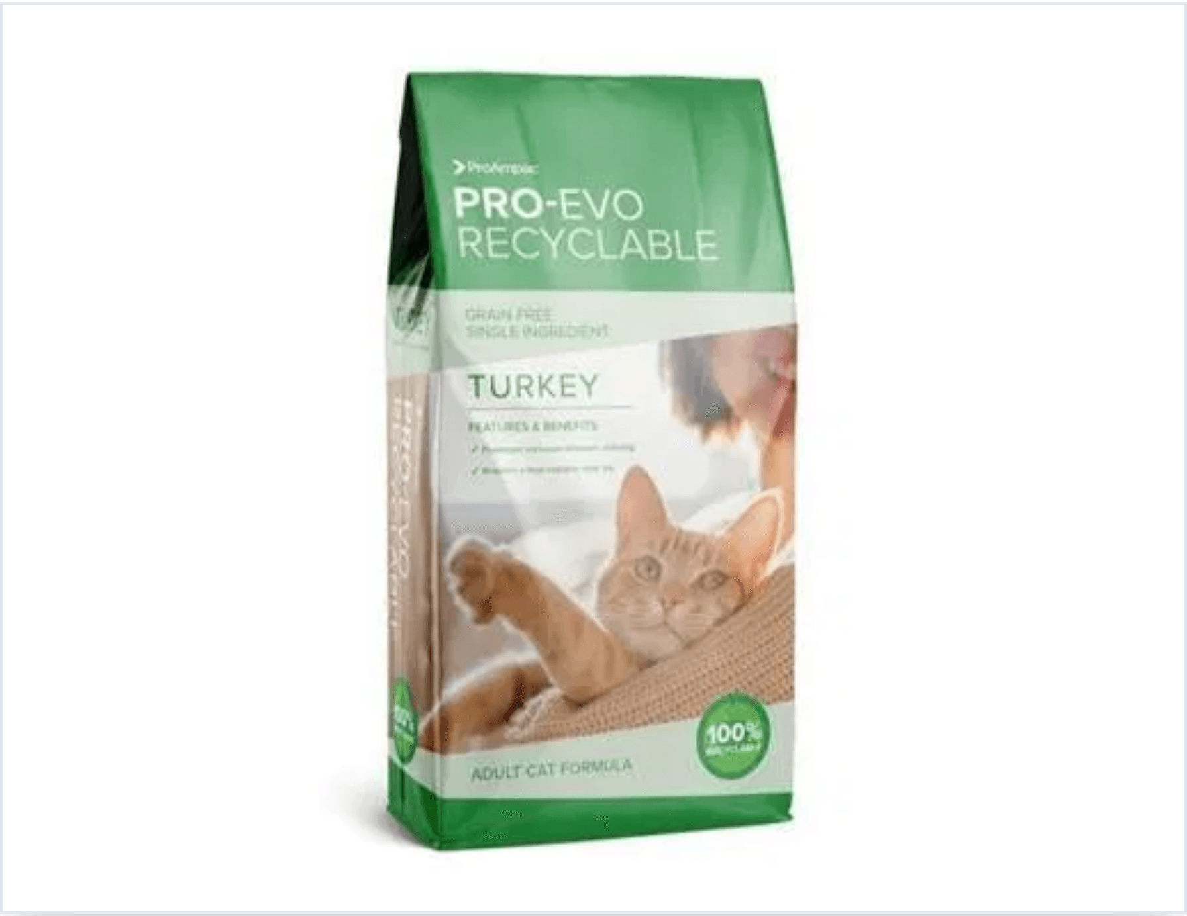



The Problem
YOUR BAG GOES HOME.
THEN WHAT?
No engagement after purchase
Customer relationship ends the moment they leave the checkout counter.
No data on usage
You don't know if they finish the bag, feed correctly, or switch brands.
No proof food works
Weight management claims remain unverified marketing promises.
Competitor one aisle away
Zero switching cost and zero loyalty mechanism to keep them.
Notes:
Here's the reality for pet food brands today. Your customer picks up a bag, takes it home, and you never hear from them again. You have no idea if they're using it correctly, if their cat is responding well, or if they're about to switch to a competitor. The competitor is literally one aisle away. There's no engagement, no data, and no proof that your weight management formula actually works. This is a $40 billion market with almost zero post-purchase customer relationship. Let's look at how we solve this.

Slide 3

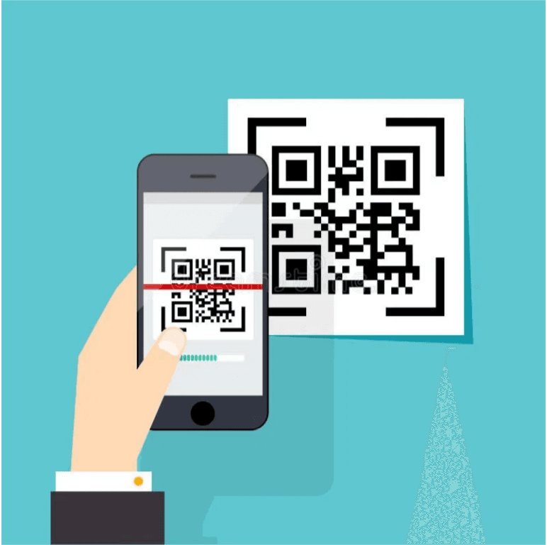
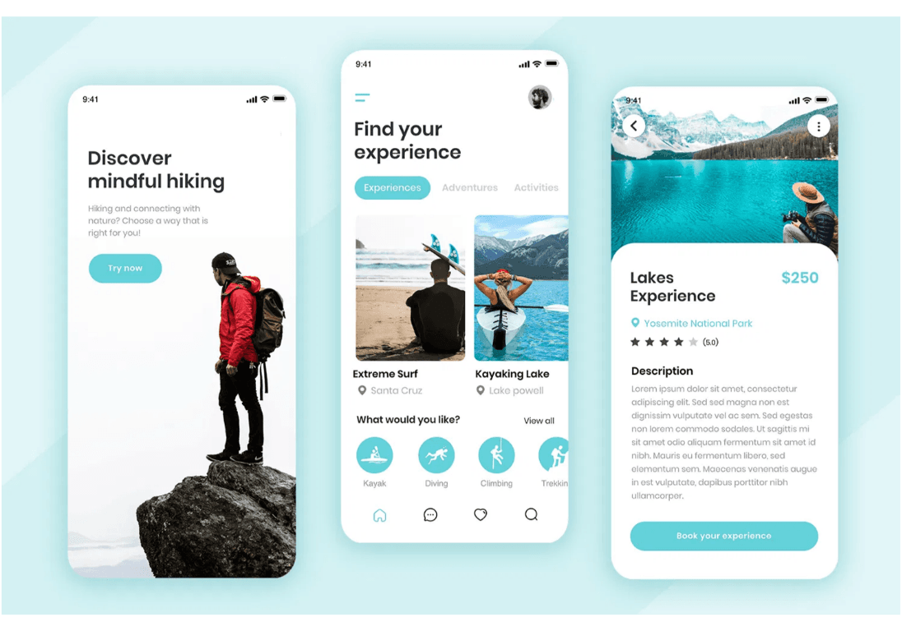
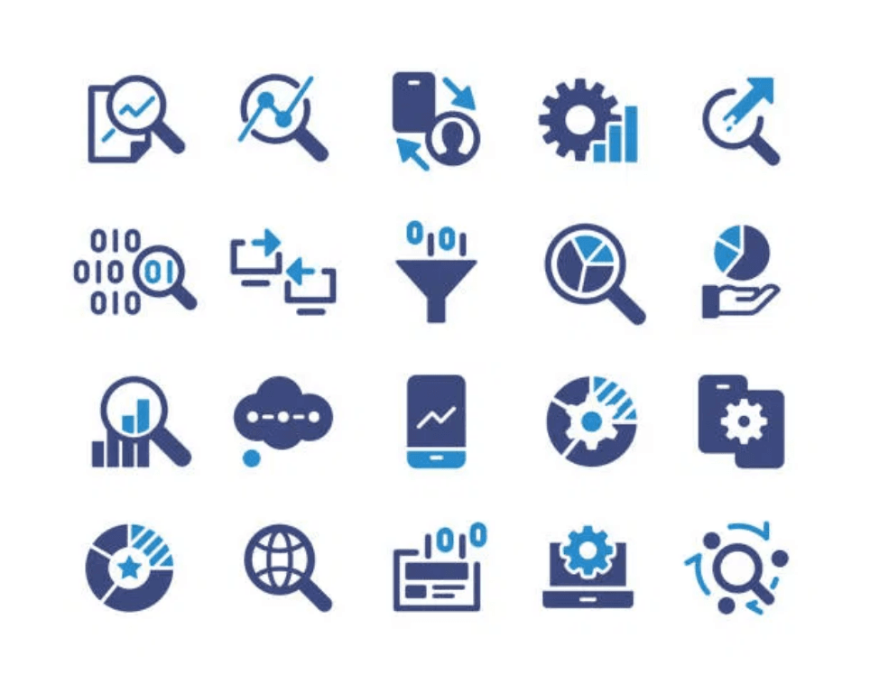


The Solution
QR CODE → BRANDED APP → DATA
QR CODE
BRANDED APP
DATA
On product bag
Customer's phone
Aggregate insights
"A closed loop that benefits everyone."
Notes:
Our solution is elegantly simple. A QR code on your packaging links to a fully branded iOS app. The customer scans, the app opens with your branding, and they can start tracking their cat's weight immediately. You get aggregate engagement data—not individual health data—that proves customers are using your product and staying engaged. It's a closed loop that benefits everyone. And it's incredibly easy to use.

Slide 4

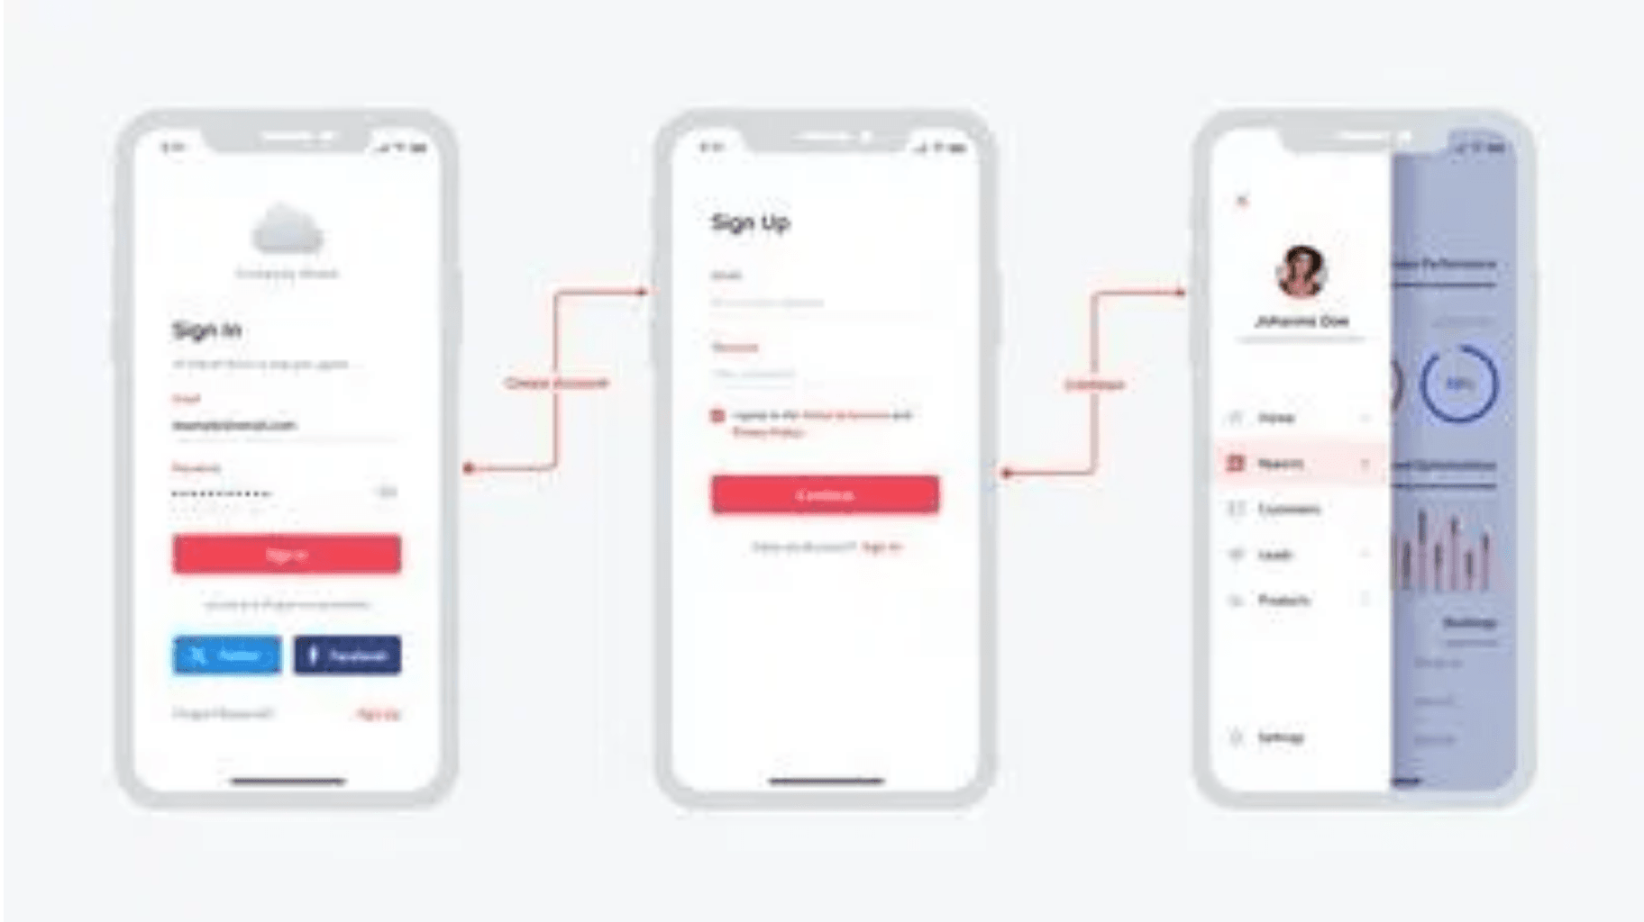


User Journey
90-SECOND EXPERIENCE
0:05
0:15
0:45
1:30
SCAN QR
BRAND SPLASH
QUICK SETUP
TRACK WEIGHT
No login
No email
NO FRICTION.
Notes:
The entire onboarding experience takes 90 seconds. A customer scans the QR code—that's 5 seconds. They see your brand splash screen—10 seconds. Quick setup asks for the cat's name and starting weight—30 seconds. The first weight entry takes 45 seconds. That's it. No account creation, no email capture, no password. We deliberately removed every friction point because we know that every additional step loses 20-30% of users. This is designed for completion, not data harvesting. And it's all about your brand.

Slide 5

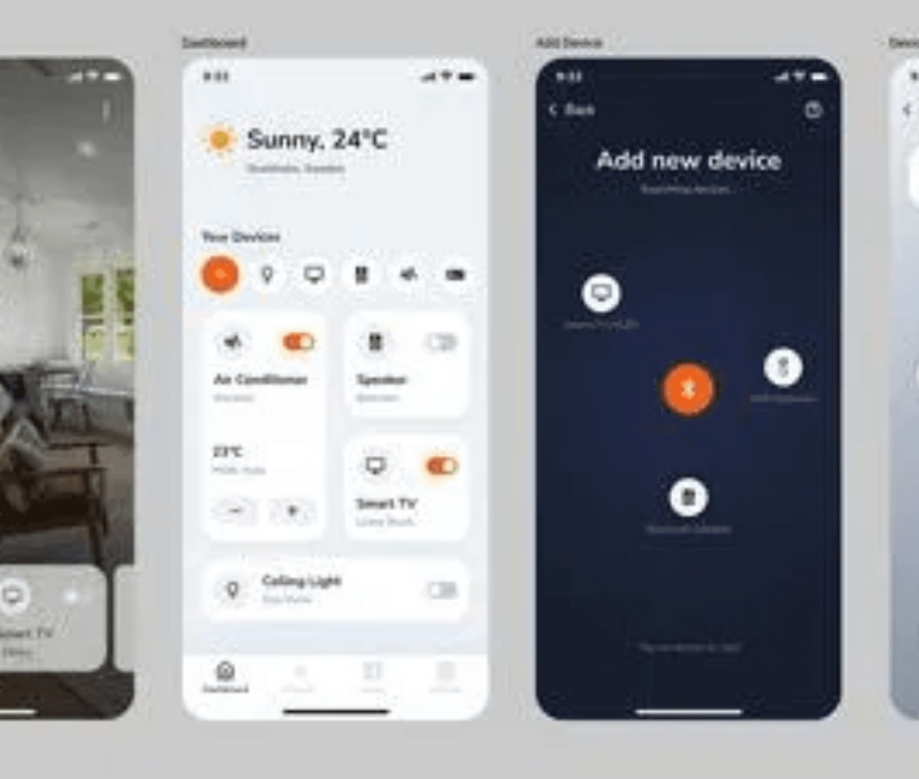
White-Label Solution
BRAND OWNERSHIP
Your Brand Name
Your Brand Colors
Your Product Name
Your Calorie Data
"We build it.
You own the experience."
Interface Preview
Notes:
This is YOUR app. Your brand name appears throughout. Your colors define the interface. Your product name and specific calorie data are pre-loaded. When a customer uses this app, they're engaging with YOUR brand, not ours. We're invisible. We handle the development, maintenance, and updates. You own the customer relationship and the brand experience. That's the white-label promise. Now, let's talk about the data you do get.

Slide 6


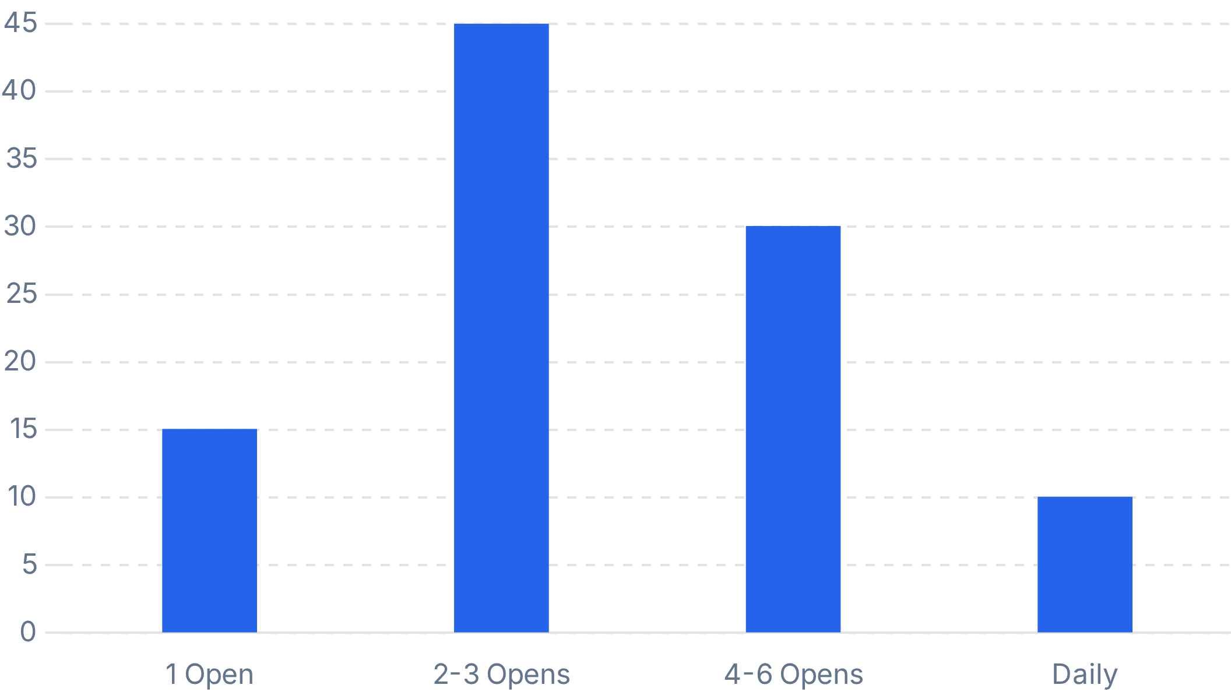
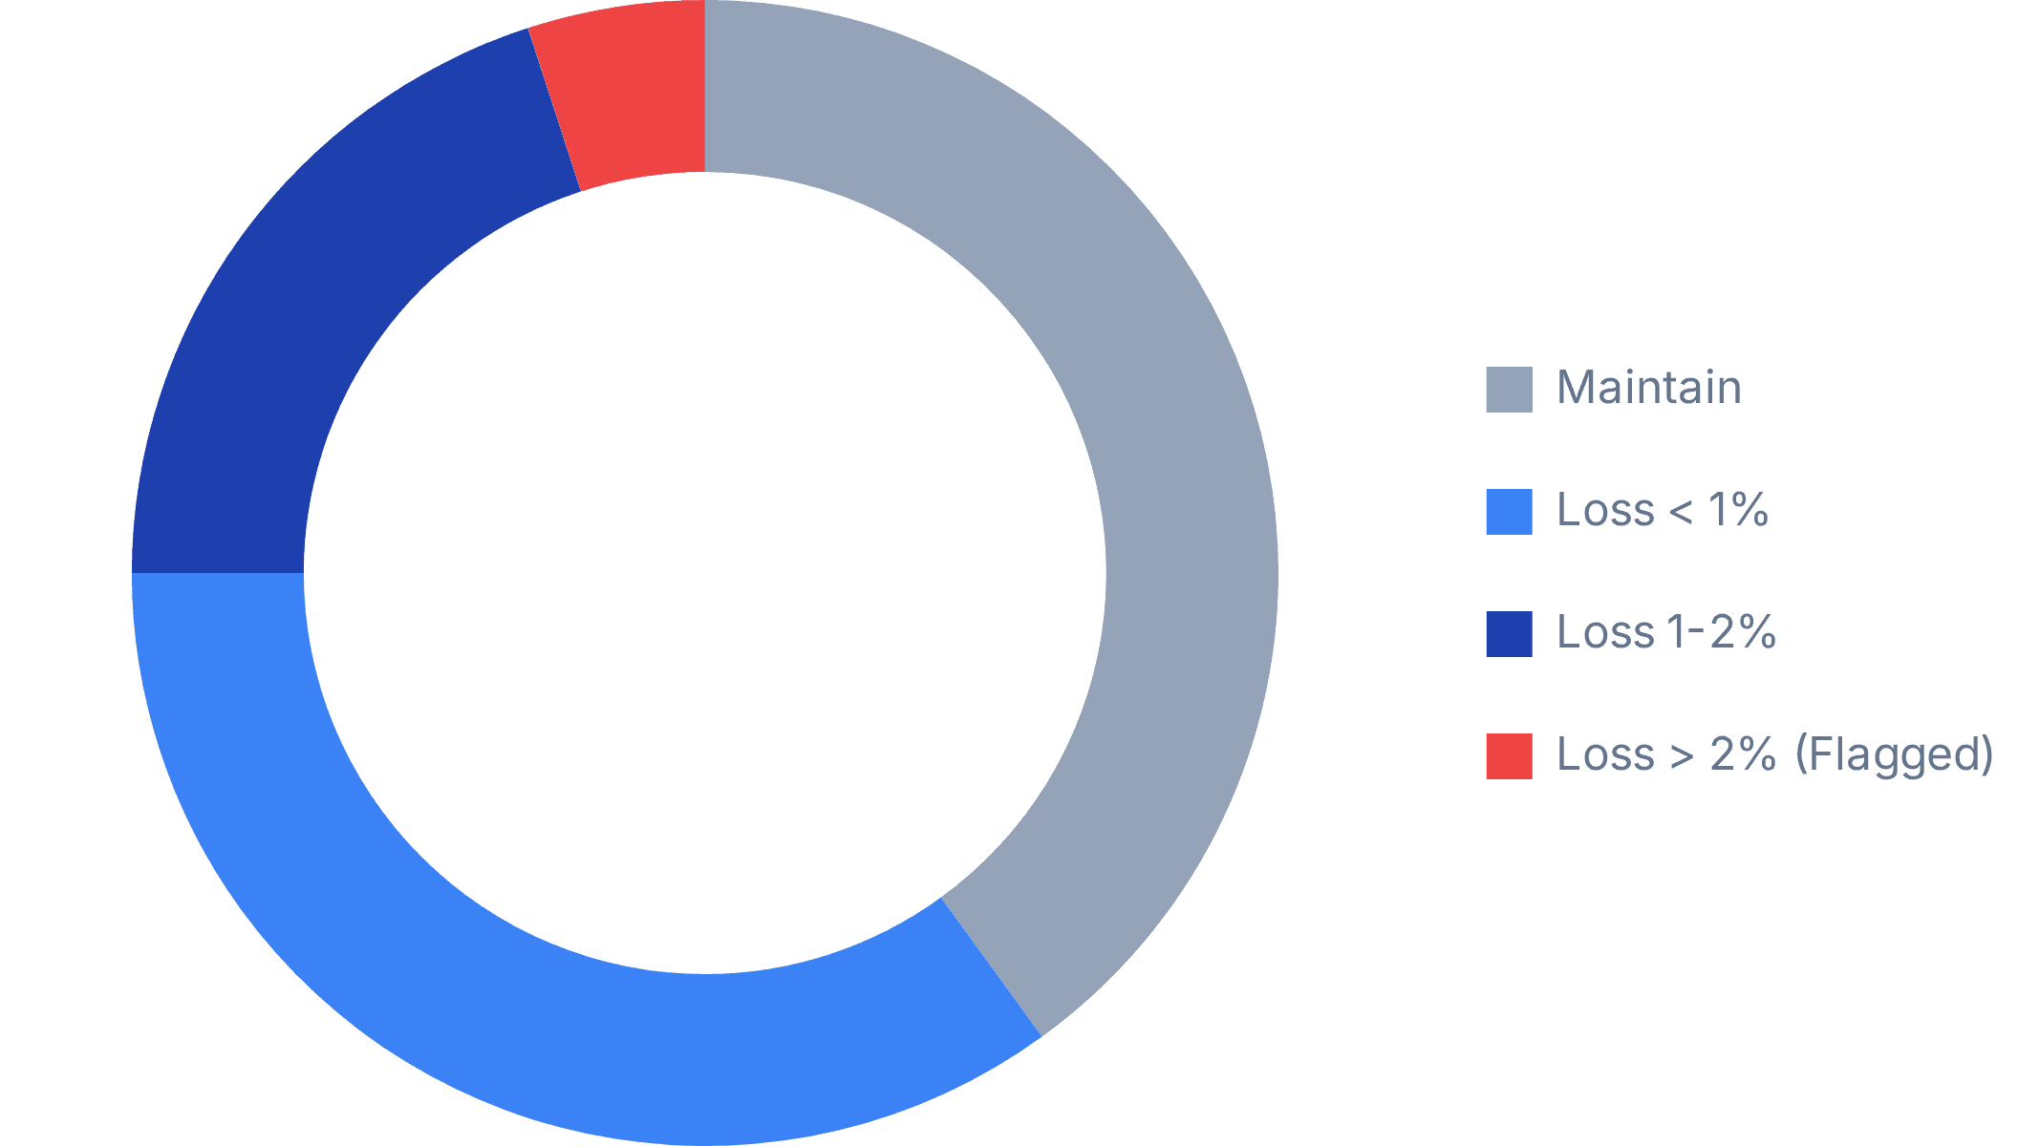
Data Insights
ENGAGEMENT METRICS
Total QR Activations
Setup Completion Rate
Users with 3+ Entries
14,205
78.4%
62.1%
▲ 12% vs last month
Industry avg: 45%
High retention cohort
Avg Opens / Week
Avg Progress Bucket (Anonymized)
Notes:
Now, let's look at what you gain: clear engagement metrics that prove your customers are using your product. These metrics give you real insight into post-purchase behavior without crossing into medical territory. Total QR activations show initial interest, and our 78.4% setup completion rate is well above industry averages. We also track average opens per week and users with three or more entries, which indicates sustained usage and loyalty. And the average progress bucket gives you anonymized, aggregated outcome data, proving product stickiness. But what's equally important is what we deliberately don't measure, and that's our next topic.

Slide 7




Risk Mitigation
WHAT WE DON'T MEASURE
Actual Weight Values
Individual Journeys
Feeding Compliance
Medical Liability
Privacy Protection
Blame Risk
We avoid collecting precise medical data to prevent classification as a diagnostic tool.
No tracking of specific user behaviors or location history. Aggregate data only.
We don't verify if they followed feeding instructions, avoiding liability for poor outcomes.
"WE DON'T KNOW IF YOUR FOOD WORKED. THAT'S THE POINT."
Notes:
We just discussed what you do get to see. Now, let's talk about what we deliberately don't measure, and why this is crucial for your brand. We avoid capturing actual weight values because that's medical data with significant liability implications. We also don't track individual customer journeys, which protects privacy and avoids data risks. And we never measure feeding compliance, which removes any blame if outcomes are poor. The key message here is simple: we cannot tell you if your food worked for any specific cat, and that's by design. This brings us to our zero liability design principles.

Slide 8



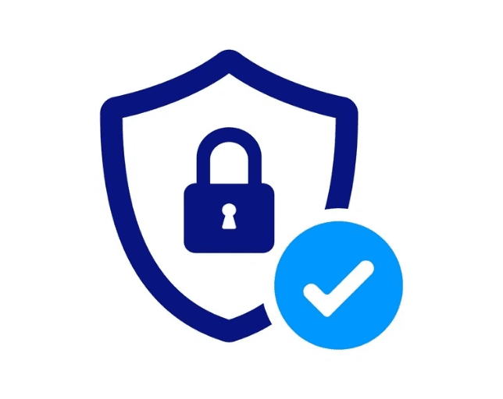
Risk Mitigation
ZERO LIABILITY DESIGN
No "recommended" language
Safety Guardrails
No outcome promises
Weight Loss Cap
No feeding instructions
2% / week max
No medical claims
Total Loss Cap
No data off-device
30% total
Notes:
Our zero liability design is a core differentiator, built to protect your brand at every turn. We never use "recommended" language or make outcome promises. The app provides no feeding instructions and makes no medical claims whatsoever. Crucially, no data ever leaves the device, eliminating a major source of risk. We even built in safety guardrails, capping weight loss at 2% per week and 30% total. This protects both the cat and your brand from potential misuse or misinterpretation. This strict approach extends to our product scope, which is intentionally frozen.

Slide 9

Product Boundaries
SCOPE IS FROZEN
NO
User Accounts
NO
Vet Integration
NO
Push Notifications
NO
Food Ordering
NO
Cloud Sync
NO
Social Features
NO
Multiple Cats
NO
Widgets
"This is not a roadmap. This is a deliverable."
Notes:
Our scope is frozen, and this is a deliberate strategic choice, not a limitation. We will never build user accounts, eliminating data breach risks. There are no push notifications, so no spam complaints. No cloud sync means no server costs or security audits. We also avoid features like multiple cats, vet integration, food ordering, social features, or widgets. This isn't a roadmap; it's a deliverable. When we say no to additional features, we're saying yes to simplicity, stability, and zero liability. And this commitment to simplicity is deeply tied to how we handle data.

Slide 10







Privacy Architecture
DATA STAYS ON DEVICE
Technical Implementation
Business Impact
Stored on iPhone
Data lives exclusively in the user's local app sandbox.
No Servers
Zero maintenance costs. Zero uptime SLAs.
Never Transmitted
Zero API calls to external servers for user data.
No Breach Risk
You cannot lose data you do not have.
90-Day Auto-Purge
Old data is automatically deleted to minimize footprint.
No GDPR Headaches
Complete immunity from data sovereignty laws.
Notes:
We've talked about what we don't measure and why our scope is frozen. Now, let's look at the ultimate risk mitigation: data stays on the device. This architecture means zero data ever leaves the customer's phone. It's never transmitted to any server, not ours, not yours, not anyone's. This eliminates server maintenance, breach risks, and all GDPR compliance headaches. When the customer deletes the app, the data is gone. This is privacy by design, not just by policy.

Slide 11

Packaging Copy
THE ONE-LINER
“
Scan this to track your cat's weight with the food you just bought.
”
11 WORDS
Notes:
So, how do we communicate all this value and simplicity to your customers? It's with this one-liner on your packaging. Just eleven words: "Scan this to track your cat's weight with the food you just bought." It's clear, actionable, and directly links the app to the product. There are no health claims, no promises, and no liability. It's a simple value proposition that customers immediately understand.

Slide 12

Execution Plan
NEXT STEPS
01
02
03
04
05
Legal Review
Brand Setup
QR Generation
Pilot
Rollout
Your team validates our liability architecture.
Integration of colors, logos, and product calorie data.
Creation of unique tracking codes for your SKUs.
Limited market test to validate engagement metrics.
Full deployment across all product lines.
Estimated Timeline: 8-12 Weeks
Ready to start.
Notes:
Now, let's talk about how we get this into your hands. Here's the path forward. First, your legal team reviews our liability architecture—we're confident it will pass scrutiny. Then we integrate your branding: colors, logos, and product calorie data. We generate unique QR codes for your SKUs. You run a pilot in a limited market to validate engagement metrics. Then we move to full rollout. The entire process from legal review to pilot can happen in 8 to 12 weeks. We're ready when you are. Do you have any questions?

