Slide 1

What is the effect of cinema camera on film festival performance?
DATA
Team members: Karl Leung, Belinda Poh,
Juliette Belley, Omar Abouelmagd
PROGRAMME

Slide 2
01 Introduction

Slide 3


Film Festival
Organized presentation of films in a screening venue
Different rules in different film festival competition
Medium of cultural exchange
Toronto Intl Film Festival is the most popular in North America

Slide 4
Objectives
Understand how technical aspects interact with creative aspects
Provide insights into possible factors that may influence films' viewership and success
Understand importance of equipment in creative movies

Slide 5

cinema
camera
.
.
.
Film festival performance

Slide 6
Significance
Explore whether and how important cinema camera choice is on film festival performance
&
Provide insights for future filmmakers on cinema camera choice and optimize their performance

Slide 7
02 Data Collection

Slide 8
Data Analyzed
Source: FilmAffinity
From diverse festivals (both international and national) across various years (10-20 years)
Films
Title, genre, director, release year, camera used, budget
Festivals
Name, type, years
Performance Metrics
Awards (won/ nominated/ shortlisted), audience ratings, critical reviews

Slide 9
Methods
Boundaries: Films nominated for best picture in several film festivals
Scrape web data from film festival websites along with secondary websites to extract large amounts of data
Mostly qualitative data

Slide 10
03 Data Analysis

Slide 11
Descriptive Statistics
To further understand data and provide a clear, concise summary of the data
To identify patterns and trends in the dataset
Crucial before conducting more complex analyses

Slide 12
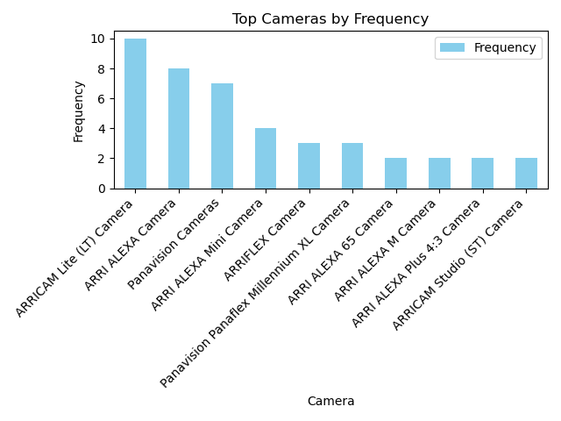
Festival Camera Data
ArriCam Lite Camera shows a visible dominance
Top 5 Cameras are of Arri with only 1 Panavision

Slide 13
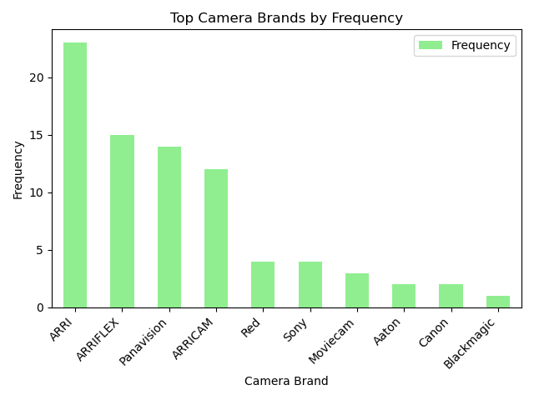
Festival Camera Data
Arri brand dominates the film festival circuit
Panavision in somewhat close competition

Slide 14
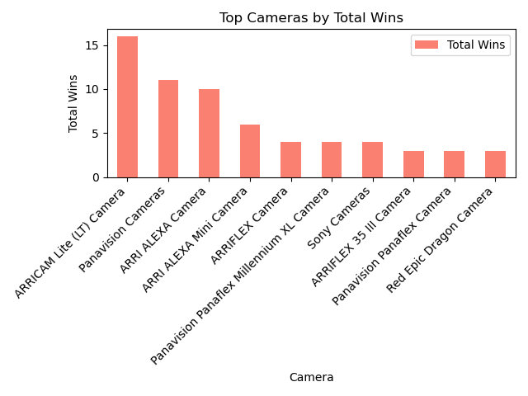
Festival Camera Data
Arricam Lite Model most awarded camera
Panavision in very close competition

Slide 15
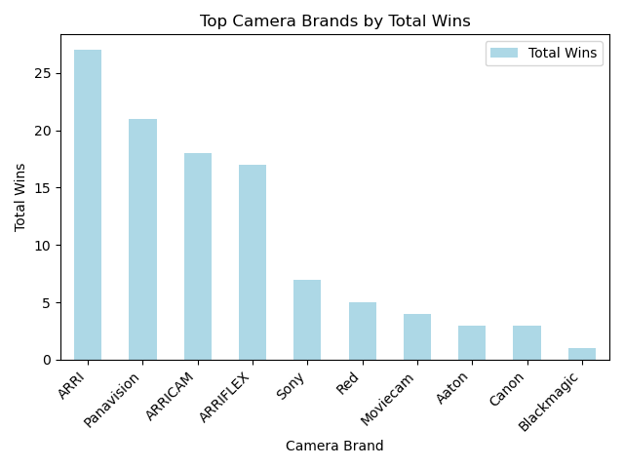
Festival Camera Data
ARRI brand still dominating by wins
Panavision still in very close competition

Slide 16
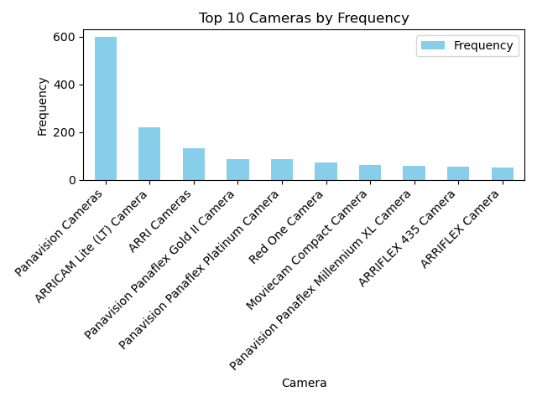
Awards Camera Data
Panavision Cameras are more frequent in awards
ARRICAM models are still frequent

Slide 17
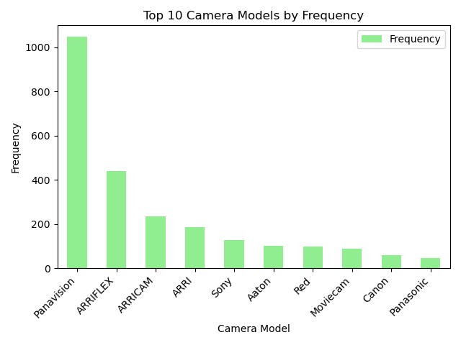
Awards Camera Data
Panavision brands are more frequent in awards
ARRI brand maintaining the 2nd most frequent brand

Slide 18
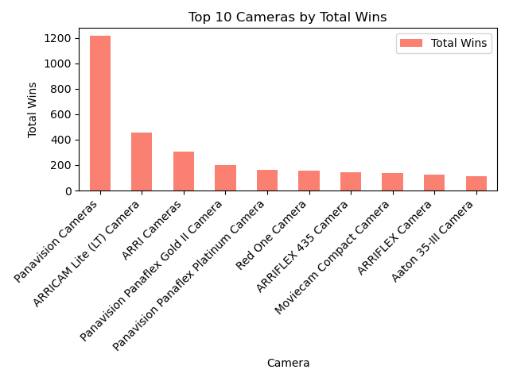
Awards Camera Data
Panavision cameras overshadow other models
ARRI cameras gathering less wins

Slide 19
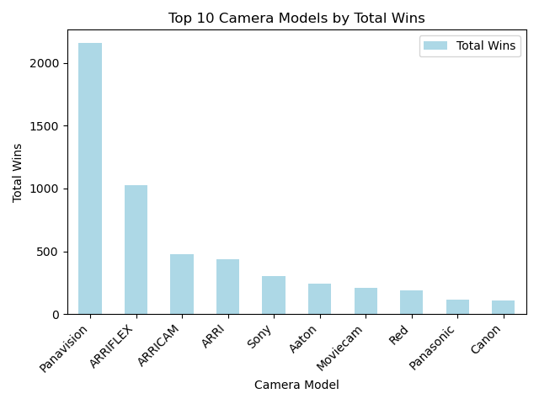
Awards Camera Data
Panavision brand has racked up the most wins
ARRI brand in 2nd place, followed by other camera brands

Slide 20
04 Methodology

Slide 21
Regression
Include different numbers of variables and interactive variables into regression models
Identify the relationships between different independent and dependent variables

Slide 22
05 Results

Slide 23
Model 1
Regression using camera models to predict if the film won a film festival for more than one category:
Only three cameras yielded statistically significant results (p <= 0.05)
Sony H, ZEISS Compact Prime CP.2 Super Speed Lenses, SLZ11 Lenses
However, all the films using these three camera models were nominated in more than one category (Coefficient 1.000)

Slide 24
Model 2
Split the linear regression results by the prestige level of each film
Low, Medium, High
Cameras that affected the possibility of getting nominated for more than one category the most for films with different prestige levels
Low: Arriflex 435 (Coefficient 0.833), Leitz M 0.8 lenses (Coefficient 0.833), Sony CineAlta HDW-F750 (Coefficient 0.833)
These cameras are significantly and positively associated with being nominated for more than one categories
Notes:
Low Prestige: Arri Amira (0.434), Arriflex 435 (0.833), Leitz M 0.8 lenses (0.833), Panavision Panaflex Millennium XL2 (0.825), Red Weapon (0.812), Sony CineAlta HDW-F750 (Coefficient 0.833), .Zeiss Ultra Prime Lenses (0.611)
Medium: Richard (-0.500), Richard (-0.500), Red (-0.875), RED (-0.750), Panavision (-0.861), Panasonic (-0.786), Moviecam (-0.667), Lenses(-0.444), Leitz (-0.667), Hawk (-0.800), Fujinon (-0.667), Cooke (-0.875), Arriscope (-0.500), Arri (-0.898), Angeniuex (-0.500), Angenieux (-0.725), Zeiss Ultra Prime Lenses (0.532), Angeniuex Zoom Lenses (-0.500)
High: ARRI Alexa Mini (0.667), Aaton XTR Prod (0.667), SLZ11 Lenses (0.5), Sony H (0.923), SLZ11 (0.500), ycam (0.667)

Slide 25
Model 2
Medium: Arri (Coefficient -0.898), Red (Coefficient –0.875), Cooke (Coefficient –0.875)
Camera models were significantly and negatively associated with being nominated for more than one categories
High: Sony H (0.923), ARRI Alexa Mini (Coefficient 0.667), ycam (Coefficient 0.667)
Camera models listed are significantly and positively associated with being nominated for more than one categories
Important for films to consider film's prestige level when choosing a camera
Notes:
Low Prestige: Arri Amira (0.434), Arriflex 435 (0.833), Leitz M 0.8 lenses (0.833), Panavision Panaflex Millennium XL2 (0.825), Red Weapon (0.812), Sony CineAlta HDW-F750 (Coefficient 0.833), .Zeiss Ultra Prime Lenses (0.611)
Medium: Richard (-0.500), Richard (-0.500), Red (-0.875), RED (-0.750), Panavision (-0.861), Panasonic (-0.786), Moviecam (-0.667), Lenses(-0.444), Leitz (-0.667), Hawk (-0.800), Fujinon (-0.667), Cooke (-0.875), Arriscope (-0.500), Arri (-0.898), Angeniuex (-0.500), Angenieux (-0.725), Zeiss Ultra Prime Lenses (0.532), Angeniuex Zoom Lenses (-0.500)
High: ARRI Alexa Mini (Coefficient 0.667), Aaton XTR Prod (0.667), SLZ11 Lenses (0.5), Sony H (0.923), SLZ11 (0.500), ycam (0.667)

Slide 26
Model 3
Regression using camera brand and models to predict if the film got won at film award for more than one category:
More cameras yielded statistically significant results (p <= 0.05)
Leitz M 0.8 Lenses (Coefficient 0.904), Sony H (Coefficient 0.873), ZEISS Compact Prime CP .2 Super Speed Lenses (0.484)
These camera models are significantly positively associated to being nominated in more than one categories
However, most of the cameras that were significantly positively associated to being nominated is from ZEISS
Notes:
T.Leitz M 0.8 lenses (0.904), T.SLZ11 Lenses (0.483), T.Arri Amira (0.480), T.Zeiss Ultra Prime Lense (0.443***), Zeiss (0.268), ZEISS Compact Prime CP.2 Super Speed Lenses (0.484), T.Arriflex 435 (0.431), Sony H (0.873)

Slide 27
06 Conclusion

Slide 28
Conclusion
Utilized descriptive statistics and regression to evaluate the impact of film camera choice on film festival nominations
Analysis highlighted the importance of using high-quality film equipment
Film camera choice could increase the possibility of being nominated
Elevates visual aesthetics and storytelling capabilities of films
Enhances cinematic experience
Maximize chances of achieving favorable outcomes in film festivals
Prioritize cinema cameras
Enhance artistic merit and resonate more positively with festival audiences

Slide 29


