Slide 1

TELNET
ISTQB Training
December 2016. Boughdiri Aymen

Slide 2
ISTQB
Founded in Edenburg on November 2002
It is the world’s only not for profit organization dedicated solely to provide practical software tester certification
Developped by more than 100 experts in more than 40 countries
ISTQB certification is the most widely recognized and fastesr growing software tester certification in the world
More than 320 000 certified testers acrros the world and over 12 000 new certificates per quarter

Slide 3
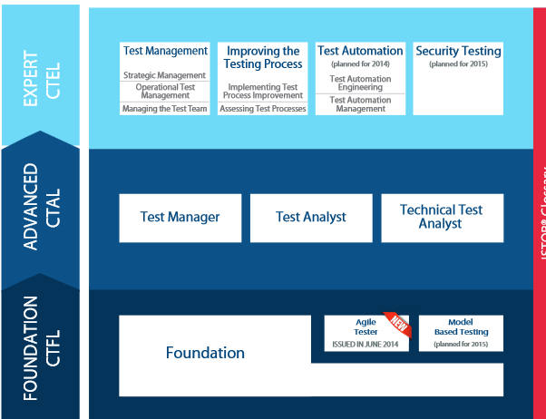
ISTQB

Slide 4
ISTQB
4
40 Multiple choice questions
Each good answer gives one point
To succeed, the participant needs to have at least 65% of good answers (26 good answers)
The exam lasts 60 minutes

Slide 5
Agenda
Chapter 1 : Fundamentals of testing
Chapter 2 : Testing throughout the software life cycle
Chapter 3 : Static techniques
Chapter 4 : Test design techniques
Chapter 5 : Test management
Chapter 6: Tool support for testing
Exam

Slide 6
Chapter 1 : Fundamentals of testing

Slide 7
Chapter 1 : Fundamentals of testing
Why is testing necessary?
What is testing?
Testing principles
Fundamental test process
The psychology of testing
Code of ethics

Slide 8
1.1 Why is testing necessary?
Software systems form an integral part of our daily lives. Whether in our home or at our workplaces, software system have become essential for our comfort
Therefore, software that does not work correctly can lead to many problems, including loss of money, time or business reputation
For critical software, these failures can also cause major finacial losses,injury or death
This why it is important to find and ectify the defects before it is released for a public use

Slide 9
1.1 Why is testing necessary?
1996: Ariane 5
Software already used for Ariane 4 (32 bits) has been used for Ariane5 (64 bits)
➔ 7 billion $
1999: Mars climate orbiter
Integration of modules using different units(Newton/Libra)
➔ 900 million $
1999: French Bank
Migration from windows NT to windows 2000 : incorrect software behavior

Slide 10
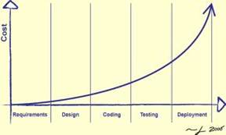
1.1 Why is testing necessary?
10

Slide 11
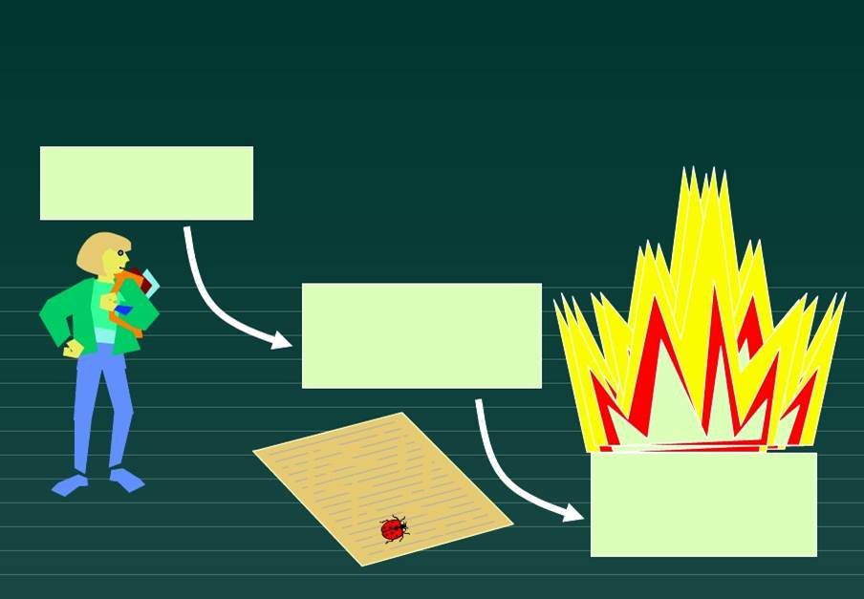
1.1 Why is testing necessary?
A person makes an error …
That creates a fault in the software
That can cause a failure

Slide 12
1.1 Why is testing necessary?
12
Causes of software issues:
Error (while using the software, analyzing client requirement, designing, coding, testing …)
Environmental conditions (strong magnetic field, pollution ,…)

Slide 13
1.1 Why is testing necessary?
With the help of testing, it is possible to measure the quality of the software in terms of defects found.
By understanding the root causes of defects found in other project, processes can be improved, which in turn should prvent those defects from reoccuring and, as consequence, improve the quality of future sustems. This is an aspect of quality assurance.
Tests is an activity of quality assurance
Deciding how much testing is enough should take account of the risk level

Slide 14
1.2 What is testing
Test is an activity of quality assurance. It exists in all life cycle activities, both static and dynamic, concerned with planning, preparation and evaluation of software products and related work products to determine that they satisfy specified requirements, to demostrate that they are fit for purpose and to detect defects [ISTQB]
Test objectives are:
Defect detects
Gaining confidence about the level of quality
Providing information for decision-making
Preventing defects

Slide 15
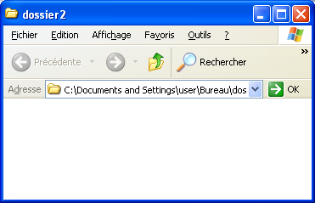
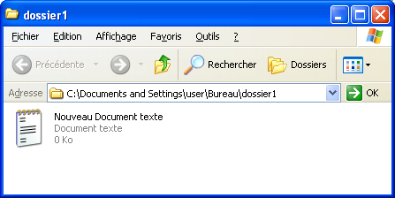

1.3 Testing principles

Slide 16
1.3 Testing principles
Try to transfer the file when it is opened
It has not write access to the folder B
The folder B is shared and its carrying capacity is reached
The file B has a file with the same name

Slide 17
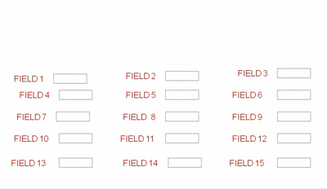
1.3 Testing principles
Supose we have 15 boxes to be tested, EVERY boxes have 5 values possibility. The number of test paterns is 5^15= 30517578125
If we test all possible combinations➔ Time + cost will explose
Exhaustive testing are impossible
Therefore we will need an optimal test sample based on the risk of the application
Notes:
C’est la question à un million de dollars

Slide 18
1.3 Testing principles
What operation is likely to cause more product failures in your application:
a) openMicrosoft world
b) Open internet explorer
c) Open 10 applications in the same time
Defect clustering : A small number of modules contains most of the defects discovered during pre-release testing
Multi- Tasks

Slide 19
1.3 Testing principles
If the smae tests are repeated many times, it will happen that the same set of test cases will no longer find new defects
This is the paradox of pesticide
To overcome this problem, test cases should be reviewed regulary, addong new test cases to detect new bugs

Slide 20
1.3 Testing principles
We can never certify that the software does no contains any BUG
http://www.youtube.com/watch?v=f-1TOeHY7as
Testing shows presence of defects: Tests reduce the probability of undiscovered defects remaining in the software but , even if no defects are found, it is not a proof of correcness

Slide 21


1.3 Testing principles
If we certify that our softawre does not contain a BUG at 99%, but this software does not satisfy client needs
Abscence of error fallacy : Find and fixing defects does not help if the system built is unusable and does not fulfill the user’s need and expectations

Slide 22


1.3 Testing principles
To fix this issue, there is the princile: Early testing
Test activities shall be started as early as possible on the software system development life cycle
Testing is context dependent : Testing is done differentlly in different contexts

Slide 23
1.3 Testing principles
Principe 1 – testing shows presence of defects
Principe 2 – Exhaustive testing is impossible
Principe 3 – Early testing
Principe 4 – Defect clustering
Principe 5 – Pesticide paradox
Principe 6 – Testing is context dependent
Principe 7 – Abscence of errors fallacy

Slide 24
1.4 Fundamental Test Process
Test planining and control
Test implementation and execution
Test analysis and design
Test closure activities
Evaluation of exist criteria and reporting

Slide 25
1.4 Fundamental Test Process
Test planning and control :
Test planning is:
Define the objectives of tests
Define test approach
Define the needed ressources (humain; Materials (PC), test environment …)
Define the exist criteria
The control is the ongoing activity of comparing actul progress against the plan, and reporting the status, including deviation from the plan. It involves taking actions necessary to meet the mission and the objectives of the project.

Slide 26
1.4 Fundamental Test Process
Test analysis and design :
Test analisis and design is the activity during wich the general test objectives are transformed into tangible test conditions and test cases
The test analysis and design actively has the following major tasks:
Reviwing the test basis (such as requirement, software integrity level (risk level), risk analisys reports, architecture, design, interfacespecification)
Evaluating testability of test basis and test objects

Slide 27
1.4 Fundamental Test Process
Designing and prioritizing high level test cases
Designing the test environment setup and identifying any requirement infrastructure and tools

Slide 28
1.4 Fundamental Test Process
Test implementation and execution :
Test implementation and execution has the following major tasks:
Finalyzing, implementation and prioritizing test cases
Developping and prioritizing test procedures, creating test data
Creating test suites from thet test procedures forefficient test execution
Verifying that test environment has been setup correctly
Execute test procedures according to the planned sequence

Slide 29
1.4 Fundamental Test Process
Loggingthe outcome of test execution and recording the identities and versions of the software under test, test tools and tesware
Comparing actual results with the expected results
Reporting discrepancies as incidents and analyzing them in order to establish their cause

Slide 30
1.4 Fundamental Test Process
Evaluating exist criteria and reporting :
Evaluationg exist criteria is the activity where test execution is assessed against the defined objectives
Evaluationg exist criteria has the following major tasks:
Cecking the test logs against the exist criteria specified in test planning
Assessing if more tests are needed or if the exist criteria specified should be changed
Whriting a test summary report for stakeholders

Slide 31
1.4 Fundamental Test Process
Test closure activities :
Test closure activities include the following major tasks:
Checking which planned delivrables have been delivred
Closing incident report or raising change records for any that remain open
Documenting the acceptance of the system
Finalyzing and archiving testware, the test environement and the infrastructure for later reuse
Handing aver the testware to the maintenance organization

Slide 32
1.4 Fundamental Test Process
Analyzing lessons learned to determine changes needed for future releases and projects
Using the information gathered to improve test maturity

Slide 33
1.5 The psychology of testing
A certain degree of independence often makes the tester more effective at finding defects and failures
Several levels of independance can be defined as showen here from low to high:
Tests designed bty the person who wrote the software under test
Tests designed by another person (e.g from the developement team)
Tests designed by a person from a different organizational group (e.g independent test team)
Tests designed by a person from a diffrent organization or company (outsourcing or certification by an external body)

Slide 34
1.5 The psychology of testing
Remind every one of the comon goal of better quality systems
Consider all stakeholders as one team
Favor frequent communication
Informal meetings between developers and testers
Try always to justify error
We all make errors
Explain that by knowing about this now we can work round it

Slide 35
1.6 Code ethics
Involvement in software testing enables individuals to learn confidential and privileged information. A code of ethics is necessary, among other reasons to ensure that the information is not put to inappropriate use.

Slide 36
Chapter 2 : Testing throughout the software life cycle

Slide 37
Chapter 2 : Testing throughout the software life cycle
37
Software development models
Test levels
Test types
Maintenance testing

Slide 38
2.1 Waterfall model
Waterfall model
Specification
Gathering requirement
Selecting the correct developemnt languge
Design
developement
Developement
Test
Test
Bug fixing
Maintenance

Slide 39
2.1 Waterfall model
Specification
Missunderstanding
of needs
Specification
Design
Incorrect
design
Developement
Developement
Test
Maintenance
Unusefull
product

Slide 40
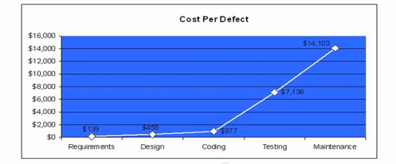
2.1 Waterfall model
50% of failures are introduced at the customer requirements collection and writing specification

Slide 41
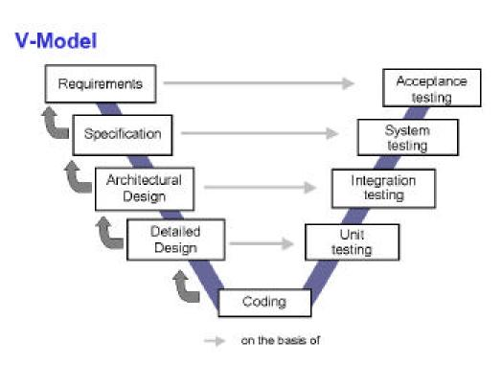
2.1 V Model

Slide 42
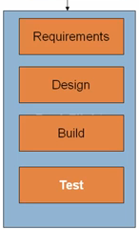
Modèle itératif
Méthode Agile

Slide 43
2.2 Test levels
1
Component test / Unit
2
Integration test
3
System test
4
Acceptance test

Slide 44
2.2 Test levels
Component (Unit) testing :
Searches for defects and verifies the functioning of modules, programs, objects, classes that are separately testable
It may include testing of functionality and specific non functional charcteristics
Typically, componement testing occurs with the access to the code being tested and with the support ofthe developement environment(unit test framework, debugging tool …)
One approach to componement testing is to prepare and automate test cases before coding, called test-driven developement

Slide 45
2.2 Test levels
Integration test:
Component integration testing tests interactions between software componement and it is done after component testing
System integration testing tests the interaction between different systems and my be done after system testing
At each stage of integartion, testers concentrate solely on the integration itself and not the functionality of modules
Ideally, testers should understand system’s architecture and integration strategies
Notes:
Incremental
Big bang

Slide 46
2.2 Test levels
System testing:
Concerned with the behavior of a whole system/product as defined by the scope of a developement project
The test environement should correspond to the final target or production environement as much as possible in order to minimize the risk of environement specific failures not found in testing
System testing should investigate both functional and non-functional requirements system
Based on specifications

Slide 47
2.2 Test levels
Acceptance testing:
It is often the responsability of the customers or users of the system
The goal is to establish confidence in the system
La recherche d’anomalies n’est pas l’objectif principal des tests d’acceptation.
Typical forms of acceptace testing include:
User acceptance test
Operation acceptance test (system administrators: backuping.security ….)
Contract and regular acceptance testing
Alpha (internal) and beta (external) testing

Slide 48
2.3 Test types
1
Functional testing
2
Non-functional testing
3
Structural testing
4
Re-testing and regression testing
5
Maintenance testing

Slide 49
2.3 Test types
Functional testing :
Functional tests are based on functions and features and may performed at all test levels
It is testing of ‘What’ the system does
Non-Functional testing:
It includes but not limited to performance testing, load testing, stress testing, usability testing and maintenability testing
It is testing of ‘How’ the system works
It is testing the caracteristics of te system
Notes:
Load testing is performed to determine a system's behavior under both normal and anticipated peak load conditions. It helps to identify the maximum operating capacity of an application as well as any bottlenecks and determine which element is causing degradation.
Stress testing (sometimes called torture testing) is a form of deliberately intense or thorough testing used to determine the stability of a given system or entity. It involves testing beyond normal operational capacity, often to a breaking point, in order to observe the results.
Maintainability is the ease with which a product can be maintained
Usability testing is a technique used in user-centered interaction design to evaluate a product by testing it on users. This can be seen as an irreplaceable usability practice, since it gives direct input on how real users use the system.^{[1]} This is in contrast with usability inspection methods where experts use different methods to evaluate a user interface without involving users.

Slide 50
2.3 Test types
Structural testing (white box) :
Used to mesure the thoroughness of testing through assessment of coverage of a type of structure
Structural testing mauy be performed at all test levels but espatially in componement testing and componement integration testing
Re-testing (confirmation testing:
To confirm that the original defect has been successfully removed
Debugging (defect fixing) is a developement activity not testing activity

Slide 51
2.3 Test types
Regression testing :
It is the repeated testing of an already tested program, after the modification to discover any defect introduced or uncovered as a result of the change(s).
It may performed at all test levels and applies to functional, non-functional and structural testing
Regression tests are run many timeq and generally envolve slowly. It is a strong candidate for automation

Slide 52
2.3 Test types
Maintenance testing :
It is performed on a deployed system due to a change or extention of the system or its environement
Usually maintenance testing will consist of two parts:
Testing the changes
Regression tests to show that the rest of the system has not been affected by the maintenance work
A major and important activity within maintenance testing is impact analysis

Slide 53
Chapter 3 : Static techniques

Slide 54
Chapter 3 : Static techniques
54
Static testing
Review process
Static analysis by tools

Slide 55
3.1 Test techniques
Test techniques
Static analysis
Review
Static
Dynamic

Slide 56
3.1 Static techniques and testing process
The Static Testing Techniques are based on the manual examination (reviews ) or the code analysis ( static analysis ) of project documentation without running the code
All software product can be reviewed , including requirements specifications, design specifications, code, test plans, test specifications, test cases, test scripts , user guides or web pages
A review could be done entirely manually or by using the support tools
static techniques find causes of defects , the dynamic tests are failures themselves

Slide 57
3.2 Review process
Review phases
Planning:
Define the review criteria , entry and exit criteria for more formal review types and select the part of the documents to be reviewed
Selecting the personnel and allocating roles
Kick-off:
Distribute documents and explain the objectives, process ...
Individual preparation:
Review documents, writing of potential defects , questions and comments …

Slide 58
3.2 Review process
Examination/evaluation/recording of result
Discuss or record , with documented results or minutes ( for more formal review types )
Note the defects, making recommendations regarding the treatment of defects , making decisions about defects
Rework
Fixing defect found (typically done by the author)
Recording updated ststus of defect

Slide 59
3.2 Review process
Follow-up:
Checking that the defects have been adressed
Gathering metrics
Cheking on exist criteria

Slide 60
3.2 Review process
Role and responsabilities
Manager: decides the execution reviews, allocates time in project planning and determines if the review objectives have been met
Moderator: the person who leads the review of documents , including planning and implementation of the review, and following-up after the meeting .
Author : The author or person with chief responsability for the document to be reviewed
Reviewers: individuals with a specific business or technical background who identify and describe findings in the product under review
Scribe: documents all the issues , problems and open points identified during the meeting

Slide 61
3.2 Types of review
Review
Technical review
Inspection
Formal
Informal
Walkthrough

Slide 62
3.2 Review process
Review types
Informal review
No formal process
May include pair programming or design review and code by a technical manager
The results can be documented.
Main purpose: Easy Way to get the results

Slide 63
3.2 Review process
Walkthrough
A step-by-step presentation by the author of a document in order to gather information and to establish a comon understanding od its content
The goal of a walkthrough are to:
Present the document to stakeholders both within and outside the software decipline in order to gather information
Explain and evaluate the contents of the document
Examine and discuss teh validity of proposed solutions and the viability of alternatives, establish consensus

Slide 64
3.2 Review process
Technical review
A peer group discussion activity that focuses on achieving consensus on the technical approach to be taken
The goal of the technical review are to:
Assess the value of technical concepts and alternatives in the product and project environement
Establish consistency in the use and reprensentation of technical concepts
Ensure at an early stage that technical concepts are used correctly

Slide 65
3.2 Review process
Inspection
A type of peer reviw that relies on visual examination of documents to detect defects, e.g. violations of developement standards and non-conformance to higher level documentation
The goals of inspections are:
Help the author to improve the quality of the document
Remove defects efficiently as early as possible
Create a comon understanding by exchanging information among the inspection participants
Learn from defects found to improve processes

Slide 66
3.2 Review process
How we can succeed a review?
Pick things that really count
Explicity plan and track review activities
Train participants
Just do it!
Report result
Continuously improve process and tools

Slide 67
3.3 Static analysis by tools
Static analisys differs from more traditional dynamic testing in a mumber of imporatant ways:
Static analysisis ideally performed before the types of a formal review
Static analisys is unrelated to dynamic properties of the requirements, design and code, such a test coverage
The goal of the static analisys is to find defects, whether or not they may cause failures
As with the review, static analysis finds defects rather than failures

Slide 68
3.3 Static analysis by tools
The most common static analysis features in day-to-date practice are:
Coding standards
Code metrics
Code structure

Slide 69
Chapter 4 : Test design techniques

Slide 70
4.1 Test design techniques
Test techniques
Specification based
Experience Based
Dynamic
Static
Structure based

Slide 71
4.2 Categories of test design techniques
Static (without execution)
Examination of documents , source code ...
Functional (black box)
Based on the system behavior (specification)
Structure (white box)
Based on structure

Slide 72
4.2 Categories of test design techniques
Black box design techniques ( techniques based on the specifications) are a way to derive and select test conditions , test cases or the test data
Black box design techniques include functional testing and non-functional testing
Techniques based on the specification does not use any information concerning the internal structure of a component or system to be tested
White box design techniques ( techniques based on structures ) are based on an analysis of the component or the system structure
These two techniques can be combined with techniques based on experience

Slide 73
4.3 Black box techniques
Equivalence partitioning:
The inputs of software are divided into groups that need to have a similar behavior and identical treatment.
Tests can be designed to cover all partitions
Partitions are applicable to all test levels

Slide 74
4.3 Black box techniques
Closing price filter 5%
If Limit <= 1.05 * closing price , Order acknowleged
If Limit > 1.05 * closing proce , Order rejected
L <= 1.05*closing price
L > 1.05*closing price
1.05 * closing price
Partition 1
Partition 2

Slide 75
4.3 Black box techniques
Boundary value testing
The min and max values ​​of a partition are its limits.
Tests can be designed to cover the limits valid and invalid
A value of each limit is selected for a test
The analysis of these values ​​can be applied to all test levels
It is a complementary technique to that of equivalence partitions

Slide 76
4.3 Black box techniques
Closing price filter 5%
If Limit <= 1.05 * closing price , Order acknowleged
If Limit > 1.05 * closing proce , Order rejected
L <= 1.05*closing price
L > 1.05*closing price
1.05 * closing price
Partition 1
Partition 2
BV1= 1.05*closing price
BV2= 1.05*closing price -tick

Slide 77

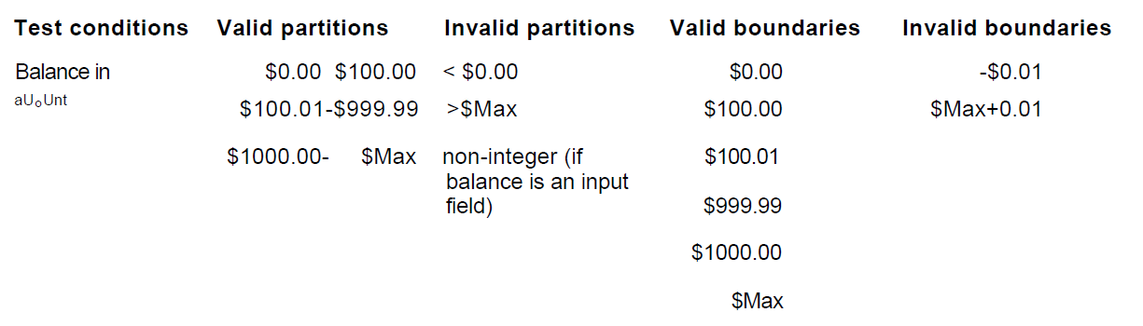
4.3 Black box techniques
Exercice
77

Slide 78
4.3 Black box techniques
Decision table
A black box test design technique in which test cases are designed to execute the combinations of inputs and/or causes shown in decision table

Slide 79
4.3 Black box techniques
Conditions | Rule 1 | Rule 2 | Rule 3 | Rule 4
Modality | Market | Market | Any Price | Any Price
Validity | FOK | E&E | FOK | E&E
Actions
Results | Y | Y | N | N

Slide 80
4.3 Black box techniques
State transistion testing
A black box test design technique in which test cases are designed to execute valid and invalid state transition
This aspect of the system can be shown by a diagram of states and transitions
This allows the tester to view the software in terms of states , transitions between states , data entries and actions that may result from these transitions

Slide 81
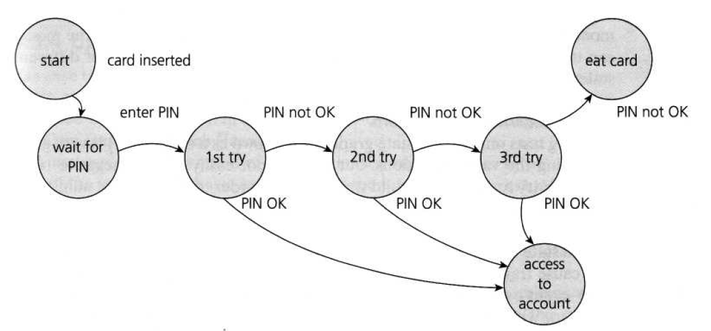
4.3 Black box techniques
Example:

Slide 82
4.3 Black box techniques
Use case
A use case describes interactions between actors and systems
Each use case has preconditions that must be reached to execute the successfully the case
Each use case terminates with post-conditions , which are the observable results and final state of the system after the end of the execution of the use case

Slide 83
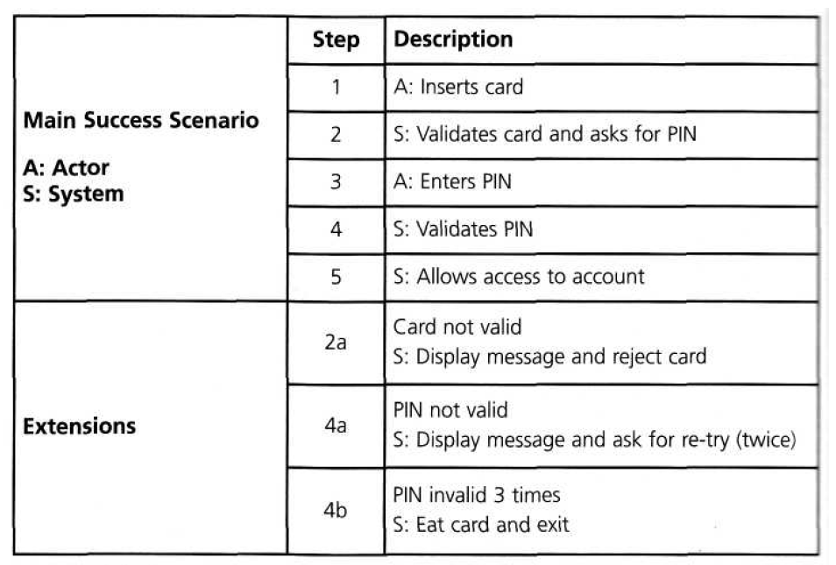
4.3 Black box techniques
Example:

Slide 84
4.4 Structural techniques
Statement coverage :
Statement coverage is the assessment of the percentage of executable statements that have been executed by a test case suite
Number of statements (can be executed)
Total number of statement (can be executed)
=
Notes:
Couverture des instructions (Statement Coverage) - Chaque ligne du code a-t-elle été exécutée et vérifiée ?

Slide 85
4.4 Structural techniques
Test
case
Input
Expected
output
1
2
3
4
5
read(a)
IF a > 6 THEN
b = a
ENDIF
print b
1
7
7
As all 5 statements are ‘covered’ by
this test case, we have achieved
100% statement coverage
Statement
numbers
85
A
Notes:
85

Slide 86
4.4 Structural techniques
Test des décisions et couverture:
Decision coverage , related to branch testing, is the assessment of results of decisions percentages ( eg the True and False options of an IF statement ) that have been processed by a series of test cases
Decision coverage is greater than the statement coverage ::
A 100% coverage decisions ensures 100% coverage instructions.
A 100% coverage instructions does not ensure 100% coverage decisions
number of decisions outcomes exercised
total number of decision outcomes
=

Slide 87
Path coverage
1
2
3
4
1
2
1
2
1
2
3
?
?
?
?
?
?

Slide 88
Example 1
Wait
Valid card?
Wait for card to be inserted
IF card is a valid card THEN
display “Enter PIN number”
IF PIN is valid THEN
select transaction
ELSE (otherwise)
display “PIN invalid”
ELSE (otherwise)
reject card
End
Yes
Display
“Enter..
No
Valid PIN?
Reject
card
Yes
Select
trans...
No
Display
“PIN in..
End

Slide 89
Example 2
Read
Read A
IF A > 0 THEN
IF A = 21 THEN
Print “Key”
ENDIF
ENDIF
IF A > 0 THEN
ENDIF
Print “Key”
IF A = 21 THEN
ENDIF
Read A
A>0
Yes
A=21
Yes
No
No
Print
End
3
Cyclomatic complexity: _____
Minimum tests to achieve:
Statement coverage: ______
Branch coverage: _____
1
3

Slide 90
Example 3
Read
Read A
Read B
IF A > 0 THEN
IF B = 0 THEN
Print “No values”
ELSE
Print B
IF A > 21 THEN
Print A
ENDIF
ENDIF
ENDIF
A>0
B=0
No
Yes
Print
No
Yes
A>21
Yes
Print
Print
No
End
4
Cyclomatic complexity: _____
Minimum tests to achieve:
Statement coverage: ______
Branch coverage: _____
2
4

Slide 91
Example 4
A<0
Yes
Read
Print
No
Read A
Read B
IF A < 0 THEN
Print “A negative”
ELSE
Print “A positive”
ENDIF
IF B < 0 THEN
Print “B negative”
ELSE
Print “B positive”
ENDIF
Note: there are 4 paths
Print
B<0
Yes
Print
No
Print
End
3
Cyclomatic complexity: _____
Minimum tests to achieve:
Statement coverage: ______
Branch coverage: _____
2
2

Slide 92
Example 5
A<0
Yes
Read
Print
No
Read A
Read B
IF A < 0 THEN
Print “A negative”
ENDIF
IF B < 0 THEN
Print “B negative”
ENDIF
B<0
Yes
Print
No
End
3
Cyclomatic complexity: _____
Minimum tests to achieve:
Statement coverage: ______
Branch coverage: _____
1
2

Slide 93
Example 6
A<0
Yes
Read
Print
No
Read A
IF A < 0 THEN
Print “A negative”
ENDIF
IF A > 0 THEN
Print “A positive”
ENDIF
A>0
Yes
Print
No
End
3
Cyclomatic complexity: _____
Minimum tests to achieve:
Statement coverage: ______
Branch coverage: _____
2
2

Slide 94
4.4 Structural techniques
Condition coverage
The concept of coverage can also be applied to other levels of testing
For example, the integration level , the percentage of modules , components or classes that have been executed by a series of test cases can be expressed as a module coverage, components or classes...

Slide 95
4.5 Experienced based testing
Error guessing:
Depe,dent of the skill of the tester
No rules, think of situation in which the software may not be able to handle
May be used as a complement to other formal techniques
Exploratory testing:
Usefull when there are no or poor specifications and when time is severely limited
The tester is constantly making decissions about what to test next and where to spend the limited time

Slide 96
4.6 Choosing a test techniques
There is no best
There are diffrents point to consider when choosing the test techniques:
System to be tested
Goal of testing
Client requirements
Risk
When creating test cases , testers generally use a combination of testing techniques

Slide 97
Chapter 5 : Test management
97

Slide 98
5.1.Test management
Test organization
Test plans, estimates and strategies
Test progress monitoring and control
Configuration management
Risk and testing
Incident management
98
Notes:
98

Slide 99
5.1.Test management
Test organization: Independent or integrated testing?
The benefits of independence:
Independent testers see the various defects and of a different nature and are impartial
An independent tester can verify the assumptions made ​​during the specification and implementation of the syste
Drawbacks of independent testing:
Tester become isolated
Developpers lose the responsability of quality
99
Notes:
99

Slide 100
5.1. Test organization
Tasks of test leader and a tester
Typical test leader tasks may include:
Write or review a test strategy for the project
Plan tests
Initiate the specification, preparation, implementation and execution of tests, monitor the test results and check the exist criteria
Adapt planning based on test results and progress and take any action necessary to compensate for problems
Introduce suitble metrics for measuring progress and evaluation the quality of testing and the product
100

Slide 101
5.1. Test organization
Typically tester tasks may include
Review and contribute to test plan
Analyze, review and asses user requiremenetw, specifications and models for testability
Create test specifications
Set up the test environment
Prepare and acquire test data
Implement tests, execute and log the tests, evaluate the results and document the deviations from expected results
Review tests developped by other
101

Slide 102
5.2 Test planning and estimation
Test plan is a project plan for the testing work to be done
Why do we write a test plans?
Writing a test paln guides our thinking
A test plan help us to manage change
A test plan serve as vehicles for communicating whith other memebers of the project team and other stakeholders
102

Slide 103
5.2 Test planning and estimation
Estimating what testing will involve
We may estimate testing effort by:
Consulting the people who will do the work and other people whith expertise on the tasks to be done
Analyze metrics from past projects
Use a sophisticated approaches such as TAP (test point analysis)
There are three factors that might impact the test effort:
Product (project documentation, complexity, …)
Process (availability of test tools, the life cycle adopted, ressources,…)
The result of testing
103

Slide 104
5.3 Test progress monitoring and control
Test monitoring can serve various purpose during the project, including the following:
Give the test team and the test manager feedbacks on how the testing work is going
Provid ethe project team with visibility about the test results
Measure the status of teh testing, test coverage and test items against the exist criteria to determine whether the test work is done
Gather data for use in estimating future test efforts
Test reporting is often about enlightening and influencing project stakeholders by analyzing the information and metrics available to support conclusion, recomendation and decission
Test control is about guiding and corrective actions to try to acheive the best possible the outcome for the project
104

Slide 105
5.4 Configuration management
The purpose of the configuration management is to establish and maintain the integrity of the products of the software or system through the project and product life cycle
The test configuration manaement may involves:
All items are identified, version controlled, tracked for changes, related to each other and related to developement ites so that traceability can be maintained throughout the test process
All identified documents and software items are refrenced unambiguously in test documentation
For the tester, configuration management helps to uniquely identify (and reproduce) the tested item, test dociments, the tests and the test harness
105

Slide 106
5.5 Risk and testing
Project risk
Organizational factors : lack of competence and Staff training, personal problems , Policy Issues , ...
Technical problems : Environment unavailable test, quality of design , code and test data
Problems of acquisition : On failure a third party, contractual problems , ...
Product risk
Risks related to the product are a particular type of risk to the success of a project
The test, as risk control activity provides feedback about the residual risk by measuring the removal efficiency of critical defects and contingency plans
Risks are used to decide when to start testing and where to test more; The test is used to reduce the risk that an adverse event occurs or to reduce the impact of the latter
In addition , the test can help identify new risks , determine what risks should be minimized and reduce uncertainty about risks
106

Slide 107
5.6 Incident management
The discrepancies between actual and expected outcomes need to be logged as an incident
An incident must be analyzed and mau turn out to be a defect
In order to manage all incidents to completion, an organization should establish an incidents management process and rules classification
Incidents may be raised during developement, review, testing or use of a software product
Incidents reports have the following objectives:
Provide a developpers and other parties with feedback about the problem to enable identification, isoolation and correction if necessary
Provide test leaders a means of trackingthe quality of the system under test and the progress of the testing
107

Slide 108
Chapter 6 : Tool support for testing
108

Slide 109
6.1. Tool support for testing
Types of test tool
Effective use of test tool
Introducing a tool into an organization
109
Notes:
109

Slide 110
6.1 Types of test tool
Tool for support management of testing and tests
Test management tools
Requirement management tool
Incident management tool
Configuration management tool
110
Notes:
110

Slide 111
6.1 Test management tool
Product | Company | Category
Quality center | HP | Paid
TestManager | IBM | Paid
CARS | Compuware | Paid
Testlink | X | Free
Salome | X | Free
Xstudio | X | Free
111
Notes:
111

Slide 112
6.1 Requirement management tool
Product | Company | Category
Quality center | HP | Paid
Doors | IBM | Paid
Caliber RM | Borland | Paid
Testlink | X | Free
Salome | X | Free
Xstudio | X | Free
112

Slide 113
6.1 Incident management tool
Product | Company | Category
Quality center | HP | Paid
ClearQuest | IBM | Paid
TrackRecord | Borland | Paid
Mantis | X | Free
Xstudio | X | Free
113

Slide 114
6.1 Configuration management tools
Product | Company | Category
VSS | Microsoft | Paid
Clearcase | IBM | Paid
Perforce | Perforce software | Paid
CVS | X | Free
Subversion | X | Free
114

Slide 115
6.1 Test tool execution
Product | Company | Category
QTP | HP | Paid
Rational Robot | IBM | Paid
Test partner | Compuware Paid | Paid
Badboy | X | Free
Selenium | X | Free
115

Slide 116
6.2 Effective use of the tool
Potential benefits of using the tools
Reduce of the repetitive works
Greater consistency and repeatability
Objective assessment
Ease of access to information about tests or testing
Risk of using tools
Unrealistic expectation for the tool
Underestimating the time, cost and effort for initial introduction of the tool
Underestimating the effort reqired to mainain the test assets generated by the tool
Over-reliance on the tool
116

Slide 117
6.3 Introduire un outil dans une organisation
Les principes
Evaluation de la maturité de l’organisation, de ses forces et de ses faiblesses et identification des possibilités d’amélioration du processus de test.
Evaluation au regard d’exigences claires et de critères objectifs.
Une preuve de concept (test d’évaluation du bon fonctionnement de l’outil avec l’existant en terme d’infrastructure et avec l’outil sujet de test).
Evaluation du vendeur (aspects de formation, de support et de commerce).
Identification des exigences internes pour le soutien et la tutelle dans l’utilisation de l’outil
Evaluation de besoin de formation.
Evaluation du rapport coût/bénéfice basés sur un cas métier concret
117

Slide 118
6.3 Introducing a tool in an organization
Assessment of the organization’s maturity
Identification ofthe area whithin the organization where tool support will help to improve process
Evaluating of tools against clear objective criteria
POC
Identifying and planning internal implementation
118

Slide 119
Test
To start ISTQB Mock Test - 1 , Click Here
To start ISTQB Mock Test - 2 , Click Here
To start ISTQB Mock Test - 3 , Click Here
http://www.testingexcellence.com/istqb-quiz/istqb-foundation-practice-exam-1/

