Slide 1
Do You Need a Server? Low code, managed services, and flat files (and code too)
Andy Boughton
Abecasis Group Meeting
Jan 4, 2024

Slide 2
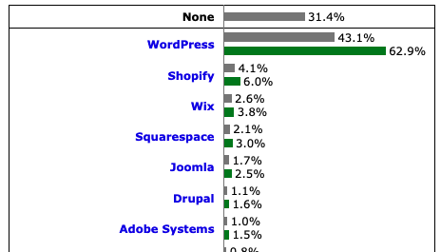
Motivation
In early days of computing, almost every web site had its own developer or infra
webmaster@thing.com
Modern tools allow people to help themselves...
How do we stay relevant?
https://docs.github.com/en/pages/setting-up-a-github-pages-site-with-jekyll https://docs.aws.amazon.com/Route53/latest/DeveloperGuide/getting-started-cloudfront-overview.html https://w3techs.com/technologies/overview/content_management

Slide 3
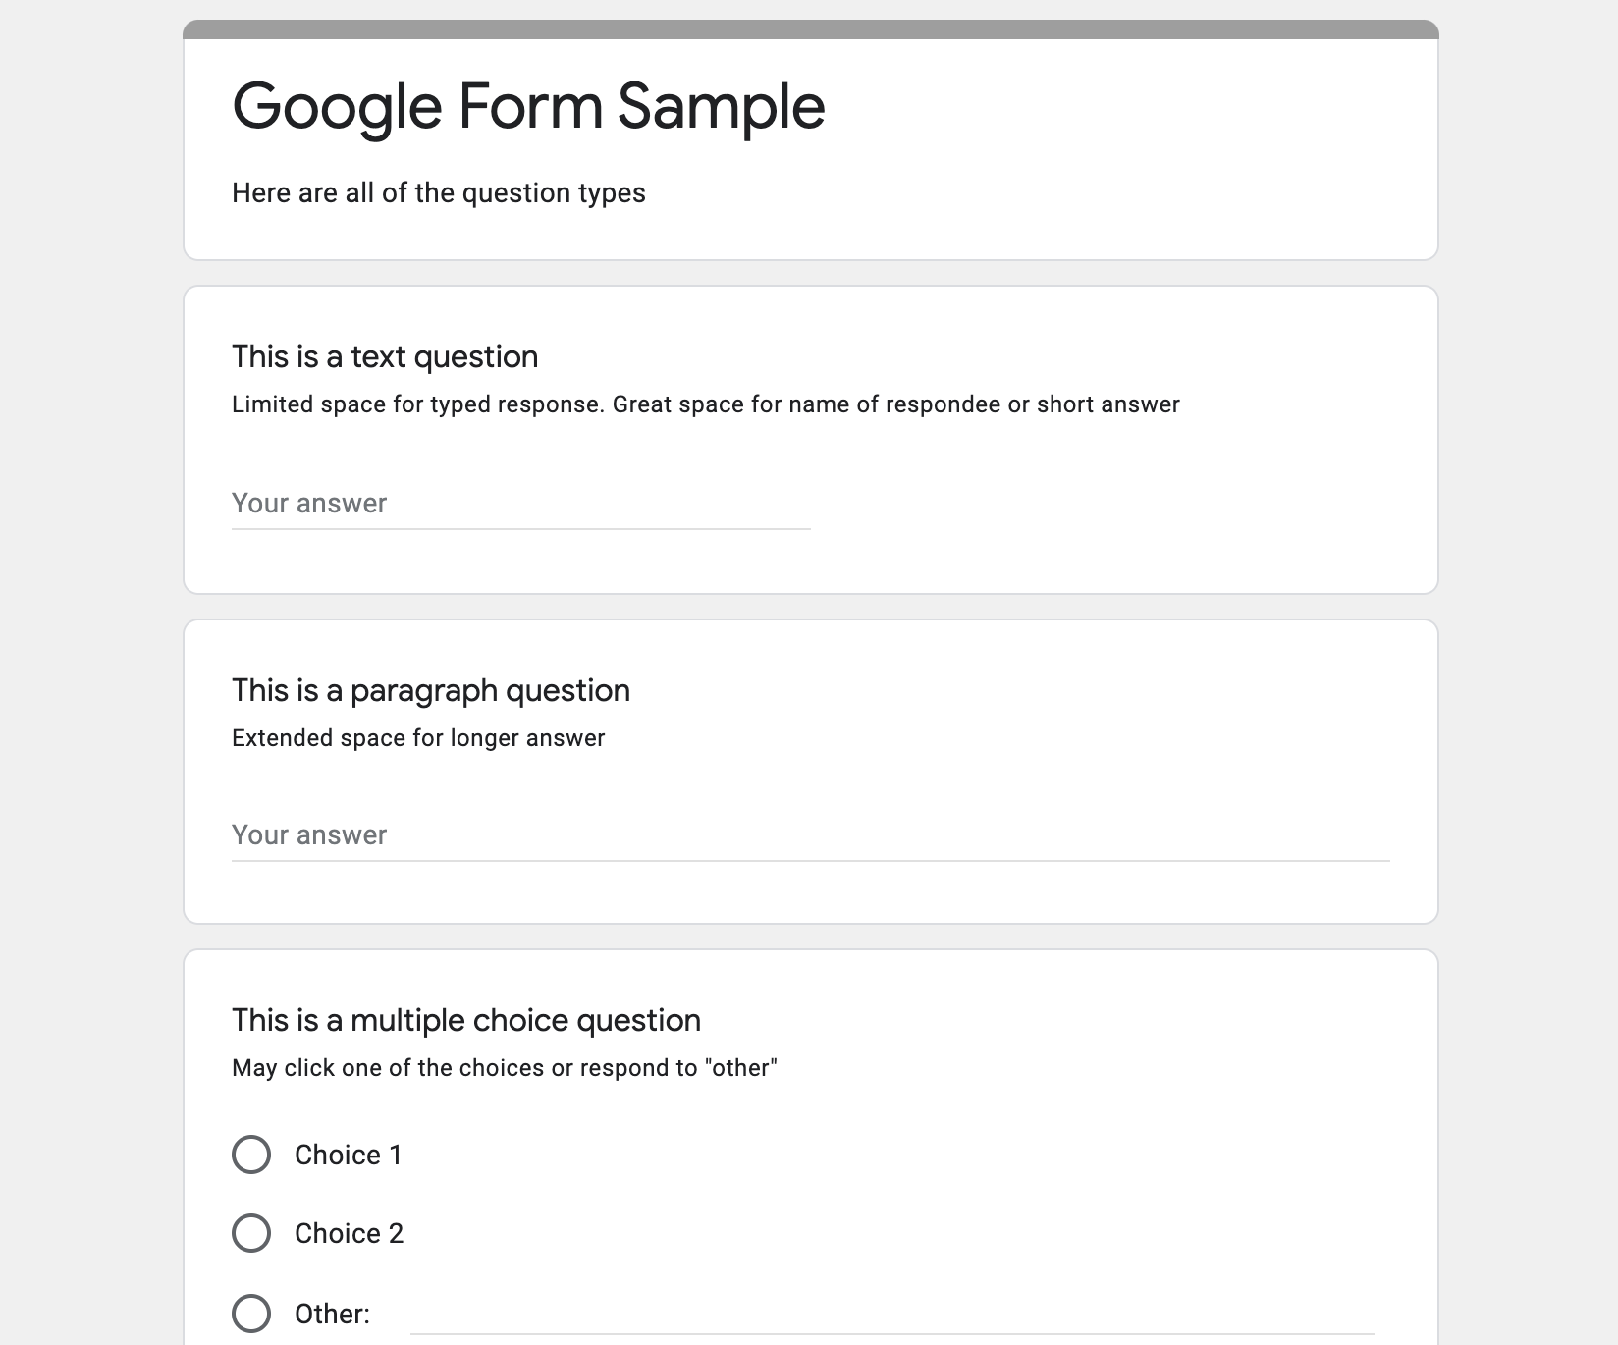
Low / No code: Platforms and tools
Solve common types of tasks with a little customization
Wordpress, Smartsheet, Google Forms...
Sometimes a very simple tool solves many common needs!
Must understand pricing, customization, and requirements to use well
SaaS can be $$$ if you have many people or lots of data
Some tools offer choice of SaaS or on prem options. (Warning: they know what pays the bills)
May offer limited control over UI, permissions, etc.
Beware of plugins
Wordpress has a plugin for anything, but most features you add this way will have security issues
Plugins often stop receiving updates, leaving migration path unclear

Slide 4
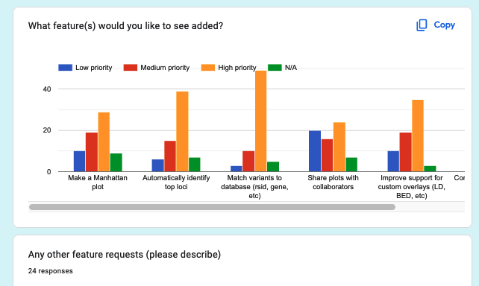
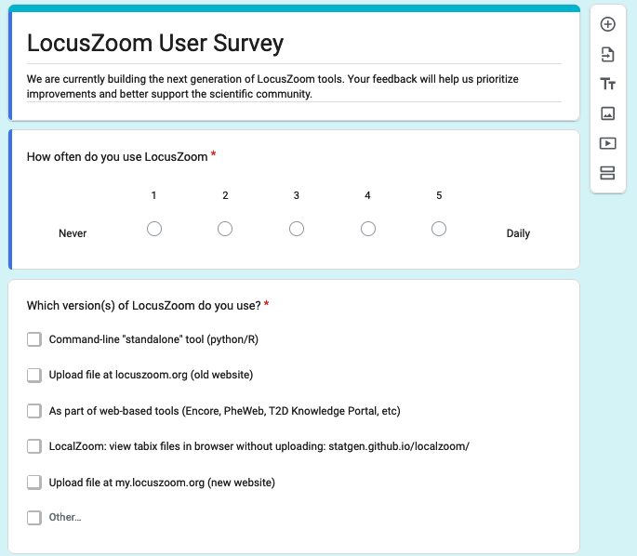
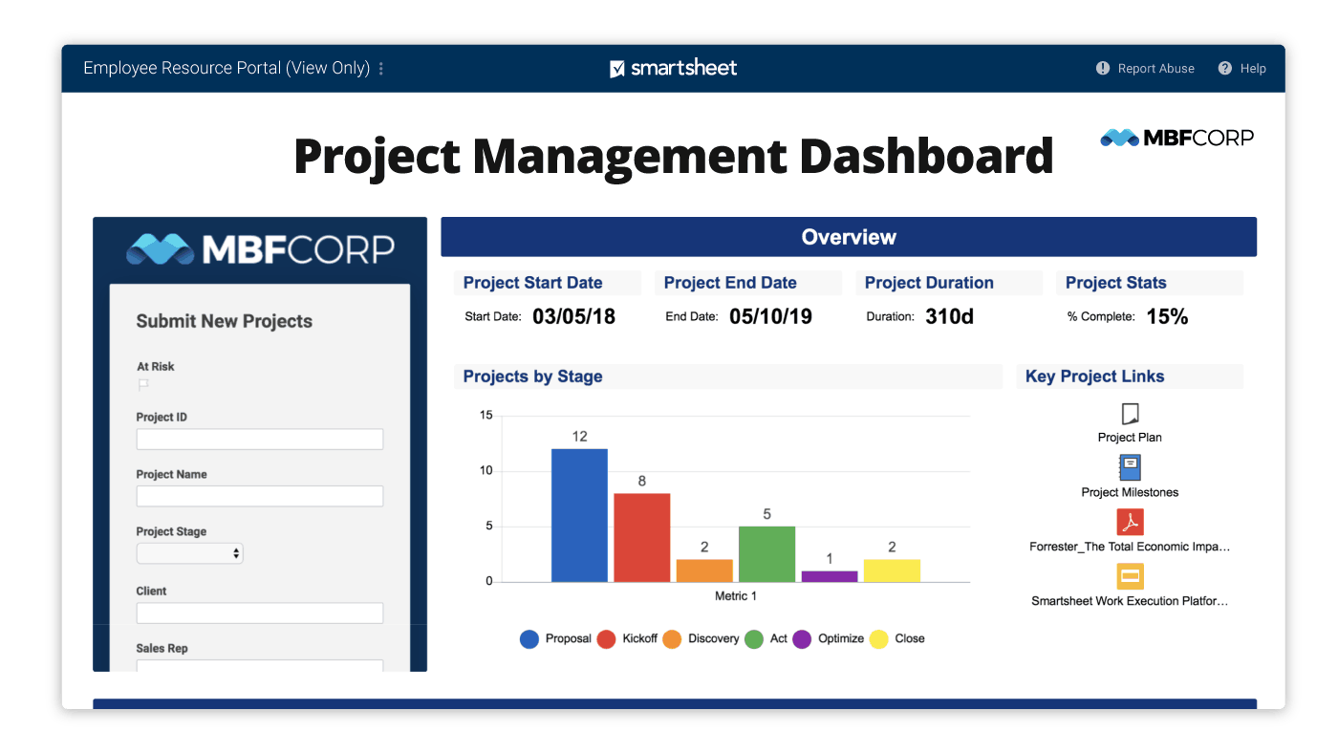
Spreadsheets all the way down
People use spreadsheets for a lot of weird stuff- some tools build on what business people already know!
Good for single-purpose projects with limited scope and one clear owner: “event RSVP” or “Project management dashboard”
Beware of data corruption or “copy paste” errors as your project grows
A bad choice when you need “one clear source of truth”
https://www.theverge.com/2023/10/21/23926585/microsoft-excel-misreading-dates-human-genes-conversion-fixed
https://www.smartsheet.com/content-center/product-news/reports-dashboards/smartsheet-dashboard-gallery

Slide 5
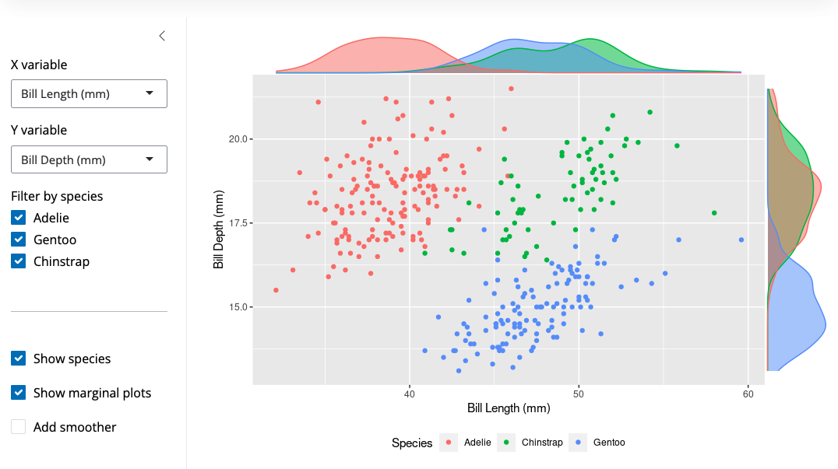
GUI-driven data exploration tools
Popular for data exploration
R Shiny
Plot.ly / Dash
Jupyter notebook widgets
Provide basic UI controls for freeform data exploration websites! Differentiators to look for:
How hard is this to set up / move to a new host?
Does it scale?
Access controls for public / private/ granular sharing
UM has some tools!
Biostatistics offers R Shiny workshops
Some compute environments have JupyterLab installed for hosted notebooks

Slide 6



Host your own dataset
For very well structured data, tools can automate data ingest and create a UI
PheWeb for genetics
Datasette for CSVs
PostgREST
AWS Athena, Snowflake, etc: SQL on CSV data lakes
May automate data import, website creation, or both
PheWeb, Datasette
Often designed with basic setup instructions: you need to provide your own server
Plugins enable maps, custom templates, and other features
https://datasette.io/tutorials/explore
https://congress-legislators.datasettes.com/legislators/offices
Notes:
Demo website here

Slide 7
Where does this break down?
Someone has to run the server and keep it updated
Think about “multi user” scenarios
Controlling access to private data
“Per user” pricing is common in SaaS platforms. Can you release your prototype?
Plan for change
“SQL from CSV” works great.... if the file formats are consistent! Research data changes schema often
Many “low code” tools focus on the ”baked data” pattern: user-provided or new data may be beyond the design of the tool
Imagine a timesheet system that didn’t let you enter data! Developers are still relevant.
Often, low code tools are better for UI and exploring, but break down when offering complex new calculations
If you invite the entire planet to use one server, it may crash
https://simonwillison.net/2021/Jul/28/baked-data/

Slide 8




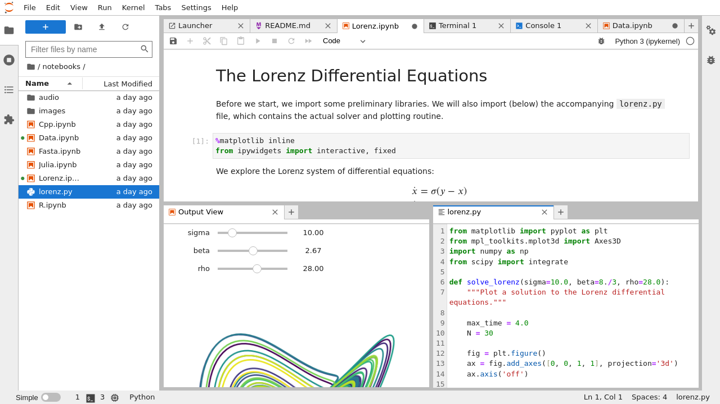
Notebooks
Mix code, results, and explanation
An old idea for the modern age: Galileo, Literate Programming, etc.
If archived properly, would let a peer reviewer check your calculations and trace how analysis was done
Some journals are experimenting with notebooks as a first-class artifact for publication / review.
A potential win for portability / collaboration across teams: focus on exploration and communicating results!
Not every data set needs to live forever
https://datasciencenotebook.org/compare/jupyter/observable

Slide 9
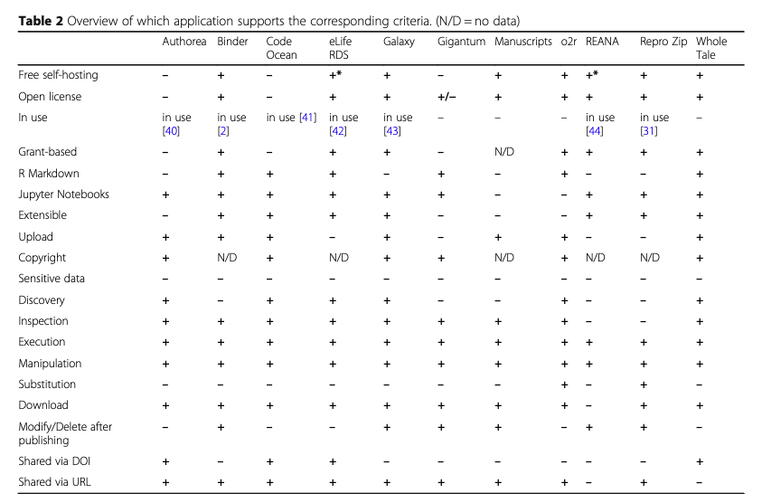
A future for publishing?
“Notebooks are not included in the paper peer-review workflow, ... evaluation by reviewers into the data processing and thus results. ...
AGU’s current recommendations support the more popular end-to-end workflow that involves ... Jupyter Notebooks using GitHub (which, can also be used to render/display Notebooks), and creating/linking to a runnable version via Binder 14”...
Galileo’s notebooks are 400 yr old, but most published links last < 10 yr
....And analysis code might break by the time the paper is submitted!
AGU is experimenting with notebooks as a submission artifact
Physical science data is often less sensitive than human genetics
No one has a great plan for how to archive the code parts long term
https://data.agu.org/notebooks-now/about
https://arxiv.org/ftp/arxiv/papers/2001/2001.00484.pdf
Hennessey, J. & Ge, S. X. A cross disciplinary study of link decay and the effectiveness of mitigation techniques. BMC Bioinformatics 14, S5 (2013).
Trisovic, A., Lau, M. K., Pasquier, T. & Crosas, M. A large-scale study on research code quality and execution. Sci Data 9, 60 (2022).

Slide 10
Archiving notebooks
Who runs the backend to show the notebook?
What happens when old software is unsupported?
What if all “smart” logic could be done by the client?
Web based notebooks are trying to bridge this gap: basic compute features using WASM in the browser
Observable
JupyterLite
Caveats:
Data still has to live somewhere, and that means you still need a server to query big data. Often not a self-contained archive
An incomplete solution for archiving: The notebook might run in the browser, but the library you use might not
JS is a bad language for data science
https://observablehq.com/@jkeefe/electoral-turnout
https://www.destroyallsoftware.com/talks/wat

Slide 11
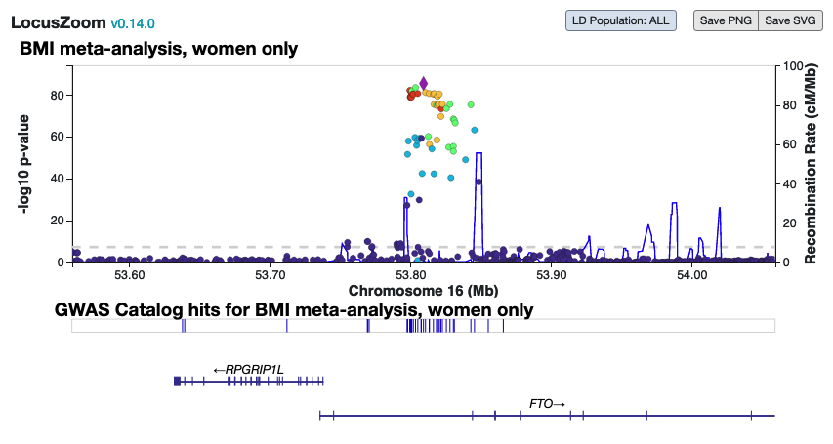
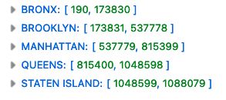
Tabix: Sometimes all you need is disk
Popular genomics library for querying arbitrary parts of compressed data. Tiny index can be read client side and queried over HTTP
Can be used to query big datasets client-side
The basis of our LocalZoom visualization tool
Small index of “start / stop” ranges
Fetch part of a big file
HTTP Byte-range queries
https://samtools.github.io/hts-specs/tabix.pdf
https://abought.github.io/weetabix/ ← Please don’t use this library for anything real
https://statgen.github.io/locuszoom/examples/ext/tabix_tracks.html
Notes:
Idea: an interactive website doesn’t have to load all the data at once. You can create a dynamic query backend using a small index file and nothing but an s3 bucket.
This could enable archives of static files with living functionality- notebooks that survive even after the backend server is turned off, or after a linux package is deprecated!

Slide 12
Strengths and limitations
A notebook could use this to provide interactive exploration of big files, without running a server!
Drop files in S3 bucket and you have a website that “just works”
BUT:
Usually requires data to be sorted (contiguous) for index to be useful
Fetching “every other row” would be messy, and the index would become bloated
Only ~1 kind of query per file: Since the dataset is queried as a block of bytes, much less flexible than SQL
“best of all time” are probably not “the first 10 sorted by year”
Bad for “JOIN logic”: you might fetch 200 records and end up using only 2
Network operations have way more overhead than disk I/O
SELECT table1.id, table2.val
FROM table1
INNER JOIN table2
ON table1.id = table2.id
WHERE table2.val<100
SQLite in the browser. Not great for “big data”- but possible! https://sql.js.org/#/

Slide 13
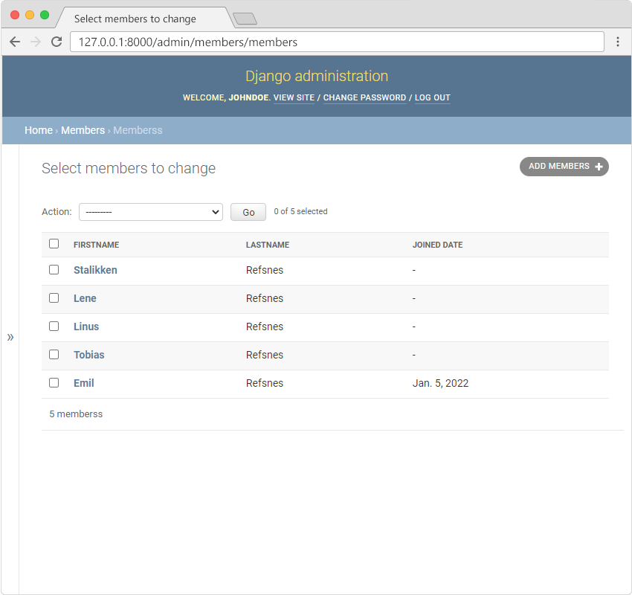
The future for specialized developers
Our skills are still needed for:
Granular access/ security requirements
Complex, long-lived datasets with one source of truth
Unique needs, especially across big data or large amounts of compute
We must focus on enabling productivity- don’t be a gatekeeper!
Let users handle common tasks themselves via admin interfaces and data validation

Slide 14
“
...historically our teams have been pretty independent from Enterprise IT... HPC operations ... [are] different technologies, “weird” operationally, and has very different quality of service requirements ...
There’s been six shifts in the last 15 years which have brought us closer to their orbit:
Enterprise adoption of cloud
Everyone wants Agile
The explosion of data, funder requirements for data management
The emergence of teaching data science
Expansion of computing beyond RCD’s traditional fields
Cybersecurity concerns
”
https://www.researchcomputingteams.org/newsletter_issues/0171

