Slide 1
Getting to Maybe:
Making the case for changes
USRSE Community Call
Andy Boughton

Slide 2
We all have tech debt
How do you convince your manager to spend the resources to change things?

Slide 3
Suggestion 1: Do you have requirements?
You may be affected by rules without knowing it!
ITAR, HIPAA, GDPR, IRB agreements, NIH CoC, SLAs, contract timelines....
Organizational policies
These may define your maintenance schedule
They will determine your end-of-life schedule
Protip: your vendors have end-of-life schedules too!
Notes:
Knowing vendor plans can help you decide which parts of your code need to be modular. If they disappear, would you know how to replace a critical system component?
(opaque data formats, SaaS dependencies on downloads from a remote server... etc)

Slide 4
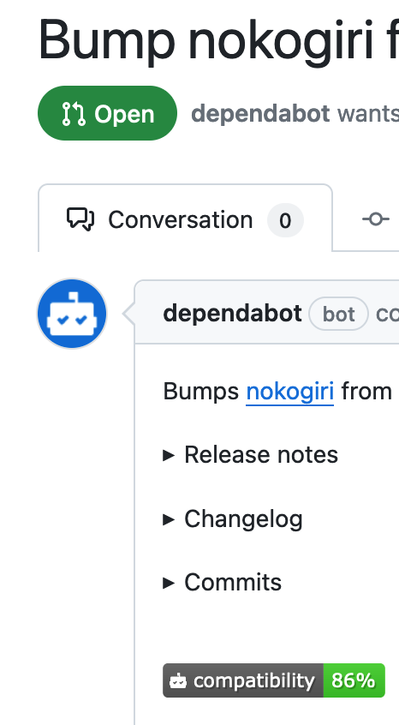

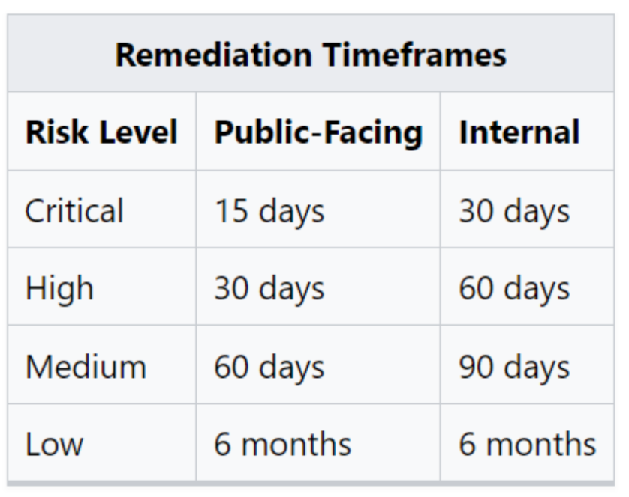
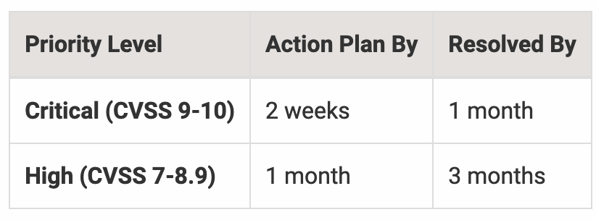
Security means maintenance
Your institution/ grant / funders may have explicit mandatory timelines
Public systems may have more specific timelines
Use automated tools to keep up
Dependabot, snyk, npm audit...
Reproducible deployments (like containers) to make releases safer
Sample NIH policy
https://it.umich.edu/information-technology-policies/general-policies/DS-21

Slide 5
Suggestion 2: Chores are opportunities
Federal procurement standards require considering accessibility of tools (sect 508, WCAG, etc)
This can be a good chance to incorporate automated tools into your dev process and drive improvements going forward
Tie internal goals to external features
“We’ve always wanted to x and it will make y easier”
Give downstream users a reason to upgrade
https://github.com/dequelabs/axe-core

Slide 6




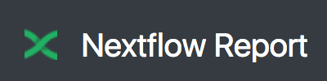
Suggestion 3: Measure now, decide later
Find a way to track ongoing usage
Analytics for websites (matomo, Google analytics, Goaccess, etc)
For CLIs: Download counts for plugins/assets/datasets (find a place where users engage with your infra)
Use what your metrics provide
Automated error reports help make the case for refactoring
Performance/runtime metrics make the case for optimization
Feature level analytics make the case for deprecations
Don’t send reports from secure systems; people will get cranky

Slide 7
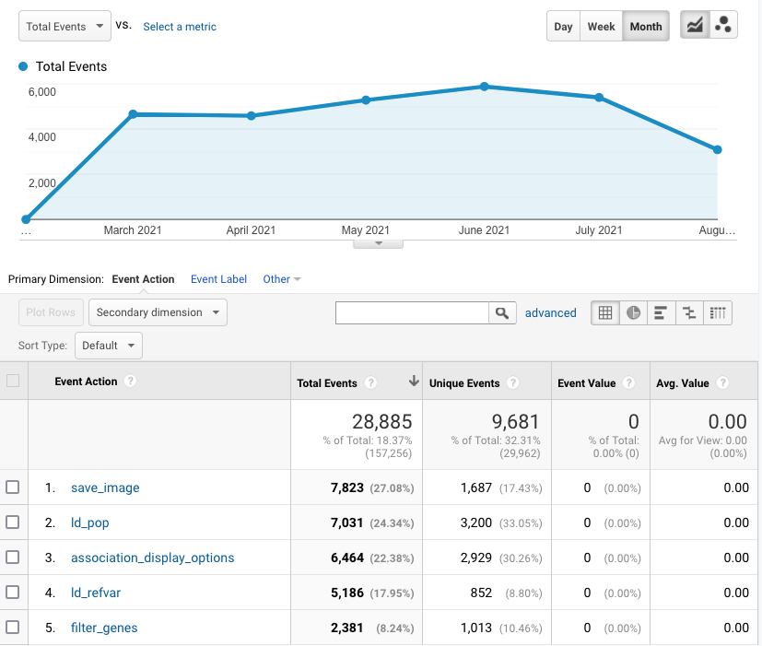
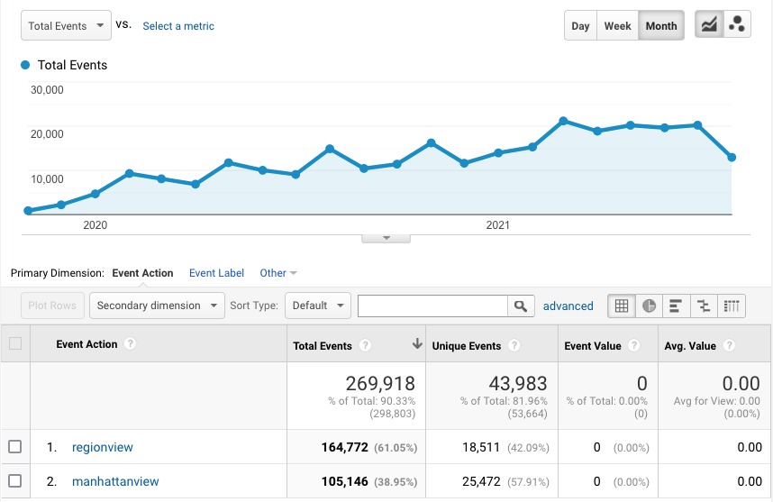
Beyond Pageviews: analytics by feature/ event
Example: ~10% of region plots are saved for followup
Avg 10 region plots generated for every file uploaded

Slide 8
Suggestion 4: Define victory
Who can issue updates?
When are you willing to stop development?
What happens if your vendor stops development first?
Identify path to usage when your support ends
What components need to be flexible to keep the tool running?
Eg data retrieval, type of compute environment
Notes:
How do you decide when to “end of life” a project?
Instead of waiting until a crisis, have this conversation at the start of the project. Create a few metrics, and sample risks. Is your website/maintenance required to run the tool? Can you give the user alternatives that preserve functionality without recurring costs for your team?

