Slide 1
House value prediction
Executive summary:
Accurately assessing the value of a property holds significant importance for individuals, families, and real estate enterprises alike.
When engaging in transactions involving residential real estate, such as buying or selling a property, determining its value is imperative to establish a fair market price. Furthermore, the valuation of a property directly impacts the annual tax obligations of its owner.

Slide 2
House value prediction
Market analysis and objective:
Numerous platforms are available in the market, such as
the Zillow estimator or,
The estimator from different banks, e.g., Chase, or Bank of America,
enabling users to estimate the property values by considering the property's location.
The objective of the house value prediction project is to harness the power of predictive models to enhance the accuracy of forecasted values incorporating additional property descriptors such as the number of bathrooms, bedrooms, property size, and building year holds promise for refining tax predictions.

Slide 3
House value prediction
Value proposition and market segmentation:
The project aims to develop a platform to asses home value for
Homeowners to achieve:
Simplified house value estimation, key factors influencing the property value, and informed decision-making.
Real Estate Professionals to support in:
Enhanced service offerings to clients, increased customer satisfaction, and competitive advantage.
Through the introduction of this offer on our platform, our objectives are manifold:
To augment client contacts by 50% and enhance client acquisition by 10%,
To refine the company's strategy towards targeting high-demand properties,
To elevate the quality of service delivered by our real estate professionals,
To assess the impact of online offers with the potential for launching new online platforms

Slide 4
House value prediction
Constraints:
Time frame:
The pilot project need to deployed within 6-months for the given budget
Budget:
It needs to account for the data acquisition and the engineering work
Milestones:
Business Impact Metrics:
Enhancement of client outreach via the online application
Alteration in the ratio of contacts converted to contracts
Acquisition of data facilitated by the online application
Data collection and preparation
Exploratory Data Analysis
Model building and testing
Deployment and results collection
Review
Launch of the project
Launch of the project
1 month
3 months
4 months
4 months
5 months
6 months

Slide 5
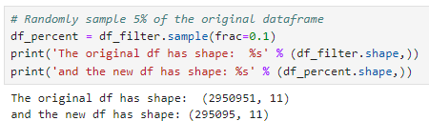
Model evaluation
We investigated the following regression models:
LinearRegression
DecisionTreeRegressor
KneighborsRegressor
XGBRegressor
GradientBoostingRegressor
To facilitate efficient model evaluation with our DataFrame containing nearly 3 million records, we opted to randomly downsample it. This ensured that our cross-validation routine ran within a reasonable timeframe.

Slide 6
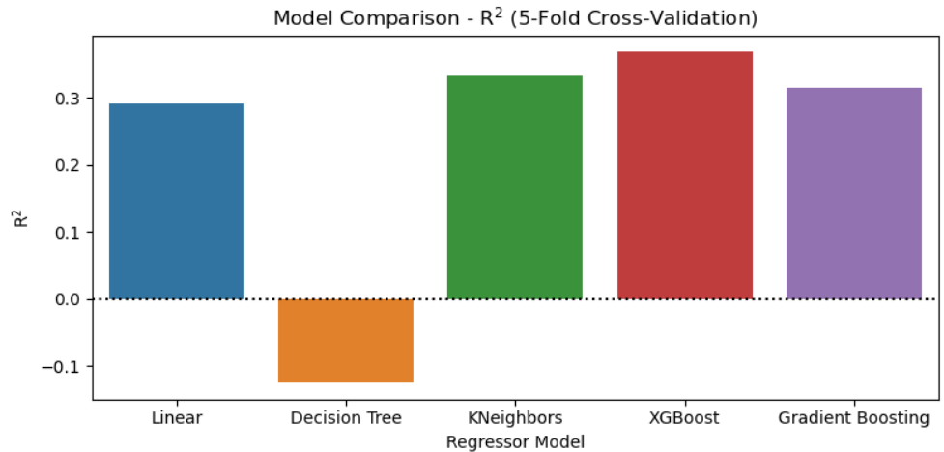
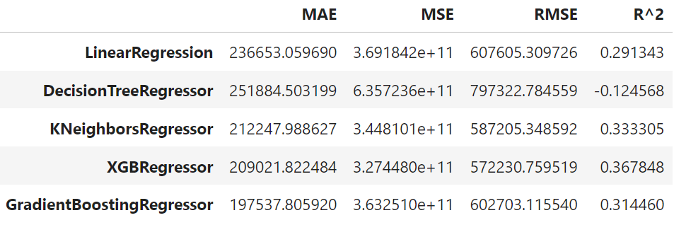
Model evaluation
The models were tested using the KFold cross validation method with 5 splits.
The evaluation of the models has been done using 4 metrics:
Mean Absolute Error (MAE)
Mean Squared Error (MSE)
Root Mean Squared Error (RMSE)
R²

Slide 7
Model evaluation
The best model, was then used to train the entire dataset

Slide 8
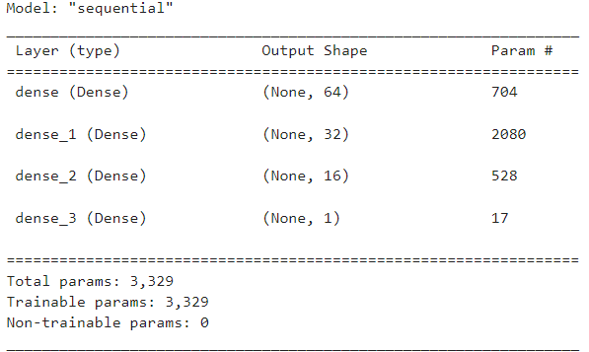
NN Model
We trained also a simple Neural Network with 4 dense layers
However, the model did not outperform the XGBoost model, achieving and R² of 0.199

