Slide 1


Toward MPI-based Workflow Execution: Features & Applications
Language tools for scientific workflows
drhgfdjhngngfmhgmghmghjmghfmf
Justin m wozniak
Data Science & Learning Division Argonne National Laboratory
woz@anl.gov
PMIx Workflows Call March 6, 2020

Slide 2

Justin m Wozniak
Introduction
Swift/T designer and maintainer
An MPI-based workflow-like language
R&D 100 winner 2018
ECP CANDLE- Cancer Distributed Learning Environment
Swift/T: used for deep learning workflows
PMIx: Could be used for configuration and data parallel training
ECP CODAR- Co-design for Online Data Analysis Reduction
Swift/T: Used to launch ensembles of parallel components that communicate over ADIOS, etc.
PMIx: Same?
XLOOP@SC Co-chair (with N. Schwarz (ANL)):
Workshop on Extreme-scale Experiment-in-the-Loop Computing
Swift/T: Used to manage parallel x-ray beamline data analysis tasks
PMIx: Could be used for configuration

Slide 3
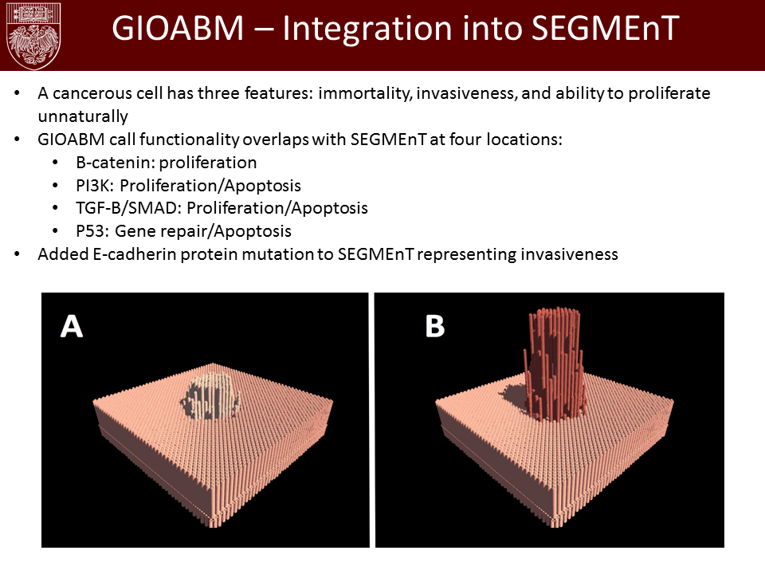
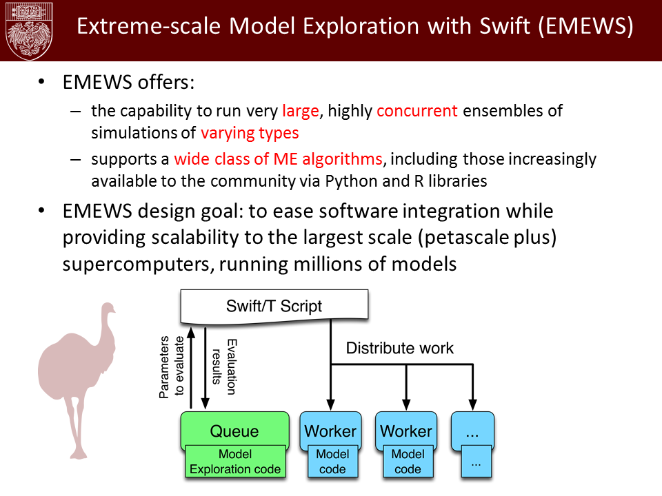
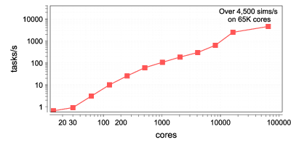
U. Chicago hospitals: Cancer Ensembles
Best paper at SC Cancer Workshop 2016
Parameter fitting for biological phenomenon (DNA repair rate) via massive scale evolutionary algorithm in Swift/T framework
Anatomic-scale cancer modeling using the Extreme-scale Model Exploration with Swift (EMEWS) framework. Proc. Cancer Workshop @ SC, 2016 (Best paper)

Slide 4
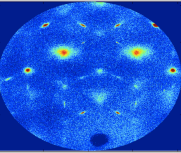
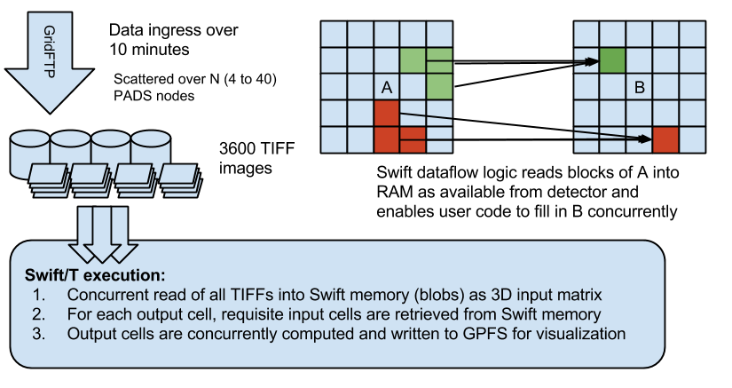

APS: Crystal Coordinate Transformation Workflow
MapReduce-like pattern expressed elegantly in Swift
Set record for data collection at Cornell High Energy Synchrotron Source Argonne group sets record for largest x-ray dataset ever at CHESS, CHESS News 2015.

Slide 5
What happens when the task is mpi
Outline
Background: Overview of the Swift/T language
Advanced features
Big data
Model exploration
Parallel tasks
Example application: Cancer Deep Learning Environment
Parallel tasks
Toward MPI-based workflows
Requirements
Standardization

Slide 6
Swift/T basics

Slide 7
Goals of the Swift language
Swift was designed to handle many aspects of the computing campaign
Make it easy to run large batteries of external program or library executions
Ability to integrate many application components into a new workflow application
Enable complex tasks based in other scripting languages (e.g., Python) or parallel MPI tasks
Provide rich programming language at the top level – fully generic
Data structures for complex data organization
Portability- separate site-specific configuration from application logic
Logging, provenance, and plotting features
Support implicit concurrency and conventional programming constructs

Slide 8
The Swift programming model
All progress driven by concurrent dataflow
(int r) myproc (int i, int j)
{
int x = F(i);
int y = G(j);
r = x + y;
}
F() and G() implemented in native code or external programs
F() and G()run in concurrently in different processes
r is computed when they are both done
This parallelism is automatic
Works recursively throughout the program’s call graph

Slide 9
Swift syntax
Data types
int i = 4;
string s = "hello world";
file image<"snapshot.jpg">;
Shell access
app (file o) myapp(file f, int i)
{ mysim "-s" i @f @o; }
Structured data
typedef image file;
image A[];
type protein_run {
file pdb_in; file sim_out;
}
bag<blob>[] B;
Conventional expressions
if (x == 3) {
y = x+2;
s = strcat("y: ", y);
}
Parallel loops
foreach f,i in A {
B[i] = convert(A[i]);
}
Data flow
merge(analyze(B[0], B[1]),
analyze(B[2], B[3]));
Swift: A language for distributed parallel scripting. J. Parallel Computing, 2011
Compiler techniques for massively scalable implicit task parallelism. Proc. SC, 2014

Slide 10
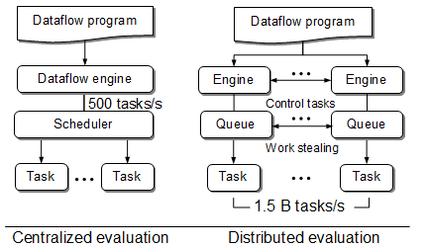
Centralized evaluation is a bottleneck at extreme scales
Had this (Swift/K):
Now have this (Swift/T):
Turbine: A distributed-memory dataflow engine for high performance many-task applications. Fundamenta Informaticae 28(3), 2013

Slide 11


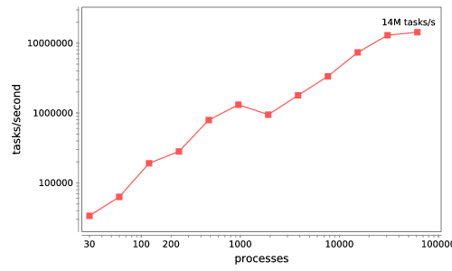






Swift/T: Enabling high-performance Scripted workflows
Supports tasks written in many languages
Write site-independent scripts, translates to MPI
Automatic task parallelization and data movement
Invoke native code, script fragments
Rapidly subdivide large partitions for MPI jobs in multiple ways
Swift/T control process
Swift/T worker
C
C++
Fortran
C
C++
Fortran
MPI
C
C++
Fortran
64K cores of Blue Waters
2 billion Python tasks 14 million Pythons/s
Swift/T: Scalable data flow programming for distributed-memory task-parallel applications Proc. CCGrid 2013.
$ spack install stc
$ conda install -c lightsource2-tag swift-t

Slide 12
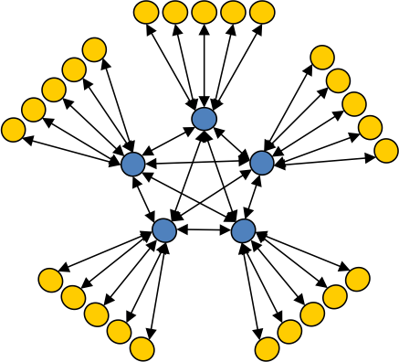
Asynchronous Dynamic Load Balancer
ADLB for short
workers
An MPI library for master-worker workloads in C
Uses a variable-size, scalable network of servers
Servers implement work-stealing
The work unit is a byte array
Optional work priorities, targets, types
For Swift/T, we added:
Server-stored data
Data-dependent execution
masters
Lusk et al. More scalability, less pain: A simple programming model and its implementation for extreme computing. SciDAC Review 17, 2010

Slide 13

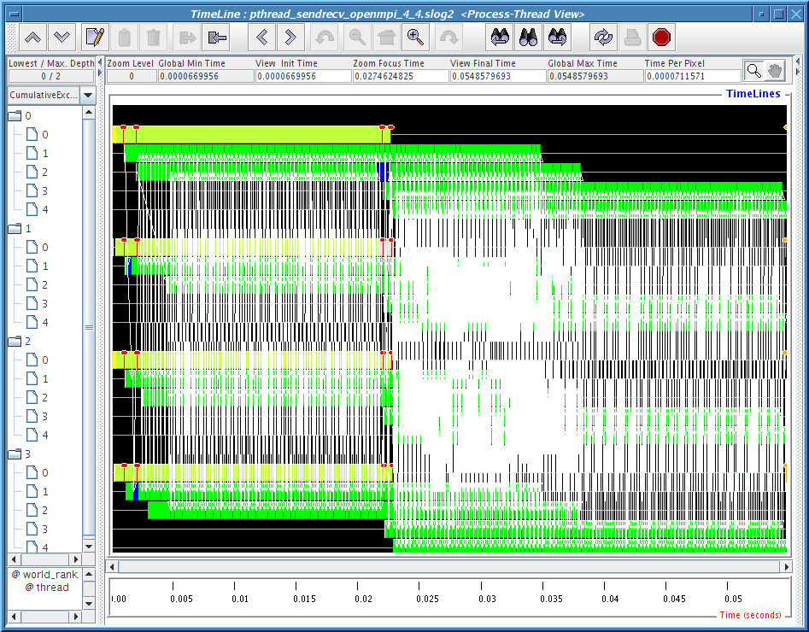
MPI: The Message Passing Interface
Programming model used on large supercomputers
Can run on many networks, including sockets, or shared memory
Standard API for C and Fortran; other languages have working implementations
Contains communication calls for
Point-to-point (send/recv)
Collectives (broadcast, reduce, etc.)
Interesting concepts
Communicators: collections of communicating processing and a context
Data types: Language-independent data marshaling scheme

Slide 14
Advanced features

Slide 15
Features for Big Data analysis
Location-aware scheduling User and runtime coordinate data/task locations
Collective I/O User and runtime coordinate data/task locations
Application Dataflow, annotations
Application I/O hook
Runtime MPI-IO transfers
Runtime Hard/soft locations
Distributed data
Distributed data
Big data staging with MPI-IO for interactive X-ray science. Wozniak et al. Proc. Big Data Computing 2014.
Experimental evaluation of a flexible I/O architecture for accelerating workflow engines in ultrascale environments. F. Duro, Wozniak, et al. Parallel Computing 61, 2017.
Parallel FS

Slide 16
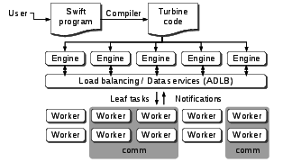
Parallel tasks in Swift/T
Swift expression: z = @par=8 f(x,y);
When x, y are stored, Turbine releases task f with parallelism=8
Performs ADLB_Put(f, parallelism=8)
Each worker performs ADLB_Get(&task, &comm)
ADLB server finds 8 available workers
Workers receive ranks from server
Perform MPI_Comm_create_group()
ADLB_Get() returns: task=f, size(comm)=8
Workers perform user task
communicate on comm
comm is released by Turbine
Can hand the communicator to LAMMPS, NAMD, DIY, CODES/ROSS, etc.
Wozniak et al. Dataflow coordination of data-parallel tasks via MPI 3.0. Proc EuroMPI, 2013.

Slide 17
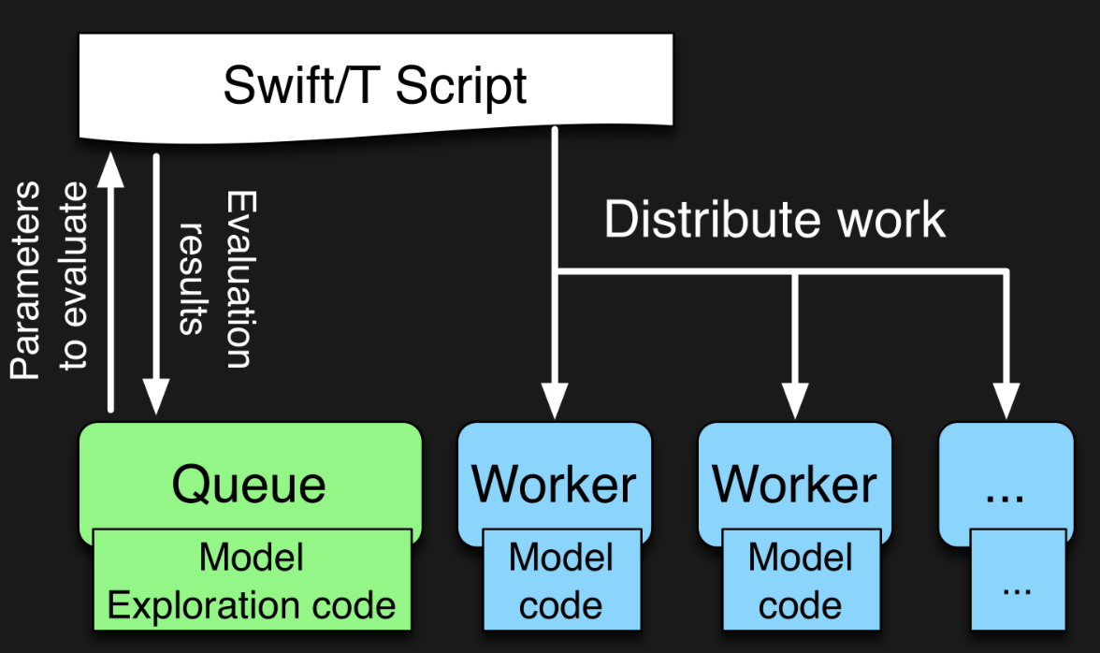

EMEWS workflow structure
The core novel contributions of EMEWS are shown in green, these allow the Swift script to access a running Model Exploration (ME) algorithm, and create an inversion of control (IoC) workflow
Both green and blue boxes accept existing multi-language code
http://emews.org

Slide 18
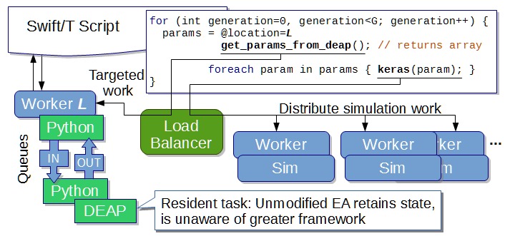
EMEWS: Extreme-scale model exploration workflows in Swift/T
How do we couple complex model exploration algorithms with workflows?
Optimization, active learning, uncertainty quantification…
http://emews.org
From desktop to large-scale model exploration with Swift/T Proc. Winter Simulation Conference 2016

Slide 19
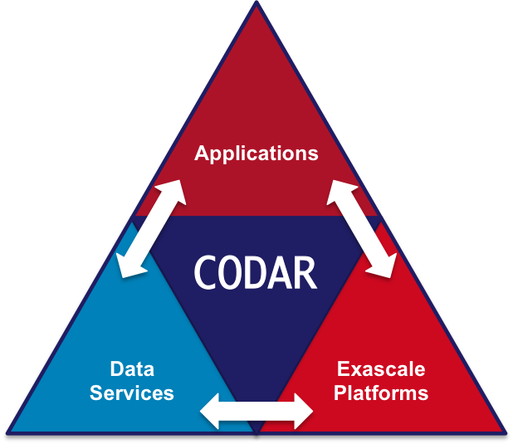
ECP CODAR: Swift-controlled ADIOS transfers
Enable Swift to dynamically lay out tasks
Control large simulation/redistribute/analysis ensembles
Highly flexible, programmable use of MPI subjobs
ADIOS analysis pipelines
Model exploration algorithm
Swift workflow control and load balancing

Slide 20
Example application: CANDLE

Slide 21
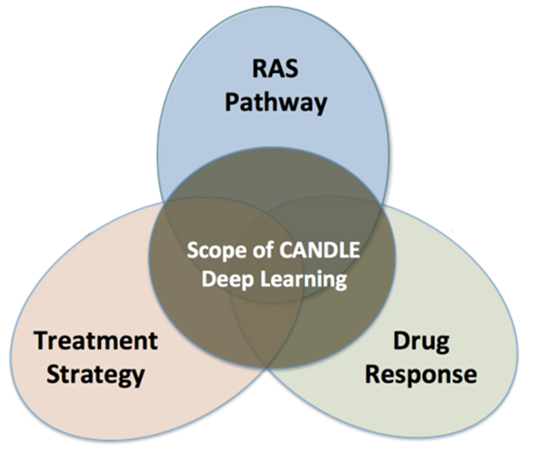
CANDLE
CANDLE (PI: Rick Stevens) is an Argonne led multi-DOE lab collaboration developing a suite of software to support scalable deep learning for cancer applications on DOE supercomputing resources
Funded by the DOE Exascale Computing Project
Developing implementations of deep neural networks on targeted problems related to the three core DOE-NCI Joint Design of Advanced Computing Solutions for Cancer (JDACS4C) pilot projects
GitHub: http://github.com/ECP-CANDLE

Slide 22
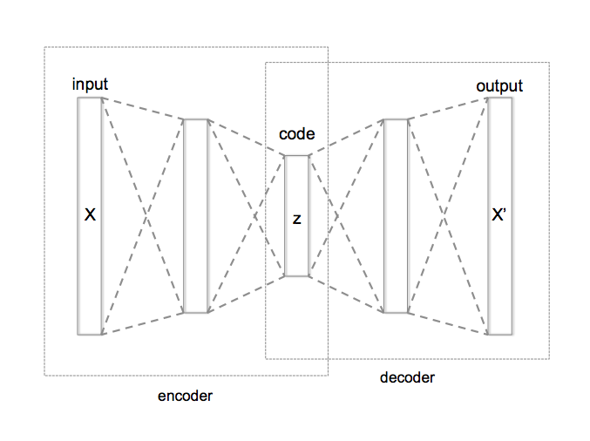
WHAT IS HYPERPARAMETER OPTIMIZATION?
Hyperparameter optimization = HPO
Neural networks have a large number of possible configuration parameters, called hyperparameters
Avoids collision with NN weights, which are sometimes called parameters
Applying optimization can automate part of the design of the neural network
In the cancer Pilot 1 autoencoder shown, the system can determine
How many neurons to put in each layer
What activation function to use
What batch size to use
Etc.

Slide 23
Parallelism strategies
10,000 x 10-1000 x 10-100 = 1M – 1000M processing elements
Hyperparameter Search: up to ~10,000x
Depends on search strategy
Data Parallel: 10x-1000x
Data Parallel
10x-1000x
Model
Parallel
10x-100x
Model
Parallel
10x-100x
Model
Parallel
10x-100x
Model
Parallel
10x-100x
Model
Parallel
10x-100x
...
...
...

Slide 24
WORKFLOW support for ML frameworks
Concurrency:
Scalable task distributor
Intranode concurrency, accelerators left up to the framework
Multinode ML tasks are parallel tasks
Data management:
Could reuse input staging methods
Intermediate caches via DataSpaces/Mochi
Software integration:
Usually launch frameworks in separate process
Launching within process is a configuration challenge
Search methods launched within process

Slide 25
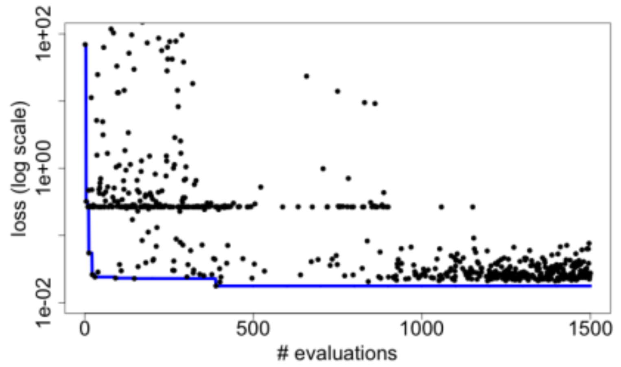
Candle Hyperparameter learning
Search trajectory of mlrMBO (R model-based optimization) algorithm
Each iteration does 300 evaluations (batch size)
Minimum and average performance on validation data set decreases as the ME algorithm learns
Predicting Tumor Cell Line Response to Drug Pairs with Deep Learning, F. Xia, M. Shukla, T. Brettin, C. Garcia-Cardona, J. Cohn, J. Allen, S. Maslov, Y. Evrard, S. Holbeck, J. Doroshow, E. Stahlberg, and R. Stevens. Computational Approaches for Cancer Workshop @ SC 2017

Slide 26
Parallel tasks in CANDLE workflows
Complex concurrency structures
Model parallelism: running the same network across nodes
Library approach:
Use Swift/T @par syntax
Uses MPI 3 to dynamically create communicator from group
User task library accepts communicator via function input
Approach developed for other scientific computing cases, LAMMPS, NAMD, DIY, etc.
Have patched Horovod library
Should work with LBANN
MPI_Launch approach
Use Swift/T launch() function
Creates MPI 3 group
Launches mpiexec on those resources, creating a new MPI_COMM_WORLD and separate processes (fault tolerance)
Works on clusters and Cray
Would work with unmodified Horovod or LBANN

Slide 27
ECP Interaction: CODAR, CANDLE
CANDLE workflows produce a great number of medium-sized ML models
Goal: Cache these on compute node storage for possible later use. Need to flush to global FS before end of run, but many models will be discarded
Approach: Integrated Swift/T workflow system used in CANDLE with DataSpaces client
Provide an opportunity for workflow-based data analysis and I/O reduction
Demonstrate the utility of node-local storage for complex workflows
Scaling deep learning for cancer with advanced workflow storage integration. Proc. MLHPC @ SC 2018.
Swift/T training workflow
…
CANDLE benchmark
CANDLE
TensorFlow
TensorFlow
Good NN model
DataSpaces
Parallel FS

Slide 28
TOWARD MPI_COMM_Launch()

Slide 29
New MPI_Launch feature
Allows Swift/T to run external parallel programs on subcommunicators inside a large allocation on a big machine
Swift/T syntax: @par=8 launch("./my-program", args[], envs[]);
Provides:
Scalable, in-place job launch
Handles cases where called program crashes
Can pack many such variably-sized programs within a large workflow
Based on a proposed MPI function (available on clusters and Cray):
int MPIX_Comm_launch(const char *cmd, char **argv,
MPI_Info info, MPI_Comm comm,
int *exit_code);

Slide 30
context
Want to run scientific ensembles controlled by C/C++/Fortran programs:
Parameter sweeps, searches, optimizations
Tests under varying parameters and process counts
Workflows and code coupling cases where jobs can exit or fail
State of the art:
MPI_Comm_spawn() has limited availability
in part due to complexity of implementing?
MPI_Comm_spawn() does not support job exit detection and failures
Users write complex shell scripts against vendor-specific job launchers
Proposing an alternate function: MPI_Comm_launch()
Implemented on clusters (via MPICH/mpiexec hack) and by a vendor (internal)

Slide 31
MPI_COMM_LAUNCH(): details
int MPIX_Comm_launch(const char *cmd, char **argv,
MPI_Info info, MPI_Comm comm,
int* exit_code);
Runs “in-place” on given communicator- no interaction with scheduler, etc.
Parent is blocked
No communication between parent and child
Parent gets exit code- easy recovery from child failures

Slide 32
MPI_COMM_LAUNCH(): Benefits
Allows user to use familiar communicator management to setup subjob
We have done things with MPI_Comm_split() and MPI_Comm_create_group()
Easy to work with unmodified child codes
Allows for the development of MPI-based workload management systems
Write simple test harnesses or parameter sweeps in C or Fortran + MPI
Or use an MPI-based system like ADLB, Swift/T, or MPI-Bash (all implemented!)
Possibly work with other parallel programming systems?
Collaboration opportunity?

Slide 33
Swift/T example
When file A is created, launch N sub jobs of varying size
file B[]; // Define an array of file variables
A => {
foreach i in [0:N-1] {
file B_i<"B-%i.txt"%i>;
string args_B[] = [ int2string(i),
filename(A), filename(B_i) ];
@par=i launch("./child.x", args_B) => B_i = touch();
B[i] = B_i;
}}
Child tasks are load-balanced, MPI_Comm_create_group() is done automatically!

Slide 34
MPI-Bash Example
Author: Scott Pakin (LANL)
Forked and extended for MPI_Comm_launch() by Wozniak
#! /usr/bin/env mpibash
enable -f mpibash.so
mpi_init mpi_init
mpi_comm_rank rank
mpi_barrier
if [ $rank -eq 0 ] ; then
iter=0
while [ $iter -lt $niters ] ; do
mpi_send 1 X
mpi_recv 1 msginfo
let iter++
done
. . .
# Run with:
$ mpirun -np 16 ./my-script.sh
#! /usr/bin/env mpibash
enable -f mpibash.so
mpi_init mpi_init
mpi_comm_rank rank
mpi_comm_split $rank $rank newcomm
echo newcomm: $newcomm
mpi_comm_set $newcomm
mpi_comm_rank rank
mpi_comm_launch my-simulator
echo exit_code $?
. . .
Current use case: doing send and recv from inside Bash!
Proposed use case: doing job configuration and launch from inside Bash (isn’t this what we want?)

Slide 35
NewER MPI_Launch_MULTI feature
Allows Swift/T to run external parallel program groups on subcommunicators inside a large allocation on a big machine
Call these groups Functional Online Bundles (FOBs)
Swift/T syntax: @par=8 launch_multi(procs[], programs[], args[][], envs[][], <colors>);
Provides:
Scalable, in-place simultaneous job launch
The programs are able to find each other and communicate with ADIOS (or other techniques)
Job layout can be controlled with the optional colors argument
A variety of other controls are available via special environment variables

Slide 36
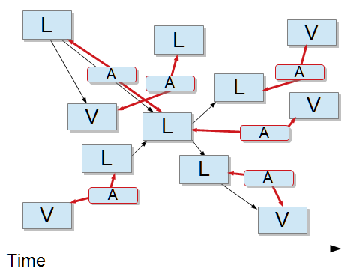
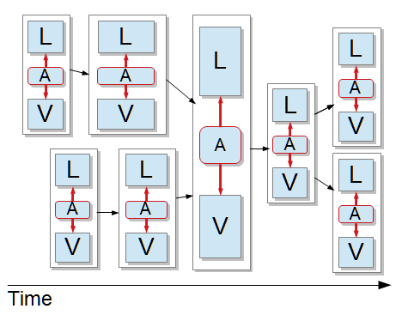
Workflow abstractions for in situ
Need to provide workflow structure to capture in situ communication
Default load-balanced scheduling results in disordered layout
L: LAMMPS A: ADIOS V: Voro++
add’l structure!
MPI jobs within MPI jobs: A practical way of enabling task-level fault-tolerance in HPC workflows. Wozniak, Dorier, et al. FGCS 101, 2019.

Slide 37
LINKS
Swift/T Home: http://swift-lang.org/Swift-T
Swift/T Guide: http://swift-lang.github.io/swift-t/guide.html
Swift/T Sites Guide: http://swift-lang.github.io/swift-t/sites.html
Swift/T GitHub: https://github.com/swift-lang/swift-t
Support: https://groups.google.com/forum/#!forum/swift-t-user
Book chapter (easiest introduction): http://www.mcs.anl.gov/~wozniak/papers/ProgrammingModels_Swift_2015.pdf
Other papers: http://swift-lang.github.io/swift-t/pubs.html

Slide 38
QUESTIONS?
This research was supported by the Exascale Computing Project (17-SC-20-SC), a joint project of the U.S. Department of Energy’s Office of Science and National Nuclear Security Administration, responsible for delivering a capable exascale ecosystem, including software, applications, and hardware technology, to support the nation’s exascale computing imperative.

