Slide 1
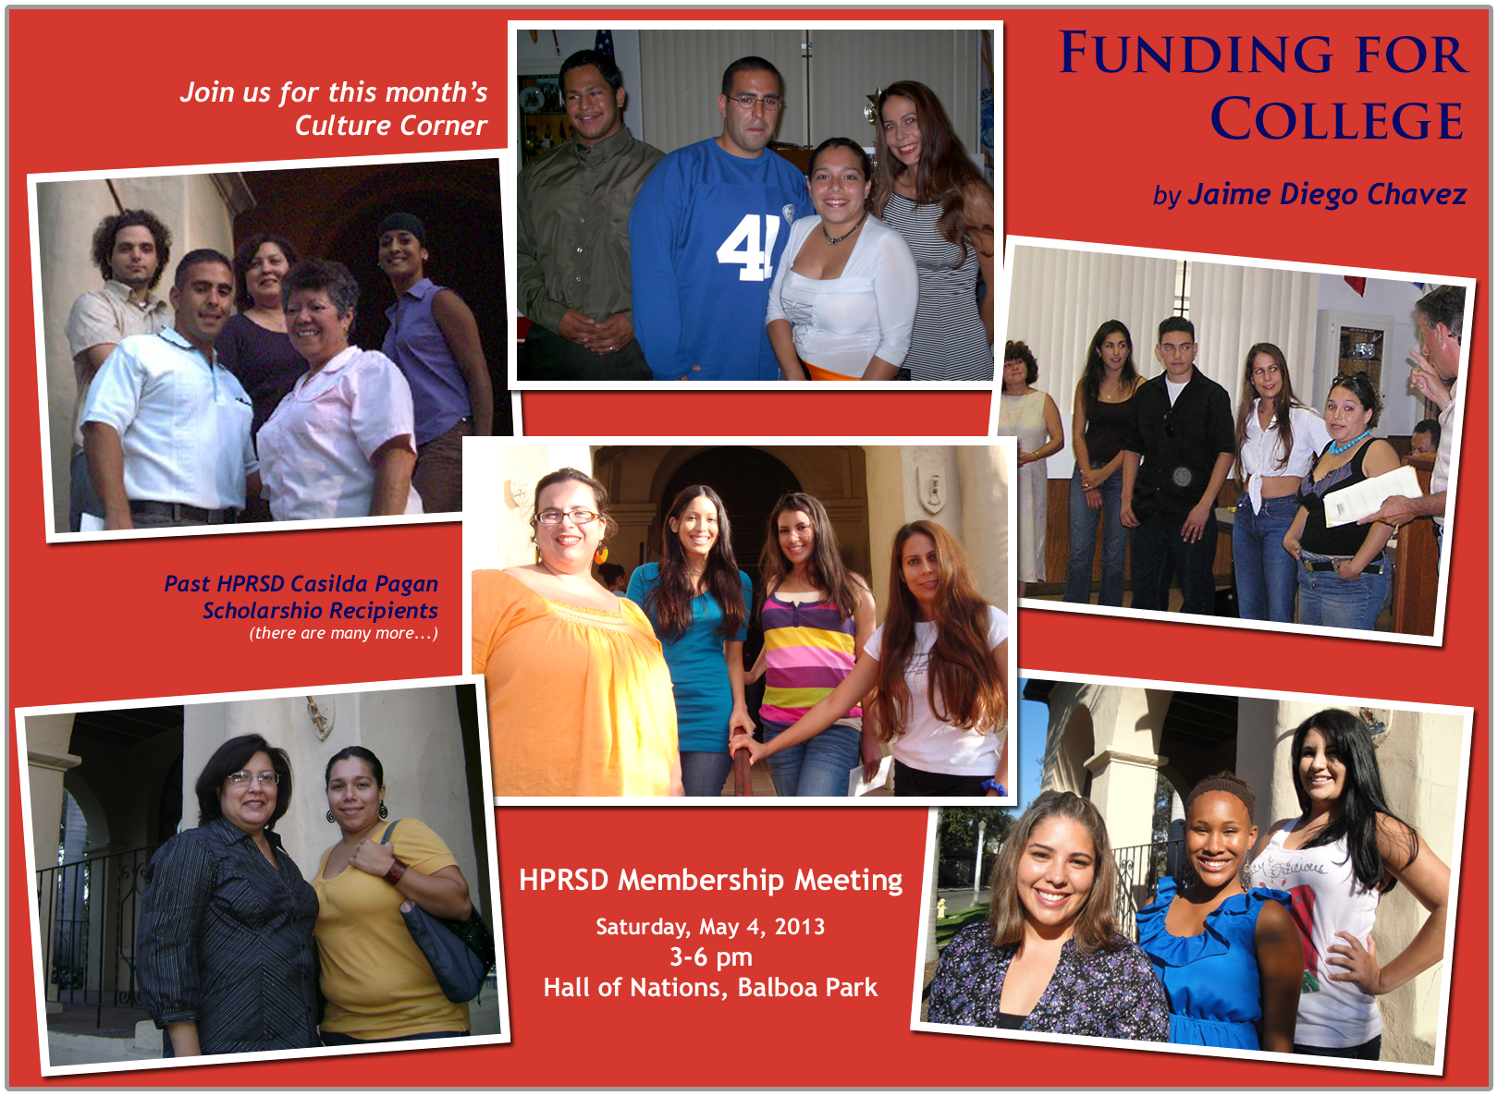

Slide 2

Funding for College!
Financial Aid
Scholarships
Casilda Pagan Scholarship

Slide 3

Why go to College?

Slide 4
Why go to College?
Easier to find a job
More secure future
Improve confidence
Increase understanding of society, politics,
economics, and the world

Slide 5

Why go to College?
More options later in life
Prepare for a career
Make more money!
College graduates make
more money than those
who do not graduate from
college. (U.S. Census Bureau)

Slide 6
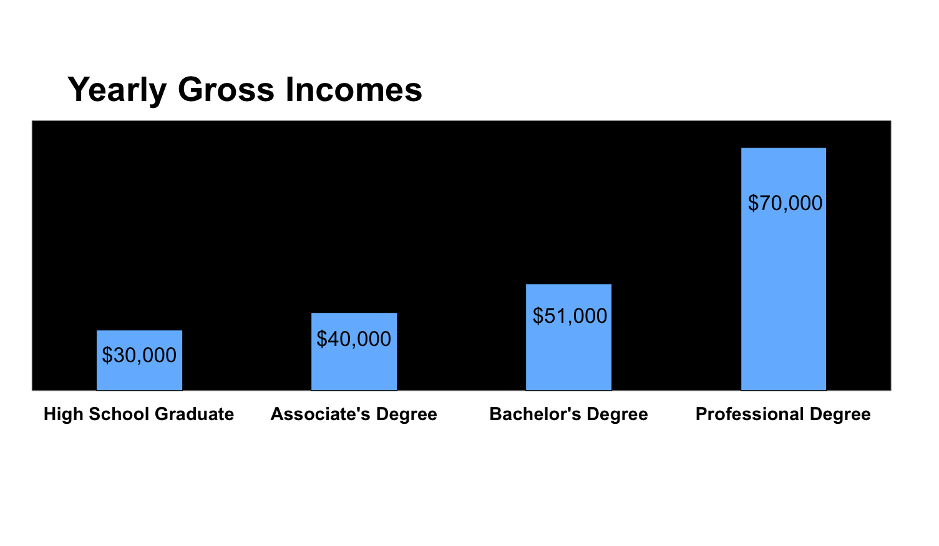
Earning Potential for Different
College Degrees

Slide 7


Financial Aid
Federal Financial Aid based on financial need
  No GPA requirement
  Must fill out FAFSA
  Peel Grants and Loans
California Financial Aid (Cal Grants) are based on financial need and GPA
  Meet GPA requirements
  Must fill out FAFSA and return CAL GRANT AUTHORIZATION FORM (GPA Verification Form)

Slide 8
Financial Aid Websites
For federal financial aid, complete the FAFSA application by March 2, @ www.fafsa.ed.gov
In California, please go to www.calgrants.org for California financial aid and complete by March 2

Slide 9


Types of Financial Aid
(Federal and State $)
Grants
    Free Money!
    Pell Grants (Fed)
    Cal Grants (CA)
    Smart Grant (CA)
    (Science, math)
        Loans
        Pay back 6 months after leaving college
“”WORK STUDY”
    Employment

Slide 10

Scholarships- FREE $
Based on:
GPA
Financial Need
Community service
Ethnicity/Religion
Athletic ability
Club involvement
Essays or contests
Other
Check out www.fastweb.com

Slide 11
Scholarship Checklist
Review Weekly Scholarships on internet
Apply for Free scholarship searches at www.fastweb.com
Put together a personal scholarship folder (Letters of recommendation, resume, transcript, personal essay)
KEEP APPLYING!

Slide 12
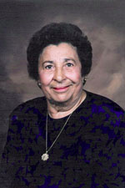
HPRSD CASILDA PAGAN SCHOLARSHIP
The House of Puerto Rico San Diego sponsors the Casilda Pagán Educational/ Vocational Scholarship.
This scholarship is being offered to high school seniors/ graduates or college/post-graduate students.
The applicant must be a current active member of the House of Puerto Rico San Diego or a San Diego County resident of Puerto Rican descent, who has contributed at least 10 hours of community service through HPRSD within the last year.
www.houseofpuertorico.com/pagan.html

Slide 13
HPRSD CASILDA PAGAN SCHOLARSHIP
Personal Essay (250 word minimum) including the following information:
  Your educational /vocational goals
  Your financial needs
  Describe how you will contribute community service through the House of Puerto Rico.
  Describe Prior History of community service
Proof of current enrollment in an educational or vocational institution
www.houseofpuertorico.com/pagan.html

Slide 14
HPRSD CASILDA PAGAN SCHOLARSHIP
Transcripts reflecting most recent academic achievement.
  Those already attending a college/vocational program should submit a transcript showing all courses/grades completed to date.
  High school seniors should submit most recent transcripts)
Three letters of recommendation from teachers, counselors, employers, or community leaders
Completed application form
Any additional materials which you believe may enhance your application (i.e., awards, community service, etc.)
www.houseofpuertorico.com/pagan.html

Slide 15
Community Service through HPRSD
Contribute at least 10 hours of community service through HPRSD within the last year.
Upcoming volunteer opportunities include:
  Ethnic Food Fair
  Día de San Juan
  Host on Sundays at the Casita
  Youth Committee
  other events
www.houseofpuertorico.com/pagan.html

Slide 16
Thank you for attending!
Thank you for attending!
Join the HPRSD Youth Committee!
Volunteer with the House of Puerto Rico!
Get more information at www.houseofpuertorico.com
Casilda Pagan Scholarship deadline :
July 31, 2013

