Slide 1
Predict whether the cancer is benign or malignant
Wonjun Lee, Intelligence & Manufacturing Convergence Laboratory, ETRI, Daejun, Republic of Korea

Slide 2
Machine Learning
Data Explore and EDA
Data Explore
Load Dataset
Check Missing Value
EDA
CountPlot
Histogram
Boxplot – IQR – Outlier
Heatmap – multicollinearity
Data Preprocessing
Standard Scaler
Split data
Selecting the appropriate ML model
Prediction of Learning Machine Learning Model Algorithm
Using Deep Learning Model
Prediction performance evaluation

Slide 3
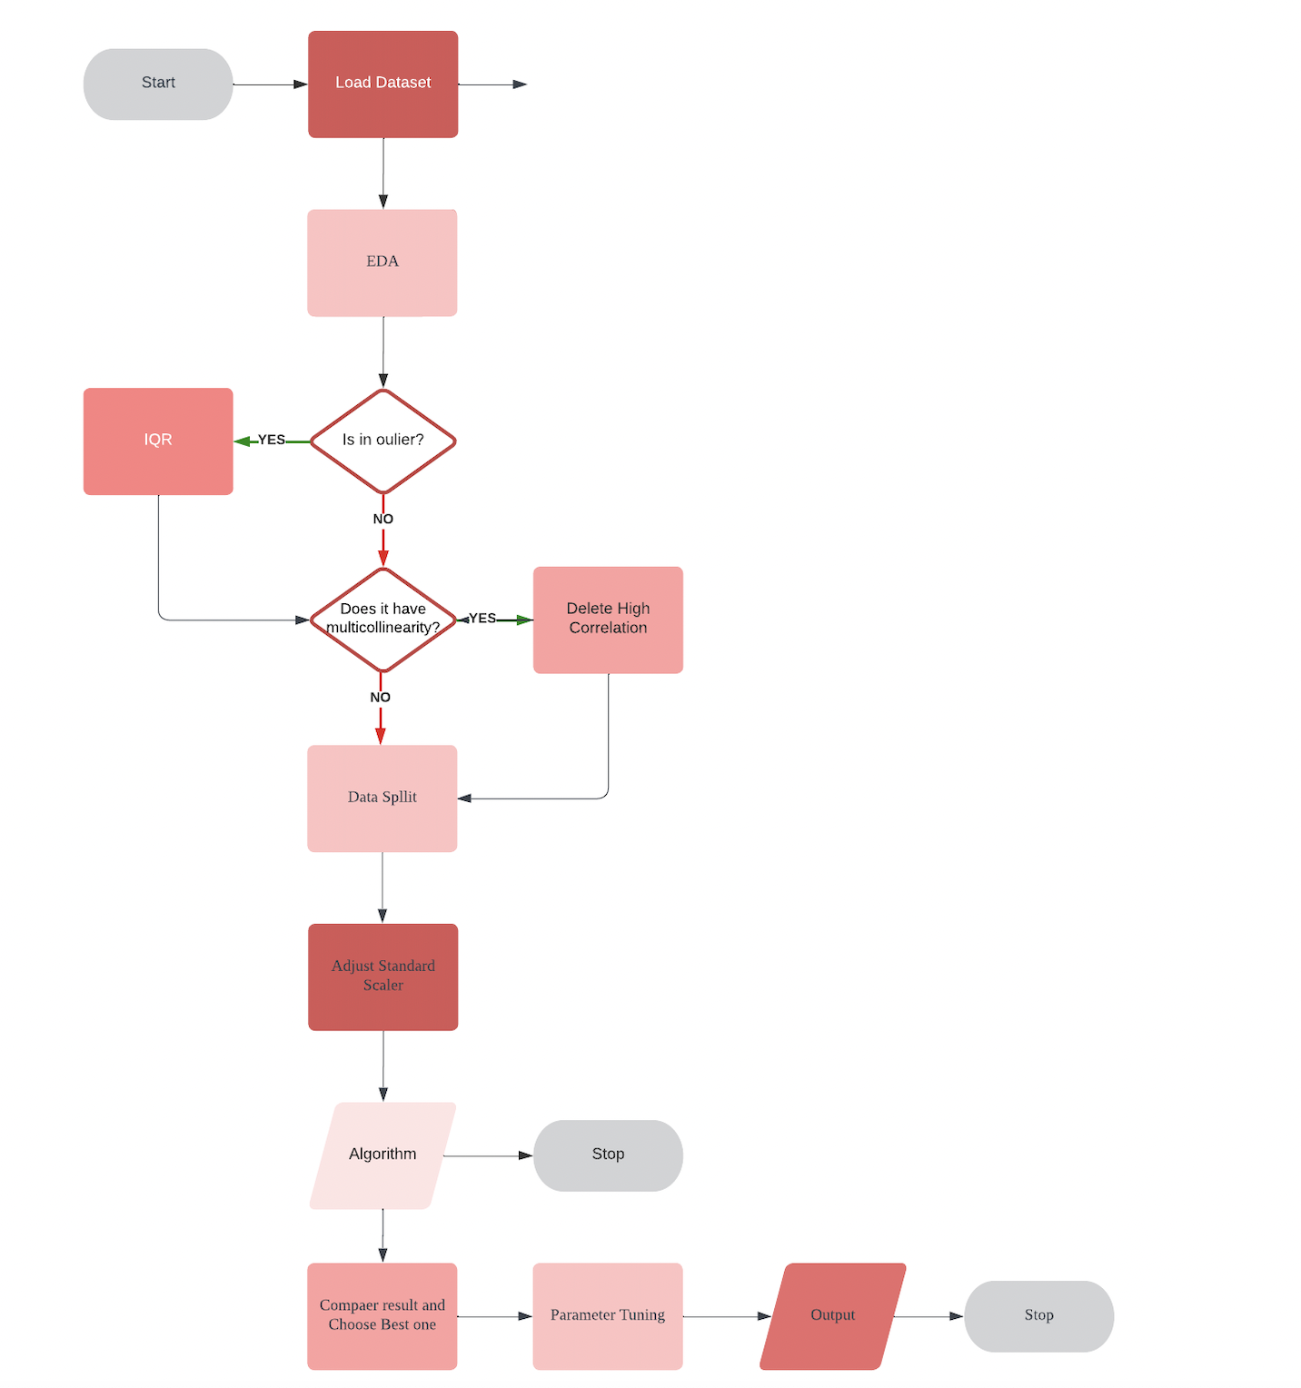
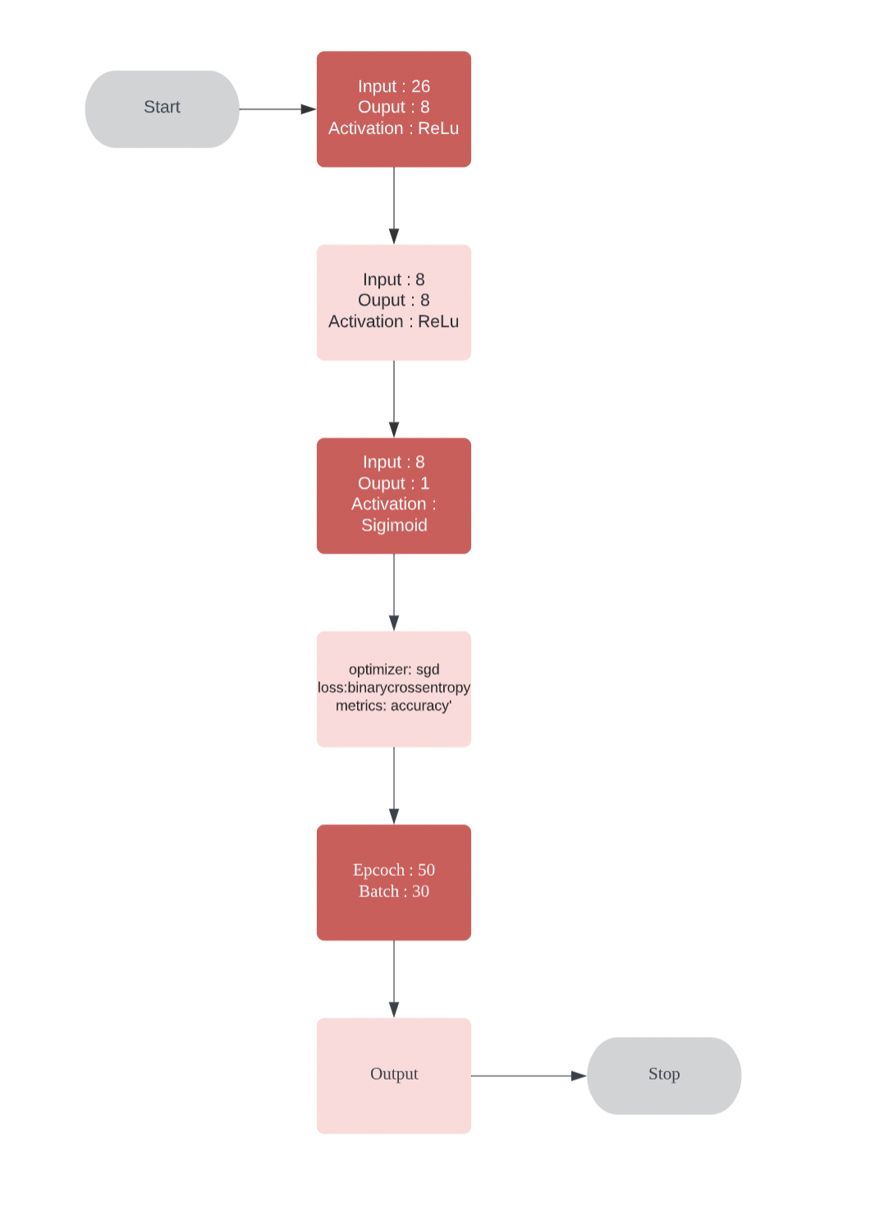
Flow Chart of Models

Slide 4
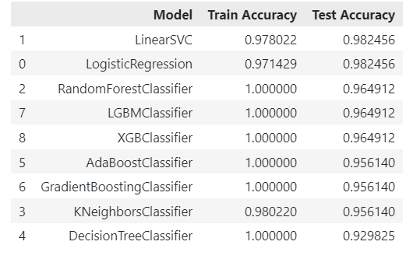
Machine Learning Output
After GirdSearch
Accuracy
improved to 0.99

Slide 5

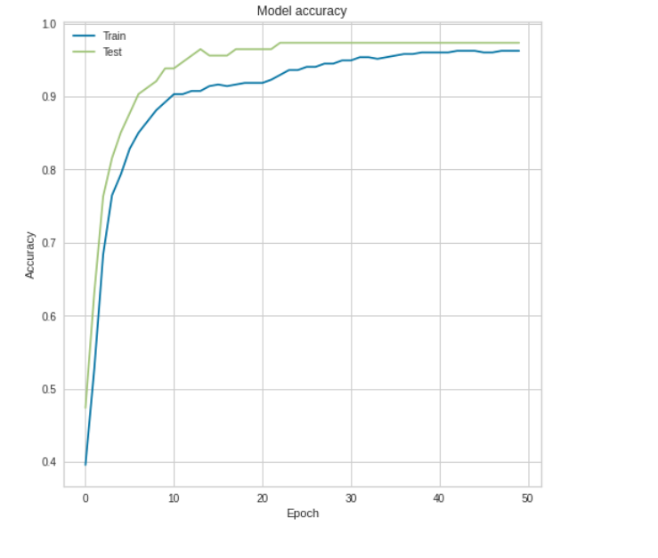
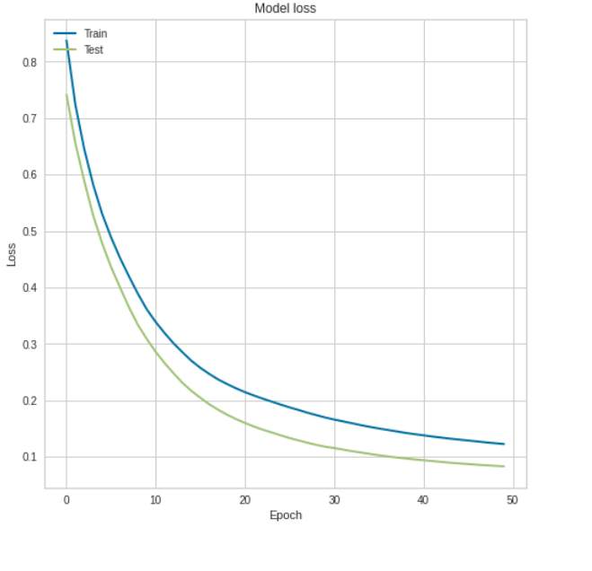
Deep Learning Output

Slide 6
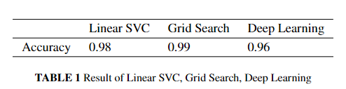
Final Accuracy
Finally, the accuracy was raised to 0.99%
Overfitting is suspected because the dataset is small
Future research requires large data sets

