Slide 1
Salifort Motors: understanding employee attrition
PACE analysis: Plan • Analyze • Construct • Execute
Goal: understand recorded departure patterns and evaluate predictive performance.
Decision: validate retention hypotheses through a measured, supportive pilot.
Salifort Motors | Retrospective analysis | 1

Slide 2
Data quality changes the story
14,999 raw rows → 11,991 after removing exact duplicates.
Observed attrition: 23.8% raw → 16.6% deduplicated.
No missing cells; no employee IDs or dates. Confirm the deduplication assumption.
Salifort Motors | Retrospective analysis | 2

Slide 3
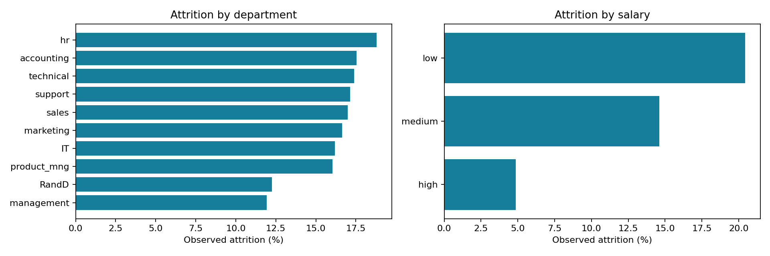
Observed attrition across employee groups
Salifort Motors | Retrospective analysis | 3

Slide 4
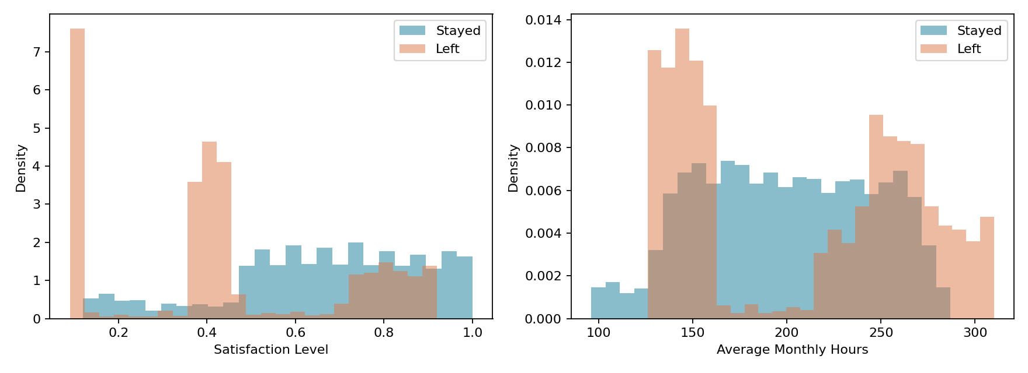
Workload and satisfaction: descriptive patterns
Salifort Motors | Retrospective analysis | 4

Slide 5
How the model was evaluated
Stratified 60/20/20 train/validation/test split; seed 42.
Training-only preprocessing; dummy, logistic, tree, and forest compared.
Select on validation average precision; refit on development data.
Evaluate the test set at a fixed 0.5 threshold.
Salifort Motors | Retrospective analysis | 5

Slide 6
Held-out results: random forest
Precision 98.1% | Recall 91.5% | F1 0.947
Average precision 0.964 | Test prevalence 0.166
364 leavers identified; 34 missed; 7 stayers incorrectly flagged.
Retrospective performance does not prove prospective readiness.
Salifort Motors | Retrospective analysis | 6

Slide 7
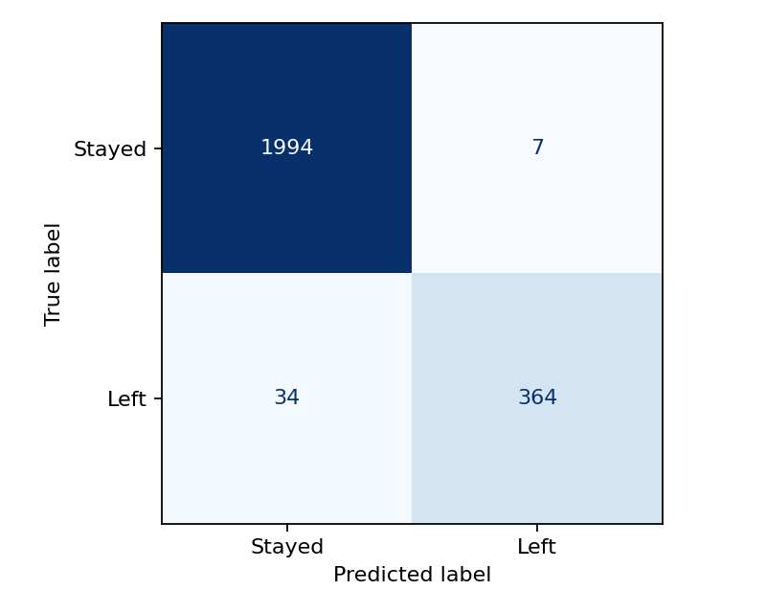
Errors on the held-out test set
Salifort Motors | Retrospective analysis | 7

Slide 8
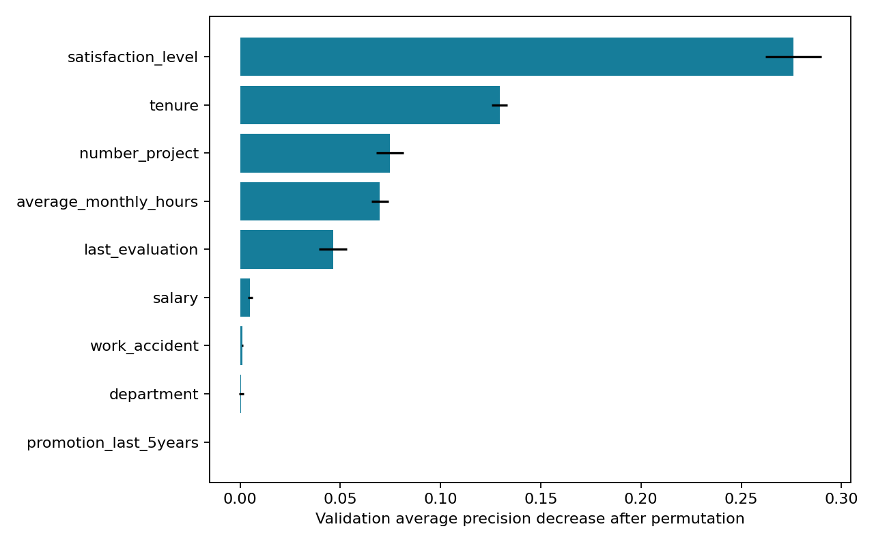
Features supporting prediction, not causal claims
Salifort Motors | Retrospective analysis | 8

Slide 9
Recommended retention pilot
HR + managers: review extreme workloads and project allocation.
Offer confidential feedback and voluntary support.
Evaluate retention and wellbeing against a defined comparison group.
Audit pay and progression; do not infer causal benefits from correlations.
Salifort Motors | Retrospective analysis | 9

Slide 10
Conditions before operational use
Confirm source, redistribution rights, and duplicate handling.
Verify when each feature was collected and define a prediction horizon.
Validate on a later employee cohort; assess calibration and fairness.
Choose an outreach threshold from costs and capacity; retain human review.
Salifort Motors | Retrospective analysis | 10

