Slide 1
Focus
A Personal AI powered Focus Trainer
COP290 Design Practices - Indian Institute of Technology Delhi
Akshat Jha (2022CS11101) and Nisarg Rudresh Pandya (2022CS11601) - COP290 Design Practices

Slide 2
Overview
We have developed a gamified android app “Focus” using Flutter that deals with a concerning issue: high screen time among phone users, that leads to decline in productivity and more often then not, mental health.
The aim is to alert the user about their screen usage and assist them to stay focused. So, many features have been provided that contribute towards this aim. This will be discussed in length in later slides.
The gamification component is two-fold: providing users with their “focus scores” and actually providing them games that are based on the app’s central theme.

Slide 3
Why Flutter and Dart?
Cross-Platform Applications; Type Safe
Flutter enables us to translate an app from one platform to another with considerable ease.
Since our target platform was phone, using flutter is even more justified as it robustly supports android development.
We also got to learn a new language. And we found Dart to be quite elegant indeed, with its versatility and extensive features.

Slide 4
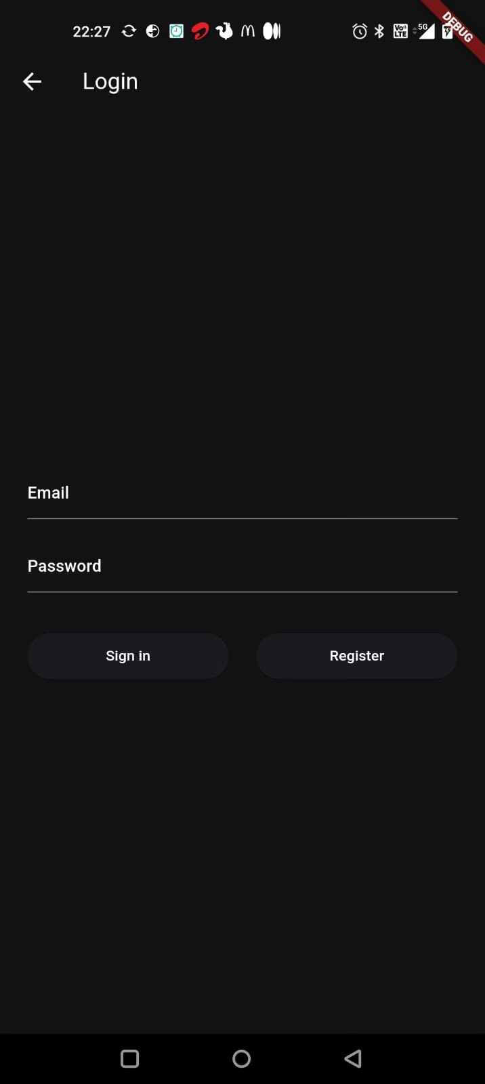
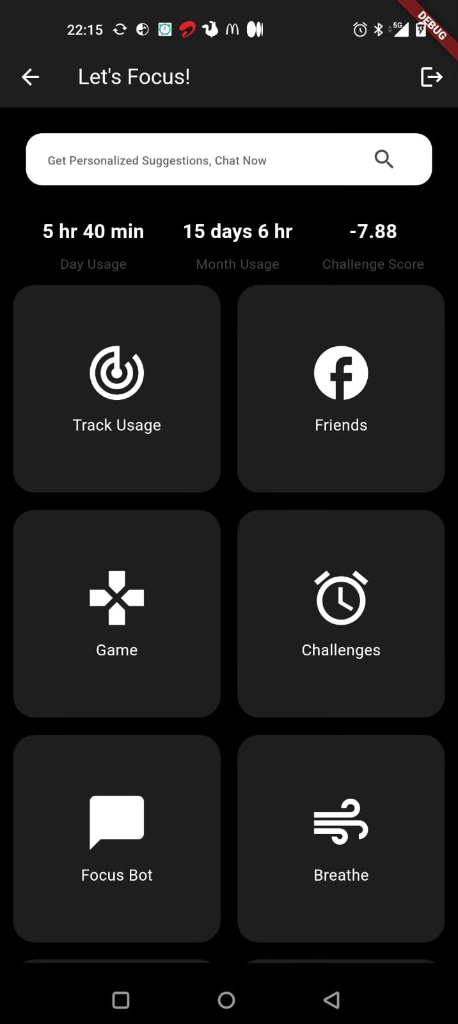
Login Page and Home Screen
Minimal; Complete
Users can register and login on the Login Page. The credential data is handled using Firebase.
We have displayed all the features on the home screen itself in the form of self-explanatory cards, making the app easy to use.
Usage times are also displayed along with challenge score that serve as a short summary for the “Track Usage” feature.
Our personalised chat bot “Focus Bot” can be accessed both by a search bar and its card.

Slide 5
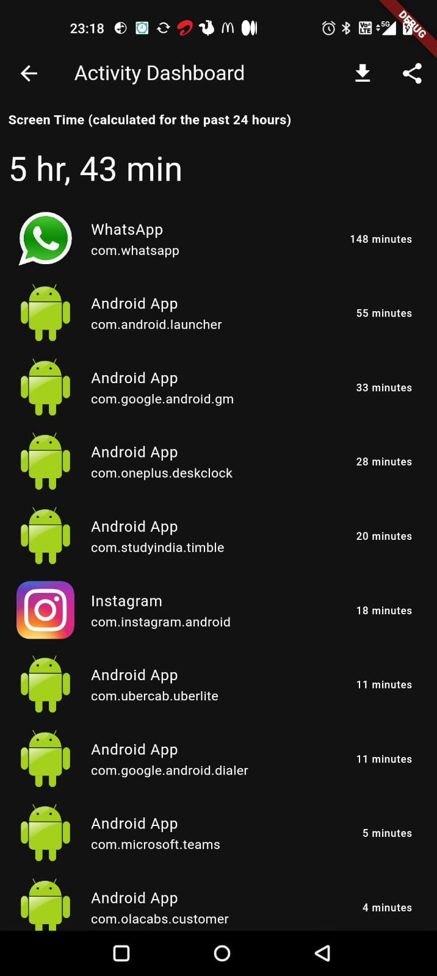
Track Usage
What have you been doing?
This section displays the app usage of the user in the last 24 hours, along with a personalised AI generated report providing insights and focus tips.
Users can also download the personalised report as a PDF on their local storage. They can also share the report.

Slide 6
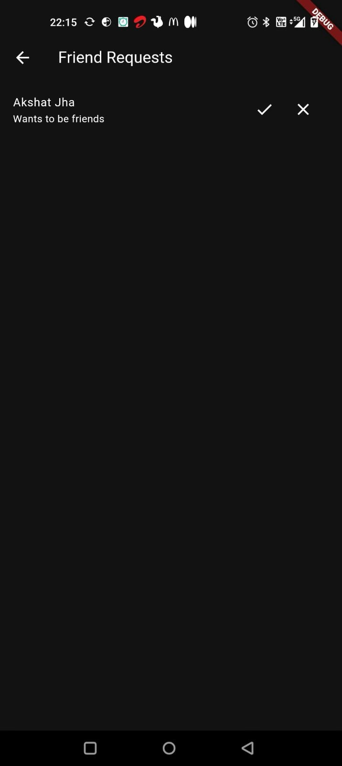
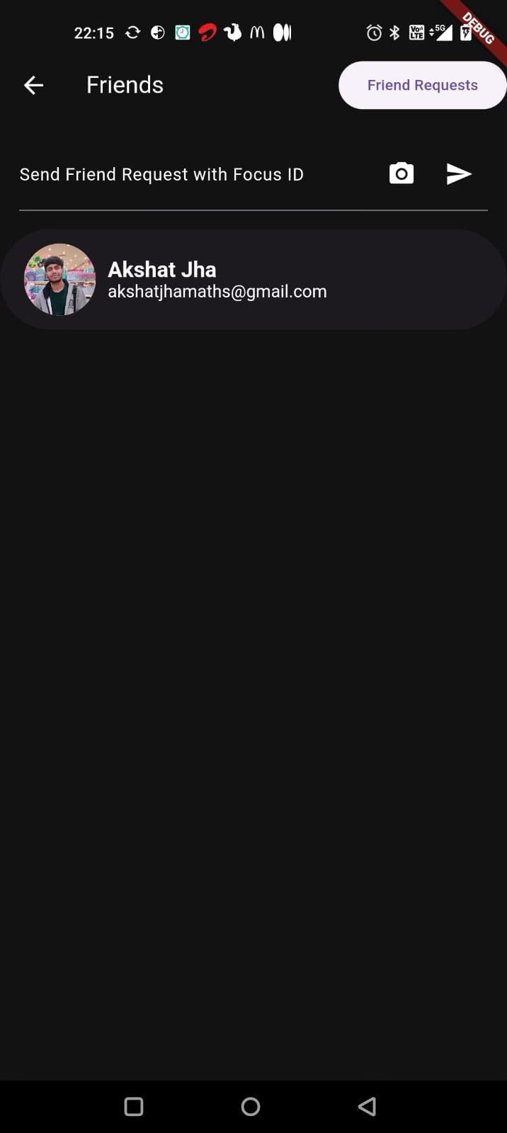
Social Component
Friends; Challenges; Map
One can send friend requests to other users, and interact with them through challenges.
The challenges can be issued and accepted, in the competitive spirit of maximising focus score.
The friends can also be viewed on a map, in their registered locations

Slide 7
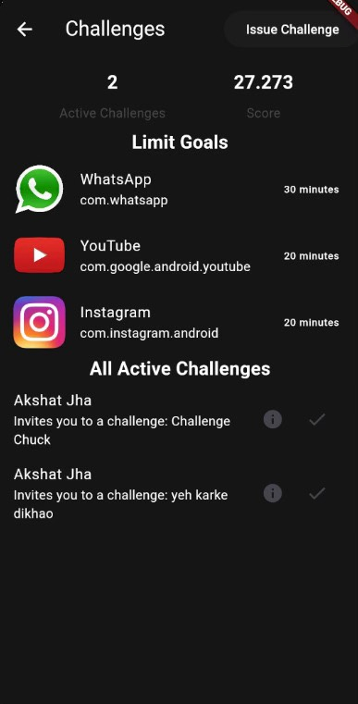
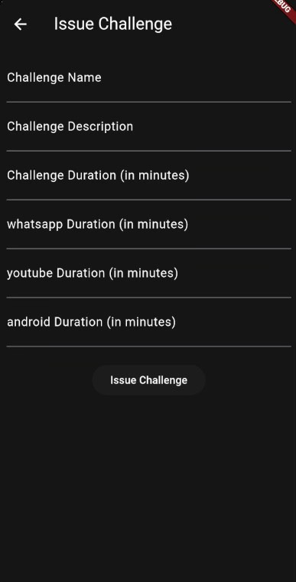
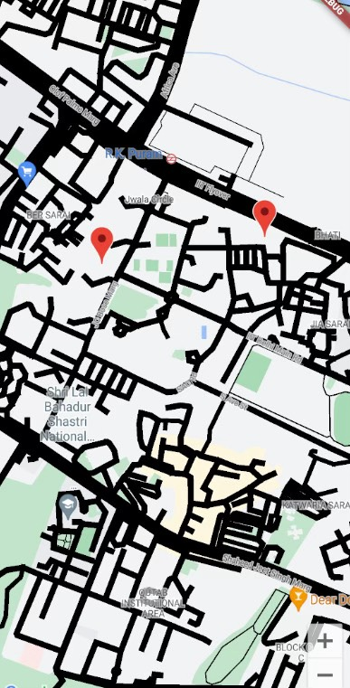
Accept Challenges
Issue Challenges
Maps

Slide 8
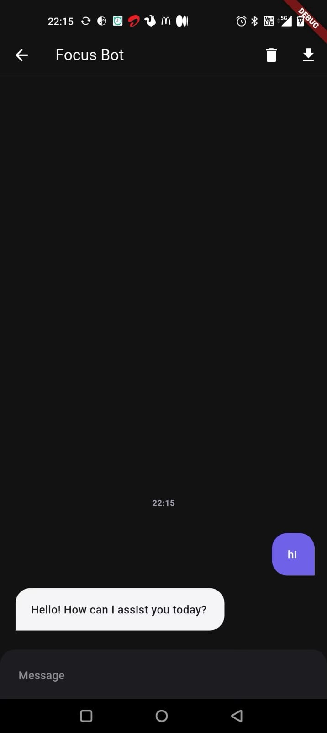
Focus Bot
Personalised ChatBot
We have integrated a chat bot in the app, with the help of ChatGPT3.5, to cater to users queries addressed towards developing focus.
By employing prompt engineering techniques, the bot could help the user get personalised directions in order to develop focus in their lives.
The bot has been designed only to answer relevant queries.

Slide 9
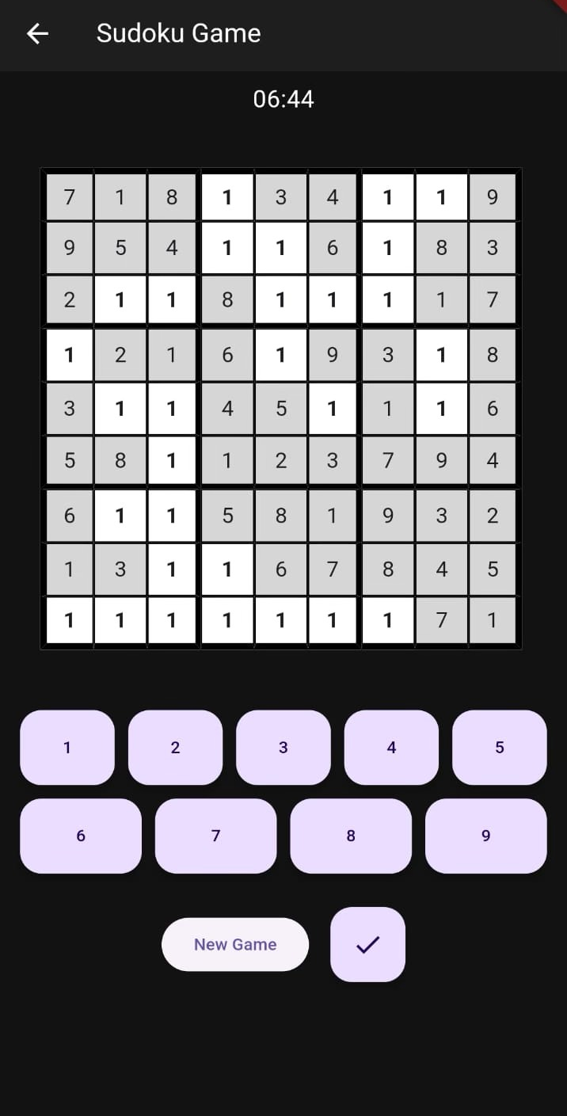
Sudoku
Brain-Train
The first game in the app is the classic Sudoku, which is meant as a mind exercise.
The game has been proven to be a great way to develop concentration, and enhance aptitude.
Users can use the on-screen keyboard to change values in the grid, a button to check whether the board has been solved or not, and a New Game button to load a new board of Sudoku.

Slide 10
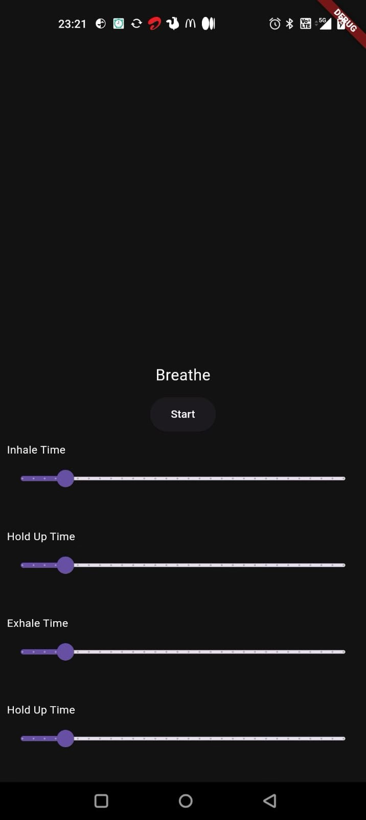
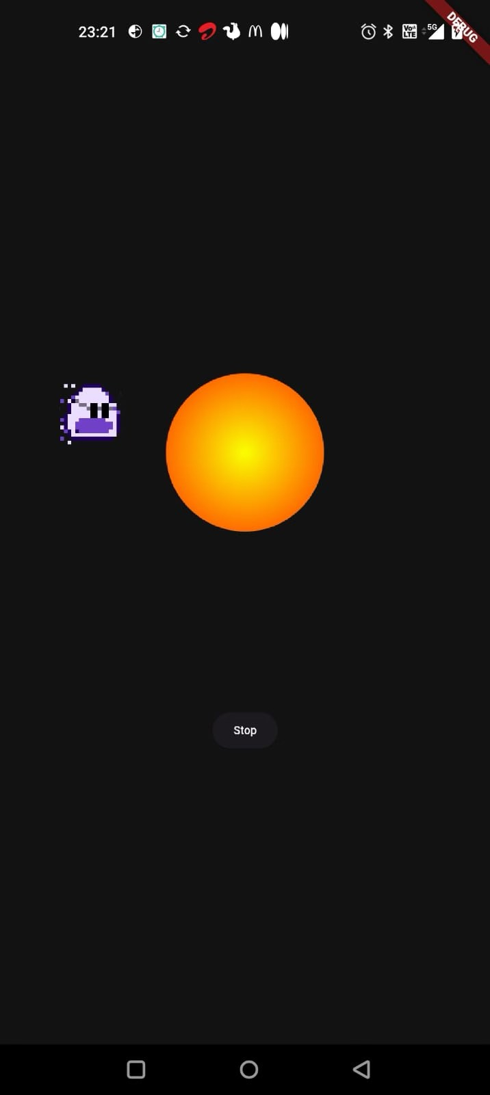
Breathe.
Relax.
Breathe is meant to be a relaxing exercise, where users can take a break and focus on their breath.
One can set Inhale Time, Hold Up Time, Exhale Time, and Hold Time before starting.
Once started, Chuck - our beloved hero - will move around and guide.
As chuck goes up and the Sun in the middle expands, one has to inhale. While chuck moves right, the breath is to be held, as chuck comes down and the Sun contracts, the user has to exhale. As chuck moves left the breath is to be held again.
Certain patterns of breathing are proven to be highly beneficial in reducing stress and improving overall health, especially respiratory and cardiac.

Slide 11
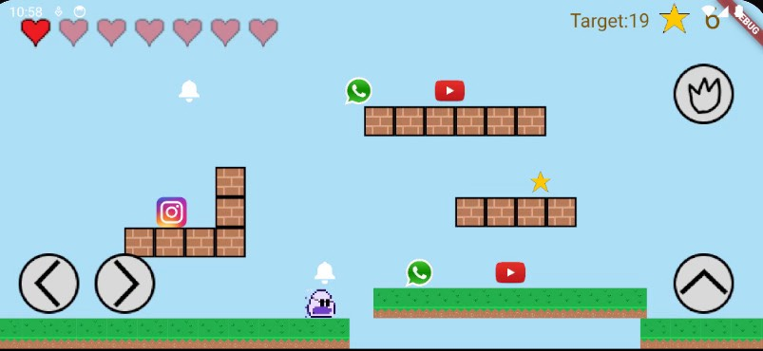
Chuck Jump
Stay away from apps!
Chuck Jump is a concept game that is inspired from 2D platform games like Mario.
Chuck has to move to avoid Logo Enemies: Apps that are major distractions, some of which can throw notifications at it. He has to collect Stars to increase his score, until a specific target is reached.
There are 40 levels in the game. With each level, the difficulty increases - the target increases, and every 10 levels, the notification fire rate of Logo Enemies increases. The next level is unlocked only after the previous is completed.
The player is given a limited number of hearts in the beginning which is proportional to their focus score (min. 5 hearts, max. 15).

Slide 12
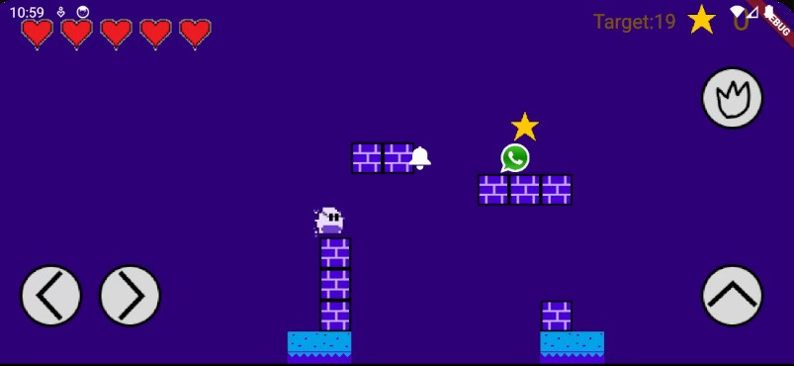
Chuck Jump
…continued
If the chuck dies, then the player respawns with 5 hearts.
A player can only play upto 10 games in a day.
One can select among 4 themes of the map to play in.
The instructions are provided as a level starts.
The game aims at telling playfully that overusing apps is harmful. The purpose is served especially well for kids.

Slide 13
Flame
A modular Flutter Engine
Breathe and Chuck Jump have been written in Flame: which is a great engine to develop games in flutter.
Just like flutter abstracts everything as a Widget, Flame abstracts game entities further to Components.
Using Components, character sprites, maps, overlays, collisions, heads-up display - everything can be handled in a modular and readable fashion.
A robust tutorial on game development helped us build the games with great control and enabled us to incorporate features that pertain to the app’s theme.

Slide 14
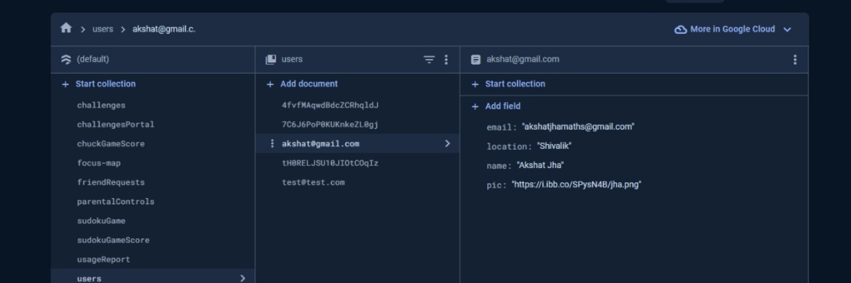
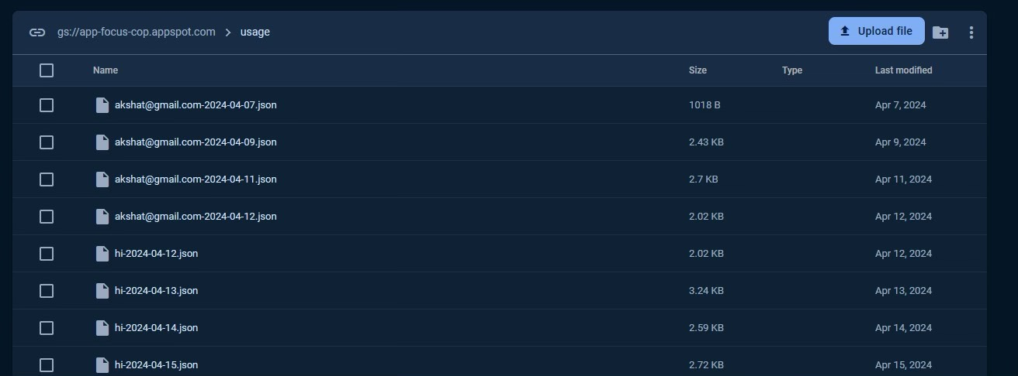
Firebase and SharedPreferences
Data Handling
To store other things, such as Sudoku boards, Chuck Jump levels cleared and number of games played, SharedPreferences library of Flutter has been used. It stores data in local storage of the device.
A master dictionary of key value pairs called ‘focus-map’ has been set up on Firebase Firestore that can be easily accessed and modified using a backend platform.
Firebase also helps us in handling the authentication and usage file uploads, information for which is JSON-encoded.

Slide 15
Design Decisions Summarised
We have decided to keep our app GUI minimal and in dark mode, which signifies focus and relaxed state of mind.
At the same time, we have communicated the message - to control phone usage - in various ways, majorly through a gamification component, which the assignment statement demands.
Chuck Jump was added in the app to add a bit of vividness, a contrast to the other features but at the same time upholding the app’s central theme.
The Social Component is to spread the awareness at a larger scale, through friends and family.
We initially planned to make the app block other apps, but some companies do not allow us to do that, so we had to scrap the idea.

Slide 16
What should we be evaluated on?
Surely not GitHub commits
The theme of the app is minimising phone usage, so we had to avoid making a fancy game as it would defeat the purpose to a great extent.
Hence, we decided to keep the game component simple, to ensure both entertainment and restraint.
So, we shall be evaluated on the efforts we have put in to make the app effective in helping one develop focus.
It is quite difficult to avoid screen time nowadays, so is developing an app for the purpose. Given the time constraints, a perfect app that would make one a better person could not be made, but we have tried our level best.
We have used Flutter, which enables great cross-platform compatibility. Unlike PyGame, we can actually get an executable that could run on a platform.
Also, to use Dart, we had to learn a whole new paradigm of programming. Though an amazing learning experience and a versatile app has been achieved, time constraints have limited us.
Same applies for Firebase: we have learnt this very useful tool to handle our data efficiently.

Slide 17
What could we have done better?
Surely, GitHub commits
Code refactoring
Consistent Firebase Management
More multimedia outputs

Slide 18
Roles
Again, not GitHub commits
Akshat: Developing overall app interface, tracking feature, social component, chat bot, memory management and authentication. Writing ppt.
Nisarg: Developing Games: Sudoku, Breathe, Chuck Jump (mainly worked on my own machine with a lot of experimenting, hence joined in GitHub later so that games could comfortably be integrated). Final touches to GUI. Writing ppt.

Slide 19
References.
Flutter Documentation: https://docs.flutter.dev/
Firebase Documentation: https://firebase.google.com/docs
Flame Documentation: https://docs.flame-engine.org/latest/

