Slide 1
Dsensor Protocol
Basic Model Thinking Examples

Slide 2
Agenda
Big picture
One peer test
Two peer test
Three peer test
Key tech processes

Slide 3
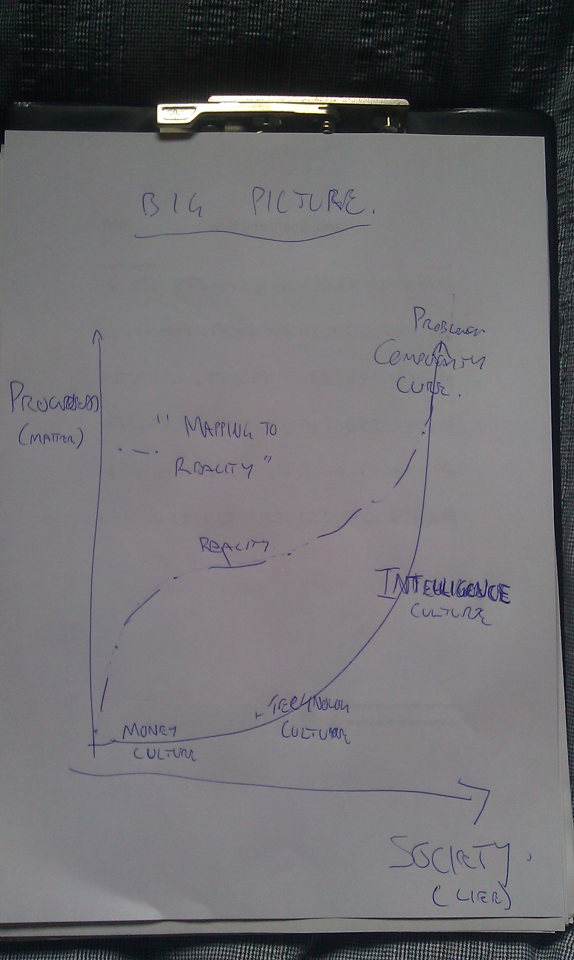

Slide 4
One peer
Works in isolation from network
Self analysis
Map basic 'income'
CIQ

Slide 5
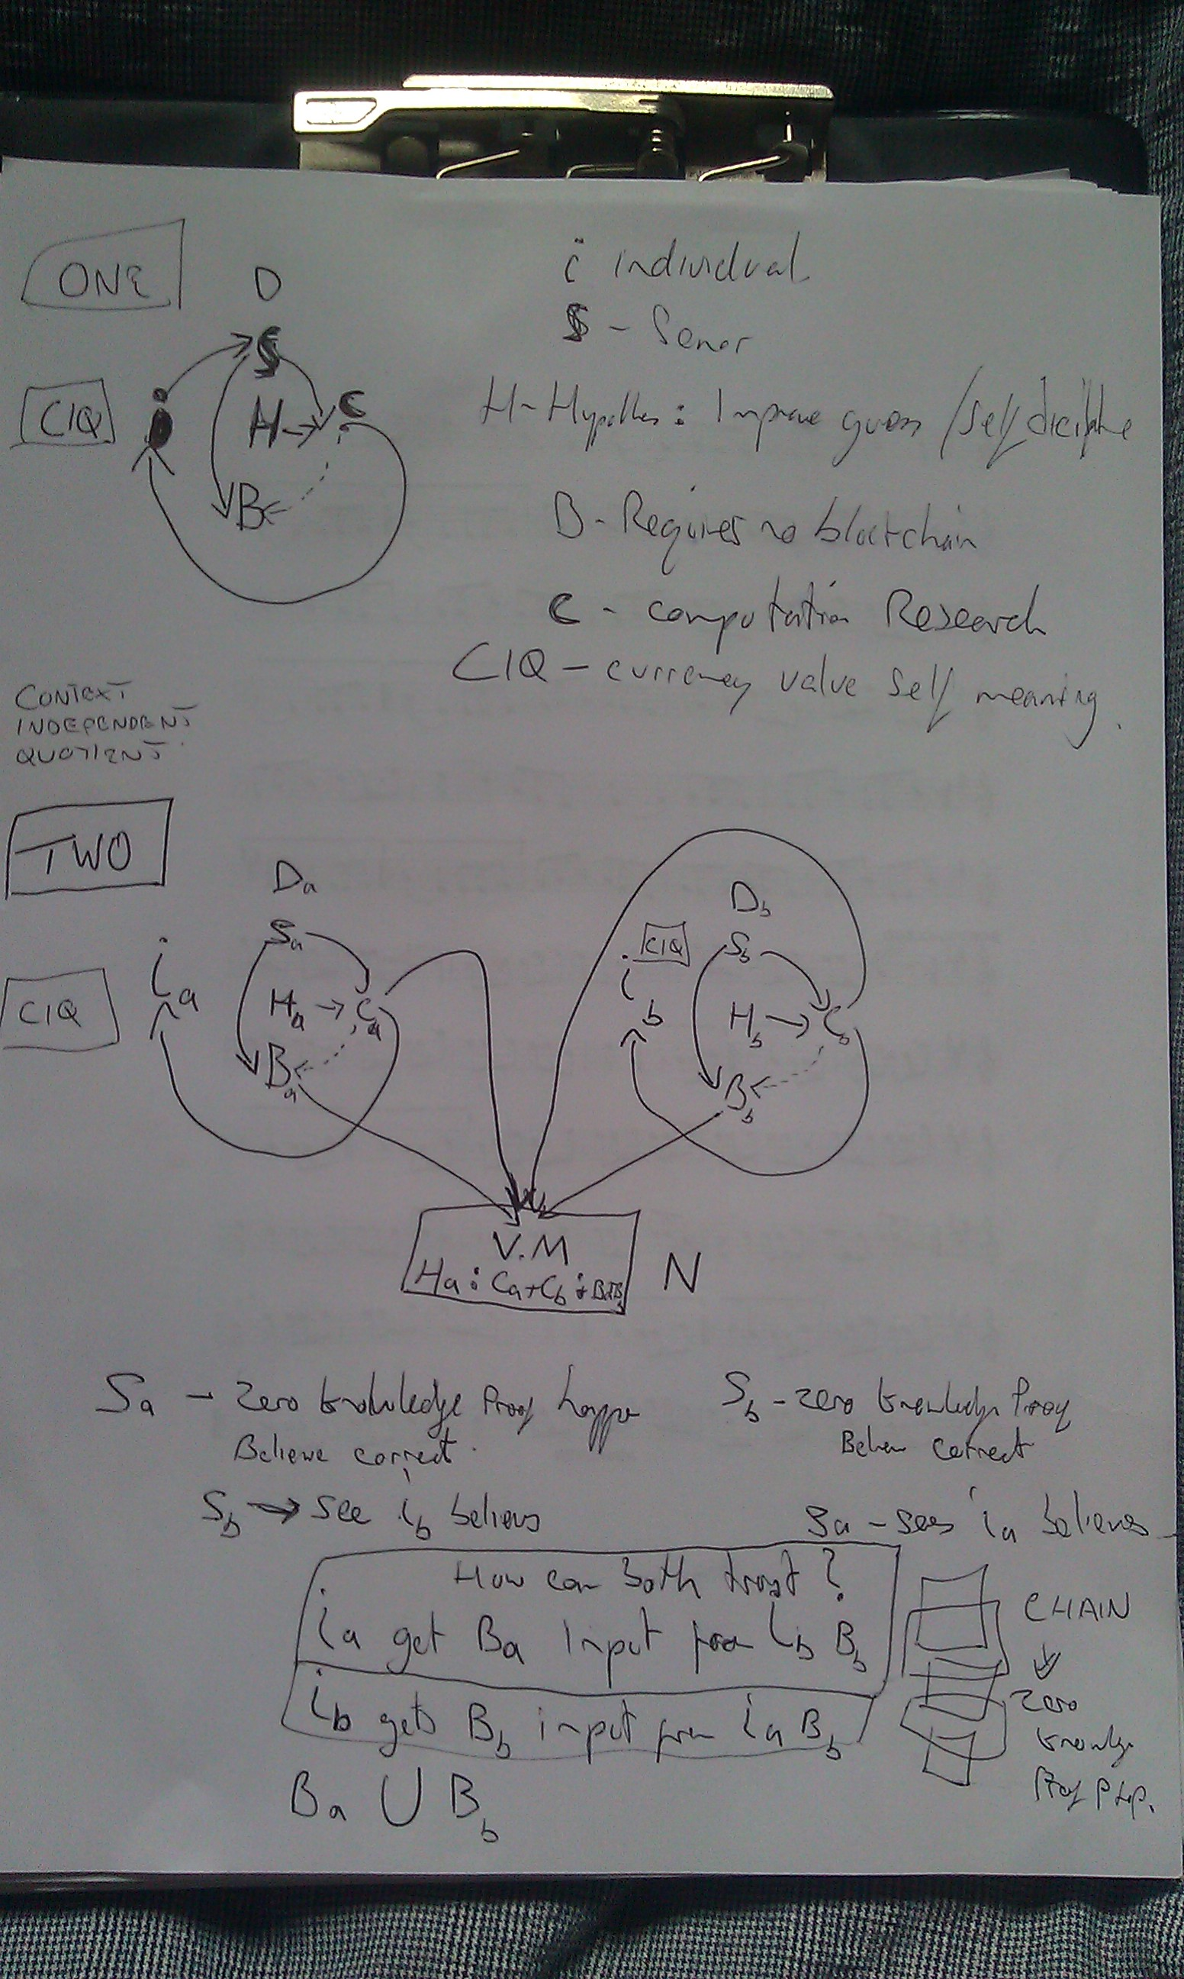

Slide 6
Two Peer test
Introduces VM (unite network via virtual machine between peers)
Trust 'proof of data' volunteer security
Network hypothesis
CIQ created by self and network value

Slide 8
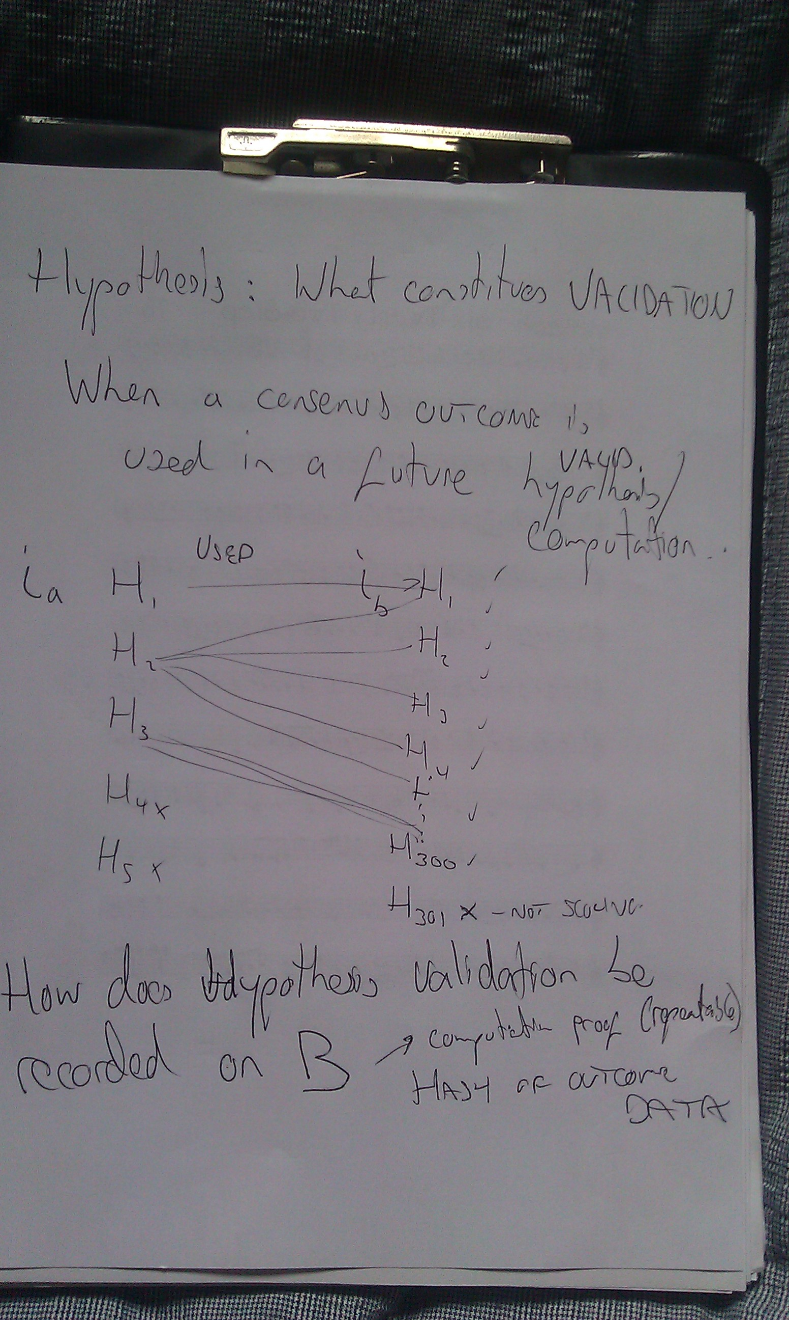

Slide 9
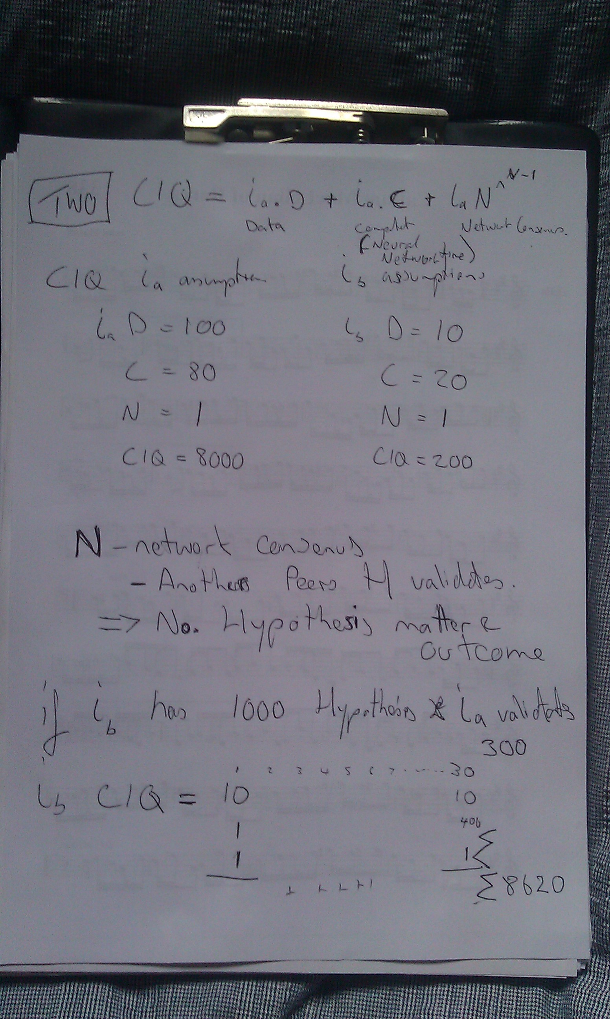

Slide 10
Three peer test
How does CIQ 'equity' look like?
One peer provides 'hypothesis' only
One peer provide by CIQ via Fiat?
How network is secured?

Slide 11
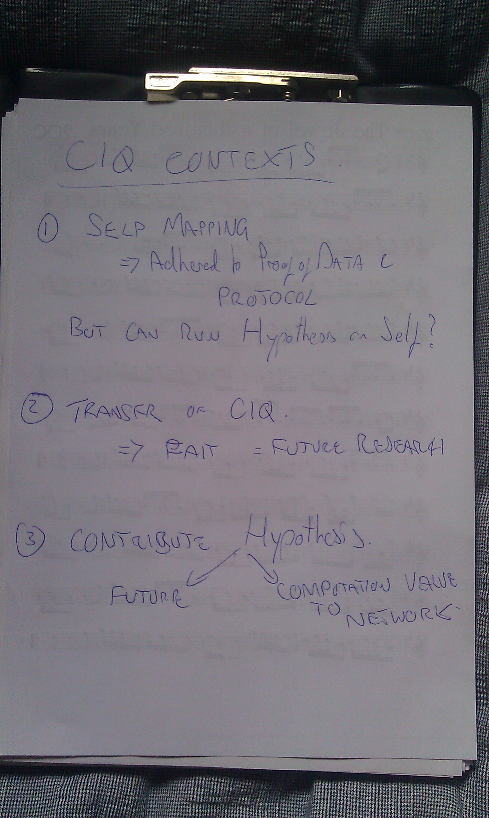

Slide 12
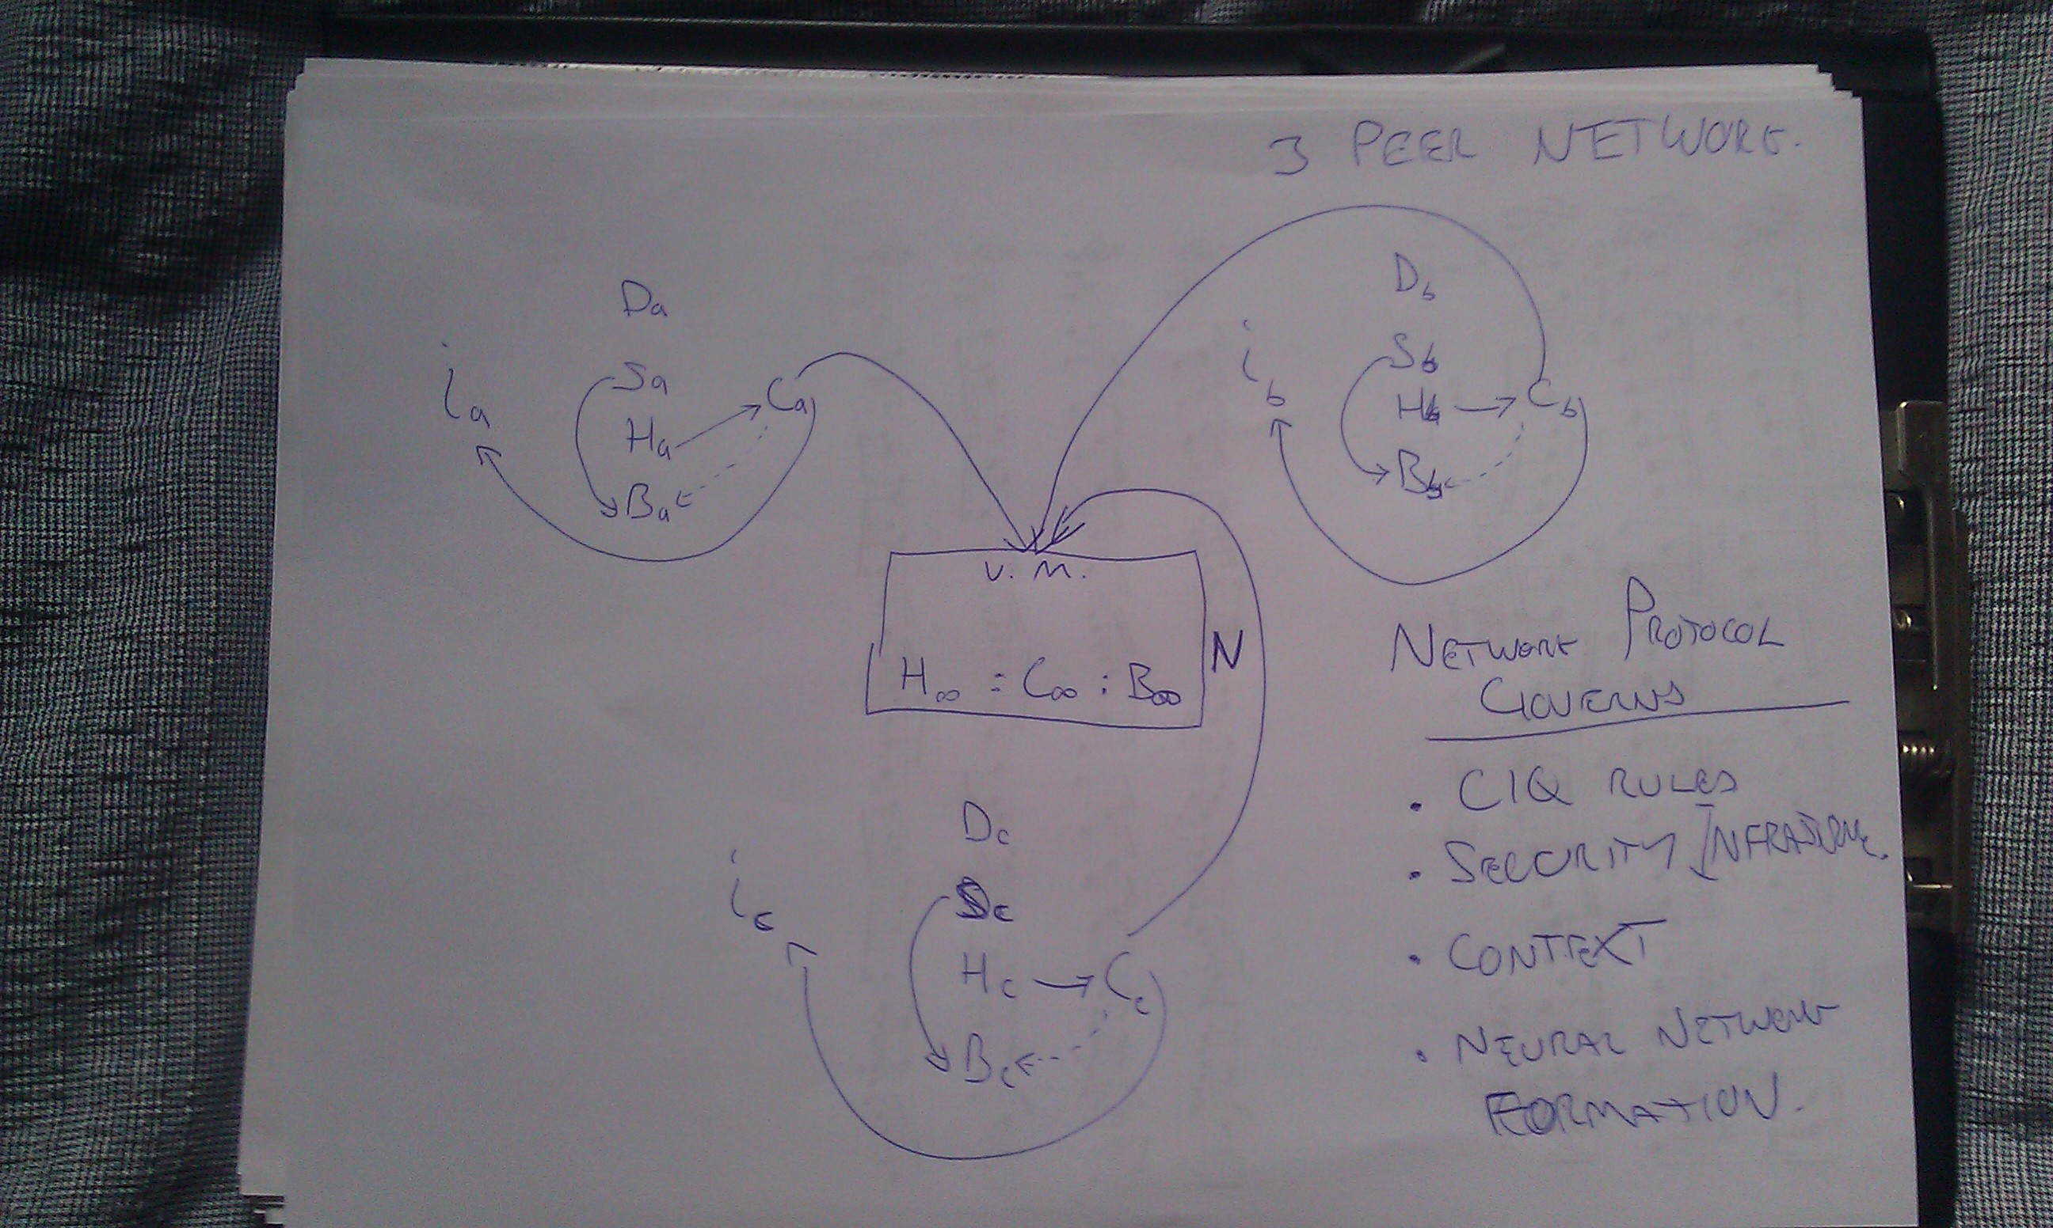

Slide 13
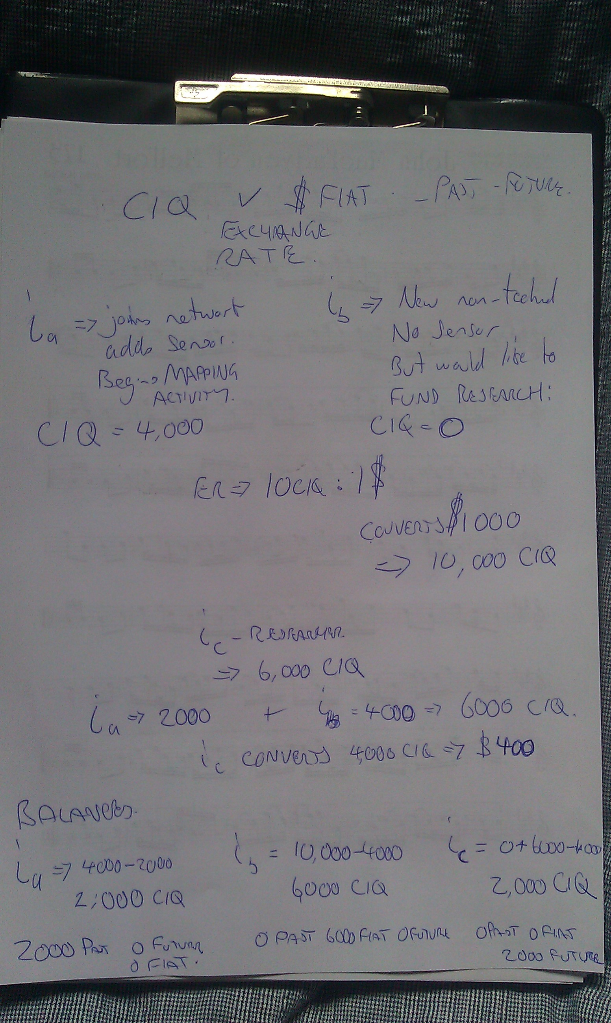

Slide 14
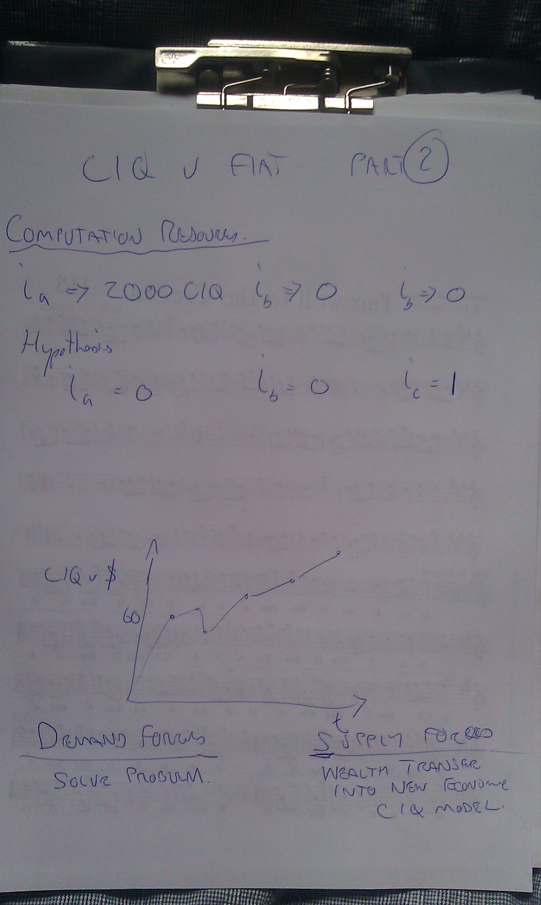

Slide 15
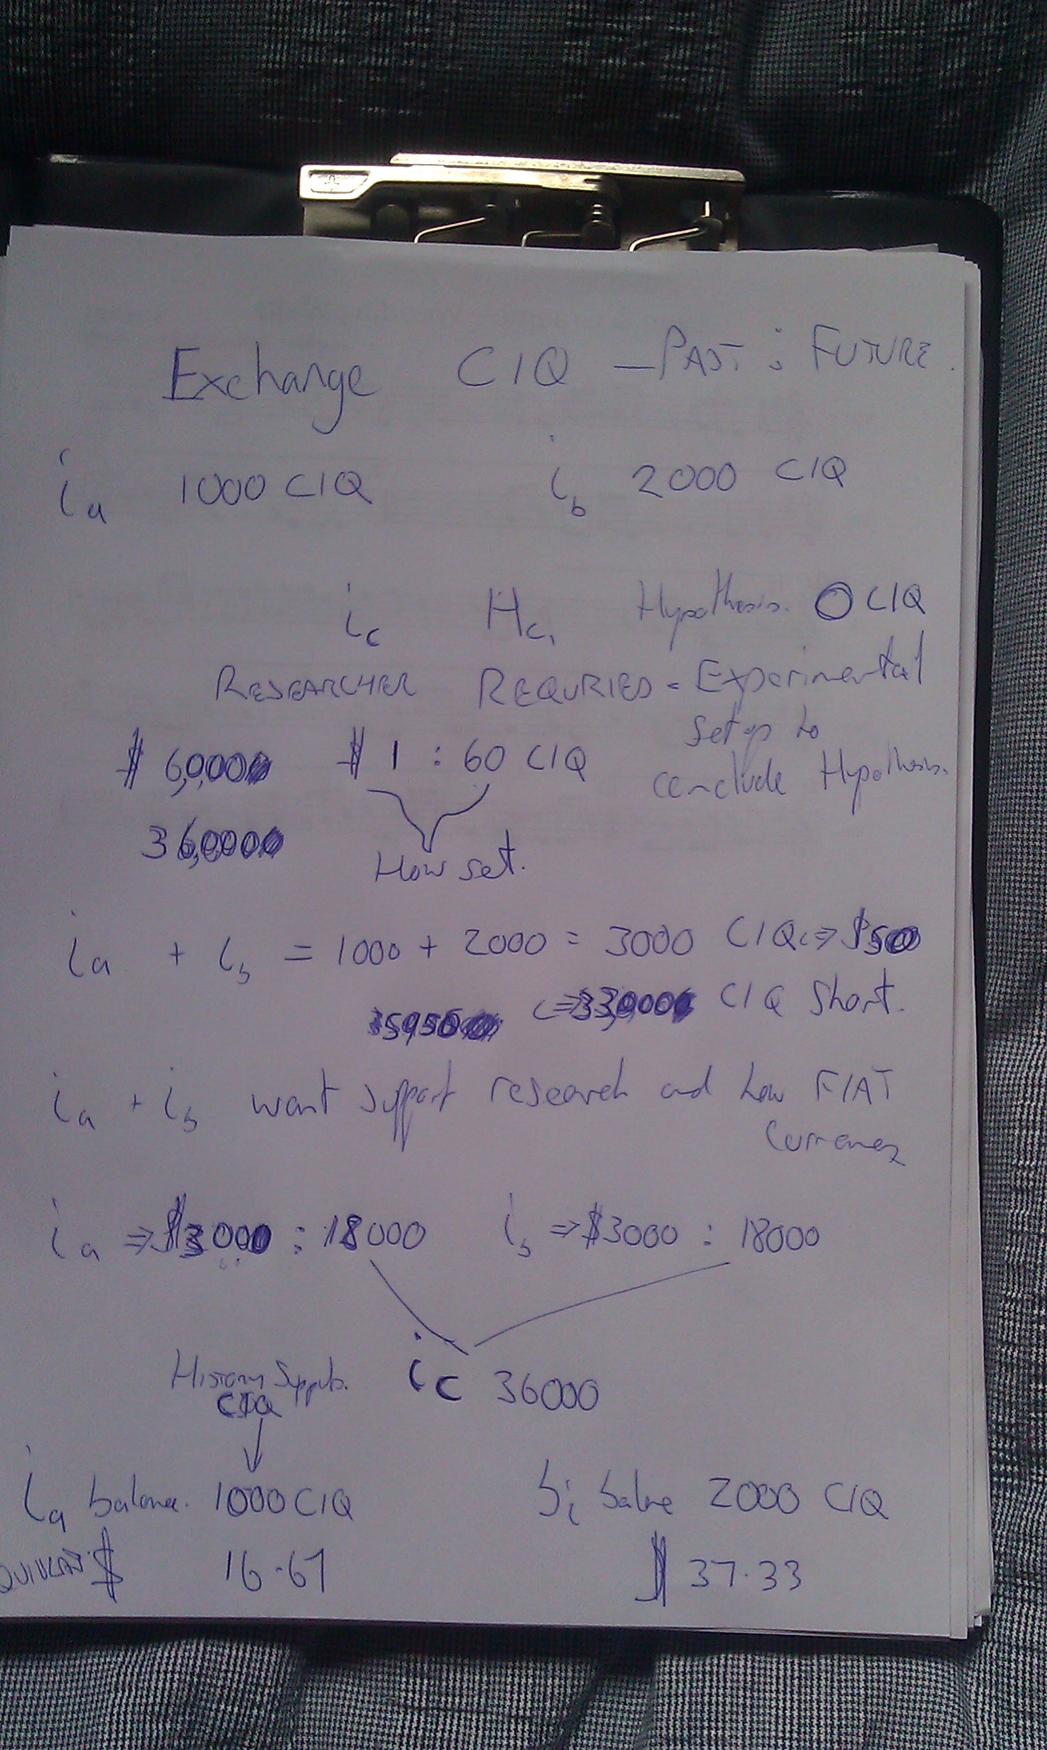

Slide 16


Slide 17
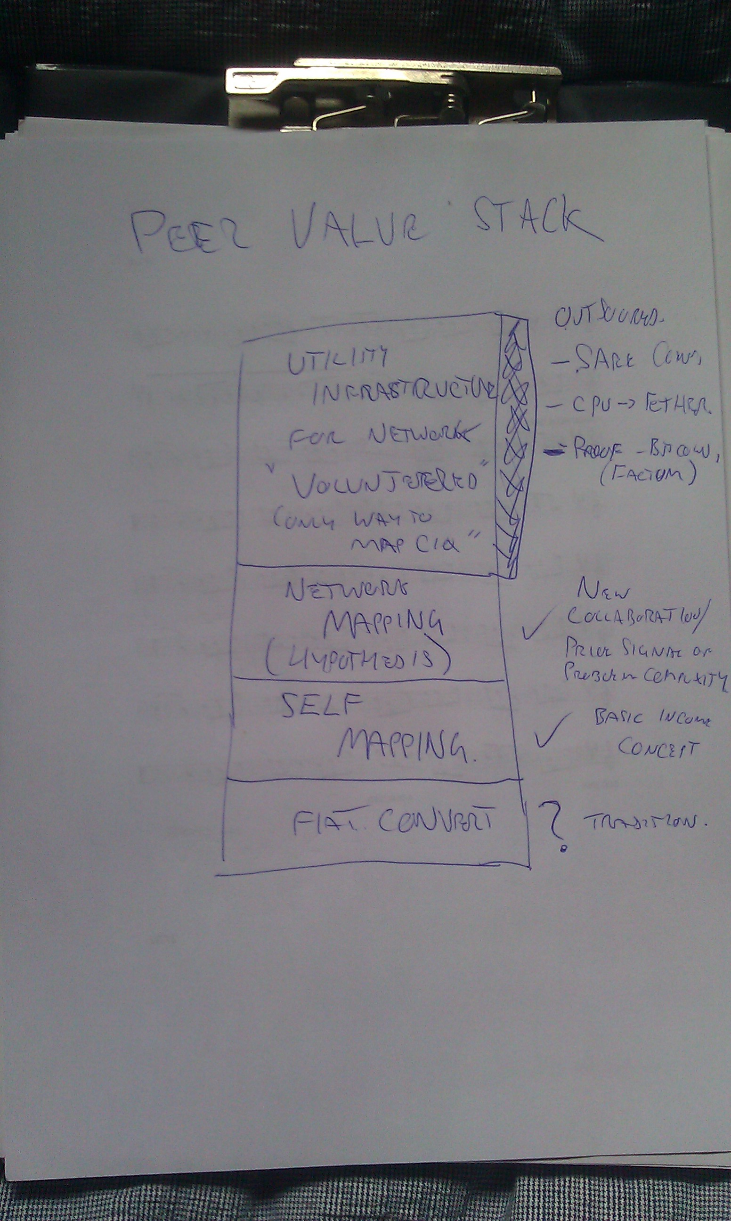

Slide 18
Key tech processes
Seeding a peer, sensor and the network
Zero knowledge proof
Secure network
Mapping
Hypothesis
Neural Fuzzy Network
Simulation (CIQ plus a probability)
CIQ

Slide 19
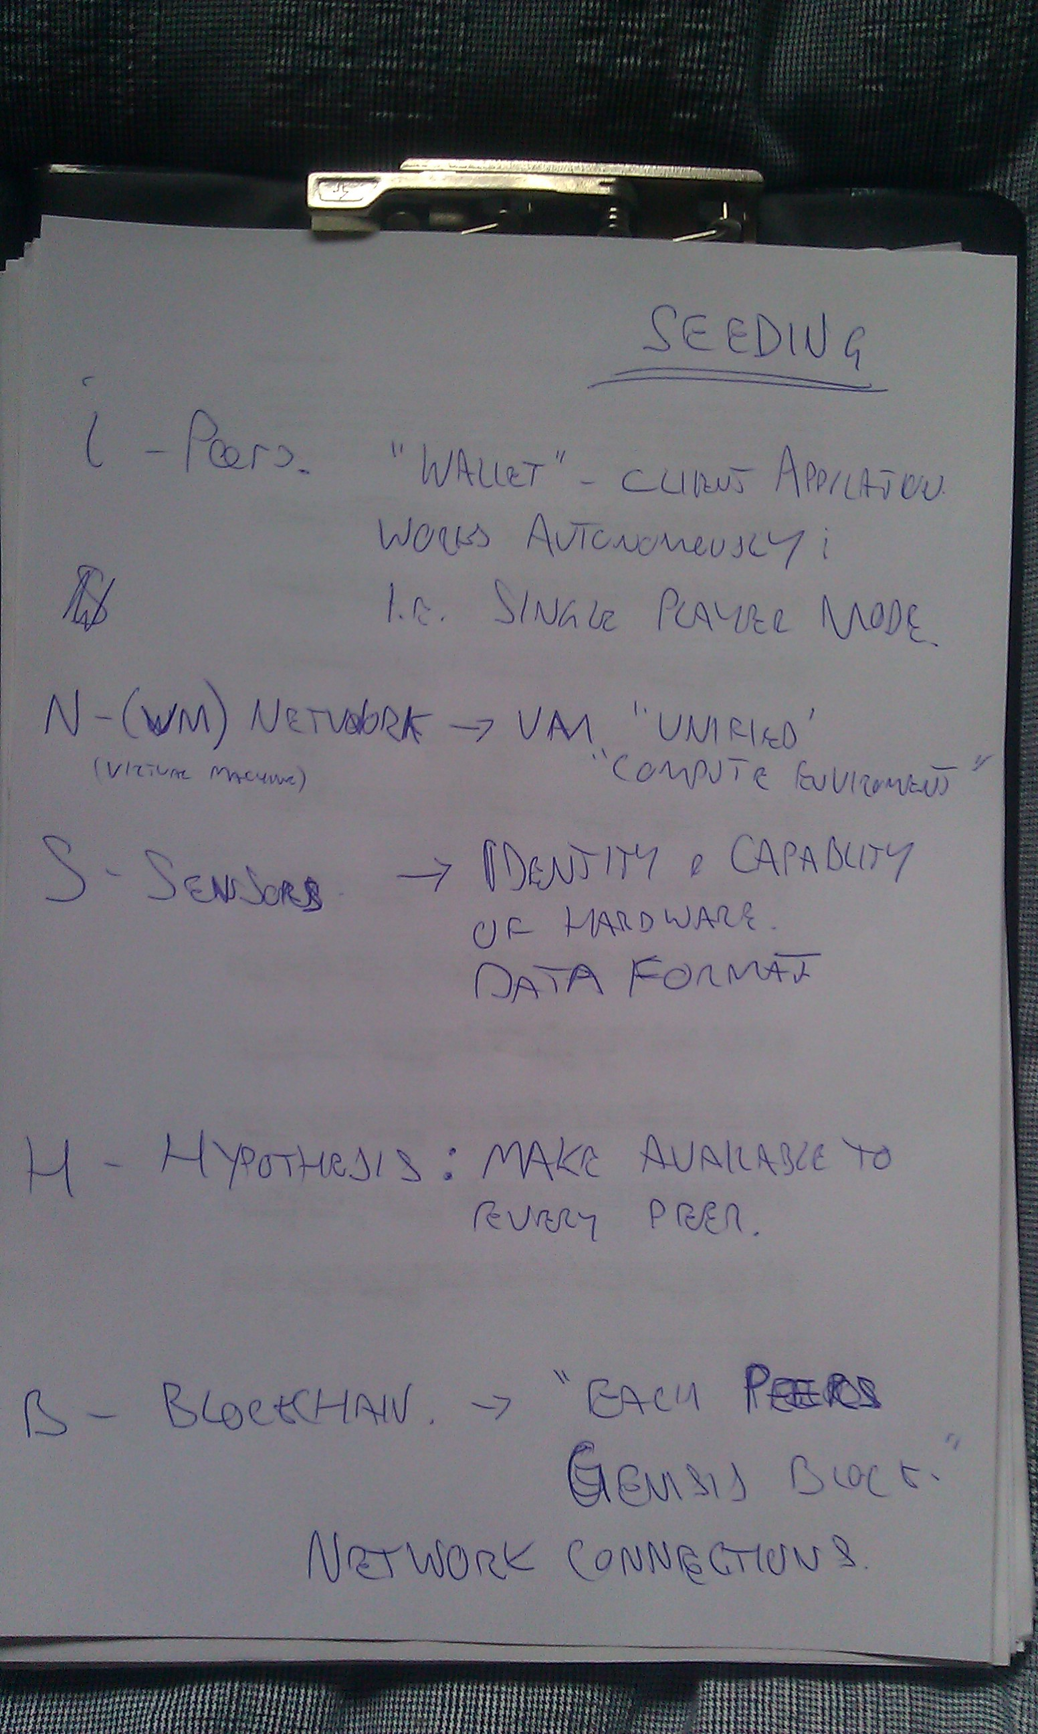

Slide 20
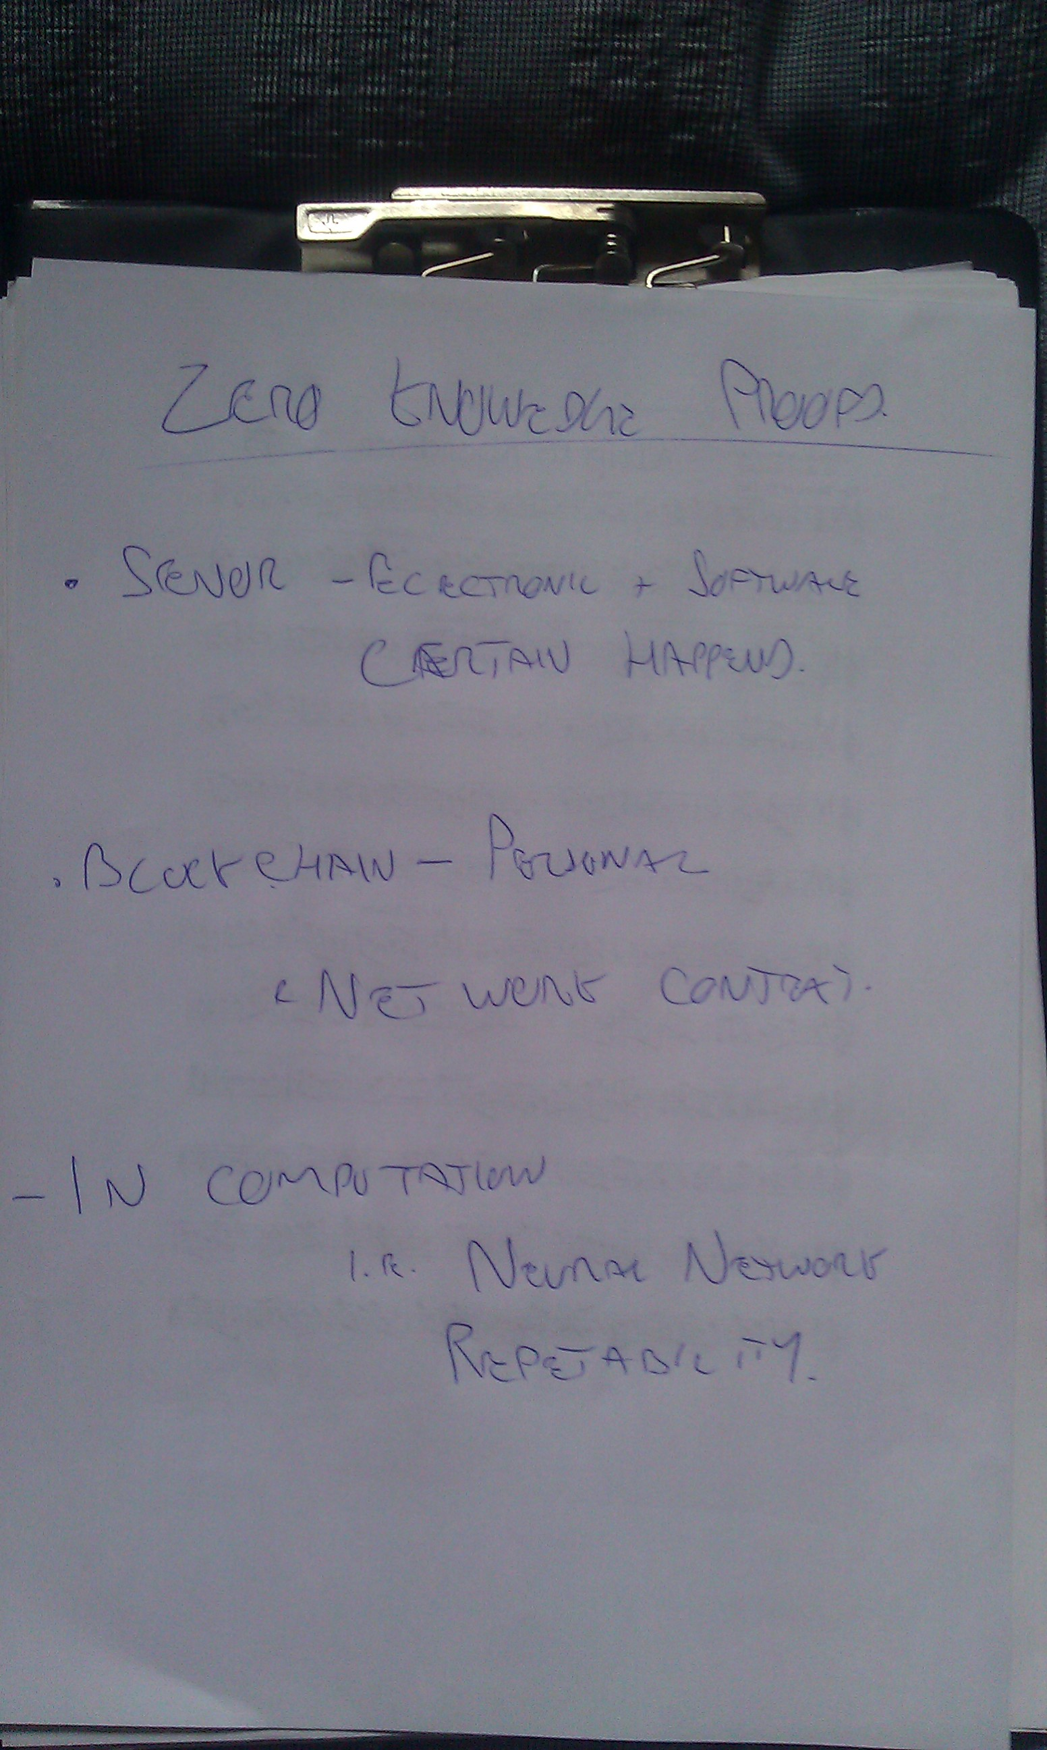

Slide 21
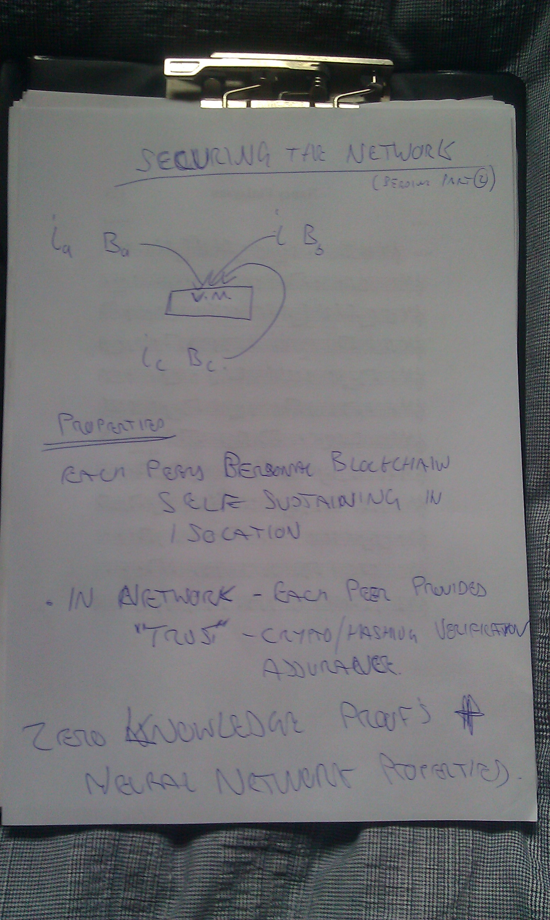

Slide 22
Mapping
A general term used to group together creation of CIQ activities:
  Computation of hypothesis
  Computation of neural network
  Computation of simulations
  Computation of CIQ

Slide 23
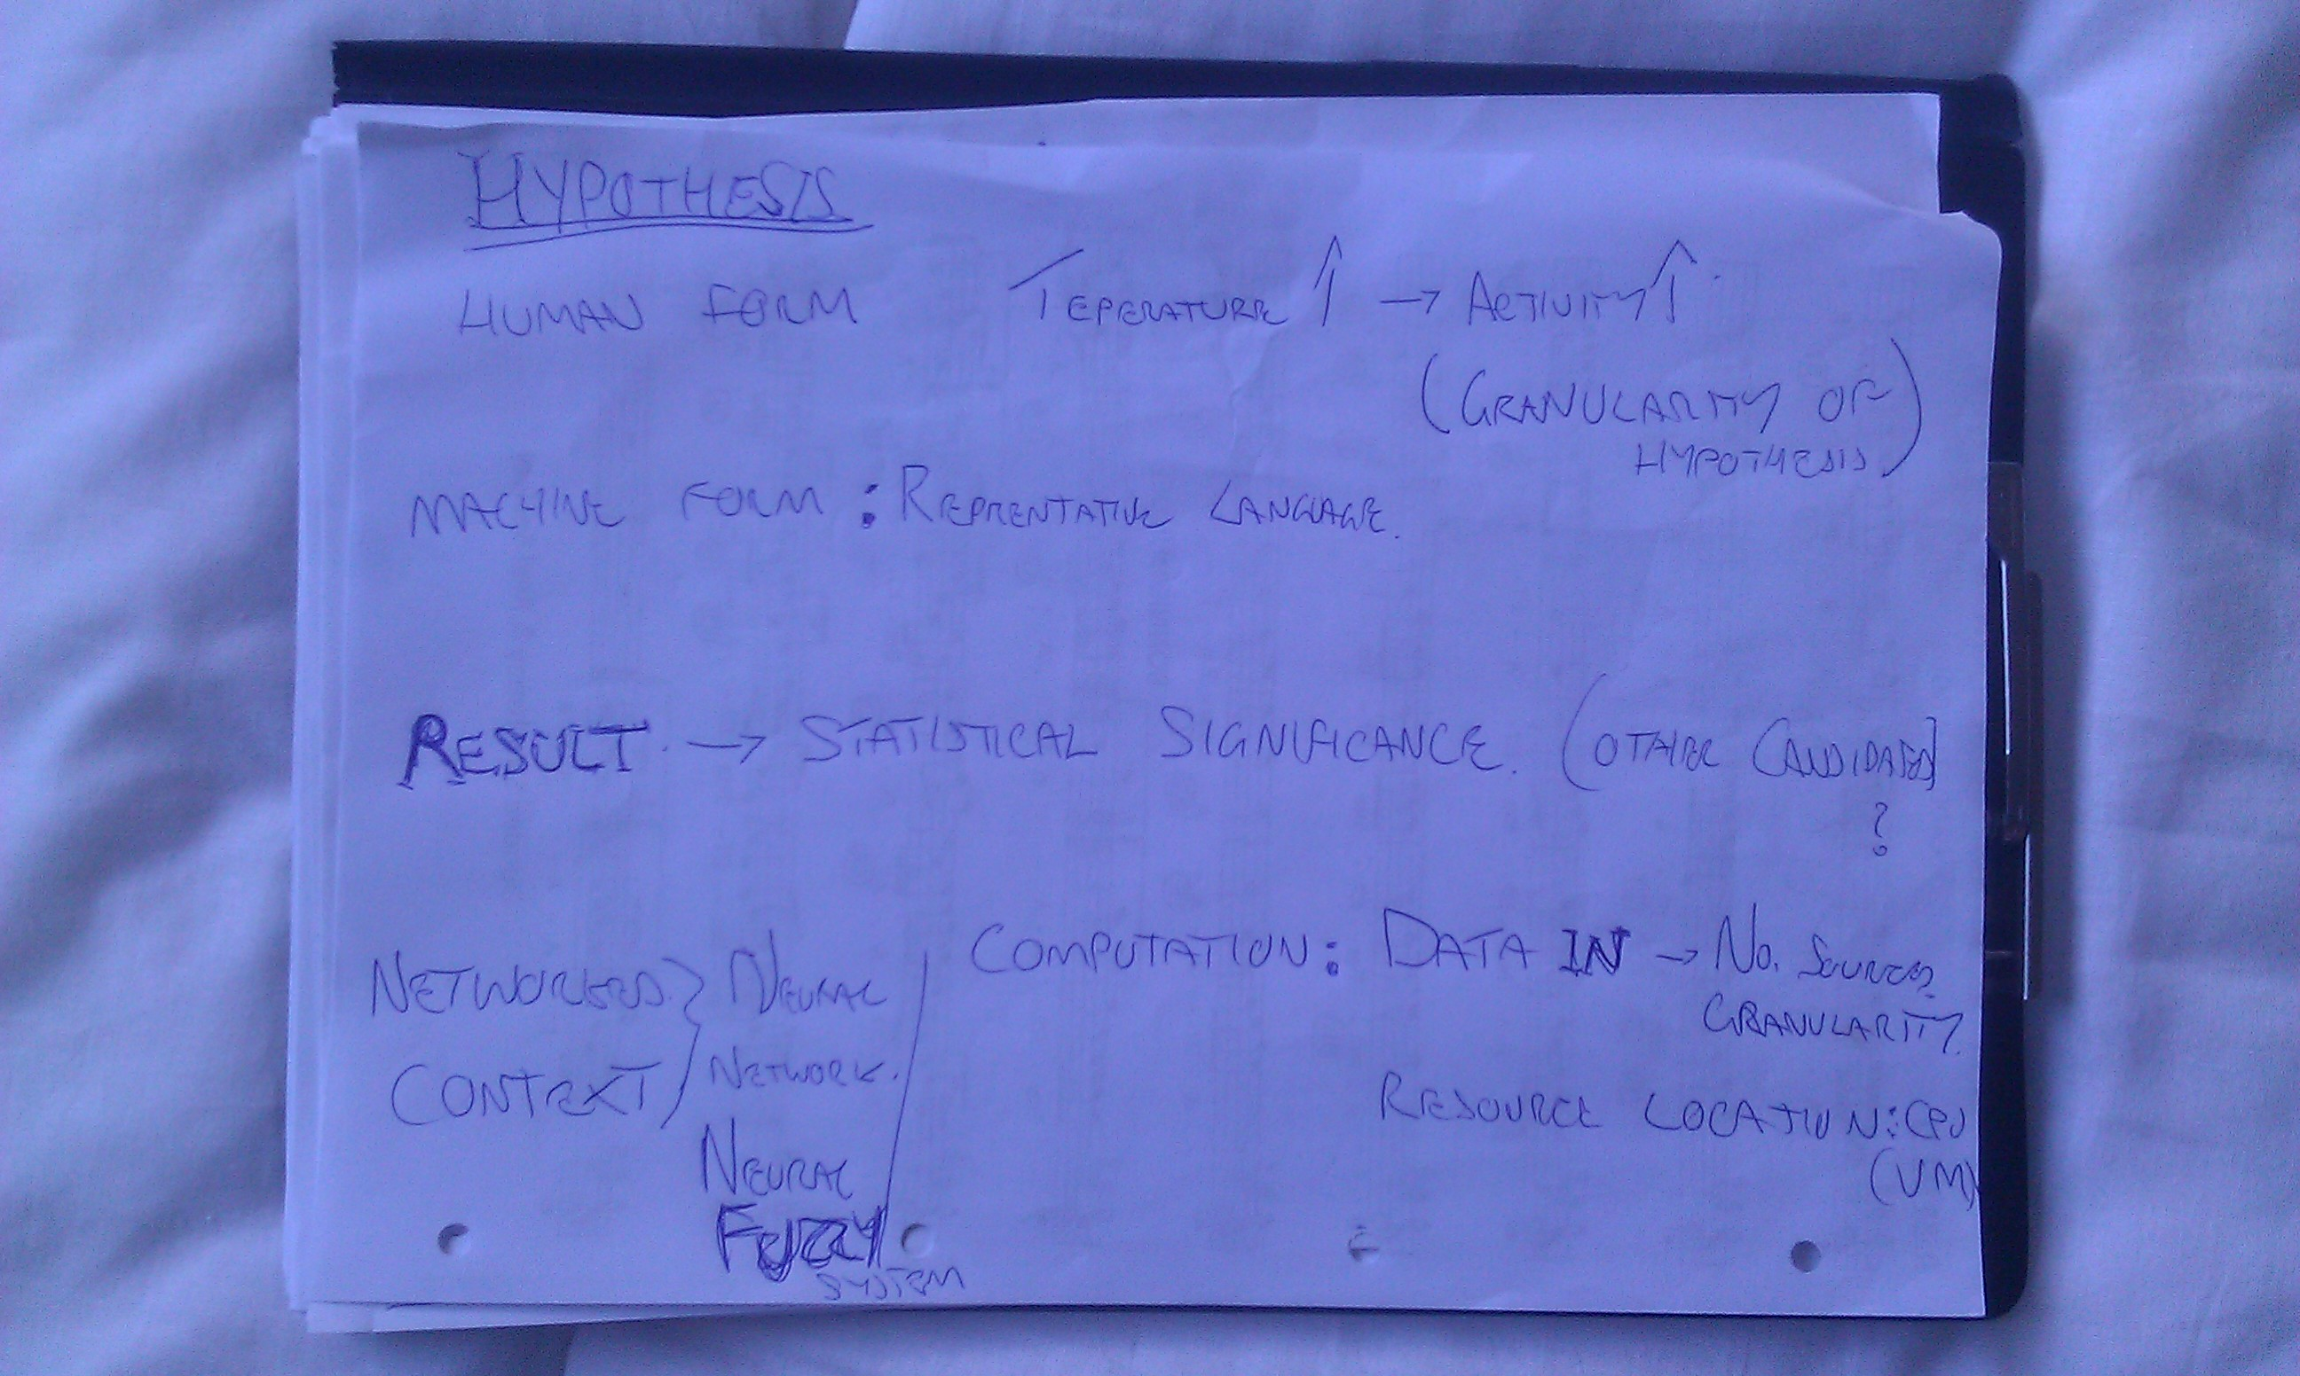

Slide 24
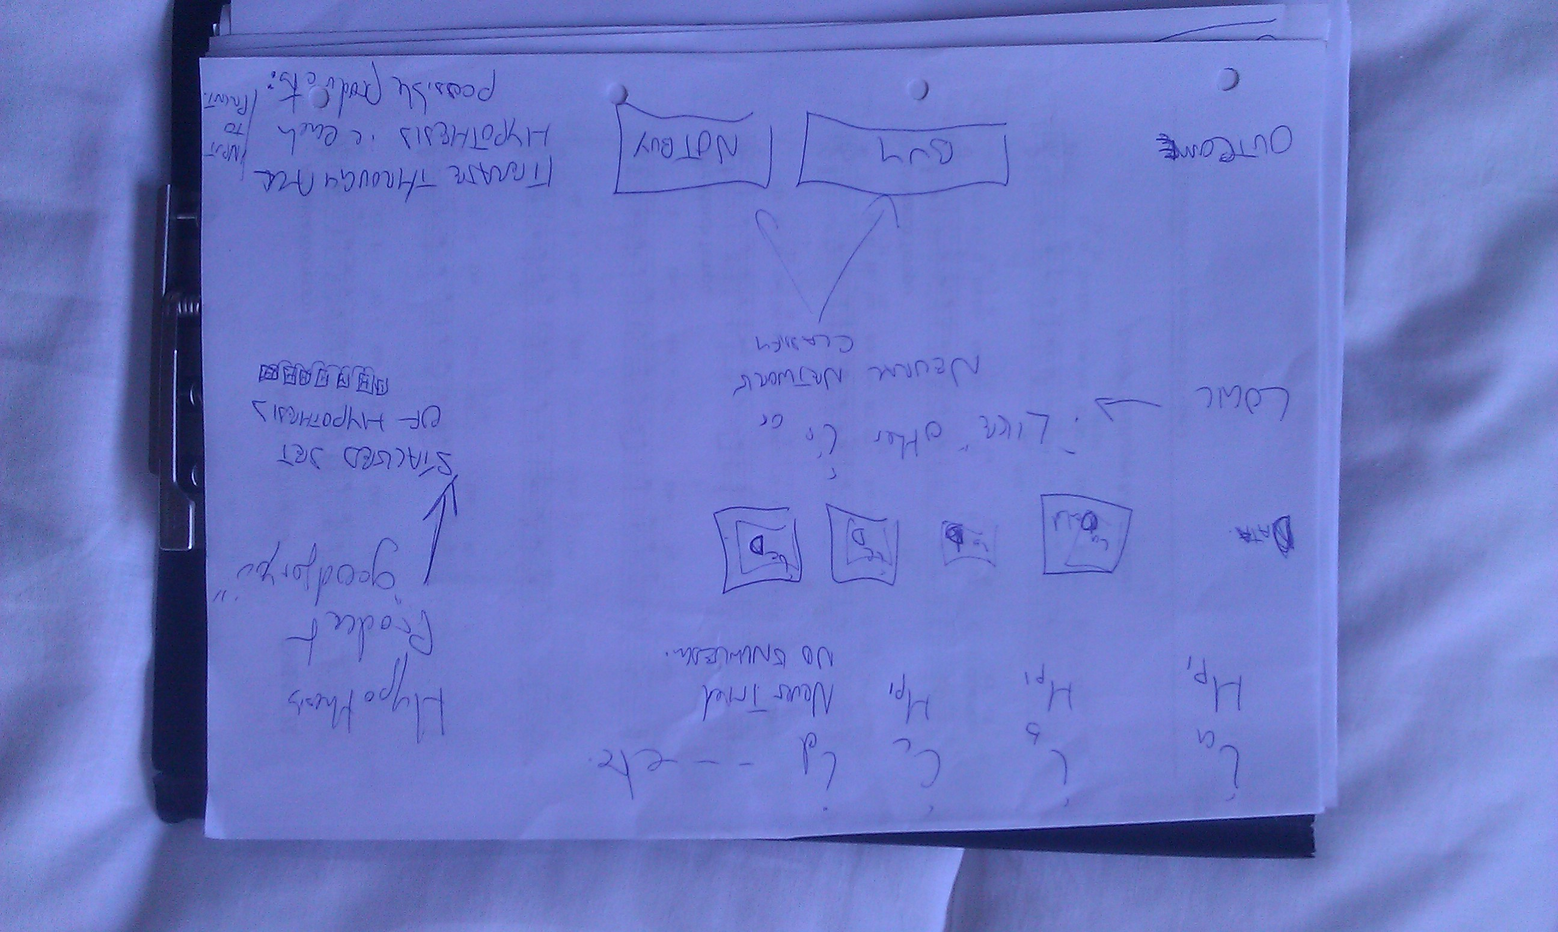

Slide 25
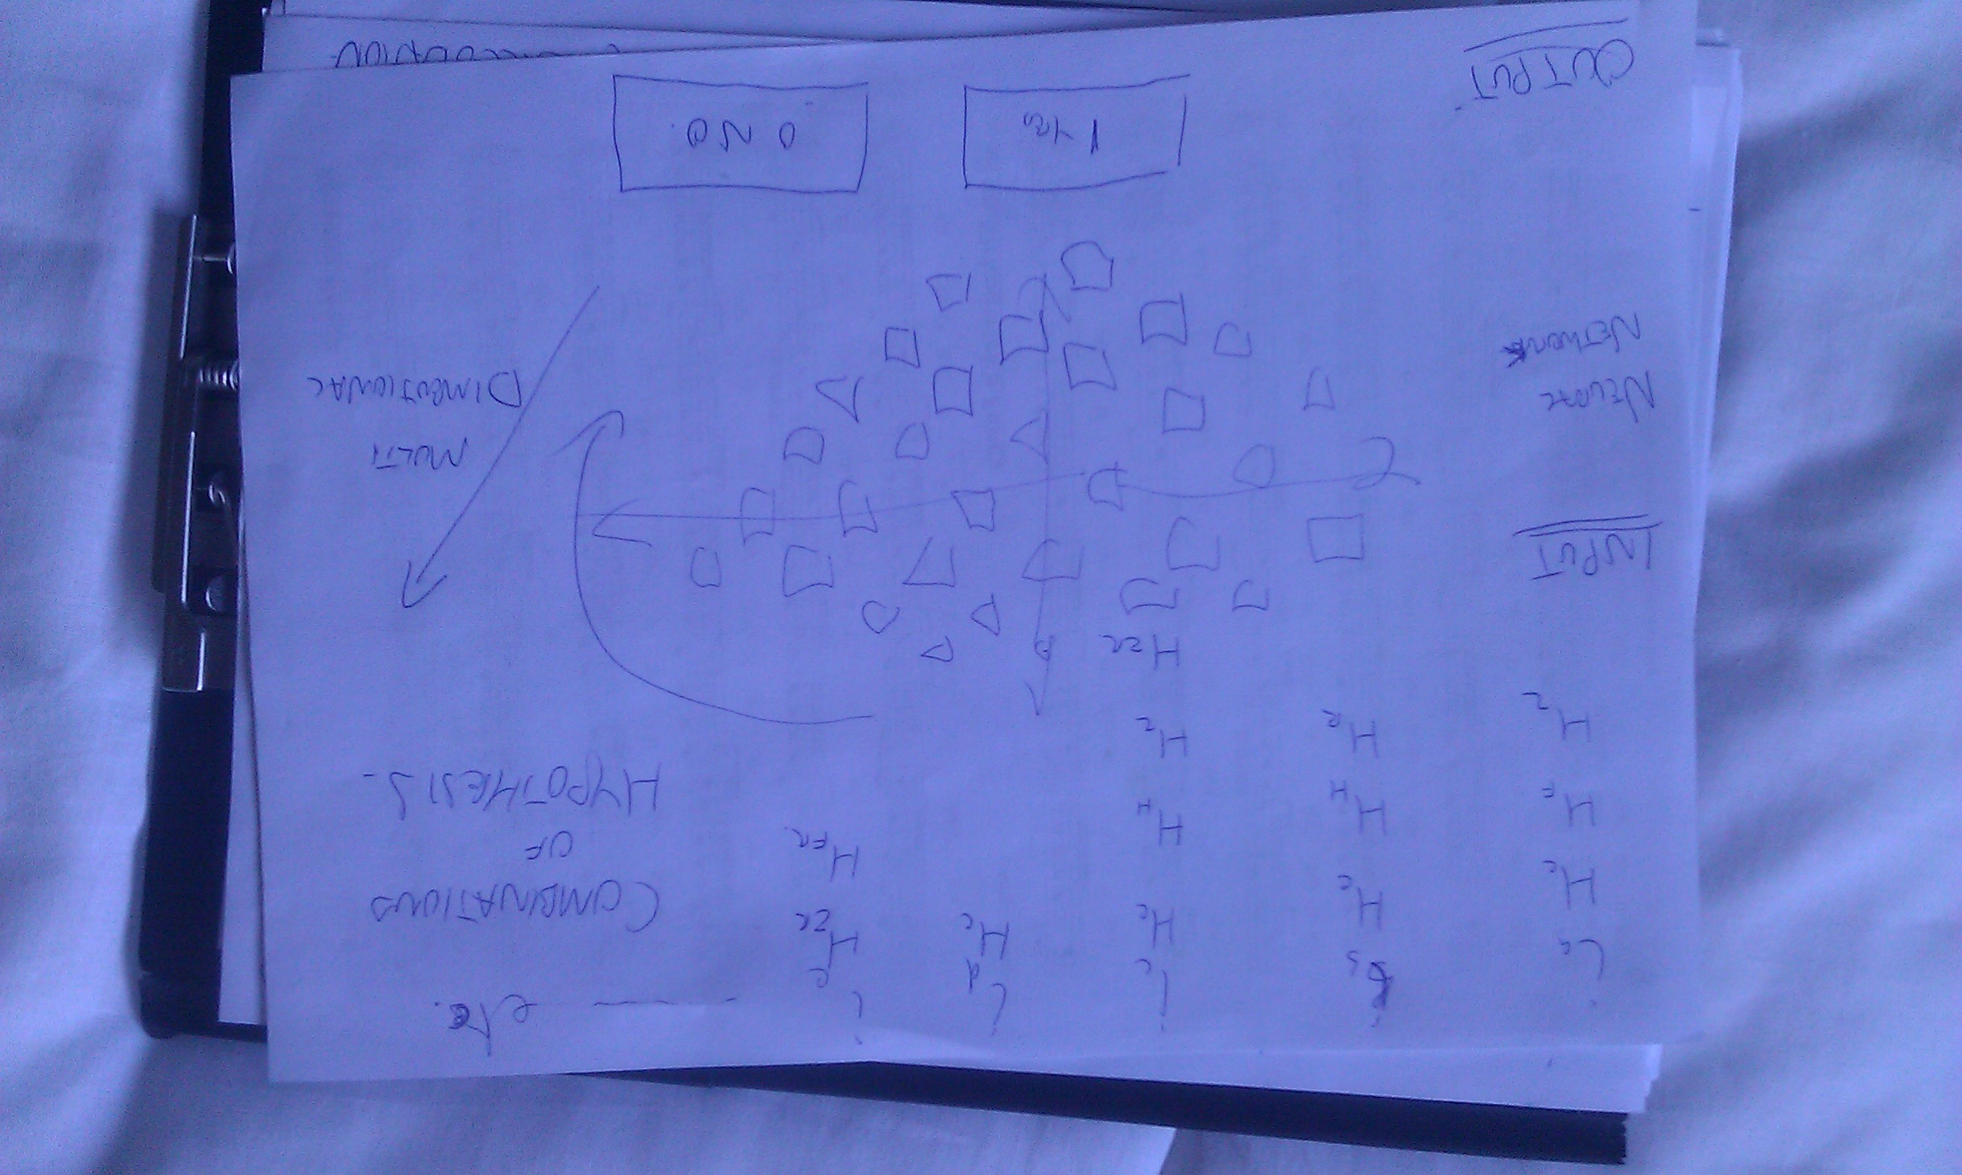

Slide 26
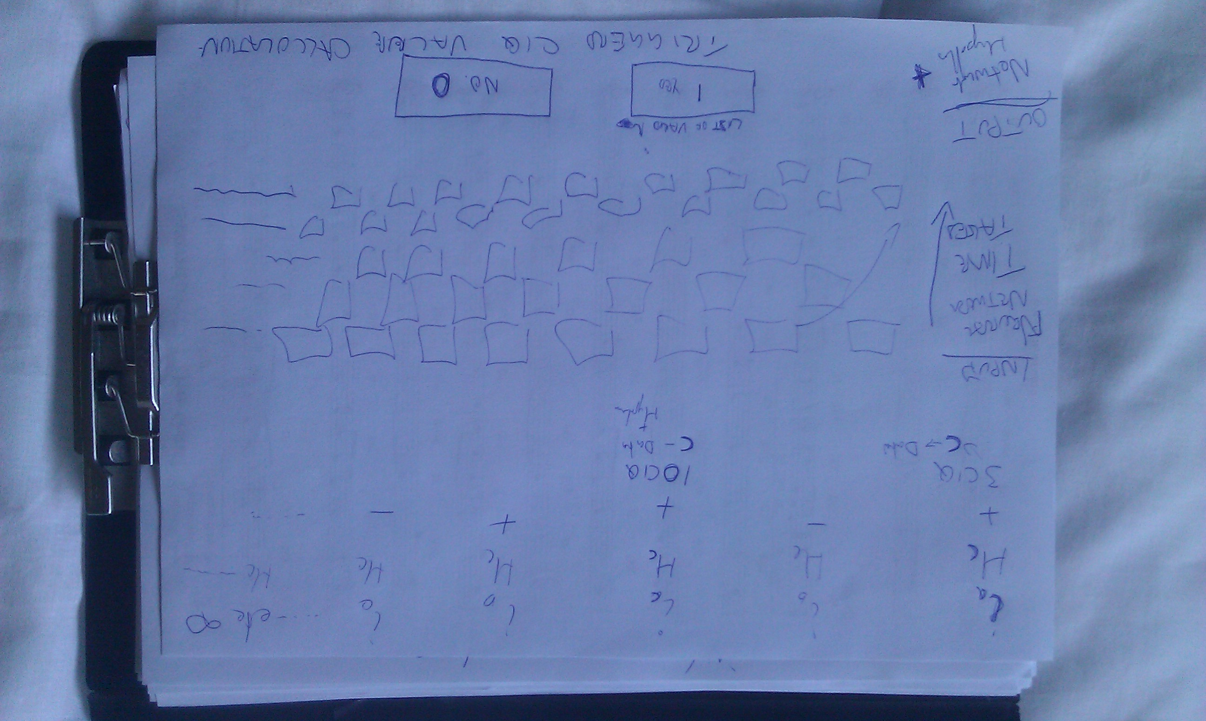

Slide 27
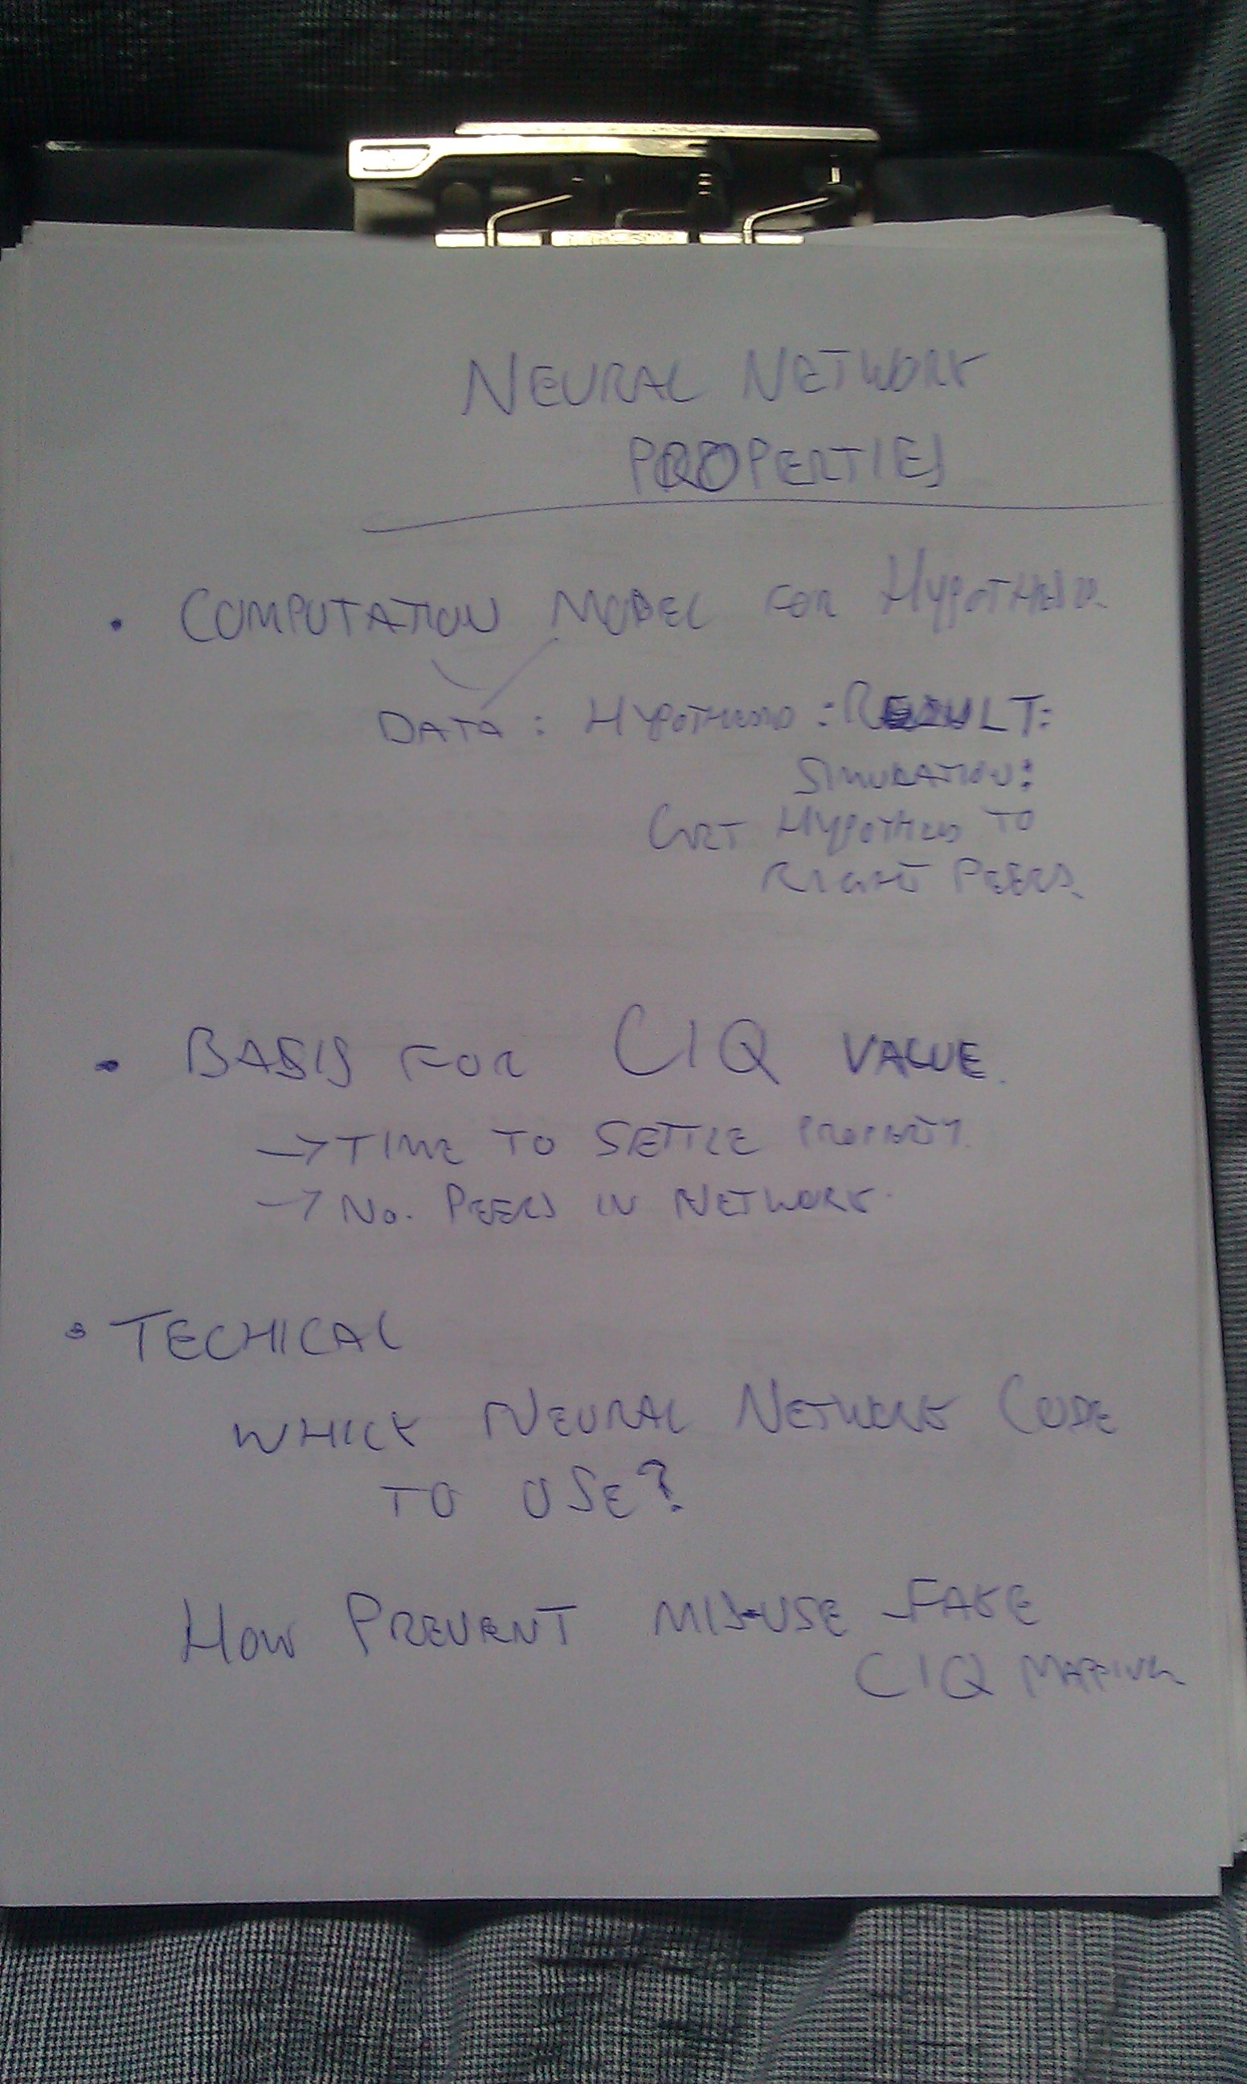

Slide 28
Simulations
Peer monte-carlo-model
Aim to combine network of peers model?
Maybe how future 'research' is given a CIQ number

Slide 29
CIQ
A CIQ (context instant/independent Quotient)
Ie. what information mean at that point in time to a peer
CIQ (Collective Intelligence Quotient)
i.e. what value in context of network

Slide 30


