Slide 1
FRAUNHOFER INSTITUTE FOR MANUFACTURING ENGINEERING AND AUTOMATION IPA
Stuttgart, September 2020 – February 2021
ROS ENDURANCE TEST
Aulon Bajrami
Tejas Kumar
Ruichao Wu
Alban Boytard

Slide 2
AGENDA
Introduction
Part 1 - Presentation of the RET Testing Device
Part 2 - Test the RET Testing Device
Conclusion

Slide 3
INTRODUCTION
Why?
Why would the user decide to choose a ROS driver instead of the native robot api provided by the constructor?
Is ROS reliable?
What?
A ROS driver test that reduces physical and analog errors that can occurs during the test
A reliable, endurant ROS driver Test
How?
Global Algorithm
Technological choice

Slide 4
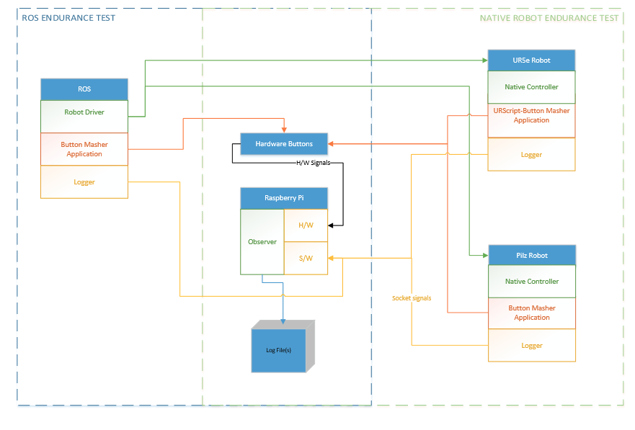
INTRODUCTION: RET ARCHITECTURE
Graph 1: RET Architecture

Slide 5
1) – PRESENTATION OF THE TESTING DEVICE : INTRODUCTION
Laboratory Setup
Prerequisite and Objectives
Global Algorithm
Technological choice

Slide 6
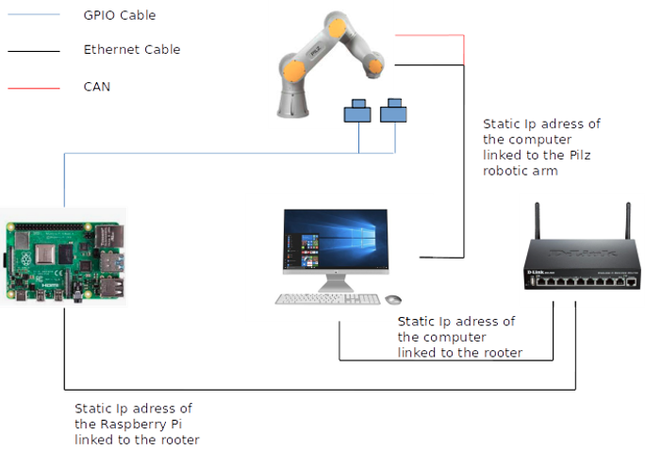
1) PRESENTATION OF THE RET TESTING DEVICE: LABORATORY SETUP
Graph 2: RET Laboratory Settlement (on the pilz)

Slide 7
PART 1 - PRESENTATION OF THE RET TESTING DEVICE:
PREREQUISITE AND OBJECTIVES
Prerequisite:
The native driver is reliable
Objectives:
The testing device reduces physical and analog errors that can occurs during the test
Each part of the testing device must remain autonomous
The test must be reliable
The Test must be endurant (> 10 h)

Slide 8
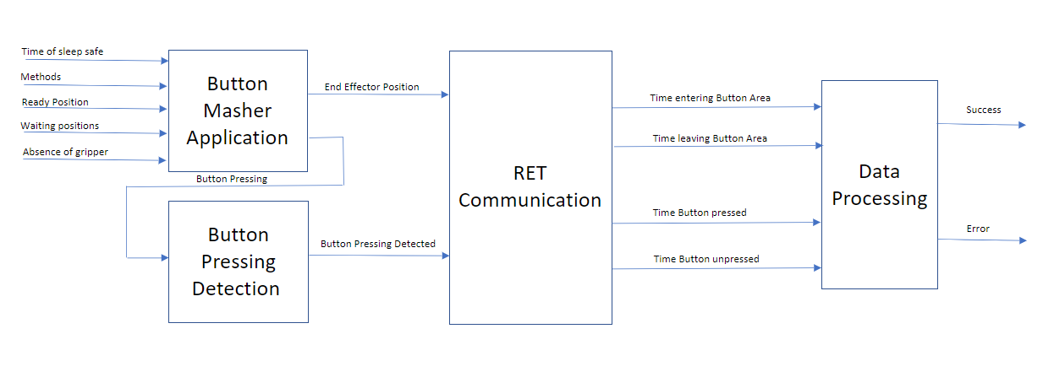
1 - PRESENTATION OF THE RET TESTING DEVICE: GLOBAL ALGORITHM
Graph 3: Global Algorithm of the RET

Slide 9
1) PRESENTATION OF THE RET TESTING DEVICE : TECHNOLOGICAL CHOICE
Button Masher Application:
Cartesian coordinates
Button Pressing Detection Application:
GPIO api and basics function
RET Communication:
Socket
Parelellism:
Thread and Daemon
Data Processing:
Influxdb/Grafana

Slide 10
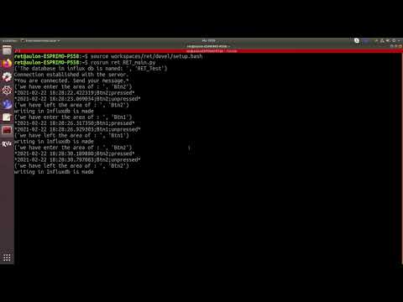
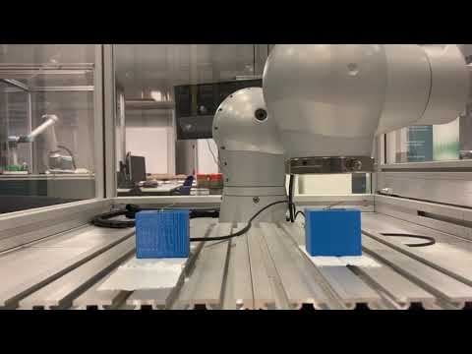
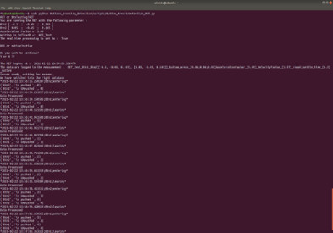
1) PRESENTATION OF THE RET TESTING DEVICE:
OVERVIEW OF THE RUNNING PROCESS
Video 1: Screencast of the RET from the computer
Video 2: Video of the RET
Graph 4: Screenshot of the RET from the Raspberry Pi

Slide 11
1) PRESENTATION OF THE RET TESTING DEVICE : CONCLUSION
Why am I in charge of that testing device?
Keep every entities as a separate project
An increasing difficulty when integrating every entities included in the learning process
How did I work on the RET Testing Device
Check the reliability of every entities separately

Slide 12
2) – TEST THE RET TESTING DEVICE : INTRODUCTION
Test the reliability
Test the reliability of the Button Pressing Detection
Test the reliability of the RET communication and data processing
Test the endurance
With the pilz_native driver

Slide 13
2) TEST THE RET TESTING DEVICE:
TEST THE RELIABILITY OF THE BUTTON PRESSING DETECTION
Devices:
Native Button Masher Application
Oscilloscope
Protocol:
Command the pilz_robot end effector to go where the button (20 times). Then Compare the Button Pressing Detection output with the electrical output seen in the oscilloscope.
Expected Result:
The Button Pressing Application is reliable: Duration of a button pressing

Slide 14
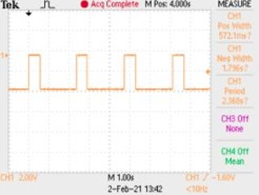
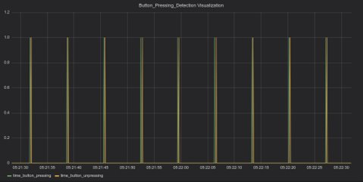
2) TEST THE RET TESTING DEVICE :
TEST THE RELIABILITY OF THE BUTTON PRESSING DETECTION
Results:
The Button Pressing Detection application is reliable
The Button Pressing Detection application reduce the analog errors occurred during the Test
Graph 6: Screenshot of the Button Pressing Detection Output from the oscilloscope
Graph 7: Screenshot of the Button Pressing Detection Output from Grafana
Main Challenges:
Noise of the button
Api function available for custom button

Slide 15
2) TEST THE RET TESTING DEVICE :
TEST THE RELIABILITY OF THE RET COMMUNICATION AND DATA PROCESSING
Devices:
Button Masher Application
Button Pressing Detection Application
Protocol:
Use a trial error scheme to define the right button area.
Choice:
Parallelepiped rectangle
Expected Result:
Detect the button pressing inside the button area.

Slide 16
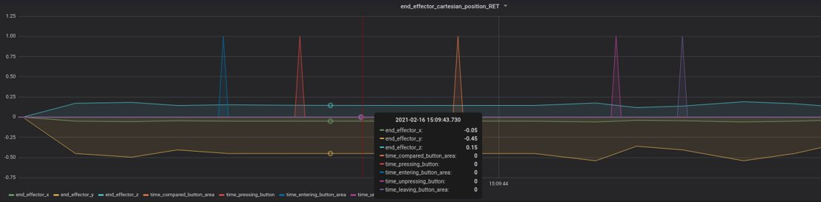
2) TEST THE RET TESTING DEVICE :
TEST THE RELIABILITY OF THE RET COMMUNICATION AND DATA PROCESSING
Result:
Graph 9: Screenshot of the RET testing device communication + dataprocessing output visualized on Grafana
For this button area dx = 6mm ; dy = 6mm ; dz = 1,3 mm, the RET communication and the data processing application are reliable.
The RET communication and data processing are reducing in this interval the physical errors occurring during the test.

Slide 17
2) TEST THE RET TESTING DEVICE :
TEST THE ENDURANCE
Used Devices:
Button Masher Application
Button Pressing Detection Application
RET communication + Data processing Application
Protocol:
We have run the global algorithm until an error is detected
Choice made:
Driver : pilz native driver
Expected Result:
The test is endurant.

Slide 18
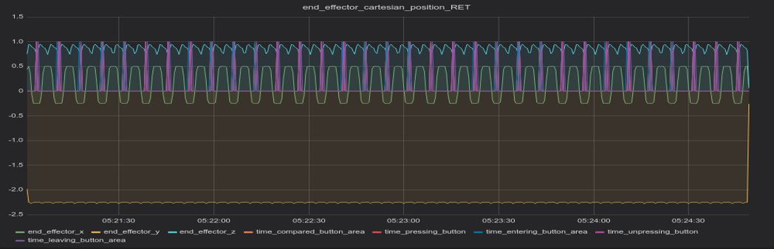
2) TEST THE RET TESTING DEVICE :
RESULT
Result:
The test is endurant.
Graph 10: Screenshot of the RET testing device output visualized on Grafana

Slide 19
CONCLUSION
We have met the following expectation:
The testing device is reducing the possible physical (Button Area) and analog errors (Button Pressing Detection)
The testing device is reliable (real-time processing with Grafana)
The testing device is endurant (>10h)
Some suggestions to improve:
Try the RET on another package
Define the impact of the moveIT acceleration factor on the inertia of the robot to have the smallest accurate button area

Slide 20
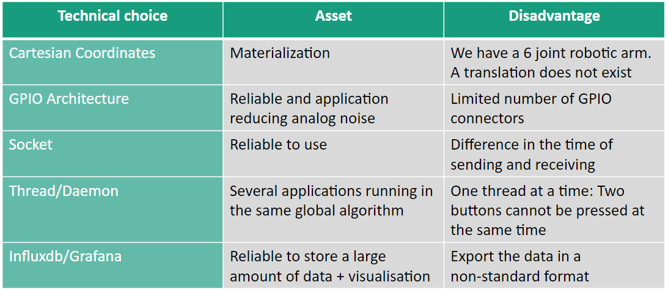
CONCLUSION ABOUT THE TECHNICAL CHOICE MADE

Slide 21
OPENING
Test a whole plan full of button:
Hypotheses:
The testing device is reliable and endurant
We have found the best compromise between the accuracy of the button area and the acceleration/velocity of the robot joints
We add an end effector for the robot to press only one button at the time
Multiple Rpi connected together
Protocol:
We design a plan of button area
We test the whole robot area by overlaying plan

Slide 22
ACKNOWLEDGEMENTS
Thank you for your attention
Thank you for your welcome and your help

