Slide 1
Understanding Authentication, Session Management, and Authorization
Key Concepts and Best Practices

Slide 2
Introduction
Brief overview of the importance of security in web applications:
In the realm of web applications, security is paramount to safeguard sensitive information, prevent unauthorized access, and ensure the integrity of user data. With the increasing reliance on digital platforms, the protection of user accounts and the information they store is crucial for maintaining trust and credibility.
Objectives of the session:
Understand the Basics: Gain a foundational understanding of key security concepts.
Authentication Mastery: Grasp the significance of authentication, session management, and authorization.
Application to Dynamics 365: Relate security principles to Dynamics 365 support responsibilities.
Best Practices: Learn recommended practices for maintaining a secure web environment.

Slide 3
What is Authentication?
What is Authentication?
the process of verifying the identity of a user, system, or application, ensuring that the entity attempting access is who they claim to be. In web applications, this is a critical first step to establish trust and control access to sensitive resources.
Importance in the context of web security:
Protecting User Data: Authentication prevents unauthorized users from accessing personal or confidential information.
Securing Systems: Ensures only authenticated entities interact with the system, preventing malicious activities.
Building Trust: Users trust systems that authenticate them securely, contributing to a positive user experience.
Common methods (e.g., password-based, multi-factor):
Password-Based Authentication: Users enter a unique password associated with their account.
Strengths: Familiar, easy to implement.
Weaknesses: Vulnerable to password-related risks (e.g., weak passwords, phishing).
Multi-Factor Authentication (MFA): Requires users to provide multiple forms of identification.
Strengths: Adds an extra layer of security, even if one factor is compromised.
Methods: Something you know (password), something you have (token), something you are (biometrics).
Biometric Authentication: Uses unique biological traits for identity verification (e.g., fingerprints, facial recognition).
Strengths: Difficult to forge, enhances user convenience.
Weaknesses: Technical limitations, privacy concerns.

Slide 4
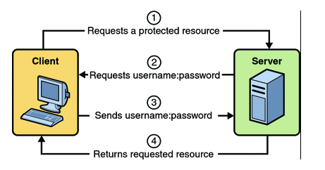
Authentication Process (1/2)
Diagram of a basic authentication process:

Slide 5
Authentication Process (2/2)
User Initiates Request:
-User attempts to access a protected resource, triggering the authentication process.
Authentication Request:
-The application prompts the user for credentials or additional authentication factors.
Credential Verification:
-User-provided credentials are validated against stored credentials (e.g., username and password check).
Token Generation (Optional):
-In some cases, successful authentication results in the generation of a token for subsequent authorization.
Access Granted/Denied:
-Based on successful authentication, the user is granted access to the requested resource; otherwise, access is denied.
Brief explanation of each step:
User Initiates Request: The process begins when a user attempts to access a secure resource within the application.
Authentication Request: The application prompts the user to prove their identity through credentials or additional factors.
Credential Verification: The provided credentials are compared against stored data to confirm the user's identity.
Token Generation (Optional): Depending on the authentication method, a token may be generated for secure communication and authorization.
Access Granted/Denied: Based on successful authentication, the user gains access; otherwise, access is denied, and the process may loop back to step 2.

Slide 6
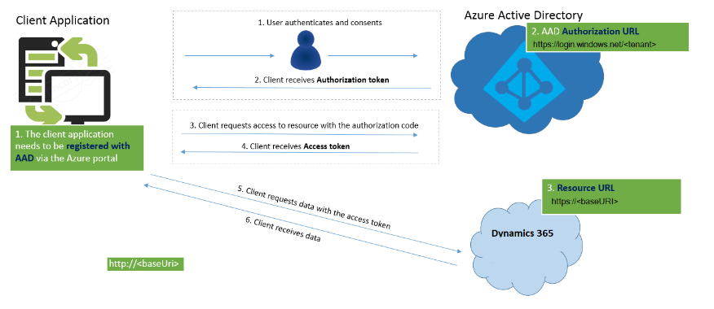
Common Authentication Protocols (1/3)
Overview of protocols like OAuth, OpenID Connect, etc.:
OAuth (Open Authorization):
-Use Case: Delegated access, allowing applications to access resources on behalf of the user without exposing credentials.
tity/ad-fs/development/ad-fs-openid-connect-oauth-concepts

Slide 7
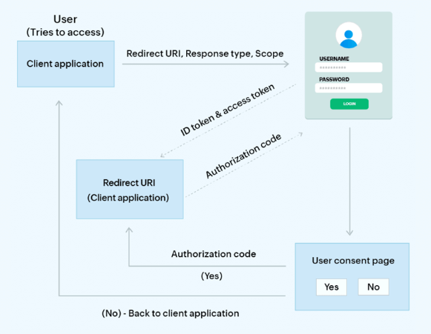
Common Authentication Protocols (2/3)
Overview of protocols like OAuth, OpenID Connect, etc.:
OpenID Connect:
-Use Case: Identity layer on top of OAuth, facilitates user authentication, providing information about the user.
https://learn.microsoft.com/en-us/windows-server/identity/ad-fs/development/ad-fs-openid-connect-oauth-concepts

Slide 8
Common Authentication Protocols (3/3)
Overview of protocols like OAuth, OpenID Connect, etc.:
SAML (Security Assertion Markup Language):
-Use Case: Exchange of authentication and authorization data between parties, particularly in single sign-on (SSO) scenarios.
https://learn.microsoft.com/en-us/entra/identity/enterprise-apps/what-is-single-sign-on
JWT (JSON Web Token):
-Use Case: Compact, self-contained means of representing claims between two parties; often used for authentication and information exchange.
Use cases for each:
OAuth: Ideal for scenarios where third-party services or applications need controlled access to user data without exposing user credentials.
OpenID Connect: Suitable for applications requiring user authentication and the acquisition of user information in a standardized manner.
SAML: Commonly used for single sign-on (SSO) scenarios where a user can access multiple applications with a single set of credentials.
JWT: Efficient for token-based authentication, often used in stateless applications or microservices architectures.

Slide 9
What is Session Management?
Definition and role in maintaining state in the stateless HTTP protocol:
Definition: Session management involves maintaining a user's state during interactions with a web application, compensating for the stateless nature of the HTTP protocol.
Role in Maintaining State: Ensures continuity for users by preserving their context, preferences, and authentication status across multiple requests and responses.
Examples of session management (cookies, tokens):
Cookies:
Role: Small pieces of data stored on the user's device.
Usage: Often used to store session identifiers or user preferences.
Tokens:
Role: Compact, self-contained pieces of information.
Usage: JWTs, for instance, can carry authentication information and user claims between parties.

Slide 10
Session Management Techniques
Cookie-based sessions vs. token-based sessions:
Cookie-Based Sessions:
Pros:
Simplicity: Easy to implement and widely supported.
Automatic Handling: Browsers handle cookies automatically, reducing developer effort.
Cons:
Vulnerabilities: Prone to session hijacking if not implemented securely.
Limited Data Storage: Size restrictions on cookies may limit the amount of data stored.
Token-Based Sessions:
Pros:
Security: Tokens can be designed to carry only necessary information, reducing the risk of exposure.
Scalability: Suitable for distributed systems and microservices architectures.
Cons:
Increased Complexity: Token handling may require additional effort.
Stateless Nature: Requires additional infrastructure to manage stateless sessions.

Slide 11
Security Considerations in Session Management
Common vulnerabilities (e.g., session hijacking, fixation):
Session Hijacking:
-Unauthorized users intercept or manipulate session data to gain unauthorized access.
Session Fixation:
-Attackers force a user's session ID to a known value, enabling them to take control of the session.
Best practices for secure session management:
Use HTTPS: Encrypt communication to prevent data interception.
Session Expiry: Implement short session lifetimes to reduce exposure.
Random Session IDs: Generate unpredictable session IDs to thwart fixation attacks.
Session Regeneration: Renew session IDs after successful login to prevent session hijacking.

Slide 12
What is Authorization?
Definition and distinction from authentication:
Definition: Authorization is the process of determining what actions or resources a user is allowed to access based on their authenticated identity.
Distinction from Authentication: While authentication verifies the user's identity, authorization dictates what the authenticated user can do within the application.
Role-Based Access Control (RBAC) and other models:
Role-Based Access Control (RBAC):
Assigns roles to users, and access permissions are associated with these roles.
Simplifies access management by grouping users with similar responsibilities.
Attribute-Based Access Control (ABAC):
Decisions based on attributes like user characteristics, environment conditions, or resource properties.
Offers fine-grained control over access.

Slide 13
Implementing Authorization
Examples of authorization checks in web applications:
Role-Based Authorization:
-Users with the "Admin" role can access admin functionalities.
Resource-Based Authorization:
-Specific users can access particular resources (access on API endpoints etc.)

Slide 14
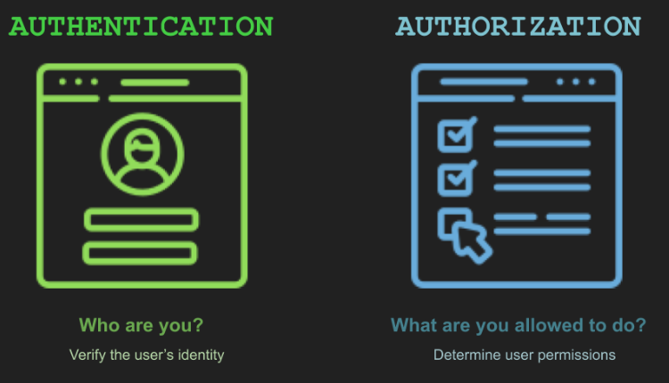
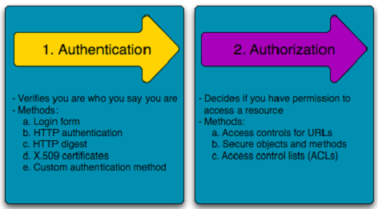
Integrating Authentication and Authorization
How authentication and authorization work together:
Authentication:
-Verify the user's identity through login credentials or other factors.
Authorization:
-Based on the authenticated identity, grant or deny access to specific resources or actions.

Slide 15
Example
Try out the code at https://github.com/microsoft/PowerApps-Samples/blob/master/dataverse/webapi/C%23-NETx/App.cs :
Here are key points related to session management in this code: Token Lifecycle Management:
- The code handles the acquisition of OAuth tokens using various methods, including silent token acquisition, username/password flow, and interactive login.
- It checks for existing accounts and attempts to acquire tokens silently. If silent acquisition fails or there are no existing accounts, it uses other methods to obtain a new token.
Token Expiry Handling: - The code is designed to handle scenarios where the cached token is expired or not available, triggering the acquisition of a new token.
Access Token Usage: - The acquired OAuth token is used to authenticate requests to the Dynamics 365 CE Web API.
Error Handling for MFA: - The code includes specific handling for the case where Multi-Factor Authentication (MFA) might be required. It opens the browser for interactive login in such scenarios.
-While the code doesn't manage user sessions in a conventional sense, it manages the OAuth token, which is a form of session representation in OAuth-based authentication systems. The token serves as a session identifier and includes information about the user's authentication and authorization.
In summary, the provided code doesn't manage user sessions in the typical web application sense but effectively manages the authentication token lifecycle for secure interactions with the Dynamics 365 CE API.

Slide 16
Best Practices and Common Pitfalls
Summary of best practices:
Cache Access Tokens: To minimize network calls from the client application and their associated latency, the client application should cache access tokens for the token lifetime that is specified in the OAuth 2.0 response. To determine the token lifetime, use either the expires_in or expires_on parameter values.
If a web API resource returns an invalid_token error code, this might indicate that the resource has determined that the token is expired. If the client and resource clock times are different (known as a "time skew"), the resource might consider the token to be expired before the token is cleared from the client cache. If this occurs, clear the token from the cache, even if it is still within its calculated lifetime.
Handling Refresh Tokens: Refresh tokens do not have specified lifetimes. Typically, the lifetimes of refresh tokens are relatively long. However, in some cases, refresh tokens expire, are revoked, or lack sufficient privileges for the desired action. The client application needs to expect and handle errors returned by the token issuance endpoint correctly. When you receive a response with a refresh token error, discard the current refresh token and request a new authorization code or access token. In particular, when using a refresh token in the Authorization Code Grant flow, if you receive a response with the interaction_required or invalid_grant error codes, discard the refresh token and request a new authorization code..
Monitoring and Logging: Implement robust logging.

Slide 17
Troubleshooting flow
Scenario: Application User used and connects via client secret
Is there a registered App in AD?
Is user_impersonation API permission added for "Dynamics CRM"?
Are the paremeters correct?
Application Id, aka, Client Id
Tenant Id
Client Secret
If we are using Application user: then does it exist in Azure AD?
Is there a security role assigned to this user in D365?
Use the custom app

Slide 18
Conclusion
Recap of key points:
Security Foundation: Understanding the importance of security in web applications is fundamental for protecting user data and maintaining trust.
Authentication: The process of verifying user identity, with methods like password-based and multi-factor authentication.
Session Management: Techniques like cookie-based and token-based sessions play a crucial role in maintaining user state.
Authorization: Dictates what actions or resources an authenticated user can access, with models like RBAC and ABAC.
Integration: Authentication and authorization work together to ensure secure access to resources.
Best Practices: Regular updates, user education, monitoring, and logging are crucial for maintaining a secure web environment.

Slide 19
Q&A

Slide 20
References
List of resources, articles, and documentation for further reading:
OWASP (Open Web Application Security Project):
Website: https://owasp.org/
Comprehensive resources on web application security, including best practices and vulnerabilities.
OAuth 2.0 and OpenID Connect Documentation:
OAuth 2.0: https://oauth.net/2/
OpenID Connect: https://openid.net/connect/
Official documentation for OAuth 2.0 and OpenID Connect for understanding secure authorization and authentication.
Auth0 Blog:
Website: https://auth0.com/blog/
Valuable insights and tutorials on authentication and authorization practices.
NIST Special Publication 800-63B: Digital Identity Guidelines:
Document: https://nvlpubs.nist.gov/nistpubs/SpecialPublications/NIST.SP.800-63b.pdf
NIST guidelines on digital identity, including authentication and lifecycle management.

