Slide 1

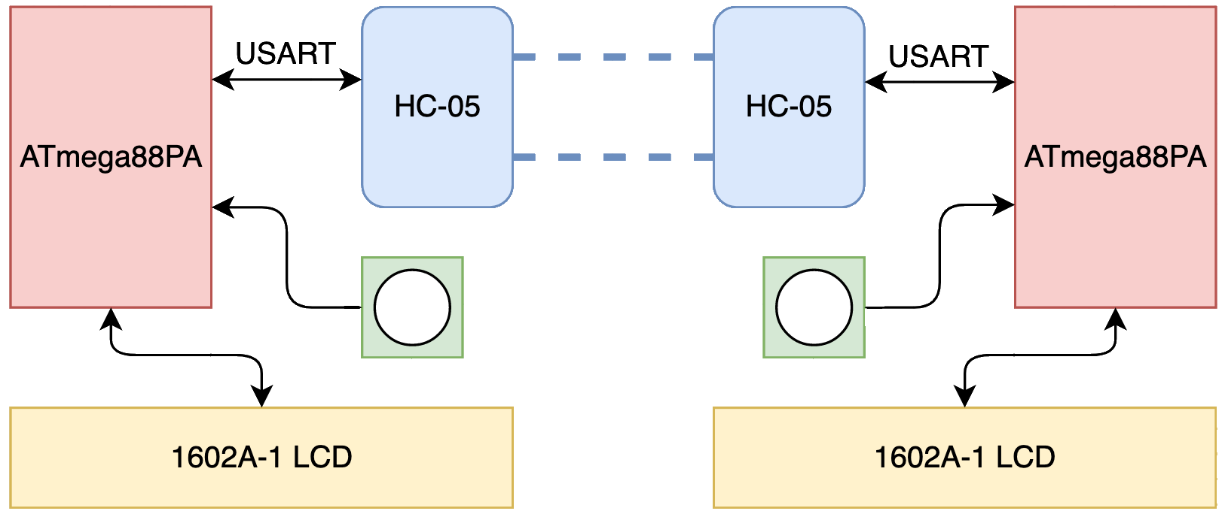
Morse Code Chat
23
Alexander Powers and Benjamin Mitchinson
Abstract
Introduction
Our project is a discrete Morse code communication set, programmed on two ATmega88PA development boards. Using our developed solution, two users are able communicate back and forth by tapping out Morse Code on a button, for transmission over Bluetooth to the LCD of their respective partner’s device.
System Design
Result
Lessons Learned
Conclusion
ECE:3360 Embedded Systems 2019
The University of Iowa

