Slide 1

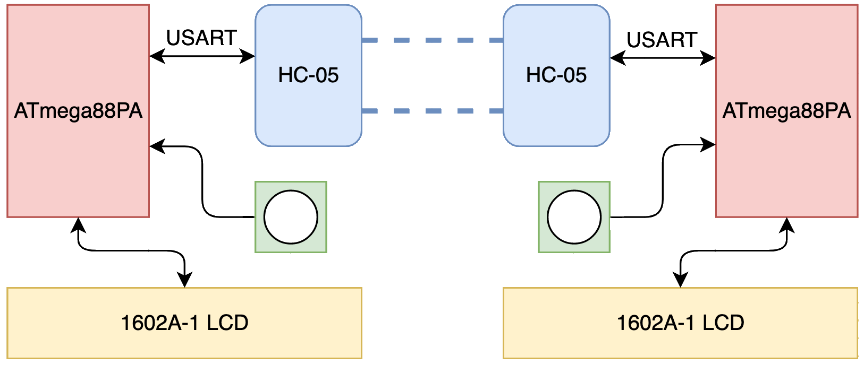
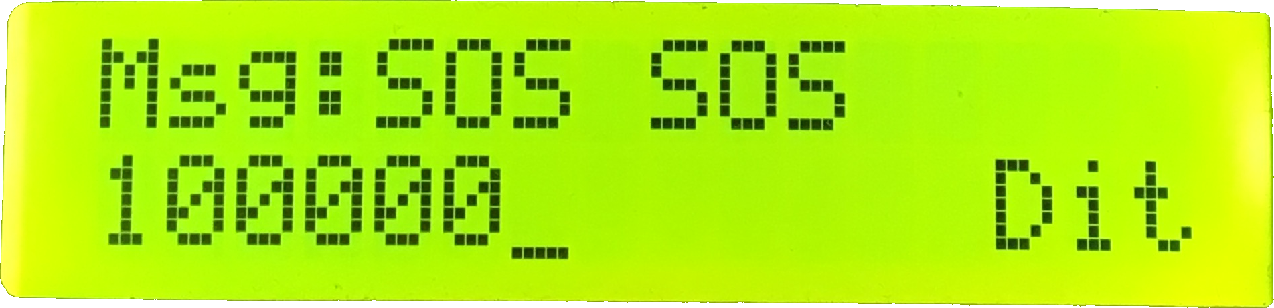
Morse Code Chat
23
Alexander Powers and Benjamin Mitchinson
Abstract
Introduction
Our project is a discrete Morse code communication set, programmed on two ATmega88PA development boards. Using our developed solution, two users are able communicate back and forth by tapping out Morse Code on a button, for transmission over Bluetooth to the LCD of their respective partner’s device.
System Design
Result
Lessons Learned
Conclusion
Reflecting on final physical hardware design, our solution would be more marketable if it was contained in a compact form factor, as opposed to being left on the development board and tethered to an outlet power source. The components are small enough to be wired to one board, and using a battery to power them all would result in an entirely portable communication device. We’re interested in pursuing this further to learn about 3D prototype printing as well as board design resources like OSHPark.
ECE:3360 Embedded Systems 2019
The University of Iowa

