Slide 1
Covid County Data Tracker
Alex Powers, Harsh Patel, Colton Miller

Slide 2
Project Description
Main Goal: To query and curate Covid-19 on the county, state, and country levels in the US
Covid records updated daily dating back to January 2020 for all three geographical levels
Allows for covid data querying based on time of year in specific areas of the country to view trends of infection rates and hotspots for the disease

Slide 3
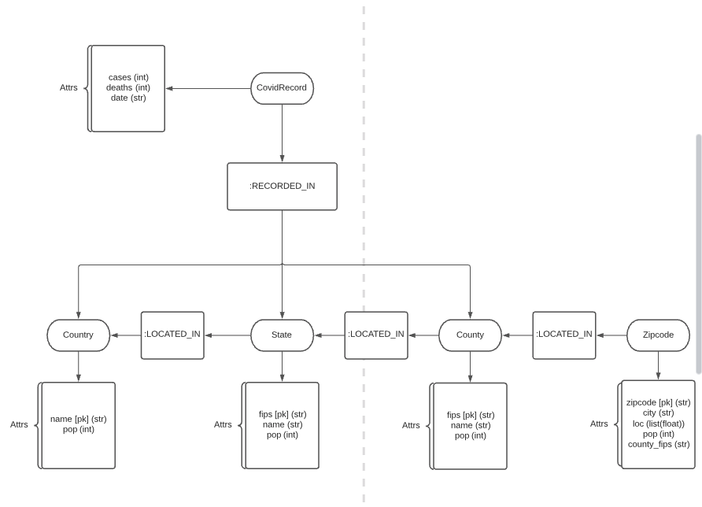
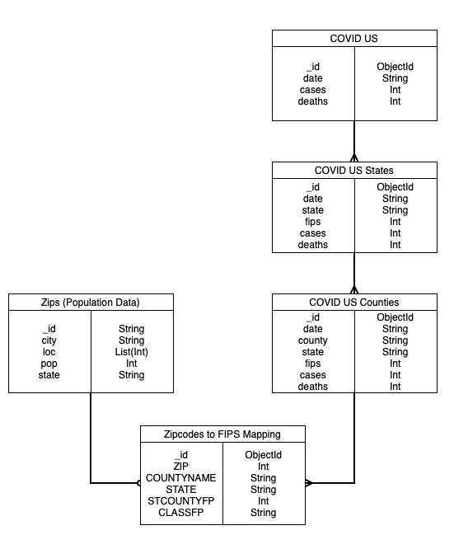
Architectural Overview
Mongo Data Model (Collections are loaded separately, arrows are just helping to visualize how the data is manipulated in future steps
Neo4j Data Model

Slide 4
Data
Covid-19 Data:
Source: NYTimes Github, https://github.com/nytimes/covid-19-data
Contains us-counties, us-states, and us covid records dating back to January 2020
Records contain date, # of cases, # of deaths, state, fips (county zipcode), county name (us-states and us don’t contain county names or county fips)
Zips Data:
Previously used in-class zips.json from mongodb assignment
Contains city zipcodes, geographical locations of zipcodes, population data
ZipsToFips Data:
Data to map zipcodes to corresponding counties using county fips

Slide 5
Database systems
MongoDB: quick and efficient initial location for uploading our data
Quicker to upload directly to mongo than Neo4j
Easy to load data from MongoDB into Neo4j with Python (Py2Neo)
Collections are separated (each csv is own table during initial upload)
Data transformation to Neo4j using py2neo
Neo4j: Best way of mapping county data to state data to US data
Creates relationships for each record within each zipcode
Each zipcode is then given a relationship to its corresponding county (:LOCATED_IN)
Each county is then given a relationship to its corresponding state (:LOCATED_IN)
Each state maps to the US node (:LOCATED_IN)
Each covid record is related to its corresponding level of data (:RECORDED_IN) based on the .csv it was read from (i.e county level covid records are given the :RECORDED_IN relationship to its corresponding county node)
Notes:
Data transformation

Slide 6
DB Schema/structure
Mapping from zips.json to county fips codes using Zips2Fips.csv, starts creation of Neo4j data model
Converting data from MongoDB into Neo4j
Removes county duplicates, state duplicates, creates relationships between states <- counties <- zips, whereas in Mongo, this data stored contains duplicate county/state covid records
Loading data into Neo4j – VERY SLOW using Object Graph Mapping with Py2Neo
Created Neo4j constraints on each level of geographic node in order to allow for quicker node-querying and data uploading
B-Tree index on the county_fips attribute of each zipcode node

Slide 7









Tools used/WorkFlow
Cast data as python data structures
Python data structure conversion to Neo4j property graph
localhost
Initial data upload
Code written in queries.py to query Neo4j DB

Slide 8
Tools used
Py2Neo
Object-Graph Mapping
Using OGM directly was very slow
Created unique constraints on the Neo4j database, generated python data structure that unwinds based on the constraints in Neo4j (much quicker data upload)
Flask
Python Front-end
MongoEngine

Slide 9
Features Designed/Implemented
Dropdown menu on Home page for query selection
Each query page contains dropdown menus for user input parameters
Dynamically load county data in a dropdown menu based on state selected
Results displayed from the query

Slide 10
Queries Performed
Number of cases in a state over a date range
Number of cases in a county over a date range
Rank states by net cases over a date range
Rank states by cases as percentage of population over a date range
Rank counties by net cases over a date range
Rank counties by cases as percentage of population over a date range

Slide 11
Lessons Learned
Uploading ~800,000 Covid Records from counties, states, and US into Neo4j can be a computationally demanding process if not optimized correctly
Importance of indexing and uniqueness constraints
Speed up insertion and query times
Stay away from wrappers and object graph mapping when uploading bulk data

Slide 12
Open Issues/Future Work
Implement Clustering Algorithms to help predict where future cases or spikes may occur
Implement a recommendation system based on county attributes to compare Similar geographical regions of similar number of infections and population
Highlight trendlines out of the ordinary for specific geographical regions

Slide 13
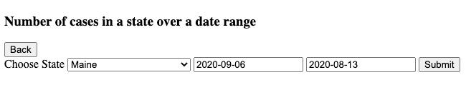
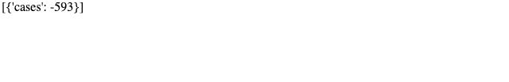
Query 1 Results

Slide 14
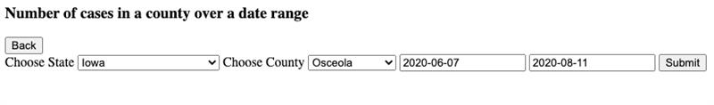

Query 2 Results

Slide 15
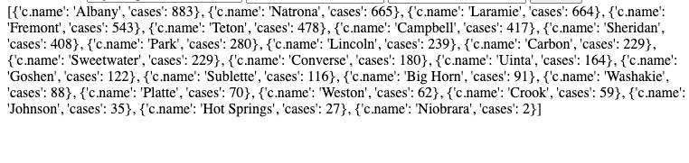
Query 3 Results

Slide 16
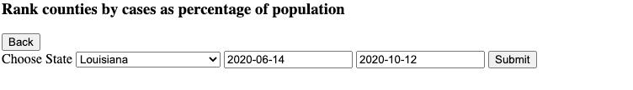
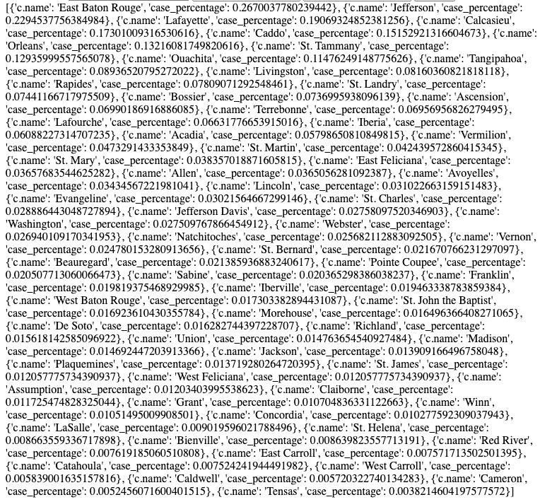
Query 4 Results

Slide 17
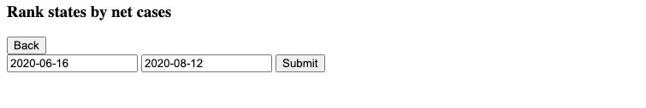
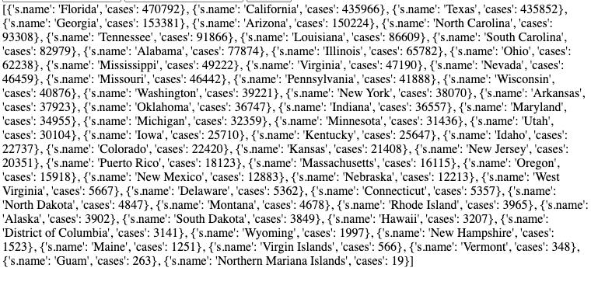
Query 5 Results

Slide 18

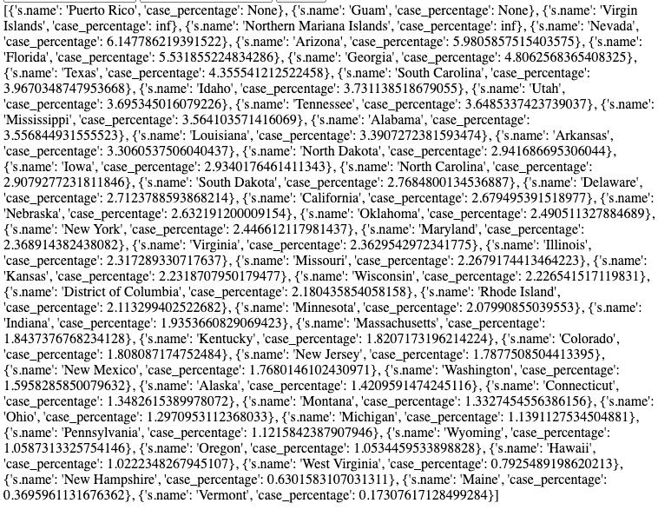
Query 6 Results

