Slide 1
AIR quality monitoring in delhi during winters
Aditya Nayak 21BCE0540
Harshit Amresh 21BCE3791
Aryan Balaji 21BCT0426
Dhaerya Chaudhary 21BCE3913

Slide 2
Introduction
Delhi's air quality has deteriorated to alarming levels, particularly during the winter months, when the concentration of particulate matter rises sharply due to a combination of crop residue burning, vehicular exhaust, and industrial emissions. This presentation delves into the integration of advanced sensor technology as a proactive approach to monitor, assess, and combat air pollution. Real-time air quality sensors provide continuous, accurate measurements of harmful pollutants, empowering government agencies, environmental bodies, and citizens to take timely and informed action. The data collected not only helps shape effective environmental policies but also aids in targeting pollution hotspots and educating the public on health risks and preventive measures. By strategically implementing these sensor-based systems, Delhi can move toward improved public health outcomes, cleaner air, and a more resilient, sustainable urban environment for current and future generations.

Slide 3

Literature review
Air pollution, especially due to particulate matter (PM), remains a pressing environmental issue in urban areas. Numerous studies have stressed the importance of integrating air quality monitoring systems within smart city frameworks to effectively address this challenge. For instance, Saha and Singh (2017) highlighted how smart city initiatives can contribute to sustainability by tackling environmental concerns like air pollution, particularly through the use of real-time monitoring systems.

Slide 4
Literature review
Further supporting this idea, Saha et al. (2020) examined the environmental effects of smart city projects in New Delhi, emphasizing the significant role of IoT-based technologies in lowering pollution levels. Similarly, Saha et al. (2019) proposed an integrated model for air quality management in future smart cities, focusing on IoT-driven monitoring of both particulate matter and gaseous pollutants.
Miles et al. (2018) also explored the role of IoT in managing air pollution, developing a decision support system that enables real-time monitoring and analysis of atmospheric conditions. This aligns with the work of Stankovic et al. (2012), who focused on using smart technologies to manage traffic-related air pollution in urban areas.

Slide 5
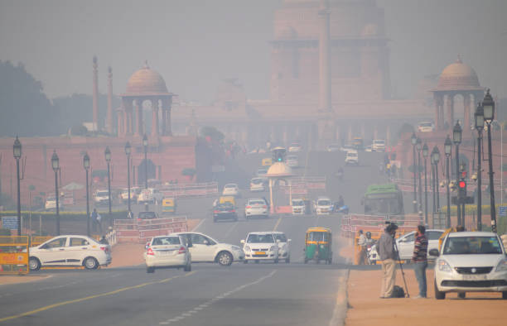
Literature review
In addition, Dwevedi et al. (2018) emphasized the importance of big data in smart cities, highlighting how the integration of air quality monitoring with data analytics can enhance decision-making processes. Overall, the literature supports the growing importance of IoT-based air quality monitoring in smart cities, while also acknowledging key implementation challenges such as cost, sensor accuracy, and data privacy that must be carefully managed for these systems to be effective.

Slide 6
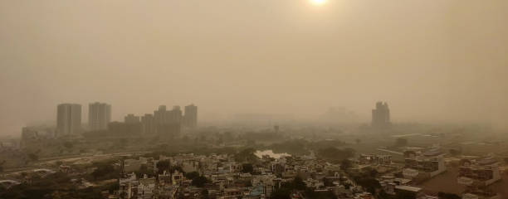
Problem formulation
Urban environments are increasingly burdened by air pollution, largely driven by rising vehicular emissions, industrial activities, and various human-induced factors. Particulate matter (PM1.0, PM2.5, PM10) poses severe health hazards, yet many existing air quality monitoring systems are expensive and often fail to provide real-time, accurate data.

Slide 7
Research problem and objective
Research Problem –
This project seeks to develop an IoT-enabled air quality monitoring system capable of accurately measuring particulate matter, temperature, and humidity in real time. The system will be integrated with cloud services for efficient data storage and offer intuitive visualizations to support public health initiatives and urban planning efforts.
Objective-
To create an affordable, scalable IoT-based solution for continuous air quality monitoring, featuring real-time data collection, cloud integration, and visual representation of environmental conditions—empowering smarter decision-making to enhance air quality in modern cities.

Slide 8
RELEVANCE OF THE PROBLEM STATEMENT W.R.T SUSTAINABLE DEVELOPMENT GOALS
SDG 3: Good Health and Well-being
Air pollution poses serious threats to public health, contributing to respiratory conditions such as asthma, bronchitis, and even cardiovascular diseases. Implementing air quality monitoring systems allows for the early detection of harmful pollutants, enabling timely interventions and policy decisions. This proactive approach helps safeguard the well-being of communities, especially vulnerable groups such as children and the elderly.
SDG 11: Sustainable Cities and Communities
Air quality monitoring plays a critical role in shaping cleaner, more livable urban environments. By continuously tracking pollution levels, city planners and authorities gain valuable insights that inform sustainable development strategies. These insights support the implementation of green infrastructure, improved traffic management, and stricter emissions regulations, all of which contribute to healthier and more sustainable urban communities.

Slide 9
RELEVANCE OF THE PROBLEM STATEMENT W.R.T SUSTAINABLE DEVELOPMENT GOALS
SDG 13: Climate Action Monitoring and reducing air pollution directly support efforts to combat climate change. By identifying and addressing sources of greenhouse gas emissions—such as CO₂ and methane—this project contributes to national and global climate goals. Improved air quality also reflects a decrease in harmful emissions, aligning with broader initiatives aimed at environmental conservation and climate resilience.
SDG 9: Industry, Innovation, and Infrastructure This project fosters innovation through the integration of Internet of Things (IoT) technologies in environmental monitoring. By leveraging sensors, data analytics, and cloud-based platforms, it advances the development of smart city infrastructure. The adoption of such cutting-edge technologies not only enhances real-time data collection but also supports evidence-based decision-making, driving sustainable industrial and urban development.

Slide 10
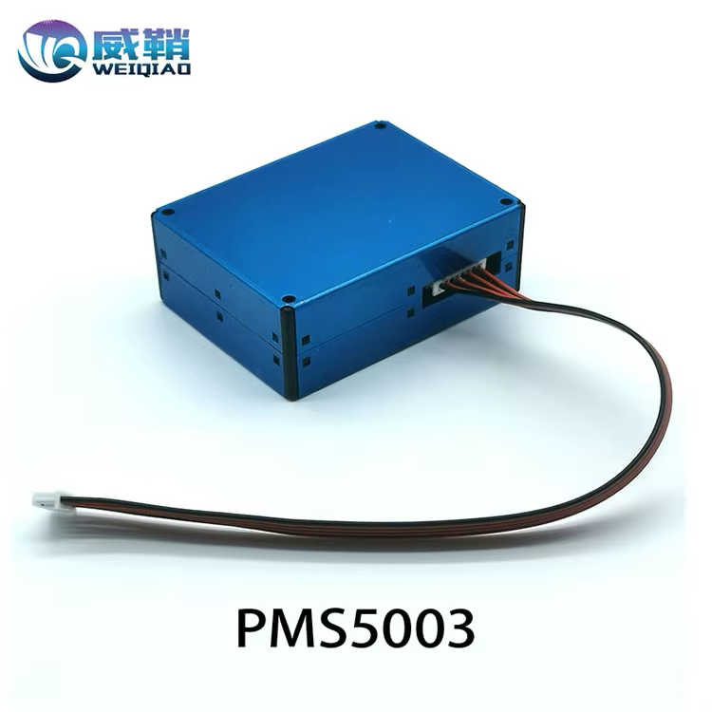
PROPOSED SYSTEM/ARCHITECTURE/DESIGN
The system employs a PMS5003 sensor to accurately measure levels of particulate matter in the air. An Arduino Uno microcontroller processes the collected data, while a dedicated power supply ensures stable operation. For output and communication, the system features an LCD screen for real-time air quality display, a data logger for storing historical data, and a GPRS modem that enables remote data transmission. This setup supports continuous, accessible, and efficient air quality monitoring.

Slide 11
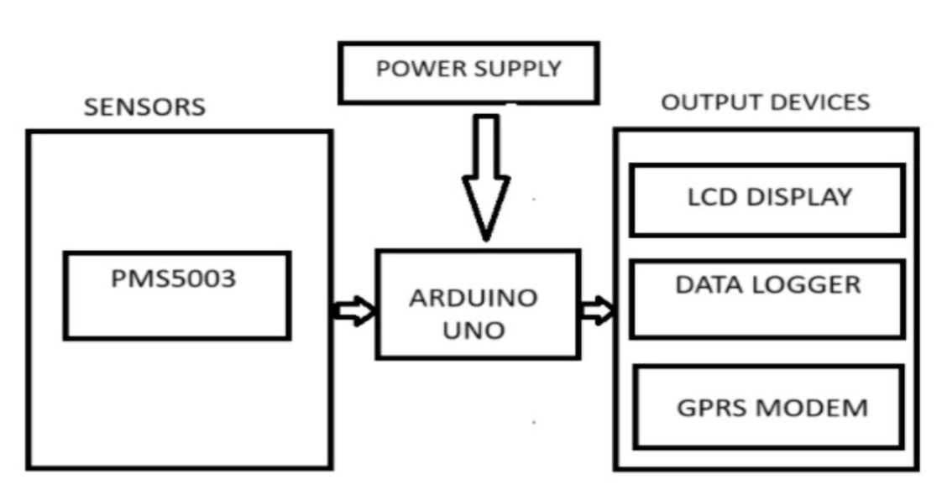
ARCHITECTURE

Slide 12
ANALYTICAL DESCRIPTION
Data Collection and Analysis
The PMS5003 sensor continuously collects real-time data on particulate matter, specifically measuring concentrations of PM1.0, PM2.5, and PM10—particles with diameters smaller than 1.0, 2.5, and 10 micrometers, respectively. This data provides valuable insights into air quality trends, such as daily pollution patterns, peak levels during rush hours, or spikes linked to specific weather conditions. Additionally, it can highlight variations in air quality across different locations. With a consistent data stream, the system can conduct detailed statistical analyses—calculating daily averages, monitoring long-term trends, and detecting anomalies or sudden increases in pollution levels.
Sensor Calibration and Accuracy
To ensure the accuracy of the readings, the PMS5003 sensor may require calibration. Environmental factors such as temperature, humidity, and air pressure can influence its measurements. Calibration involves comparing the sensor’s output with that of a high-precision reference-grade device to determine any deviations or inaccuracies. Based on this comparison, software-based correction factors or calibration tables can be implemented to adjust the readings, enhancing the reliability and precision of the data collected.

Slide 13
Analytical description
Data Processing and AQI Calculation
The raw particulate matter data collected by the PMS5003 sensor is processed and translated intoa more understandable format using the Air Quality Index (AQI). This index provides a standardized scale to represent air quality, making it easier for users to interpret pollution levels. Each measured pollutant concentration—such as PM2.5 or PM10—is mapped to a corresponding AQI value based on recognized guidelines, such as those provided by the U.S. Environmental Protection Agency (EPA) or the World Health Organization (WHO). This mapping helps categorize air quality into intuitive levels such as “Good,” “Moderate,” “Unhealthy,” and so on, allowing users to quickly assess potential health risks.
Alert Generation
The system is designed to automatically generate alerts based on pre-defined AQI thresholds. When pollution levels exceed safe limits, it can issue real-time warnings to inform users of deteriorating air quality. For instance, if PM2.5 levels rise above 100 μg/m³, the system can trigger an “Unhealthy Air Quality” alert. These notifications can prompt users to take protective measures, such as staying indoors, avoiding strenuous outdoor activity, or wearing protective masks. This feature is crucial for ensuring public awareness and enabling timely health precautions during pollution spikes.

Slide 14
Theoretical description
Principles of Particulate Matter Detection
The PMS5003 sensor operates using the principle of laser scattering to detect airborne particulate matter. Inside the sensor’s detection chamber, a laser beam is emitted. As particles in the air pass through this beam, they scatter the light in different directions. A photodetector captures this scattered light, and by analyzing the intensity and angle of the scattering, the sensor can estimate both the size and number of particles present. This detection method is based on Mie scattering theory, which describes how particles of a size similar to the wavelength of light interact with and scatter that light. This principle enables precise and real-time particulate matter measurement.
Size Differentiation
The PMS5003 sensor is capable of distinguishing particles based on size—specifically PM1.0, PM2.5, and PM10. This classification is essential for understanding the health implications of different particle sizes. PM2.5 particles, for example, are particularly harmful because they are small enough to bypass the body's natural respiratory defenses, reach deep into the lungs, and even enter the bloodstream. The scientific basis for this lies in concepts such as aerodynamic diameter and respiratory deposition, which describe how particles behave within the airways and where they are likely to settle within the respiratory tract, influencing their health impact.

Slide 15
Theoretical description
Air Quality Index (AQI) Conversion
The Air Quality Index (AQI) is a standardized metric used to communicate air pollution levels in relation to their potential health impacts. Converting raw particulate matter data—such as PM2.5 or PM10 concentrations—into AQI values involves applying mathematical formulas derived from epidemiological and environmental health studies. For instance, a PM2.5 concentration of 35 μg/m³ may correspond to an AQI value of 100, which falls into the “Moderate” category. AQI values are segmented into clear categories like “Good,” “Moderate,” “Unhealthy,” and more, each typically associated with a specific color code. This categorization makes it easier for the public to quickly assess air quality conditions and take appropriate health precautions.
System Design Theory
The system is built upon fundamental Internet of Things (IoT) principles, with the PMS5003 sensor functioning as a key component in a broader, interconnected network. In theory, the system architecture consists of several layers: data acquisition (sensor readings), data transmission (via Wi-Fi, GSM, or other communication protocols), cloud-based storage, and data processing and visualization. Additional architectural components may include security layers for protecting data integrity, user interfaces for real-time monitoring, and scalability provisions to allow easy integration of more sensors or the monitoring of additional environmental factors such as temperature, humidity, or gas levels. Furthermore, by leveraging cloud computing, the system can perform advanced analytics and support machine learning models to predict future air quality trends, enabling smarter and more proactive environmental management.

Slide 16
Hardware tools
Sensor – PMS5003:
A laser-based particulate matter sensor capable of accurately measuring concentrations of PM2.5 and PM10 in the air. It serves as the primary sensing element for detecting airborne particles.
Microcontroller – ESP8266/ESP32:
A Wi-Fi-enabled microcontroller responsible for acquiring data from the PMS5003 sensor and transmitting it to a cloud server or remote monitoring platform. The ESP32 variant offers additional processing power and Bluetooth support if needed.
Power Supply – Battery or USB Power Source:
Provides the necessary power to both the microcontroller and the sensor. The system can be powered using a rechargeable battery for portability or a USB connection for continuous operation.
Display – I2C LCD Display:
A compact and efficient display module used to show real-time readings of PM2.5 and PM10 values, allowing users to monitor air quality directly from the device.

Slide 17
Software tools
Arduino IDE:Used for programming and uploading code to the ESP8266/ESP32 microcontroller.
ThingSpeak: Cloud IoT platform for data visualization and storage.
Blynk: Mobile app platform for real-time data visualization and alerts.
Libraries: PMS.h: Library for interacting with the PMS5003 sensor.
ESP8266WiFi/ESP32WiFi: Wi-Fi library for ESP modules.
ThingSpeak.h (or Blynk.h if using Blynk): For cloud communication.
LiquidCrystal_I2C.h : For displaying data on an I2C LCD.

Slide 18
Design parameters
Data Sampling Interval:Every 20 seconds for air quality updates to ensure current data without overloading the system.
Power Management:Efficient power usage by optimizing data collection and transmission intervals.
Thresholds for Alerts: PM2.5 and PM10 threshold values can trigger alerts via the app or display when air quality reaches hazardous levels.
Data Storage: Real-time data visualization on ThingSpeak/Blynk.
Historical data storage for analysis and reporting on the cloud.

Slide 19
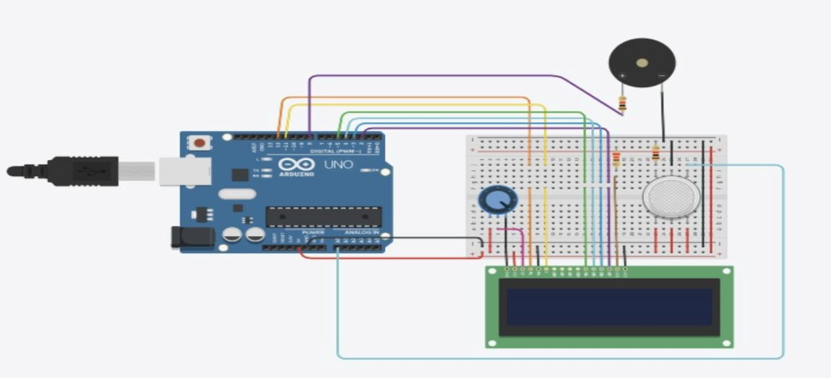
Circuit Diagram

Slide 20
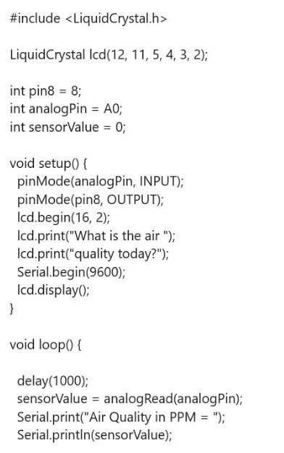
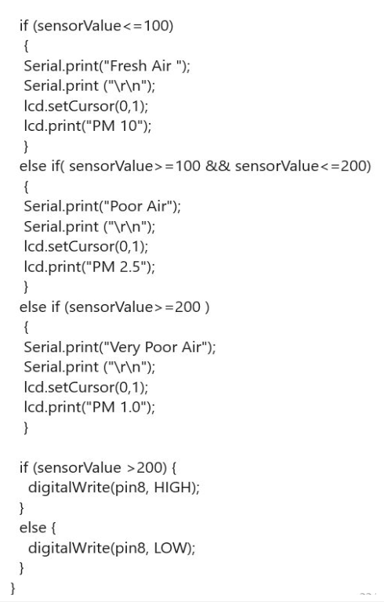
Code

Slide 21
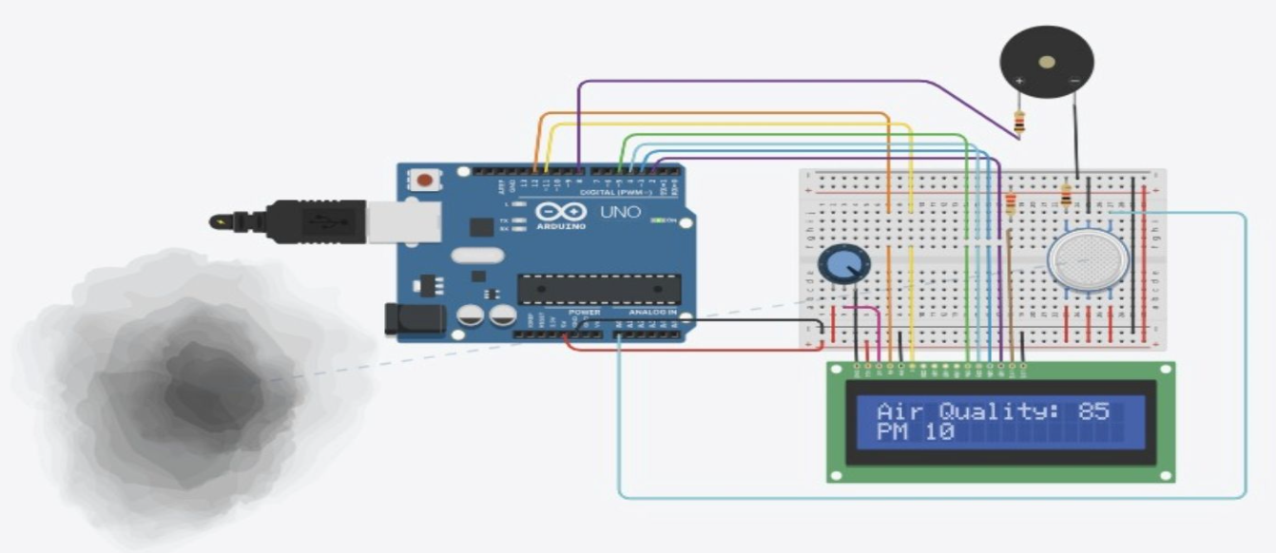
Simulation output

Slide 22
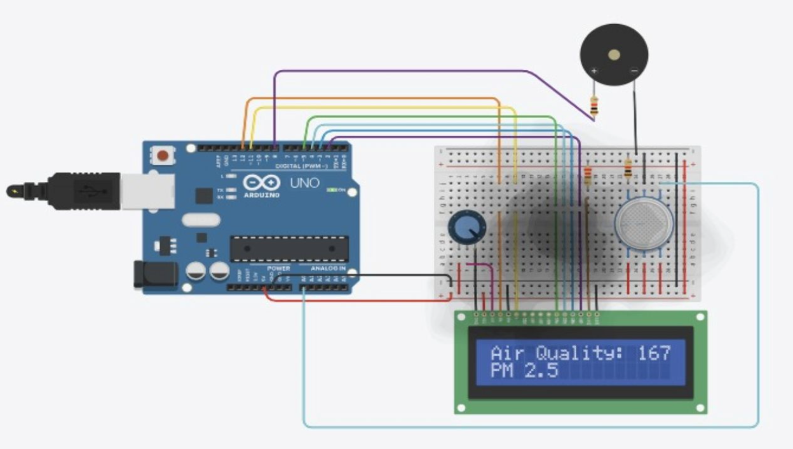
Simulation output

Slide 23
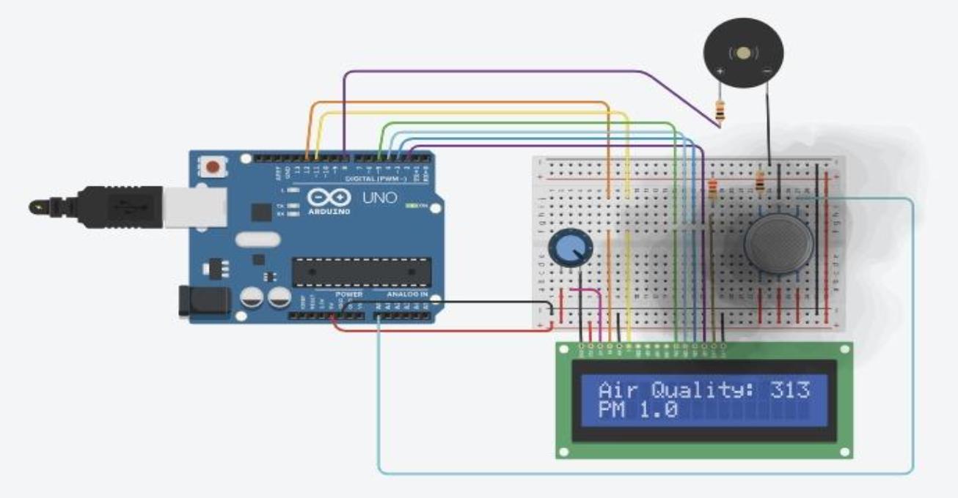
Simulation output

Slide 24
conclusion
The IoT-based Air Quality Monitoring System utilizes modern technology to combat urban air pollution by providing real-time data and insights that support informed decision-making for improved public health and environmental sustainability. By aligning with key Sustainable Development Goals—such as Good Health and Well-being (SDG 3), Sustainable Cities and Communities (SDG 11), and Climate Action (SDG 13)—the project promotes cleaner, healthier living environments. The integration of IoT ensures a scalable, cost-effective, and data-driven solution that can be deployed across various locations, enabling continuous monitoring and proactive responses to air quality challenges.

Slide 25
Impact of the project on society and environment
Society: The project improves public health by providing real-time air quality data, enabling better decision-making to mitigate air pollution risks.
Environment: It contributes to the creation of cleaner urban environments, helping reduce air pollution levels, thus supporting environmental sustainability.
Social Awareness: The project fosters awareness about air quality issues, encouraging people to take proactive steps in reducing their environmental footprint.

Slide 26
references
Saha & Singh (2017): Assesses Delhi’s preparedness for smart city development with a focus on sustainability and inclusivity.
Saha et al. (2020): Explores environmental visualization for smart urban planning in New Delhi.
Gopalaswami (2016): Analyzes how weather and traffic contribute to air pollution in Delhi.
Miles et al. (2018): Proposes an IoT-based system for monitoring and mitigating air pollution in smart cities.
Jain et al. (2018): Identifies key sources of PM10 pollution in Delhi using advanced statistical models.
Yadav et al. (2019): Studies pollutant sources in a future smart city and recommends integrated control measures.
Dwevedi et al. (2018): Highlights the role of big data in environmental monitoring for smart Indian cities.
Stankovic et al. (2012): Presents a case study on sustainable traffic-related air pollution management in Banja Luka.
NDMC Smart City Ltd. (2023): Provides an overview of smart infrastructure projects in New Delhi.
Ministry of Urban Development (2021): Lays out the urban development blueprint for Delhi’s sustainable future.

