Slide 1

SPRING QUARTER REVIEW
An Aspect-Based Hybrid YouTube Recommender System
Samyak Dubey Ashab Rahman
CI 492 · Senior Design · Drexel University · Spring 2026
Faculty Advisor: Prof. Jeff Salvage

Slide 2
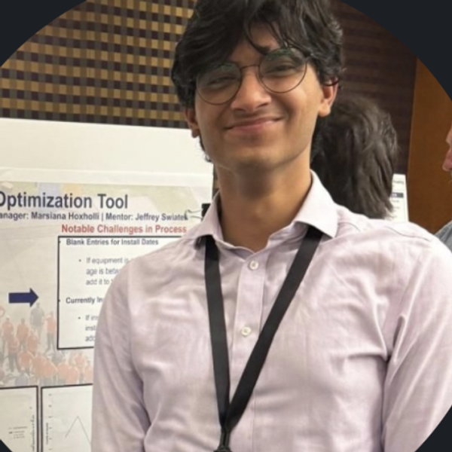

YouFeelings
THE TEAM
Meet the Team
Samyak Dubey
Ashab Rahman
ML / Data Engineer
Frontend / Integration
BERT ABSA · NCF (NeuMF) · Gaussian-Copula synthesis · YouTube scraper · AWS pipeline
React web app · Takeout parser · API integration · UI / UX · live demo
YouFeelings · Spring Quarter Review
2

Slide 3
YouFeelings
WHERE WE ARE
Agenda
01
Recap & Spring Goals
The problem, the hybrid solution, and what we set out to do
02
What We Built
YouTube scraper, Takeout parser, BERT ABSA pipeline
03
Data & Synthetic Generation
Real watch history + Gaussian Copula users
04
BERT ABSA — Results & Findings
Training statistics and the imbalance we found
05
Testing & Requirements Traceability
What is verifiably done vs. pending
06
Open Problems & Summer Plan
Risks, and the roadmap to a deployed prototype
YouFeelings · Spring Quarter Review
3

Slide 4
YouFeelings
RECAP
The Problem & Our Approach
YouTube ranks by watch-time and popularity — it never explains WHY you liked something, so it can't act on aspect-level taste.
40%
35%
25%
BERT ABSA
Neural Collaborative Filtering
Content-Based Filtering
Fine-grained aspect sentiment from comments — the WHY behind taste.
Latent user–item patterns from watch history (GMF + MLP → NeuMF).
TF-IDF cosine similarity on channel metadata — the cold-start safety net.
Weighted fusion: Final Score = 0.40·BERT + 0.35·NCF + 0.25·Content
YouFeelings · Spring Quarter Review
4

Slide 5


YouFeelings
SPRING QUARTER
Goals → Status
SRS v2.0 (40+ requirements)
Done
Introductory phases + timeline, R3.1.1–R6.2.7
YouTube Comments Scraper
Done
Quota-aware (YouTube Data API v3), graceful 403/404
Google Takeout Parser
Done
35 unit tests passing · merged to main
Synthetic Data (Gaussian Copula)
Done
103 synthetic users across 151 channels
BERT ABSA Pipeline
Done*
End-to-end; trained on bootstrap synthetic labels
NCF Model (NeuMF)
In Progress
Architecture set; training on parser output
Hybrid Fusion Layer
In Progress
Weighted ranking of all three models — actively integrating
Web App + Live Demo
In Progress
Functional prototype; demoing the end-to-end flow now
* BERT pipeline is fully built and trains end-to-end; final accuracy metrics await human-annotated labels (see Findings).
YouFeelings · Spring Quarter Review
5

Slide 6
YouFeelings
SYSTEM
Architecture
BERT ABSA
Aspect sentiment
5 heads × 4 classes
Data Sources
Weighted Fusion
React UI
Watch history (CSV)
+ scraped comments
BERT 40%
NCF 35%
Content 25%
Ranked, explained
recommendations
→
NCF (NeuMF)
→
→
GMF + MLP
user/item embeddings
Content Filter
TF-IDF cosine
on channel metadata
Data flow: inputs → three independent model scores → normalized weighted fusion → ranked recommendations served in the web app
YouFeelings · Spring Quarter Review
6

Slide 7


YouFeelings
WHAT WE BUILT
Data Acquisition Pipeline
YouTube Comments Scraper
Google Takeout Parser
Quota-aware client over the YouTube Data API v3 (10,000-unit/day budget, 500-unit safety margin).
commentThreads.list paginated to a 500-comment cap; graceful handling of HTTP 403 / 404.
English + length + spam cleaning → comments_cleaned.csv.
Parses HTML & JSON watch-history exports into a 7-column schema.
Derives an implicit rating from watch frequency (repeat views → higher).
35 unit tests passing · parser branch merged to main.
41,036
34,654
3
7
watch-history rows
unique videos
real seed users
schema columns
YouFeelings · Spring Quarter Review
7

Slide 8
YouFeelings
DATA
Synthetic Users — Gaussian Copula (SDV)
Why a Copula?
Validation Results
It models inter-channel dependencies — which channels are co-watched (e.g. Markiplier ↔ JackSepticeye) — then samples new users that preserve those co-viewing patterns, which naive perturbation cannot.
103 synthetic users 151 channels
Process
Collect diverse real users (target 10–15)
Fit GaussianCopulaSynthesizer on the binarized user–channel matrix
Generate 500–800 synthetic profiles (plan)
Validate distribution match vs. real data
Top-frequency channels match exactly; mid/low frequencies under-fit — a direct consequence of only 3 seed users.
YouFeelings · Spring Quarter Review
8

Slide 9
YouFeelings
MODEL
BERT ABSA — Architecture
YouTube Comment (raw text)
Training Configuration
▼
BERT Tokenizer — 256 tokens max
Base model
bert-base-uncased
Parameters
109.7 M
▼
bert-base-uncased — 768-dim [CLS]
Max tokens
256
Batch size
16
▼
LR (BERT layers)
2e-5
Shared Dense 768 → 256 · ReLU · Dropout 0.3
LR (heads)
1e-4
Epochs
5 (early stop, patience 2)
Content
Entertainment
Creator
Production
Informativeness
Dropout
0.3
pos / neg
neu / none
pos / neg
neu / none
pos / neg
neu / none
pos / neg
neu / none
pos / neg
neu / none
Warmup
10% linear
Split
70 / 15 / 15 stratified
5 independent softmax heads → multi-task, multi-label
YouFeelings · Spring Quarter Review
9

Slide 10
YouFeelings
RESULTS
BERT ABSA — Training Data
2,412
1,948
10
109.7M
labeled rows
unique comments
content categories
parameters
Aspect Distribution
Sentiment Split
Bootstrap dataset from a rule-based synthetic labeler — final per-aspect metrics pending human annotation.
YouFeelings · Spring Quarter Review
10

Slide 11
YouFeelings
FINDINGS
Class Imbalance — What We Found
Aspect Imbalance
Sentiment Imbalance
Creator (1,211) dominates; Production (39) is severely under-represented. The model will read creator sentiment well but stay weak on production quality.
2,141 positive vs 271 negative and zero neutral. The rule labeler has no neutral rules, so the model cannot predict neutral at all.
Category Gaps
What IS Working
Music (29) and Entertainment (33) are thin vs Self-improvement (210), risking biased predictions for under-sampled content types.
Pipeline runs end-to-end: scraper → labeler → tokenizer → BERT + 5 heads → training loop with early stopping. 70/15/15 stratified.
YouFeelings · Spring Quarter Review
11

Slide 12
YouFeelings
VERIFICATION
Testing & Requirements Traceability
Testing & Validation
Priority-1 Requirement Status
Parser unit tests — 35 passing, covering format variants & schema.
Data validation — synthetic distribution checked against real (top channels 1.00↔1.00).
BERT split — 70/15/15 with category stratification (1,363 / 292 / 293).
Schema checks on every CSV crossing a module boundary.
Component sanity — content-filter cosine, NCF loss convergence.
Data acquisition (scraper + parser)
Met
Synthetic data generation + validation
Met
BERT ABSA aspect extraction pipeline
Met
NCF user–item modeling
In progress
Hybrid weighted fusion + ranking
In progress
Web app: upload → analyze → recommend
In progress
Acceptance (per advisor rubric): demo the working system, prove Priority-1 requirements, and supply test cases.
YouFeelings · Spring Quarter Review
12

Slide 13

YouFeelings
RISKS
Open Problems
GPU training
Human annotations pending
BERT currently trains on CPU — must move to a SageMaker GPU instance for the full fine-tune.
Bootstrap labels have 0 neutral and skewed aspects; ~10–20+ human-labeled batches needed for a trustworthy model.
Thin real-user seed
Hybrid evaluation
Only 3 real users → weak mid/low channel correlations in synthetic data; need more participants (Prolific).
End-to-end HR@K / NDCG@K on held-out real users isn't measured yet — the key number for the final report.
Score calibration
Cold start
Normalizing the three score scales so the 40/35/25 weights are meaningful — the core of the fusion work in progress.
New users have no NCF signal; need a content-based fallback path until interactions accumulate.
YouFeelings · Spring Quarter Review
13

Slide 14
YouFeelings
LAST QUARTER
Summer Roadmap → Deployed Prototype
1
Human-label & retrain
Replace bootstrap labels; retrain BERT on GPU → real per-aspect metrics.
2
Build & train NCF
Train NeuMF on parser output; evaluate HR@K / NDCG@K on held-out real users.
3
Finalize fusion + profiler
Lock score normalization & 40/35/25 weights; add the per-user aspect profiler.
4
Recruit real users
Prolific crowdsourcing → richer seed → stronger synthetic data.
5
Harden & deploy
Take the working prototype to AWS (SageMaker endpoint, S3, EC2) and scale it.
6
Final report & guide
Methodology, evaluation, user guide; acceptance against Priority-1 reqs.
YouFeelings · Spring Quarter Review
14

Slide 15
YouFeelings
HOW WE WORK
Team & Project Management
Roles
Practices
Samyak Dubey — ML/Data: BERT ABSA, NCF, Gaussian Copula synthesis, scraper, AWS pipeline.
Ashab Rahman — Frontend/Integration: React app, Takeout parser, API integration, demo prep.
2-week agile sprints with demos
Git / GitHub — branch + PR review workflow
ClickUp tracking · Gantt timeline
Weekly advisor check-ins · Discord standups
Tech stack
AWS SageMaker
HuggingFace
PyTorch
SDV
scikit-learn
React.js
FastAPI
YouFeelings · Spring Quarter Review
15

Slide 16

LIVE DEMO
YouFeelings web application — current prototype walkthrough
1
2
3
4
›
›
›
Sign In
Analyzing
Taste Profile
Recommendations
Connect & upload watch history
BERT + NCF + content pipeline runs
Per-aspect preference breakdown
Ranked cards with “Why we recommend this”
youfeelings.app · powered by BERT · NCF · Content AI

Slide 17
Thank You
Questions & Discussion
Samyak Dubey · Ashab Rahman | CI 492 · Drexel University · Spring 2026

