Slide 1
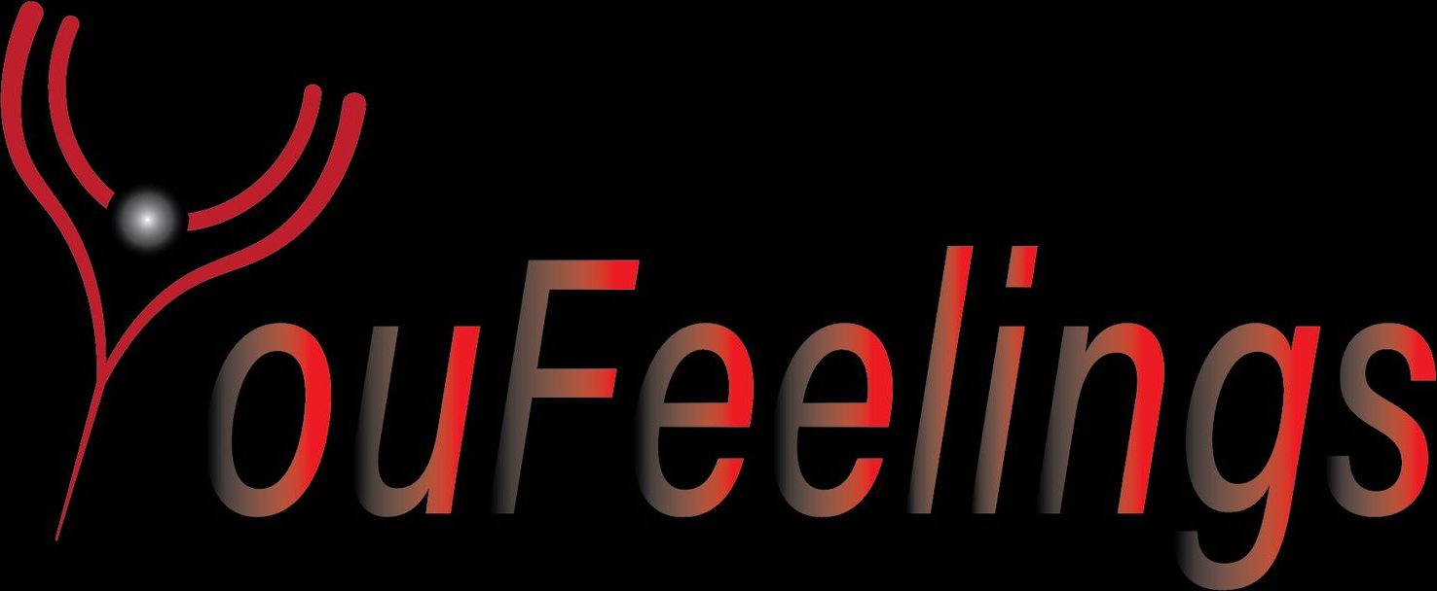
STAKEHOLDER UPDATE
Hybrid Model Rebuild — Summer Progress
Prepared for Prof. Jeff Salvage
Samyak Dubey · Ashab Rahman | CI 493 · Drexel University · August 2026
Notes:
Update on the hybrid recommender rebuild. Headline: the model is no longer a prototype on 12 channels — it now runs on 7 real users and 300 channels, with a personalization bug fixed and evaluation that previously did not exist.

Slide 2
YouFeelings
WHERE WE ARE
Scale of the Rebuild
3 → 7
12 → 300
6.5k → 28.5k
0.29 → 0.94
real participants
channel universe
analyzed comments
synthetic data fidelity
+133%
25×
4.4×
3.2×
Supporting detail
Watch history ingested
97,978 rows across 7 participants (was 41,036 across 3)
Distinct channels observed
40,594 (top 300 selected as the recommendable universe)
Channels with 2+ user overlap
166 — the collaborative signal NCF can actually learn from
Channels with aspect scores
261 of 300 (39 returned no comments after cleaning)
YouFeelings · Stakeholder Update · August 2026
2
Notes:
Every number here is measured, not projected. The 166-channel overlap figure is the one that matters for collaborative filtering — previously it was effectively 1.

Slide 3


YouFeelings
MOST IMPORTANT FINDING
The Model Was Not Actually Personalizing
What we found
What we built
The fusion layer scored every channel using a single per-channel average (bert_overall) — identical for every user. 40% of every recommendation was a constant.
A per-user aspect preference profile, derived from how the channels a user watches deviate from the global average — then matched against each candidate channel.
The aspect-based personalization — the core novelty of the product — was not implemented.
Recommendations and explanations now differ by user, and the stated reason is true.
Verified on two contrasting profiles
Education-heavy viewer
informativeness 0.61
Vsauce, Fireship
Entertainment-heavy viewer
entertainment 0.45
different set entirely
Under the old code
identical for both
MrBeast recommended to both
YouFeelings · Stakeholder Update · August 2026
3
Notes:
This is the single most consequential finding of the summer. The product claim and the implementation had diverged. It is now fixed and demonstrated on contrasting user profiles.

Slide 4




YouFeelings
HYBRID MODEL
Improvements by Component
BERT — Aspect Sentiment
NCF — Collaborative Filtering
Training was blocked by a code defect (data loaders unreachable). Fixed, retrained on GPU. Now reports per-aspect F1 and an honest metric that excludes the dominant 'none' class.
Had no evaluation at all. Added leave-one-out HR@K / NDCG@K against a popularity baseline — and caught a train/test leak that was inflating results to a perfect 1.000.
Content-Based Filtering
Fusion Layer
Replaced a category-share stand-in (which covered only 12 of 261 channels) with TF-IDF over channel metadata, as the SRS specifies. Now covers the full catalog.
Personalized aspect profiling, score normalization before weighting, reliability weighting per aspect, and graceful degradation when a signal is unavailable.
YouFeelings · Stakeholder Update · August 2026
4
Notes:
Each component had a specific defect or gap. All four are addressed. The NCF leak is worth calling out: metrics were pinning at exactly 1.000, which is a bug signature, not a result.

Slide 5
YouFeelings
ENGINEERING
Infrastructure & Data Collection
Scraper efficiency
Cold start solved
Restructured the collection route: 1,206 API quota units instead of ~30,000 — a 25× saving. All 300 channels collected in one day rather than three.
A first-time visitor has no collaborative history. Their taste profile is built from their own upload and the missing signal's weight is redistributed — no fabricated data.
Participant privacy
Deployed in parallel
Watch histories are pseudonymized at ingest (user_001…), with the identity map held outside the training data. Duplicate submissions detected and removed by content hash.
The new pipeline runs on separate cloud resources alongside the existing one, so the current system is never at risk and the two can be compared.
Serving layer
Backups & recovery
Six compact artifacts (306 KB total) sized for fast cold start, with synthetic users excluded from anything served.
Full backup of all deployed code and prior model artifacts; storage versioning enabled so overwrites are now recoverable.
YouFeelings · Stakeholder Update · August 2026
5
Notes:
The scraper saving is what made the 25x channel expansion feasible within a student API quota. Privacy handling is worth noting given we collected data from real participants.

Slide 6

YouFeelings
WHAT WE ARE NOT CLAIMING
Known Limitations
These are reported deliberately. Each is a data limitation, not a defect in the system.
Training labels are the ceiling
Small participant sample
Labels came from a rule-based generator, not human annotation. It produced no 'neutral' examples at all and only 33 for one aspect — so the model cannot learn those categories regardless of training time. Model quality now depends on annotation, not engineering.
Held-out evaluation on 7 real users is directional only; the error bars are wide. We report it with that caveat rather than as a headline accuracy figure.
Evaluation regime is favourable
Sentiment scores not yet validated
A popularity-only baseline also scores highly, which indicates the current test is easy given how densely our participants' viewing overlaps. Harder evaluation is a next step.
Scores across 261 channels come from a model trained on 12. They are usable for ranking; we do not present them as validated sentiment.
YouFeelings · Stakeholder Update · August 2026
6
Notes:
Presenting these directly is deliberate. Each is a data constraint we can name precisely, which is stronger than a headline metric we cannot defend under questioning.

Slide 7
YouFeelings
RIGHT NOW
Active Work
1
Deploying the new pipeline
In progress
Parallel cloud deployment is created and configured. Currently resolving a permissions issue on the new functions so they can run and log correctly.
2
System testing with Ashab
In progress
Working through his system test list manually, capturing screenshots and writing up results as test documentation. Automated scripts to follow for the cases that support it.
3
Human annotation
Starting
Preparing a stratified sample of comments for Ashab and me to label independently, with a shared subset to measure inter-annotator agreement. This is the binding constraint on model quality.
4
Documentation alignment
Queued
Updating the SRS and design documents to match the delivered system — new figures, and removing limitations we have now resolved.
YouFeelings · Stakeholder Update · August 2026
7
Notes:
Testing is being done manually first, with screenshots, per Ashab's request — scripted tests follow for the cases that support automation.

Slide 8


DISCUSSION
Where we would value your input
Annotation scope
Intellectual property
Participant recruitment
How many labeled comments would you consider sufficient for the final report — and is a two-annotator agreement study the right level of rigour here?
We would like a pointer to the right office at Drexel regarding protecting the work, given the aspect-profiling method.
Seven participants limits what we can claim statistically. Any avenue for reaching more would materially improve the evaluation.
Thank you — happy to walk through any of this in detail
Samyak Dubey · samyakdubeyusa@gmail.com
Notes:
Three concrete asks: annotation scope, the IP pointer, and help reaching more participants.

