Slide 1

Application Programming Interface (API)
1 hour training

Slide 2
Application Programming Interface
1 hour training
Application Programming Interface
1 hour training

Slide 3
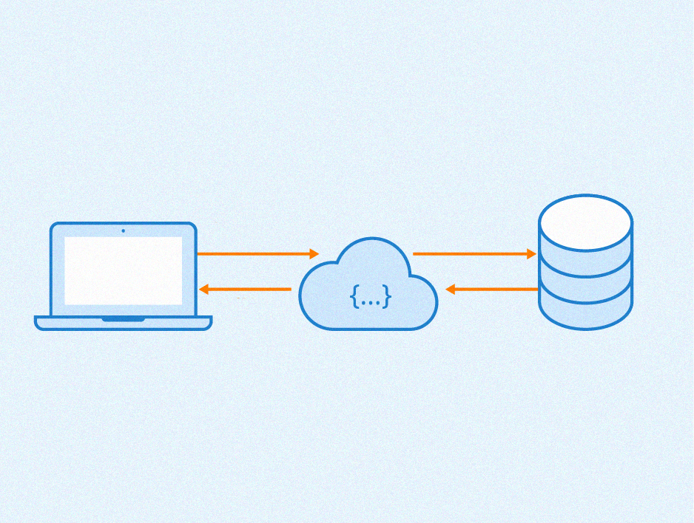

Slide 4



In this context, request means
In this context, request means access data using a web address
Make a request
Query data
Webservice
Provides data
Export data
User or Application
Database
In most of the cases the data requested is exported in JSON or XML format

Slide 5
Converting table fomart to JSON fomart
{
"Fast Food": "McDonald's",
"Address" : "Av. Prof. Abraão de Morais, 1180",
"Latitude" : -23.614336,
"Longitude": -46.627574} ,
{
"Fast Food": "Burger King ",
"Address" : "Av. dos Bandeirantes",
"Latitude" : -23.616679,
"Longitude": -46.6642382}
Fast Food | Address | Latitude | Longitude
McDonald’s | Av. Prof. Abraão de Morais, 1180 | -23.614336 | -46.627574
Burger King | Av. dos Bandeirantes | -23.616679 | -46.6642382

Slide 6
Keys
Values
{
"Fast Food" : "McDonald's",
"Address" : "Av. Prof. Abraão de Morais, 1180",
"Latitude" : -23.614336,
"Longitude" : -46.627574
}
Separated by comma
Beginning of the document
Each key is followed by colon
End of the document

Slide 7
Converting JSON fomart to GEOJSON fomart
{
"Fast Food": "McDonald's",
"Address" : "Av. Prof. Abraão de Morais, 1180",
"Latitude" : -23.614336,
"Longitude": -46.627574} ,
{
"type": "Feature",
"geometry": {
"type" : "Point",
"coordinates": [-23.614336, -46.627574]
},
"properties": {
"Fast Food": " McDonald’s",
"Address" : "Av. Prof. Abraão de Morais, 1180",
}
}

Slide 8
