Slide 1
Loan Quickr Pickr
Aaron Bradley

Slide 2





P2P Lending
$
1 Borrower
$$$
Many Lenders
Predict Return on Investment
Predict When Loan Will Default
People courtesy of clipart panda – dramatization

Slide 3
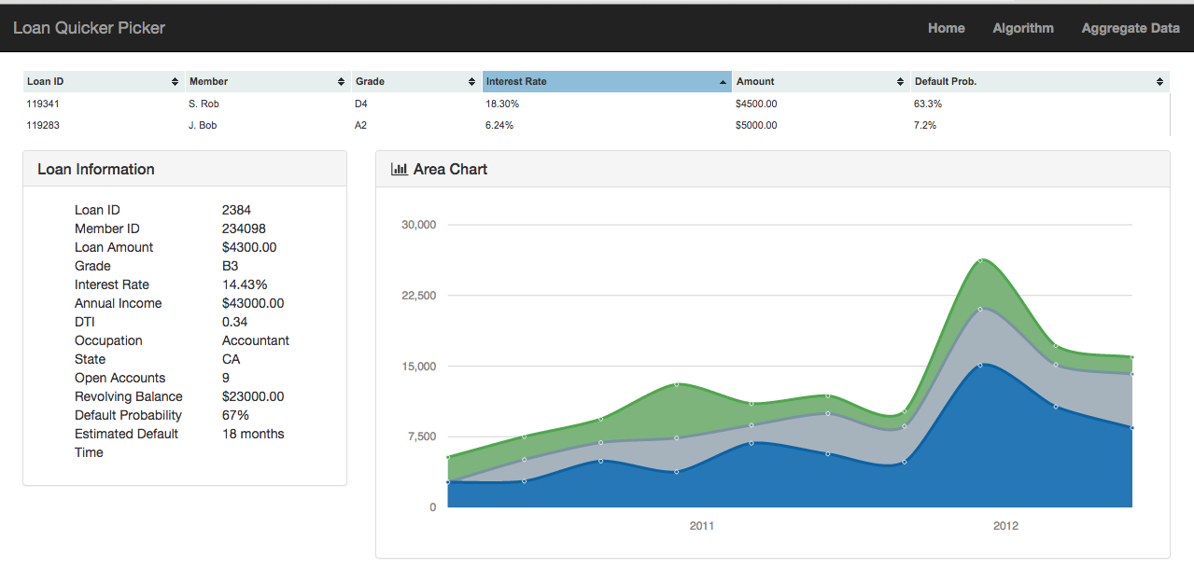
Table of Available Loans
PLUS
Recommendation on
Which loans to Invest In
Probability of Default
1.0
0.75
0.50
0.25
0
Individual Loan Detail
Probability of Default By Month

Slide 4
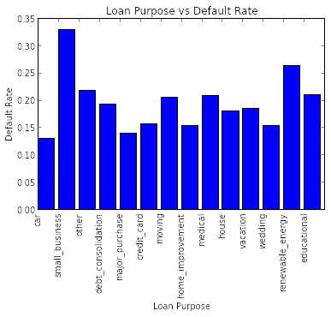
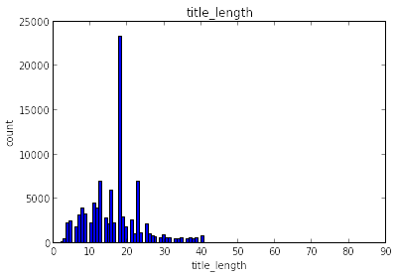
“Debt Consolidation”
19% overall default rate by # of loans
Most common purposes: debt consolidation, credit cards
Least common purposes: education, renewable energy

Slide 5
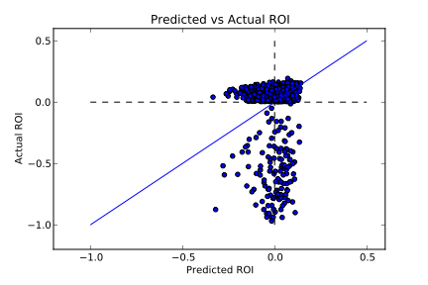
Algorithm
Grade A Loans
Data
> 99,000 loans since 2007
Credit profile on every borrower
50 features + economic data
Split 60/20/20 Train/CV/Test
R² = -0.005
Algorithm
Linear Regression
Random Forest
~Random Prediction
Perfect Prediction

