Slide 1
Data Plots
Raw data
Full dataset
Only finished loans (ie not in progress)
Default Rates are for number of loans defaulting, not $ value (yet)

Slide 2
Data Insights
80% of loans have 36 month terms
Most common subgrade is B3
27% of applicants employed 10+ years
63% of applicants have income verified
19% overall default rate by # of loans
7 applicants on a payment plan
Most common purposes: debt consolidation, credit cards
Least common purposes: education, renewable energy
CA has most borrowers, ME the fewest
Some people have had up to 29 delinquencies in the past 2 years
As many as 33 inquiries in the last 6 months
As many as 50 open accounts
As many as 99 total accounts
12% of loans are funded in whole by 1 investor
24% of loan titles have 18 characters
Small business loans are most likely to default, followed by renewable energy loans
While the default rate drops with increasing income, the interest rate actually rises

Slide 3
Data Insights
80% of loans have 36 month terms
Most common subgrade is B3
27% of applicants employed 10+ years
63% of applicants have income verified
19% overall default rate by # of loans
7 applicants on a payment plan
Most common purposes: debt consolidation, credit cards
Least common purposes: education, renewable energy
CA has most borrowers, ME the fewest
Some people have had up to 29 delinquencies in the past 2 years
As many as 33 inquiries in the last 6 months
As many as 50 open accounts
As many as 99 total accounts
12% of loans are funded in whole by 1 investor
24% of loan titles have 18 characters
Small business loans are most likely to default, followed by renewable energy loans
Of the loans that are fully paid, 77% are prepaid

Slide 4
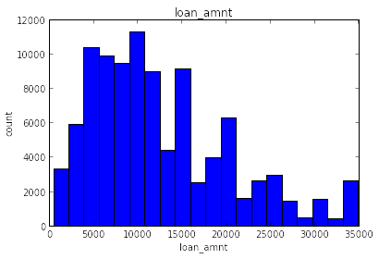
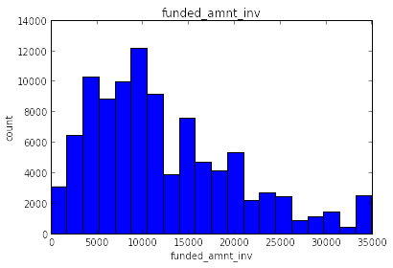

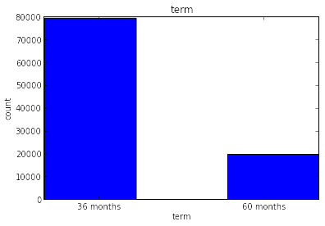

Slide 5
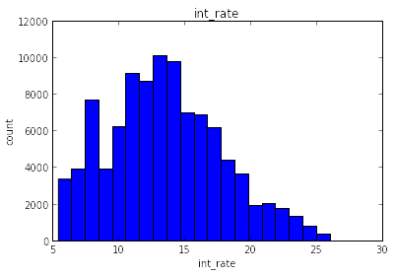
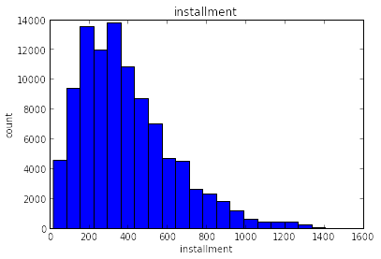
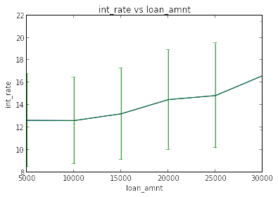
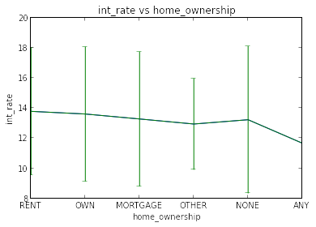

Slide 6
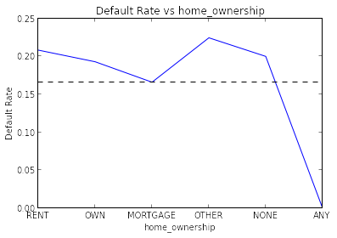
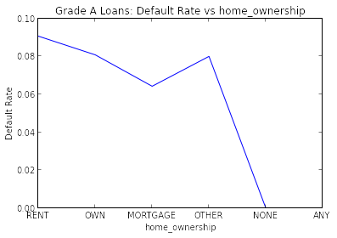
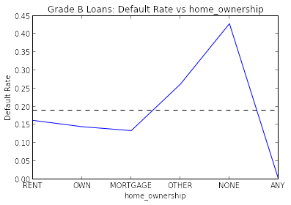
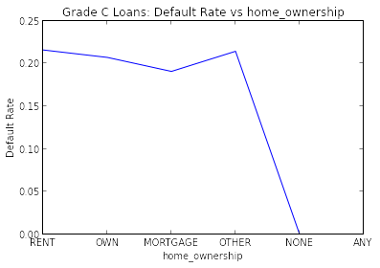

Slide 7
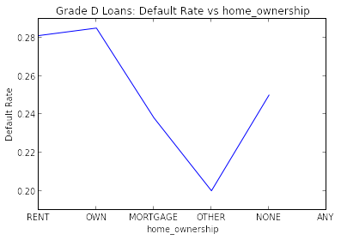
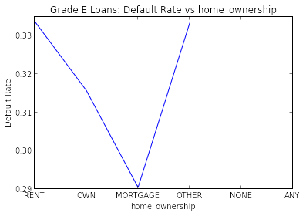
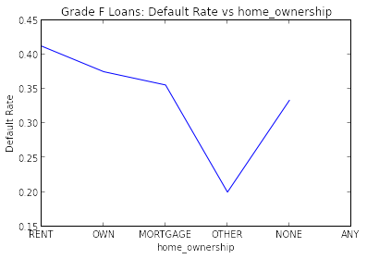
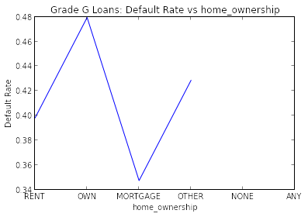

Slide 8
Overall:
Fully Paid 78832
Charged Off 17676
Does not meet the credit policy. Status:Fully Paid 1906
Does not meet the credit policy. Status:Charged Off 752
Default 100
Grade F Loans
Fully Paid 1806
Charged Off 1109
Does not meet the credit policy. Status:Fully Paid 146
Does not meet the credit policy. Status:Charged Off 91
Default 9
Grade A Loans
Fully Paid 17165
Charged Off 1390
Does not meet the credit policy. Status:Fully Paid 88
Does not meet the credit policy. Status:Charged Off 8
Default 5
Grade G Loans
Fully Paid 434
Charged Off 265
Does not meet the credit policy. Status:Fully Paid 117
Does not meet the credit policy. Status:Charged Off 71
Default 1
Grade B Loans
Fully Paid 25463
Charged Off 4339
Does not meet the credit policy. Status:Fully Paid 263
Does not meet the credit policy. Status:Charged Off 84
Default 20
Grade C Loans
Fully Paid 18523
Charged Off 4675
Does not meet the credit policy. Status:Fully Paid 471
Does not meet the credit policy. Status:Charged Off 148
Default 33
Grade D Loans
Fully Paid 10831
Charged Off 3817
Does not meet the credit policy. Status:Fully Paid 474
Does not meet the credit policy. Status:Charged Off 195
Default 18
Grade E Loans
Fully Paid 4610
Charged Off 2081
Does not meet the credit policy. Status:Fully Paid 347
Does not meet the credit policy. Status:Charged Off 155
Default 14

Slide 9
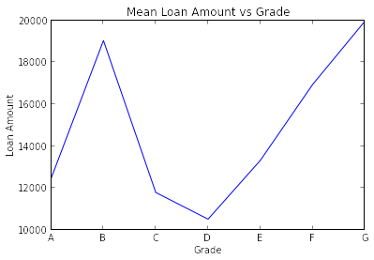
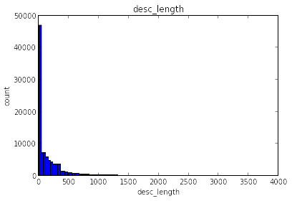
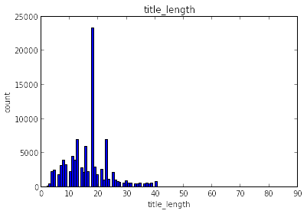
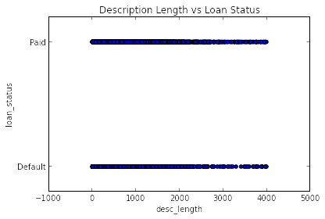

Slide 10
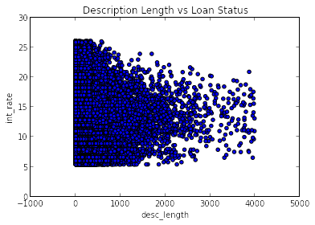
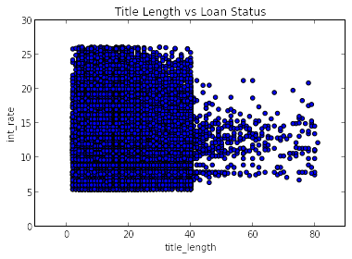
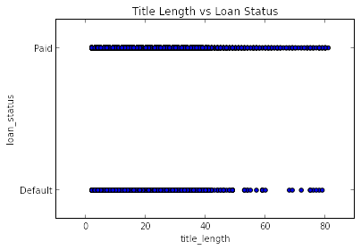
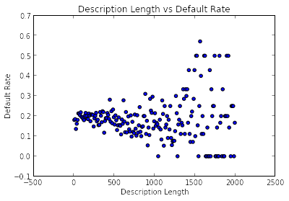

Slide 11
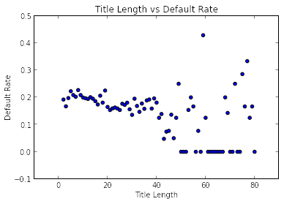
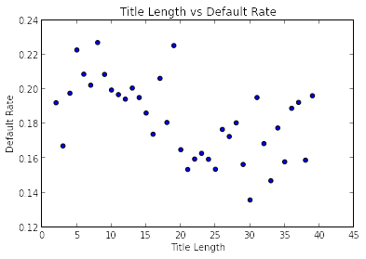
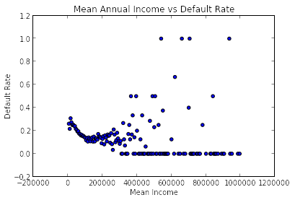
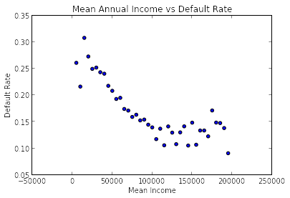

Slide 12
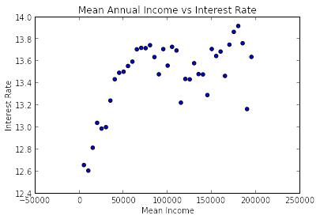

Slide 13
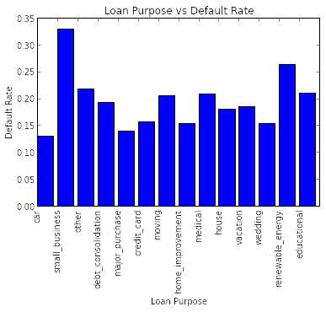

Slide 14
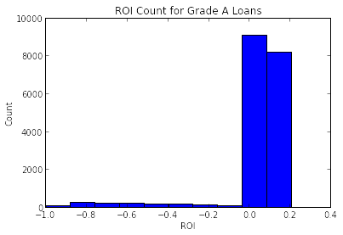
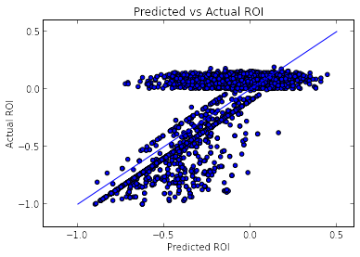

Slide 15
20150122 - Random Forest Parameter Exploration
N = 100 trees
All 36 month loans, all features:
  R2_training = 0.95
  R2_testing = 0.59

