Slide 1
COMILLA UNIVERSITY :: DEPARTMENT OF COMPUTER SCIENCE AND ENGINEERING
SmartML Advisor
An Intelligent Machine Learning Algorithm Recommendation System
Submitted by Abu Bakar Rafi (ID: 12208039)
Supervisor Md. Zahidur Rahman, Lecturer, Dept. of CSE
CSE-3210 :: Software Project Lab (SPL) | August 2026

Slide 2
AGENDA
Presentation Outline
1
Motivation
9
Methodology & Design
2
Problem Statement
10
System Development
3
Aim & Objectives
11
Database Design
4
Existing System
12
Testing & Validation
5
Proposed System
13
Results & Discussion
6
Related Works
14
Conclusion
7
Technologies Used
15
Limitations
8
System Architecture
16
Future Work
SmartML Advisor
2

Slide 3
CHAPTER 1
Motivation
Algorithm selection is critical in student projects & early-stage prototypes, yet remains scattered across notebooks, blogs, and ad-hoc peer advice.
Beginners rarely understand the assumptions behind different ML algorithms.
Goal: combine automated dataset analysis with transparent, rule-based guidance in one accessible web app.
Every recommendation is traced back to a human-readable rule — not a hidden statistical score.
“
Transparent reasoning reduces blind trial-and-error and builds real understanding of algorithm behavior.
— Core motivation behind SmartML Advisor
SmartML Advisor
3

Slide 4
CHAPTER 1
Problem Statement
Beginners don't understand the assumptions behind different algorithms.
Manual trial-and-error doesn't scale as candidate algorithms grow.
Existing AutoML systems are computationally expensive and act as black boxes.
Missing values, class imbalance, and problem type are rarely checked before an algorithm is chosen.
Core Problem
No secure, traceable, database-driven system exists that profiles a dataset and explains — in plain language — why one algorithm suits it better than another.
SmartML Advisor
4

Slide 5
CHAPTER 1
Aim & Objectives
Aim: Build a reliable, database-driven platform that helps users select the most suitable ML algorithm through transparent, rule-based reasoning.
1
2
3
Secure multi-user authentication (registration, login, sessions)
Automated data profiling of CSV/Excel datasets
Rule-based scoring engine to rank ML algorithms
4
5
6
Transparent, human-readable justifications
Reference library of algorithm strengths & weaknesses
Persistent history of uploads, recommendations & feedback
SmartML Advisor
5

Slide 6
CHAPTER 2
Existing System
Manual Trial-and-Error
Full AutoML Systems
Meta-Learning Recommenders
Try several algorithms via scikit-learn and compare metrics informally.
e.g. Auto-sklearn — automatically searches algorithms & hyperparameters.
Use dataset meta-features to predict the best algorithm.
+ Flexible, no setup
+ Highly competitive models
+ Data-driven accuracy
− Doesn't scale; no explanation
− Expensive & black-box
− Needs large historical meta-dataset
SmartML Advisor
6

Slide 7
CHAPTER 2
Proposed System — SmartML Advisor
Secure, authenticated web portal with JWT sessions & bcrypt hashing
1
Automated dataset profiling: rows/columns, types, missing values, duplicates, class balance
2
Rule-based scoring engine ranking algorithms with a human-readable reason per rule
3
Independent algorithm reference library, browsable without any upload
4
Persistent upload/recommendation history and user feedback in a normalized MySQL database
5
SmartML Advisor
7

Slide 8
CHAPTER 2
Related Works — Feature Gap
Feature | Manual Trial-and-Error | AutoML (Auto-sklearn) | SmartML Advisor
Secure multi-user portal | No | Varies | Yes
Automated dataset profiling | Manual | Yes | Yes
Rule-based explainable scoring | No | No | Yes
Human-readable reasons | No | No | Yes
Algorithm reference library | No | No | Yes
Upload/recommendation history | No | Varies | Yes
Instant result without training | Varies | No | Yes
SmartML Advisor
8

Slide 9
CHAPTER 2
Technologies Used
FastAPI (Python)
MySQL + SQLAlchemy
JWT + bcrypt
Backend routing, validation, business logic
12-table relational schema via ORM
Session tokens & password hashing
pandas / NumPy / SciPy
scikit-learn
Groq API (llama-3.1-8b-instant)
Dataset loading & statistical profiling
Algorithm reference & scoring criteria
Auxiliary AI chat assistant
Jinja2 + Uvicorn
Server-side templates & ASGI server
SmartML Advisor
9

Slide 10
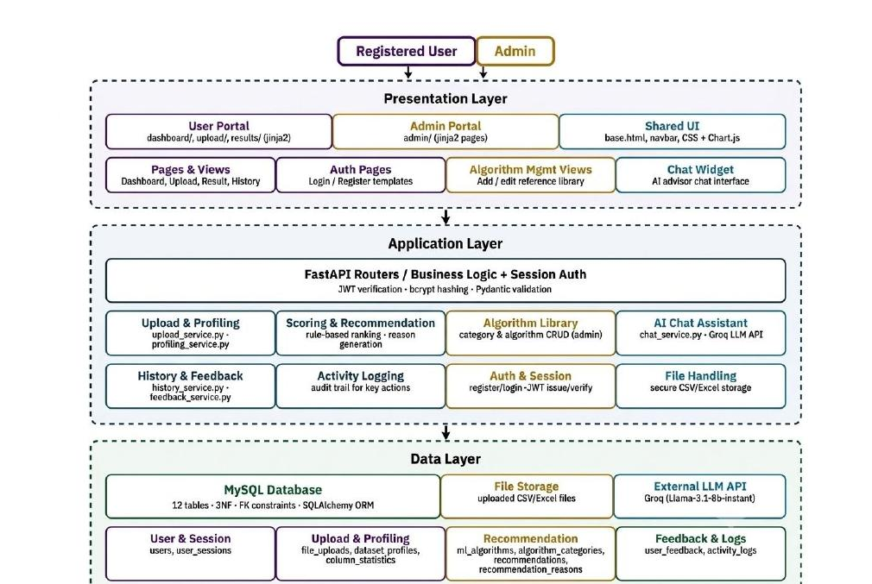
CHAPTER 3
System Architecture
Three-Tier Design
Presentation: Browser + Jinja2 templates
Application: FastAPI routers, services, JWT/bcrypt auth
Data: MySQL (12 tables), file storage, external Groq LLM API
SmartML Advisor
10

Slide 11
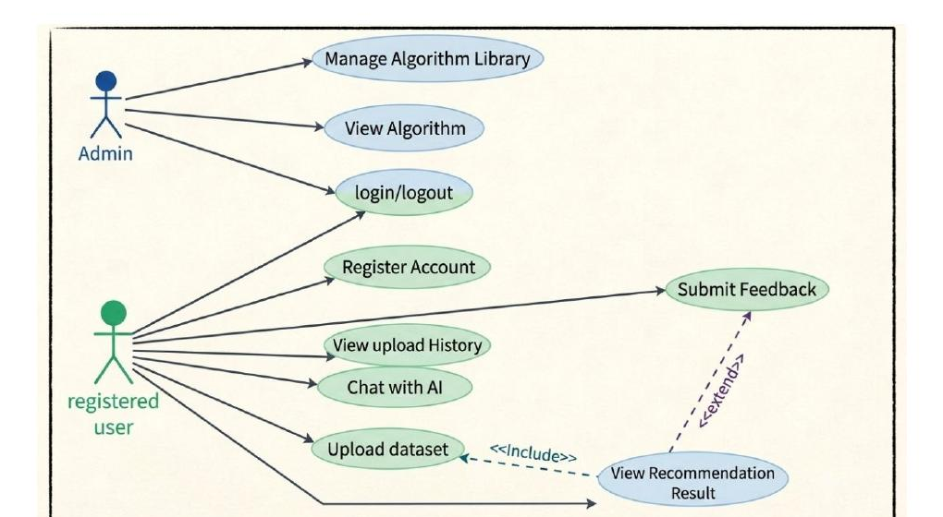
CHAPTER 3 · METHODOLOGY & DESIGN
Use Case Diagram
Registered User: register, login, upload, view results, browse library, history, feedback, chat | Admin: adds algorithm-library management
SmartML Advisor
11

Slide 12
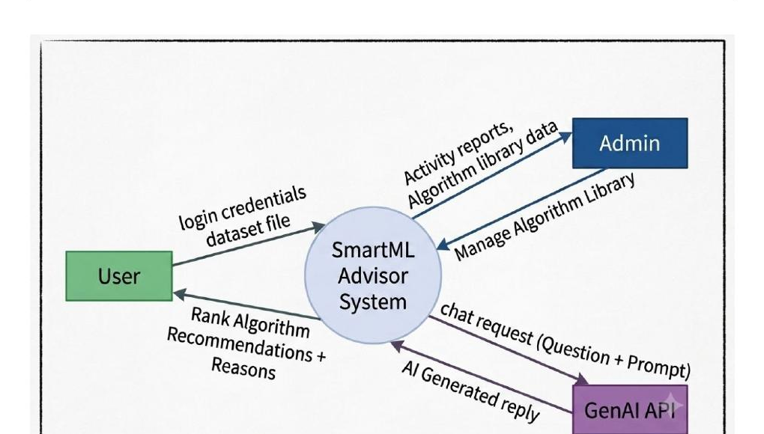
CHAPTER 3 · METHODOLOGY & DESIGN
Context Diagram (Level-0 DFD)
SmartML Advisor as one process exchanging data with the User, Admin, and the external GenAI API
SmartML Advisor
12

Slide 13
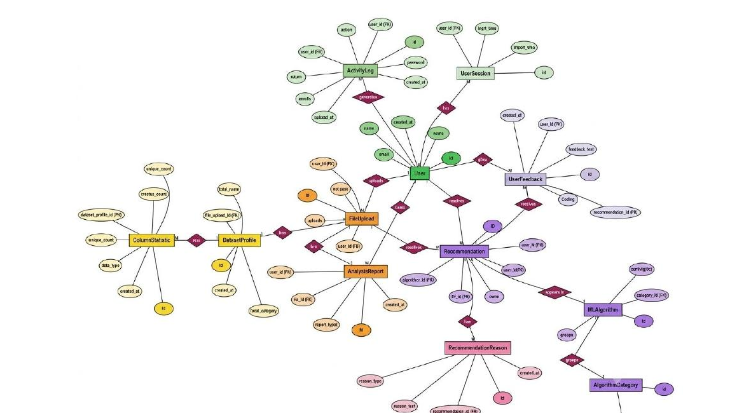
CHAPTER 3 · METHODOLOGY & DESIGN
Entity-Relationship Diagram
12 relational tables spanning identity, upload/profiling, recommendation, and feedback/auditing groups
SmartML Advisor
14

Slide 14
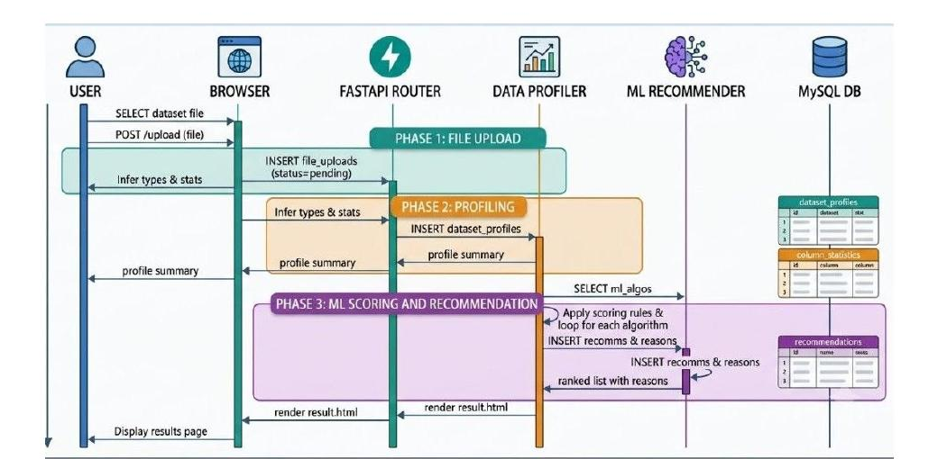
CHAPTER 3 · METHODOLOGY & DESIGN
UML Sequence Diagram
Upload → Profile → Score → Persist → Display, across Browser, FastAPI Router, Data Profiler, ML Recommender, and MySQL
SmartML Advisor
15

Slide 15
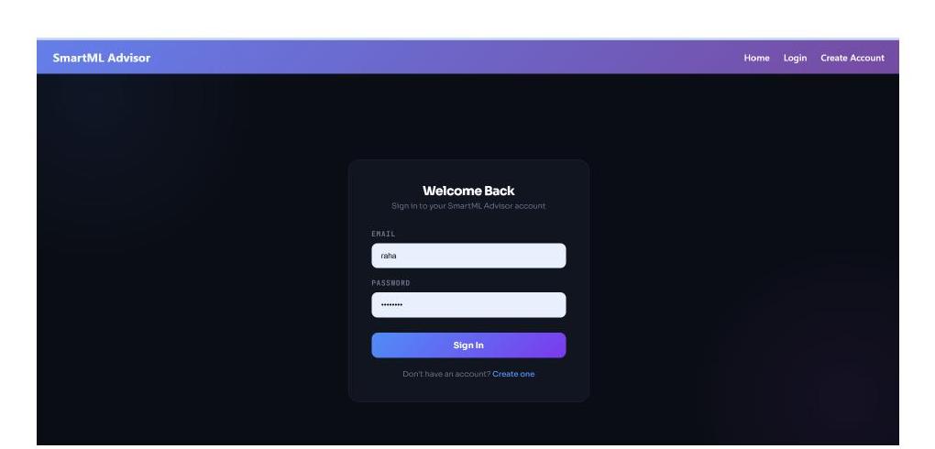
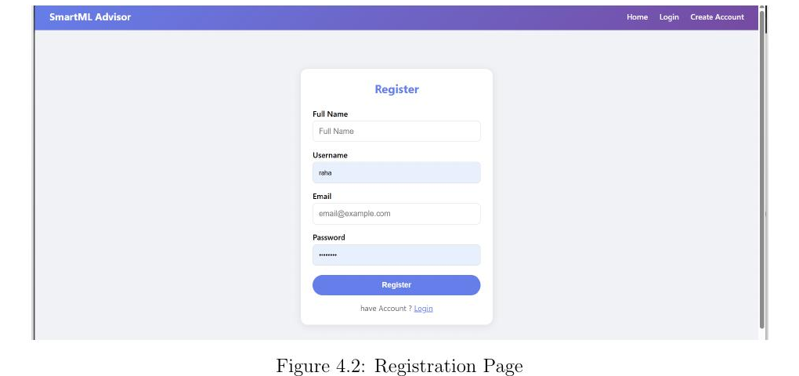
CHAPTER 4 · SYSTEM DEVELOPMENT
Authentication Flow
Login Page
Registration Page
SmartML Advisor
16

Slide 16
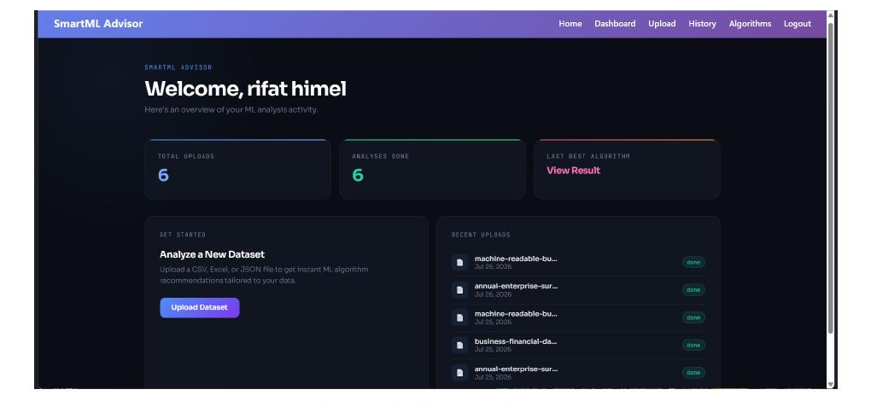
CHAPTER 4 · SYSTEM DEVELOPMENT
User Dashboard
Central hub for uploads, recommendations, reference library, history & chat assistant
SmartML Advisor
17

Slide 17
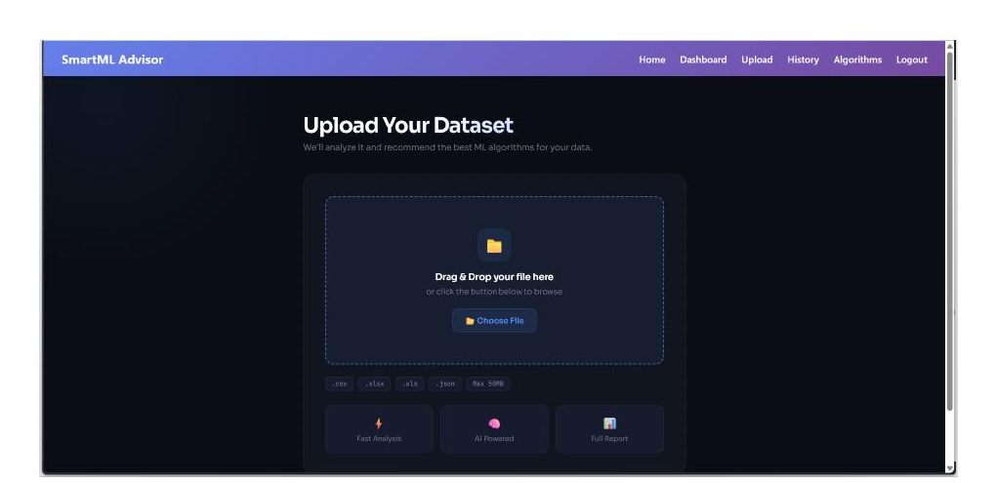
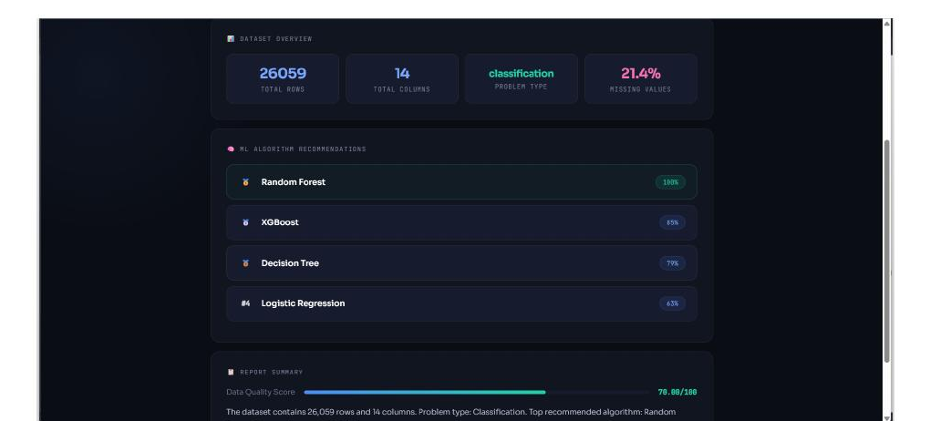
CHAPTER 4 · SYSTEM DEVELOPMENT
Upload → Recommendation Result
Dataset Upload
Ranked Algorithms with Suitability Scores
SmartML Advisor
18

Slide 18
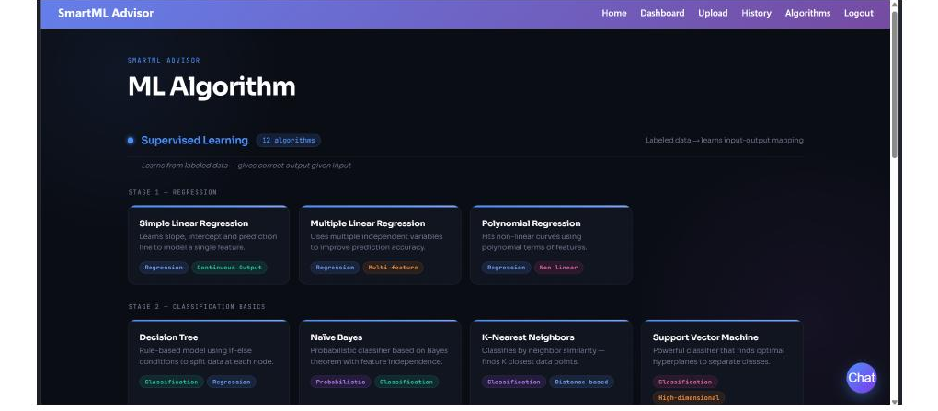
CHAPTER 4 · SYSTEM DEVELOPMENT
Algorithm Reference Library
Browsable by category (Classification, Regression, Clustering, Dim. Reduction, Association) — independent of any dataset upload
SmartML Advisor
19

Slide 19
CHAPTER 3-4
Database Design
Identity
12
users, user_sessions
Relational Tables
PK / FK constraints · ON DELETE CASCADE / SET NULL
Algorithm Reference
algorithm_categories, ml_algorithms
Upload & Profiling
file_uploads, dataset_profiles, column_statistics
Normalization Path: 1NF → 2NF → 3NF — full breakdown after the CRUD/JOIN evidence.
Recommendation
recommendations, recommendation_reasons, analysis_reports
CRUD + INNER / LEFT / RIGHT / simulated FULL OUTER / NATURAL JOINs demonstrated on live data
Feedback & Auditing
user_feedback, activity_logs
SmartML Advisor
20

Slide 20
CHAPTER 3-4
Database Normalization
1NF
2NF
3NF
Atomic values
No partial dependency
No transitive dependency
Boolean and status fields store a single atomic value instead of combined or multi-valued data.
Every non-key attribute depends on the whole primary key, never on just part of a composite key.
Reference and category data is kept in its own table rather than duplicated through a non-key attribute.
Presenter cue: walk through 1NF → 2NF → 3NF as evidence the schema is structured, consistent and ready for reliable JOINs.
SmartML Advisor
26

Slide 21
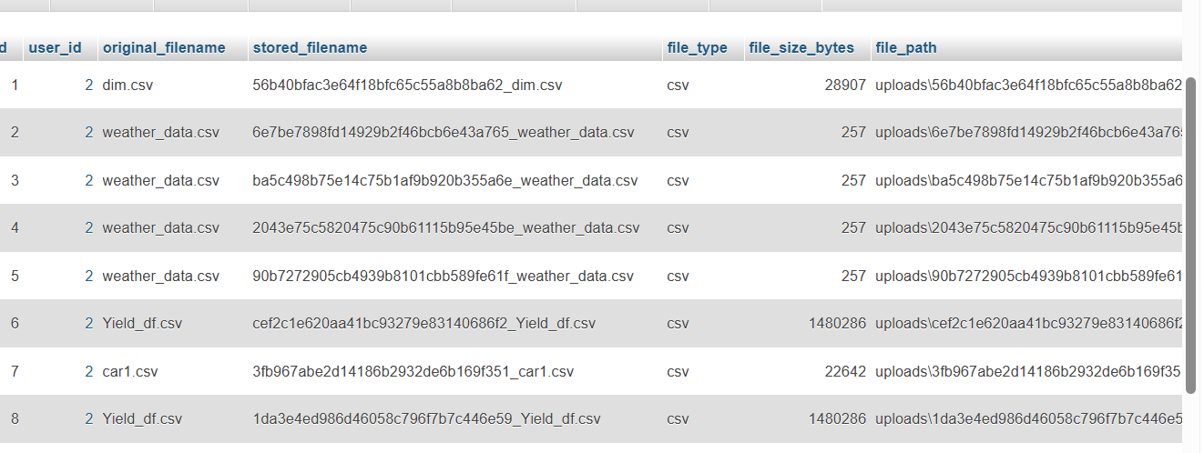
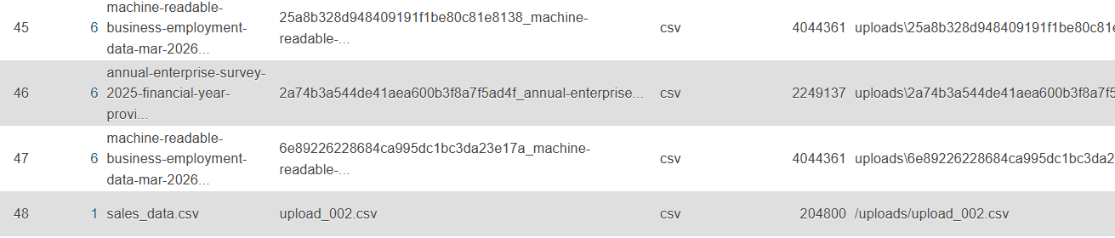
CHAPTER 4 · SYSTEM DEVELOPMENT
Database CRUD Operations — Read & Create
READ — Initial file_uploads State
CREATE — After Inserting New Upload
READ retrieves existing rows unchanged; CREATE inserts a new upload record with a new auto-incremented ID.
SmartML Advisor
21

Slide 22
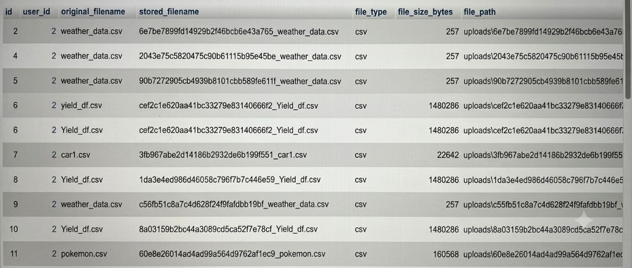
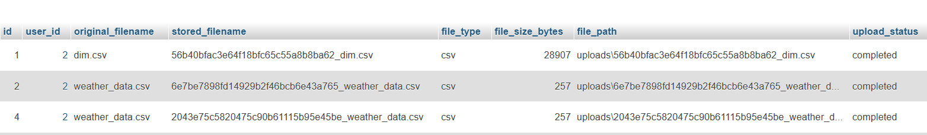
CHAPTER 4 · SYSTEM DEVELOPMENT
Database CRUD Operations — Update & Delete
UPDATE — After Changing upload_status
DELETE — After Removing Test Upload
UPDATE modifies selected values while preserving row identity; DELETE removes the targeted test record.
SmartML Advisor
22

Slide 23
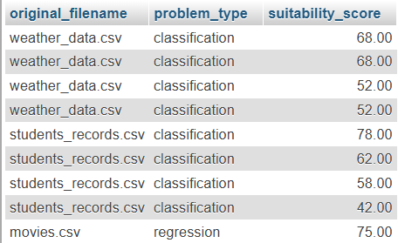
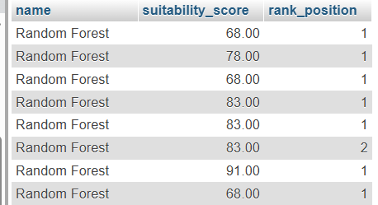
CHAPTER 4 · SYSTEM DEVELOPMENT
SQL JOIN Operations — INNER & LEFT JOIN
INNER JOIN — Uploads, Profiles & Recommendations
LEFT JOIN — ml_algorithms & recommendations
INNER JOIN returns only matching rows across all tables; LEFT JOIN keeps every algorithm, even those never recommended.
SmartML Advisor
23

Slide 24
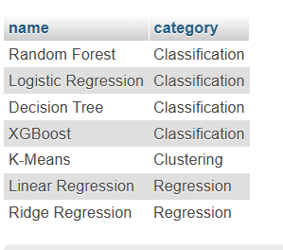
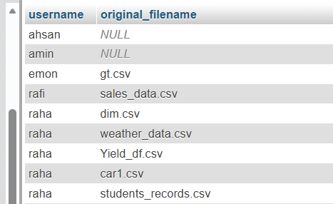
CHAPTER 4 · SYSTEM DEVELOPMENT
SQL JOIN Operations — RIGHT & FULL OUTER JOIN
RIGHT JOIN — ml_algorithms & algorithm_categories
FULL OUTER JOIN (simulated) — Users & Uploads
RIGHT JOIN preserves every category; MySQL lacks native FULL OUTER JOIN, so it is simulated via LEFT JOIN + RIGHT JOIN + UNION.
SmartML Advisor
24

Slide 25
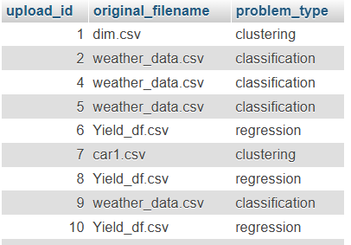
CHAPTER 4 · SYSTEM DEVELOPMENT
SQL JOIN Operations — NATURAL JOIN
Matches views on the shared upload_id attribute, avoiding accidental matches on generic id columns.
SmartML Advisor
25

Slide 26
CHAPTER 5
Testing & Validation
18 / 18
Authentication & sessions
Dataset upload & profiling
Recommendation scoring & ranking
History & feedback
Chat assistant (Groq API)
Functional test cases passed
Non-Functional Checks
JWT-protected routes reject missing/invalid tokens
Passwords verified via bcrypt (never stored in plain text)
SQLAlchemy ORM parameterized operations prevent SQL injection
Datasets sampled up to 50,000 rows for responsiveness
Failed Groq API call doesn't crash the recommendation workflow
Uploads/ownership scoped strictly per authenticated user
SmartML Advisor
27

Slide 27
CHAPTER 5
Results & Discussion
26,059
100%
9
rows profiled
(weather_data.csv example)
Random Forest suitability
(top-ranked, handles missing values)
real-world datasets tested
across all three problem types
Classification datasets (weather_data.csv, students_records.csv) correctly favored Random Forest, Decision Tree, XGBoost.
Regression datasets (Yield_df.csv, Real_Combine.csv) favored Linear/Ridge Regression and Random Forest Regressor.
Datasets without a clear target (bal2.csv, car1.csv) were correctly routed to clustering algorithms (K-Means, DBSCAN).
Algorithms unsuited to high-missing-value data (Logistic Regression, SVM) were consistently penalized — with stored, readable reasons.
SmartML Advisor
28

Slide 28
CHAPTER 6
Conclusion
Achieved the objective of a database-centered, explainable ML algorithm recommendation platform.
Connects secure authentication, profiling, rule-based scoring, reference library, and history/feedback through one shared MySQL database.
Demonstrates core DBMS concepts: entity modeling, FK constraints with cascades, normalization to 3NF, all major JOIN types, ORM-based access.
The scoring engine's most distinctive contribution: translating algorithm selection from a black-box decision into a structured, traceable, explainable relational design.
SmartML Advisor
29

Slide 29
CHAPTER 6
Limitations
Fixed, hand-crafted scoring rules — not a learned meta-model.
Problem-type detection uses simple heuristics (target column name / last column).
Large datasets sampled to a maximum of 50,000 rows during profiling.
Recommended algorithms are not actually trained/evaluated on the user's data — scoring is purely meta-feature based.
AI chat assistant depends on a third-party hosted LLM (Groq API), adding external latency/availability risk.
Testing is manual and scenario-based (18 cases); automated unit/security/performance tests are not yet comprehensive.
SmartML Advisor
30

Slide 30
CHAPTER 6
Future Work
Optionally train top-ranked algorithms on a sample of the user's data and report real performance metrics (accuracy, F1, RMSE).
Incorporate a trained meta-learning model using historical feedback to refine rule-based scores.
Generate concrete preprocessing recommendations (imputation, encoding) from the stored dataset profile.
Add streaming/chunked processing to support datasets beyond the 50,000-row limit.
Build an administrative dashboard for algorithm-library management and activity monitoring.
Add automated unit, integration, security, and performance test suites.
SmartML Advisor
31

Slide 31
Thank You
Questions & Discussion
Abu Bakar Rafi · ID: 12208039 · Dept. of CSE, Comilla University
SmartML Advisor
32

