Slide 1

G6: Image Database
A lesson in patience with the Azure Cloud Platform
Abraham, Baumgartner002, Preiser

Slide 2
The Big Picture
Image Database WebApp
Filtering based on AI-powered tags
Image-processing pipeline in the backend
Analysis of how the System handles large amounts of requests

Slide 3
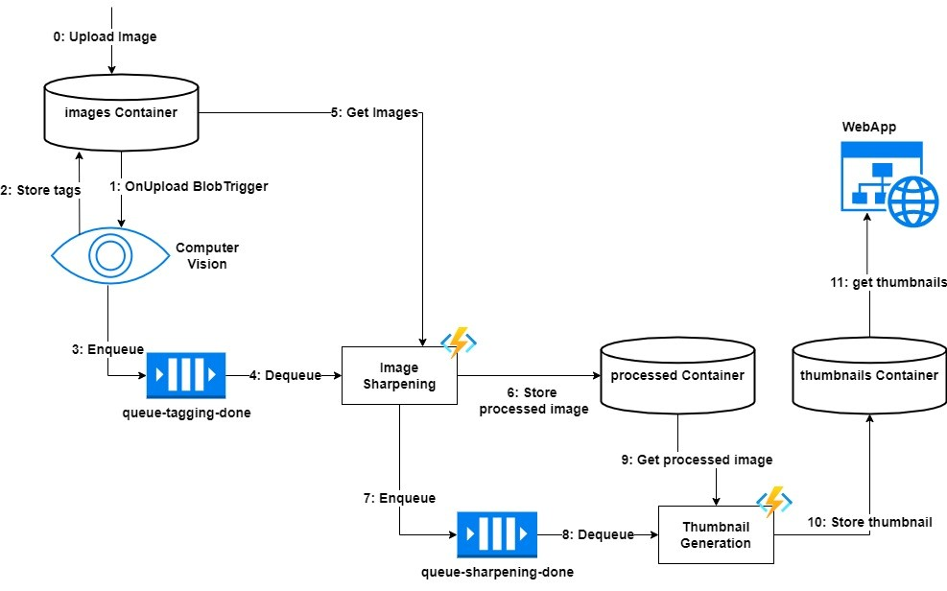
Our Setup - Concept

Slide 4
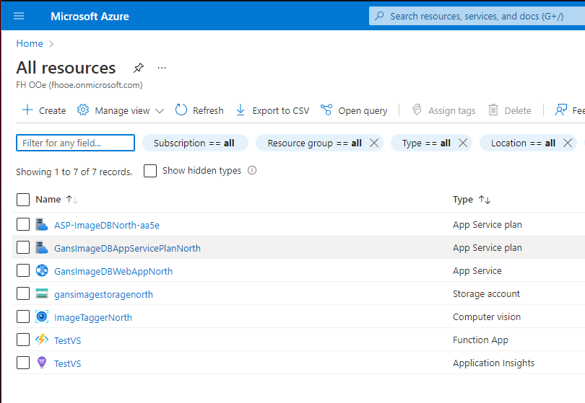
Our Setup - Reality

Slide 5
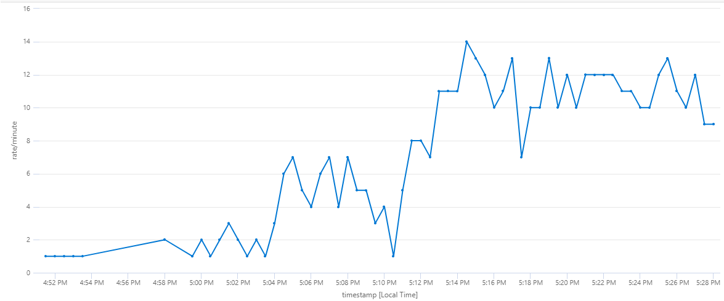
Why move to the cloud?

Slide 6
Why move to the cloud? II
Many functionalities are covered
All parts (kind of) play together
Easy deployment (functions, web app)
Integrated Monitoring

Slide 7
Challenges
Functions
Queues
Linux vs. Windows
Web development experience
Keeping costs in check

Slide 8
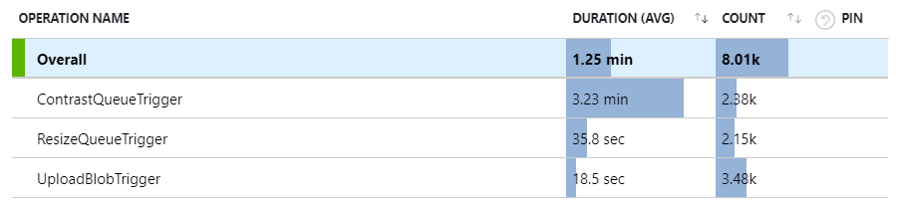
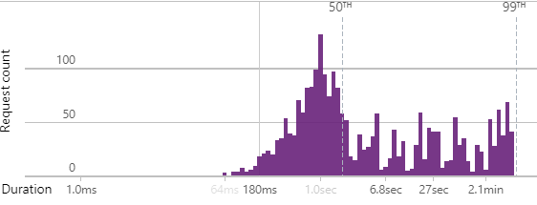
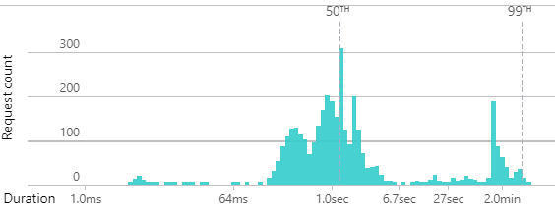
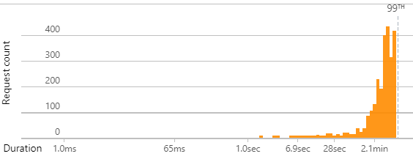
Performance Analysis
ResizeQueueTrigger
UploadBlobTrigger
ContrastQueueTrigger

Slide 9
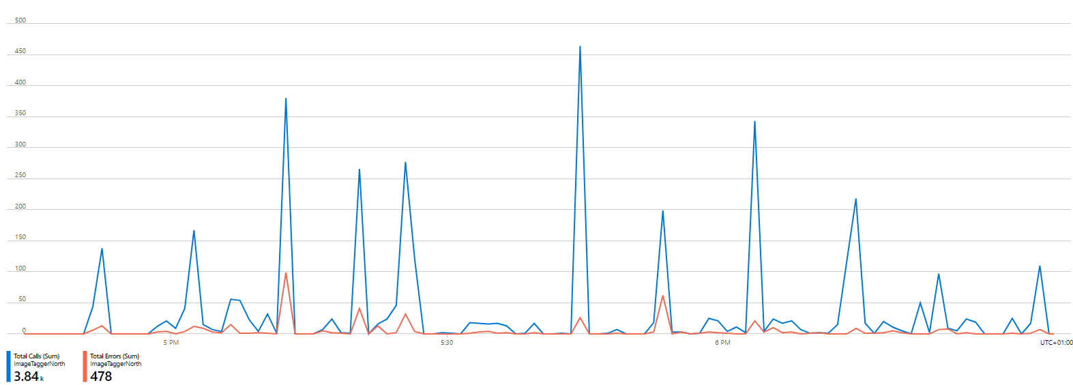
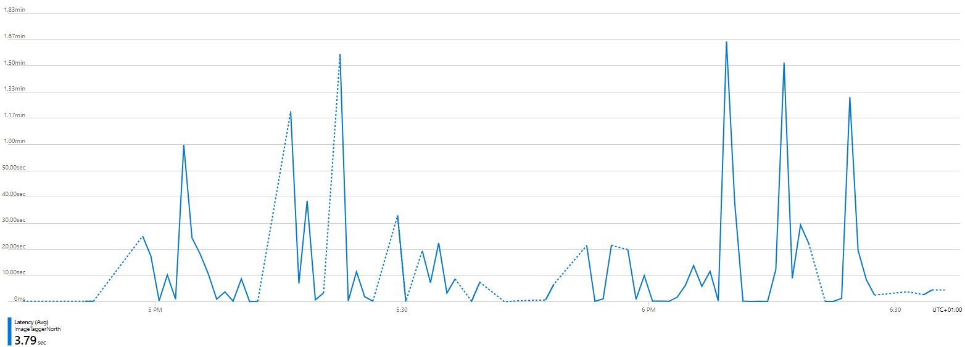
Cognitive Services

Slide 10
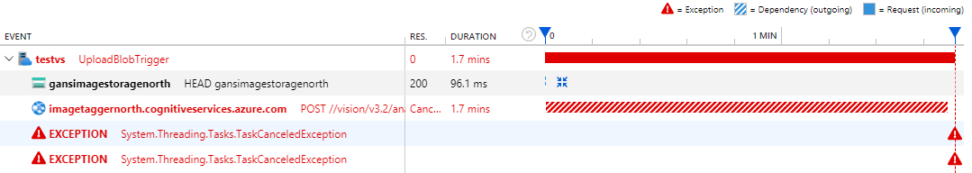
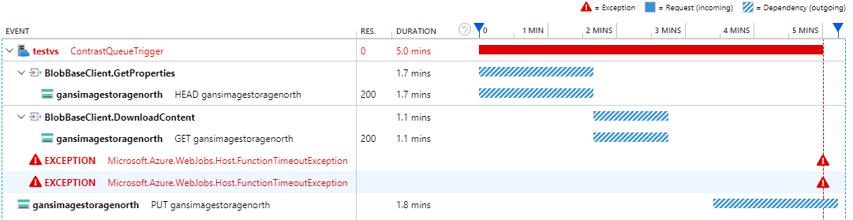
Recurrent Error Cases

Slide 11
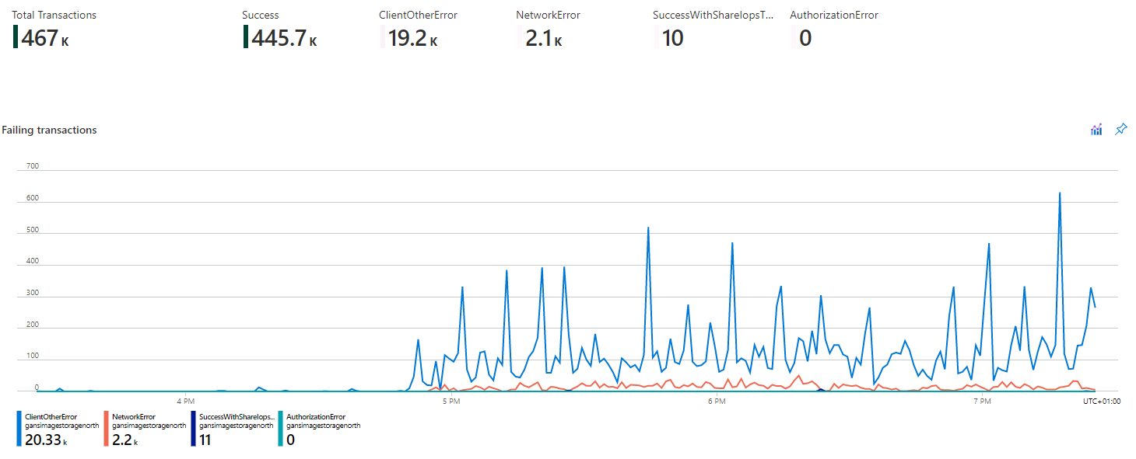
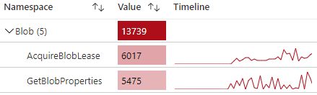
Storage Account Failings

Slide 12

Demo

Slide 13
Github
https://github.com/abraham-fl/CLC3_G-ans-6

