Slide 1
Split-Easy
Split-Easy is a modern web application designed to simplify bill splitting among friends, roommates, or groups. Whether you're dining out, traveling, or sharing expenses, Split Easy makes it effortless to track and settle shared costs transparently.

Slide 2
Technologies used
Frontend: React, TypeScript, Tailwind CSS, shadcn/ui
Backend: Node.js, Express.js
Database: MongoDB Atlas
Payment Processing: Razorpay
Email Service: Nodemailer
Build Tool: Vite
State Management: React Hooks

Slide 3
AI tools used
Lovable AI (creating frontend )
Grok AI ( debugging errors)
Bolt AI ( creating backend)
Cursor AI (creating backend)
ChatGPT (debugging errors)

Slide 4
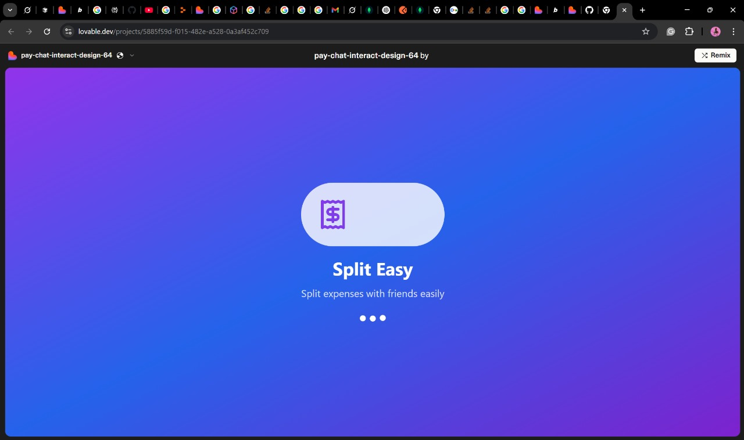

Slide 5
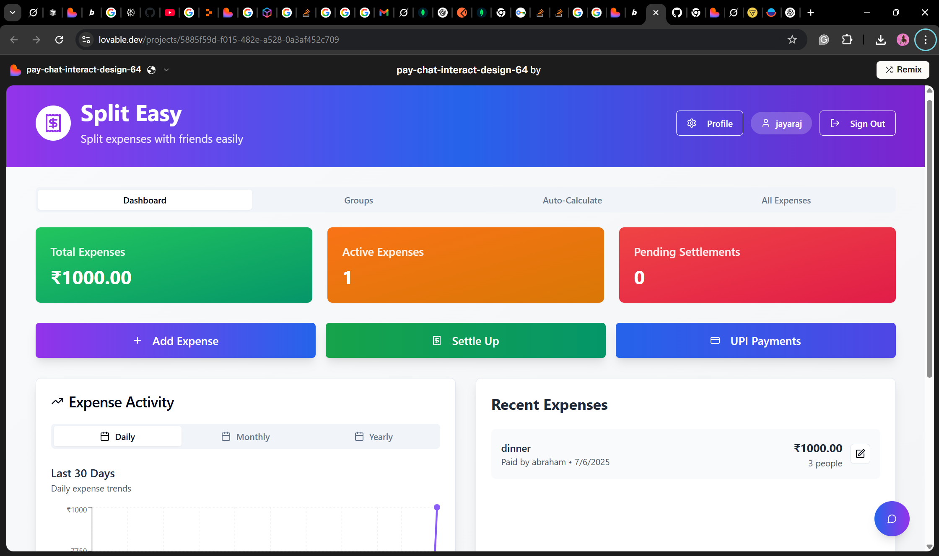
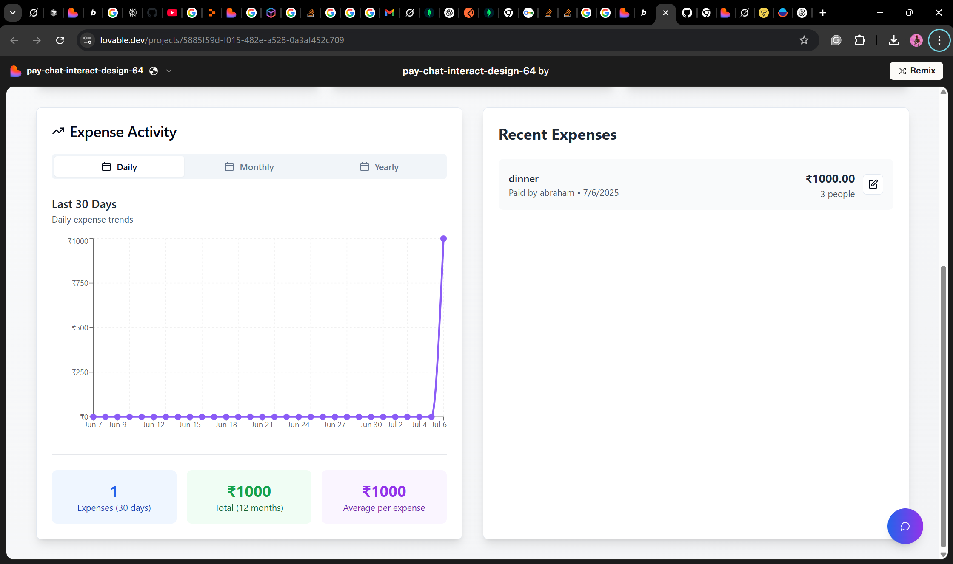
User home page

Slide 6
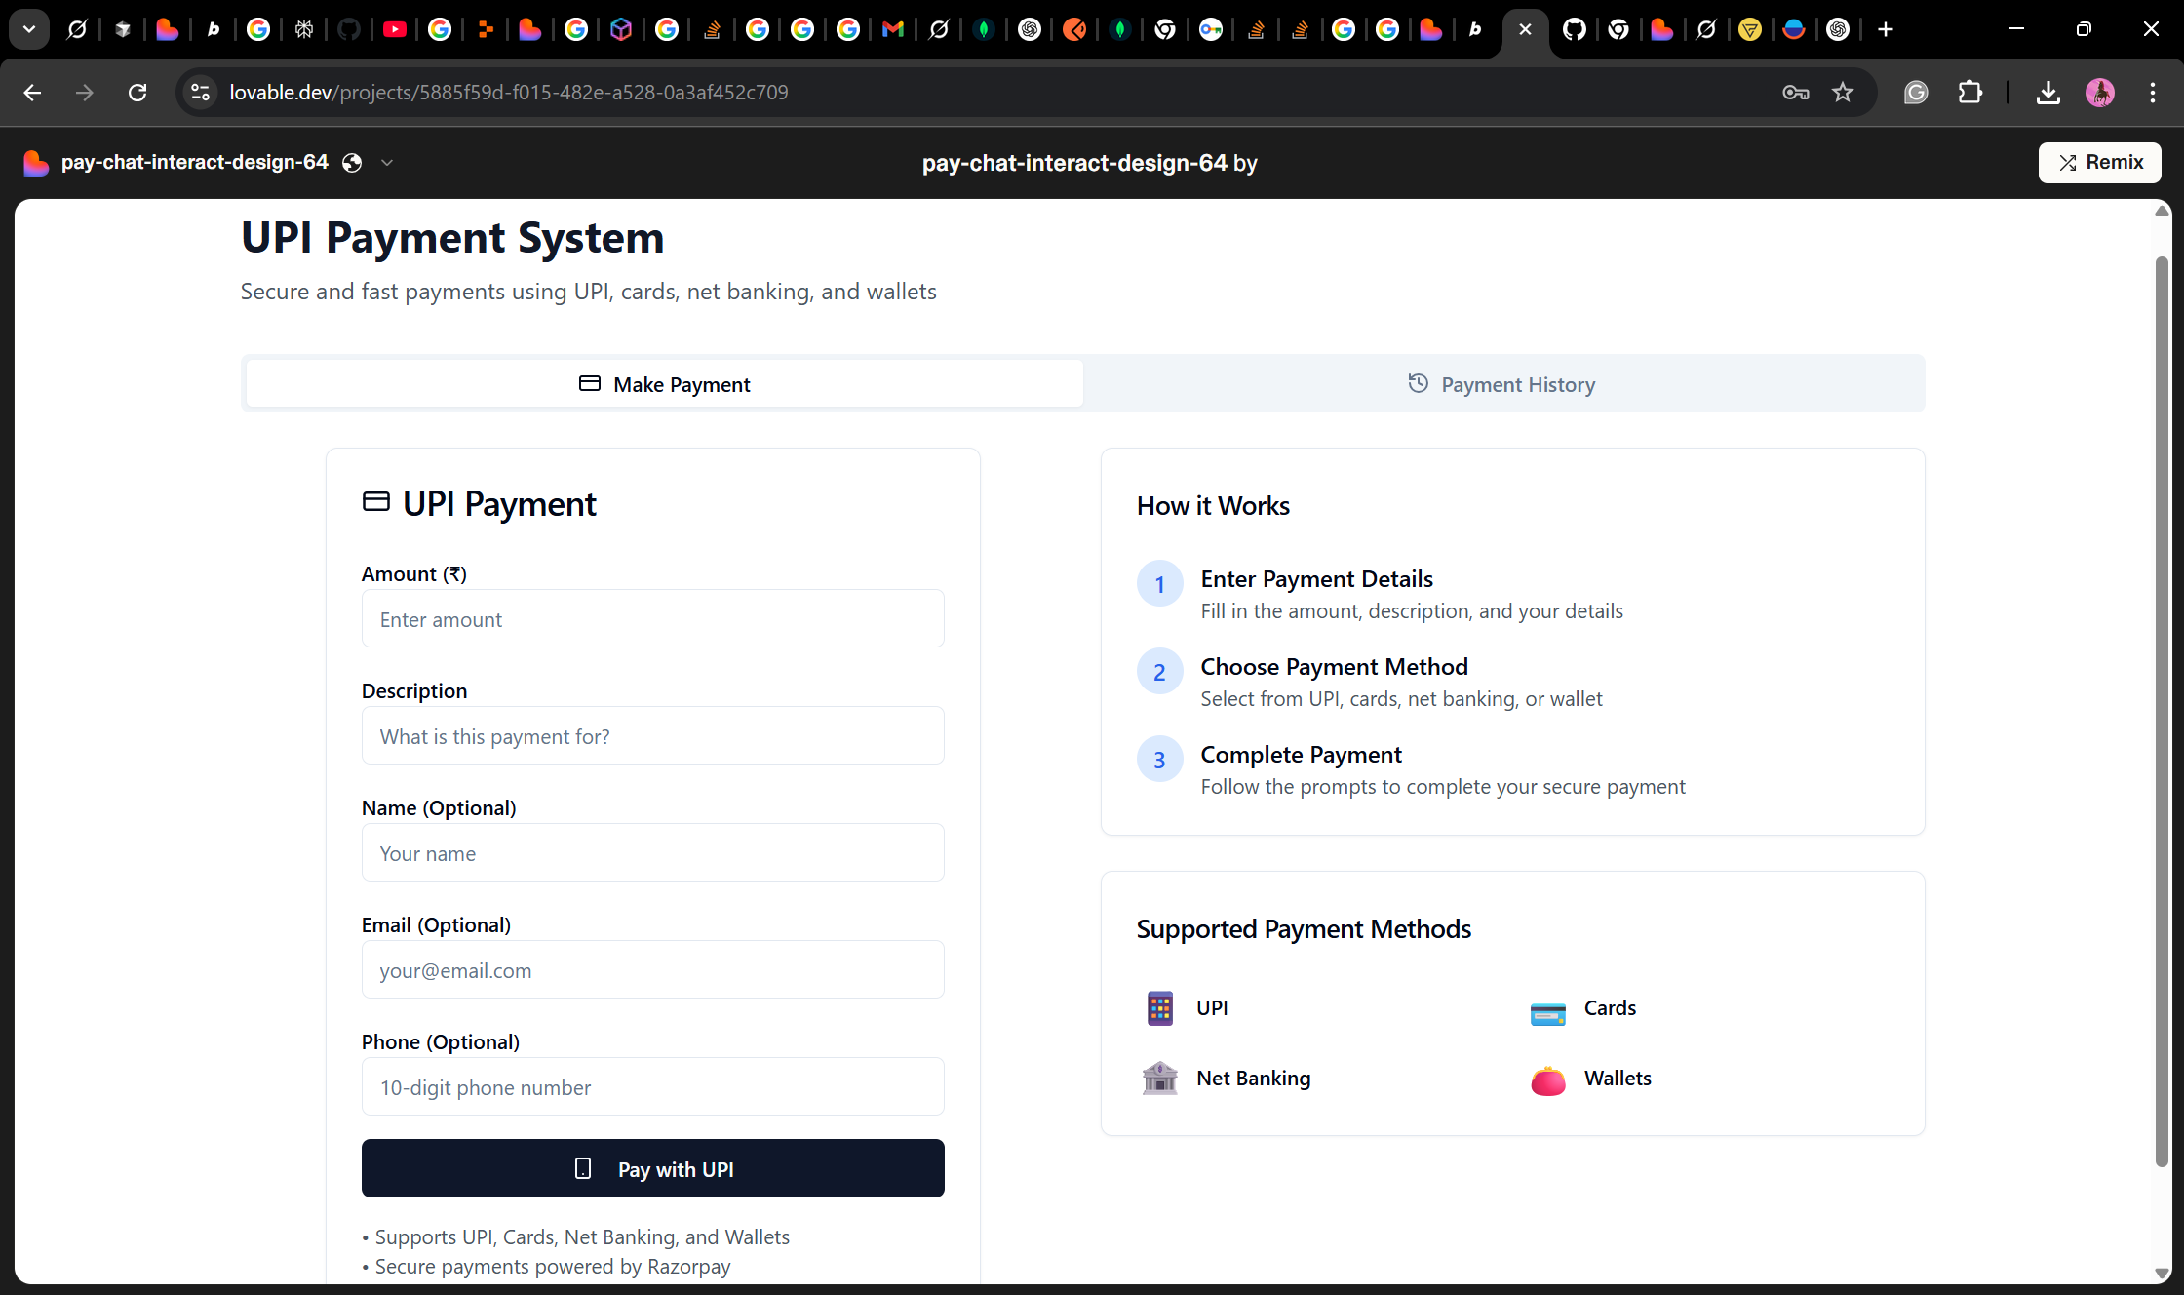
UPI Payment interface

Slide 7
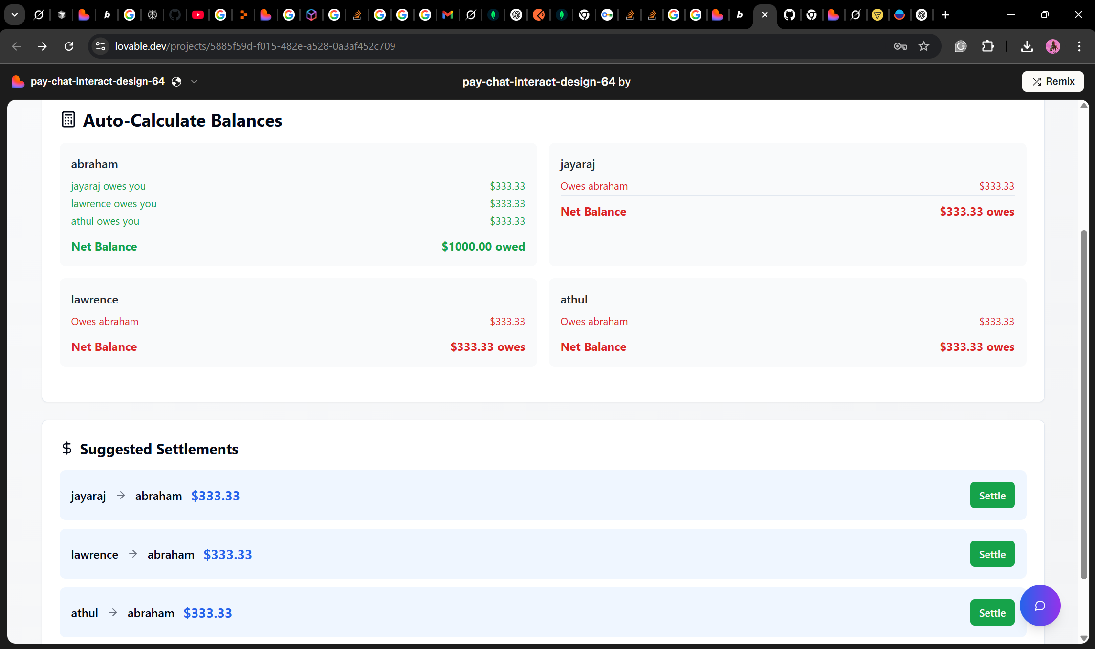
Auto calculate

