Slide 1
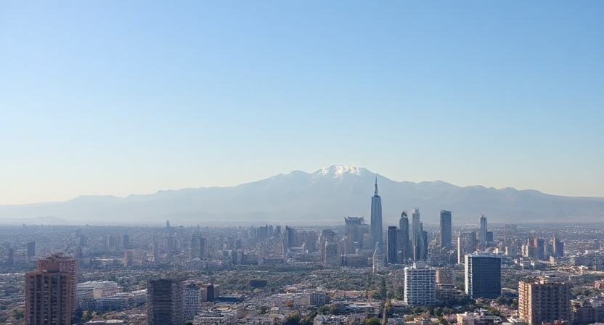
Avalon City Wealth Inequality 2025
A City District Wealth Inequality Analysis
Abraham C. , May 2025

Slide 2
Introduction

Slide 3

Analyzing Wealth Inequality Within the City
An analysis covering each city’s districts regarding gaps in wealth
Synopsis:
Purpose
Data Analysis Findings
Allocation
Conclusion
Credits & Citations

Slide 4
Purpose

Slide 5
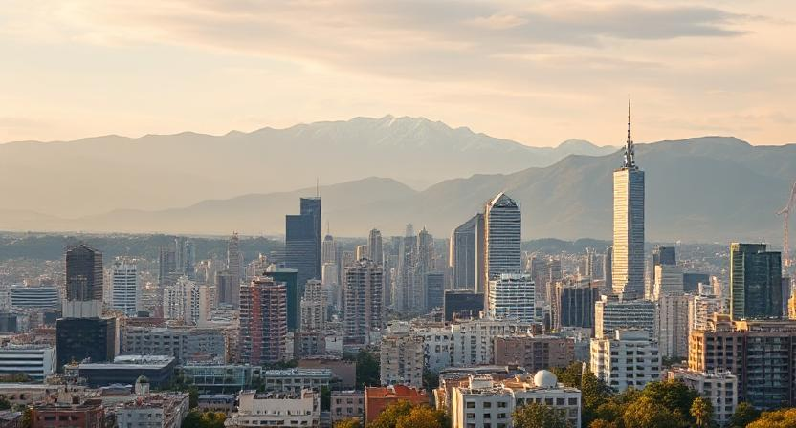
The purpose is to find which citizens need economic help within in Avalon City to improve the general quality of life for everyone.

Slide 6
Data Analysis Findings

Slide 7
23%
Average of Avalon City residents are on governmental housing
&
The city’s average Human Development Index Score of
0.890

Slide 8
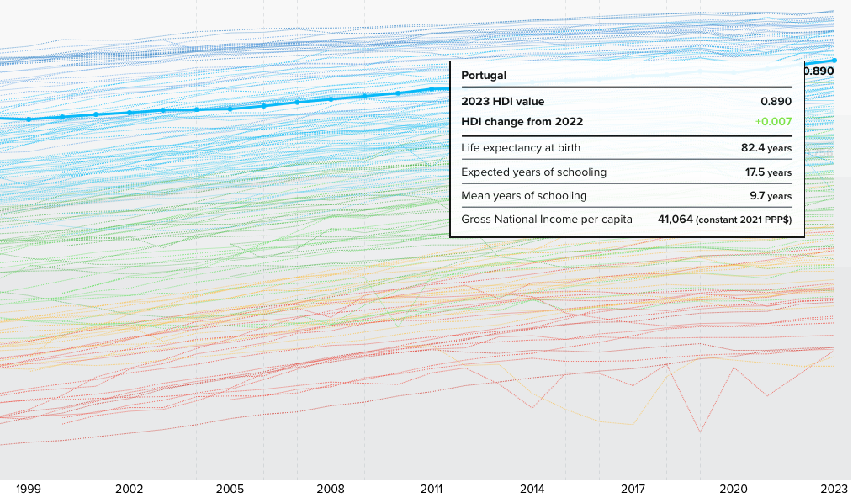
According to the UN, Avalon City has an average comparable to Portugal as of 2023*

Slide 9
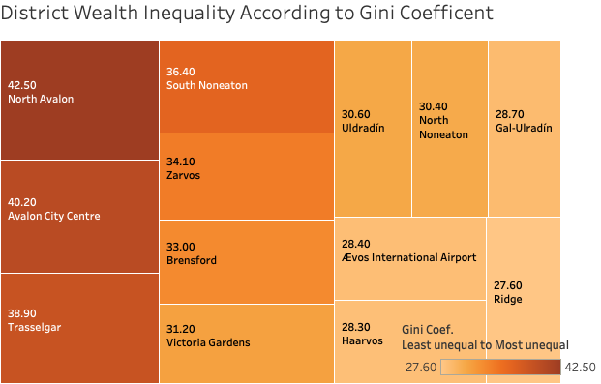
Gini coefficient
Measure of how unequal a society is with 0 (everyone having an equal share to an income) to 1 (an unequal income where 1 individual has all the income). *
According to the Avalon City Wealth Inequality 2025 data, the 3 districts with the biggest gaps in terms of wealth inequality are; North Avalon (at a Gini Coef. Score of 42.5), Avalon City Centre (at 40.2) and lastly Trasselgar (at 38.9)

Slide 10
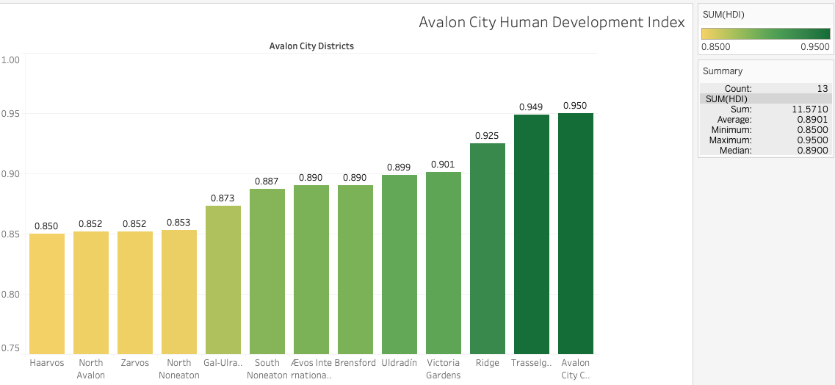
Human Development Index
A summary measure of average achievement in key dimensions of human development: a long and healthy life, being knowledgeable and having a decent standard of living.*
As the bar graph shows, residences that live in Haarvos, North Avalon & Zarvos have the lowest HDI scores due to their low levels of economic output and higher poverty rates.

Slide 11
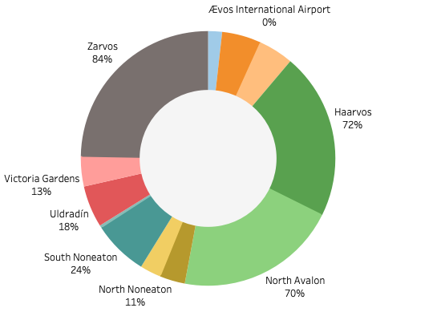
Residences in Gov. Housing
% of population living each district with governmental assistance partly provided by the city through provincial and national taxes
Zarvos, Haarvos and North Avalon account for the highest proportion of residences using governmental assistance towards living.
Note: Ævos International Airport is omitted from the data due to no one living in the self-contained airport district.

Slide 12
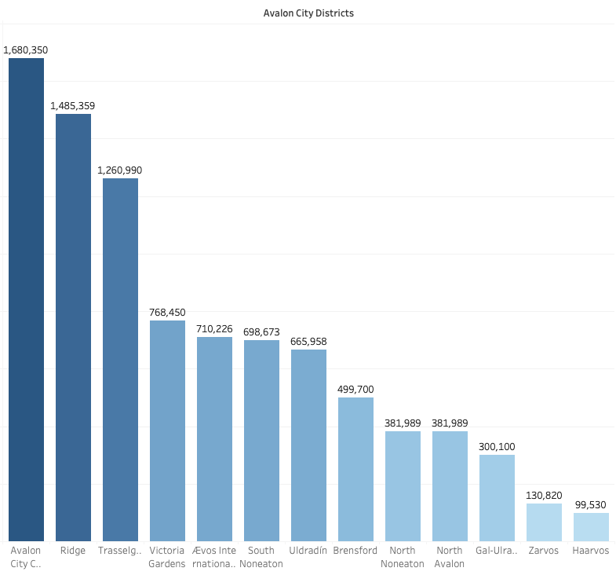

Gross Domestic Product
Measures the monetary value of goods & services produced.*
Avalon City Centre, Ridge & Trasselgar have the highest GDP within the city at a combined average of ₳1,475,566
Haarvos, Zarvos & Gal-Ulradín have the lowest GDP within the city at a combined average of ₳176,756

Slide 13
Allocation

Slide 14

Addressing Where Additional Resources are Needed

Slide 15
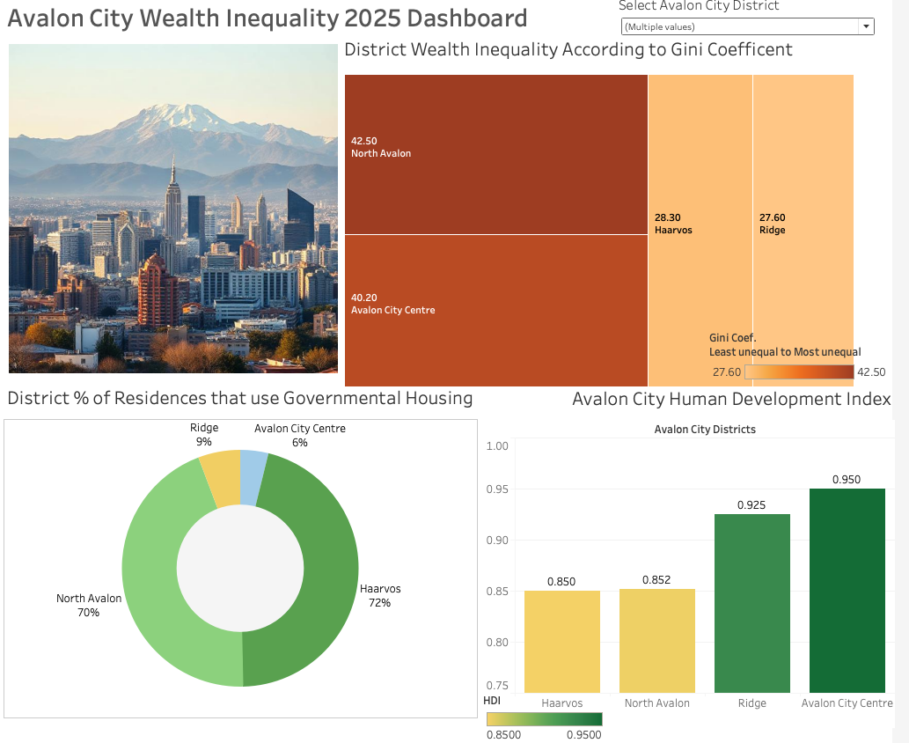
Inequality Allocations
By pinning the 2 highest and the 2 lowest Gini Coefficient of each district, North Avalon & Avalon City Centre need the most action towards reducing wealth inequality.
Whereas, the districts of Ridge & Haarvos are of least concern for the time being.

Slide 16
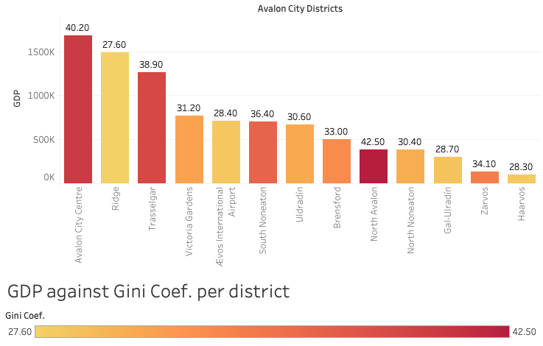
Preconceptions
One would accuse that GDP correlates towards wealth inequality. However, the data shows while districts like Haarvos has low GDP, Its Gini Coefficent is actually pretty equal at 28.90. This is because most people living and working within the same income levels while having little or no major properties or economic disparity.
The opposite is true when some districts with the high GDP have the highest levels of wealth inequality because the way of life of some citizens are far outpaced by multi-million ₳ revenue generating businesses and properties. Therefore, despite Avalon City Centre and Trasselgar having the highest GDP’s in the city, they also have a high disproportion of wealth and need to allocate government resources to address the issue for lower income residents.

Slide 17
Conclusion

Slide 18
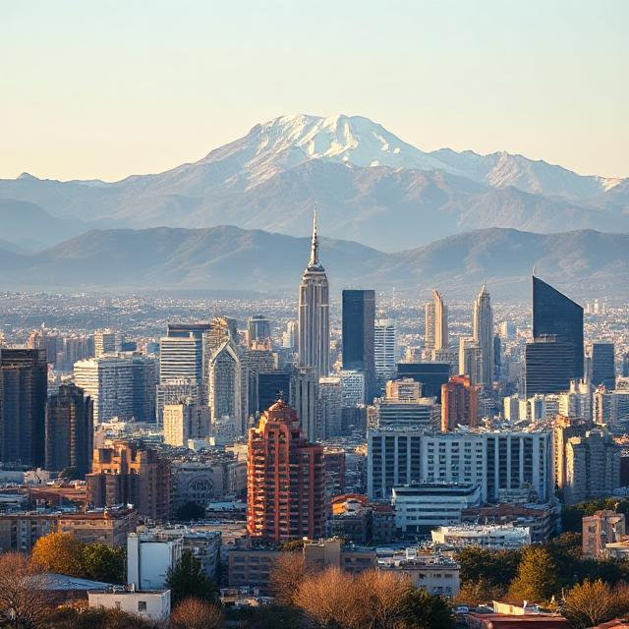
In conclusion
Government resources should develop plans to mitigate wealth inequality in these key districts within Avalon City for those who’s income levels are displaced but maintain or improve their HDI.
North Avalon (the most unequal district)
Avalon City Centre (the most unequal district with the highest GDP)
Trasselgar

Slide 19
Credits & Citations
UN Visualization Chart; UN online database via: https://hdr.undp.org/data-center/human-development-index#/indicies/HDI
Gini Coefficient definition: OCED via; https://www.oecd.org/en/data/indicators/income-inequality.html
UN definition of HDI: UN online data base via ; https://hdr.undp.org/data-center/human-development-index#/indicies/HDI
GPD Definition: IMF online website via; https://www.imf.org/en/Publications/fandd/issues/Series/Back-to-Basics/gross-domestic-product-GDP
All images are generated by AI via DeepAI Image generator: https://deepai.org/machine-learning-model/text2img

