Slide 1

Advanced SQL – IMDb Dataset Analysis
Analyzing movie trends using SQL
Presented by: Abraham PonnuRaj
Course: DA & DS
Batch: Feb 2025
Date: 31-March-2025

Slide 2
Introduction to the Dataset
The dataset provided is a simplified version of the IMDb database, structured to capture essential information about movies, their genres, actors, directors, ratings, and more. This database consists of six tables that contain various details such as:
Movie: Contains basic information about each movie, including title, release year, duration, country, income, languages, and production companies. (7997 records)
Genre: Describes the genres associated with each movie. (14662 records)
Director Mapping: Maps movies to their directors. (3867 records)
Role Mapping: Maps actors/actresses to movies and specifies the role category (e.g., actor, director, producer). (151615 records)
Names: Stores information about people (actors, directors, etc.), including their birthdates, heights, and known movies. (25735 records)
Ratings: Contains ratings information for movies, including the average rating, total votes, and median rating. (7997 records)

Slide 3
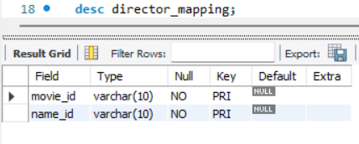
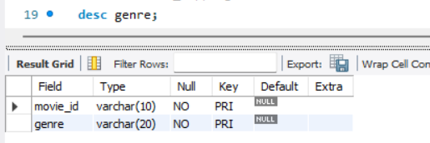
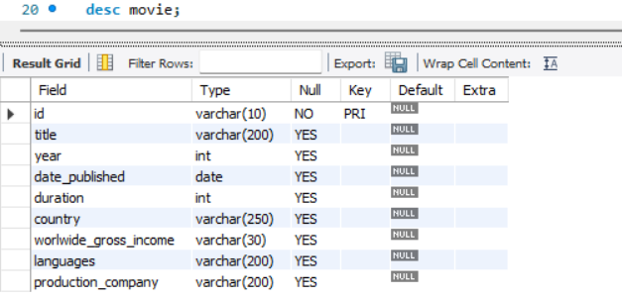
IMDb Database - Table Structure
1. director_mapping
Columns: movie_id (FK), name_id (FK)
Records: 3,867
Purpose: Maps movies to their directors
2. genre
Columns: movie_id (FK), genre
Records: 14,662
Purpose: Categorizes movies
3. movie
Columns: id (PK), title, year, date_published, duration, country, worldwide_gross_income, languages, production_company
Records: 7,997
Purpose: Stores movie details

Slide 4
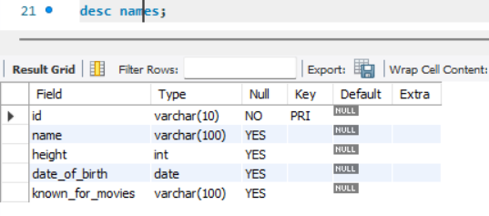
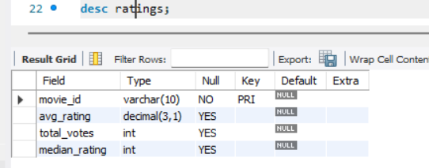
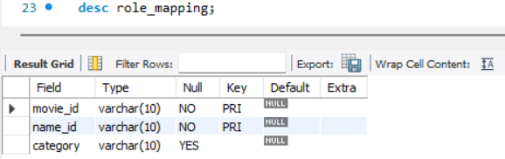
IMDb Database - Table Structure (Continued)
4. names
Columns: id (PK), name, height, date_of_birth, known_for_movies (FK)
Records: 25,735
Purpose: Stores actors, actresses, and directors’ details
5. ratings
Columns: movie_id (FK), avg_rating, total_votes, median_rating
Records: 7,997
Purpose: Stores movie ratings
6. role_mapping
Columns: movie_id (FK), name_id (FK), category
Records: 151,615 (9,362 actors, 6,253 actresses)
Purpose: Maps actors/actresses to movies

Slide 5
SQL Techniques Used
Joins – To fetch data from multiple tables.
Aggregation – To calculate ratings, income, votes, etc.
Filtering & Grouping – To categorize and rank movies.
String Functions – GROUP_CONCAT() to list genres.
Ranking – RANK() function for top movies by votes.

Slide 6
Key Insights from Analysis
Most Common Language: The language in which the most movies were produced.
Top 5 Movies by Votes: Ranked using RANK() function.
Longest Duration Movie: Identified using ORDER BY duration DESC LIMIT 1.
Highest Grossing Movies: Extracted using aggregation on worldwide income.

Slide 7
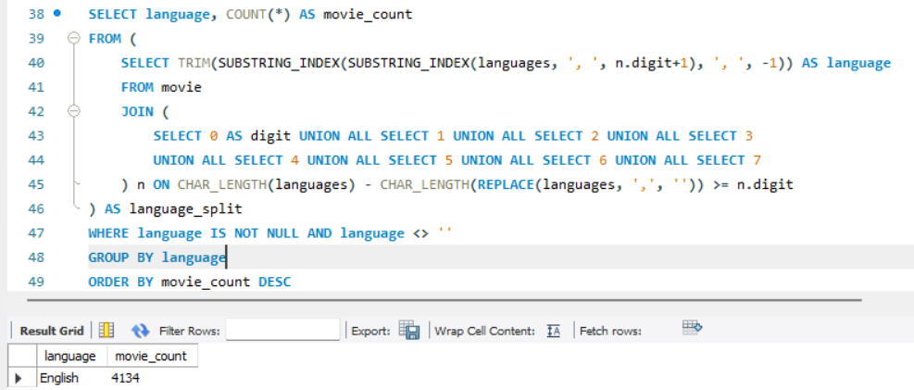
Most Common Language
Identified the language in which the most movies were produced.
Helps understand the dominant language in the movie industry.
Useful for targeting language-specific audiences and analyzing regional cinema trends.
English is the most common language in movies, with 4,134 movies produced.
This is significantly higher compared to the other languages in the dataset.

Slide 8
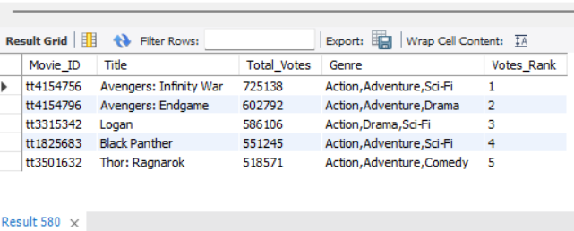
top 5 movies with the highest total votes, along with their genres.
Lists the top 5 movies with the highest total votes.
Uses GROUP_CONCAT() to combine multiple genres for each movie.
Applies RANK() function to assign ranks based on total votes.

Slide 9
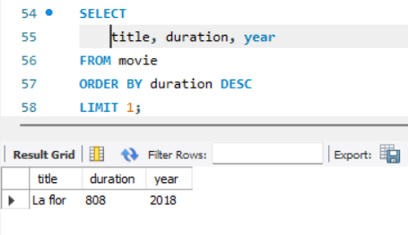
Longest Duration Movie
The movie with the longest runtime is identified by sorting the duration column in descending order and selecting the top record.
This helps analyze movie trends regarding length and audience engagement.
The longest movie in the dataset is "La Flor", released in 2018, with a runtime of 808 minutes.
This film stands out for its exceptional length, making it one of the longest narrative films ever made.

Slide 10
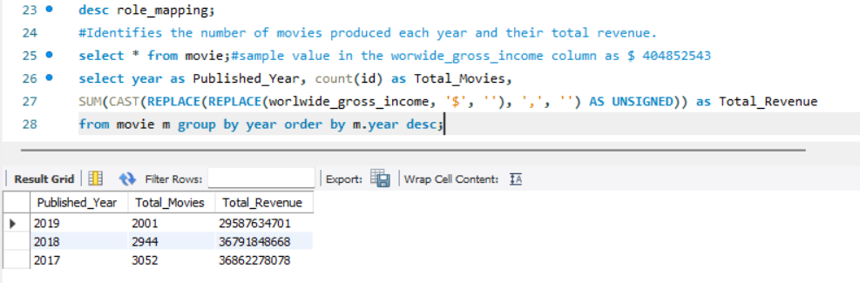
Movie Trends & Performance
Analyzed the number of movies released per year and their total revenue.
Found that the total revenue was initially incorrect due to non-numeric values in worldwide_gross_income.
After cleaning and converting the data, we now accurately track box office performance over the years.
This helps identify peak years for movie releases and revenue trends.

Slide 11

Movie Release Trend (Yearly & Monthly Analysis)
The dataset reveals how many movies were released each year, further breaking it down by month.
This helps identify seasonal trends in movie releases.
For instance, some months might have higher movie releases due to festive seasons or peak audience engagement periods.
The dataset shows a declining trend in the number of movies released from 2017 to 2019.
The peak months for movie releases were September and October, with consistently high numbers across years.
December 2019 saw the least movie releases (only 16), possibly due to industry slowdowns or external factors.
September 2017 had the highest releases (327), suggesting it might be a peak release period.

Slide 12
Challenges Faced & Solutions
Handling Multiple Values: GROUP_CONCAT() helped list multiple genres/languages.
Splitting Data: Used SUBSTRING_INDEX() to separate multiple languages.
Performance Optimization: Used LIMIT to fetch only required data.

Slide 13
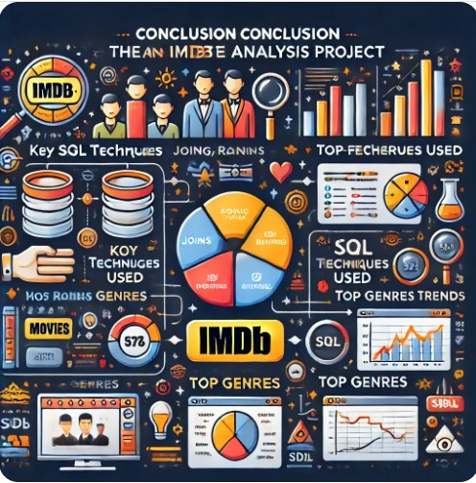
Conclusion
Successfully extracted movie insights using SQL.
Applied joins, ranking, filtering, and aggregation.
Found most popular movies, genres, and production trends.

Slide 14

Abraham Ponnuraj
abrahamcbe@gmail.com

