Slide 1
Healthcare Data Analysis Using Excel and Tableau
A Comprehensive Study on Patient Demographics, Diagnostics & Billing
Presented by: Abraham PonnuRaj
Date: 13-05-2025
Course: Data Analytics & Data Science, KGiSL Micro College

Slide 2
Dataset Description
Source: The data was created using Mockaroo, a tool for making sample (fake) data.
Key Columns: Patient ID, Gender, Age, Department, Diagnosis, Blood Group, Billing Amount, Length of Stay, and more.
Tools Used:
  Microsoft Excel – Used to clean and prepare the data.
  Tableau – Used to create charts and dashboards.
Purpose: To study and understand patterns in patient care and hospital services using sample data.

Slide 3
Project Objective
To analyze hospital patient data using Excel for cleaning and Tableau for creating charts and dashboards.
To understand trends in patient age, gender, and other personal details (demographics).
To find out which health problems (diagnoses) are most common among patients.
To study hospital billing details like total cost and length of stay.
To show all the findings visually using charts, so it's easy to understand and useful for making better decisions in healthcare.

Slide 4
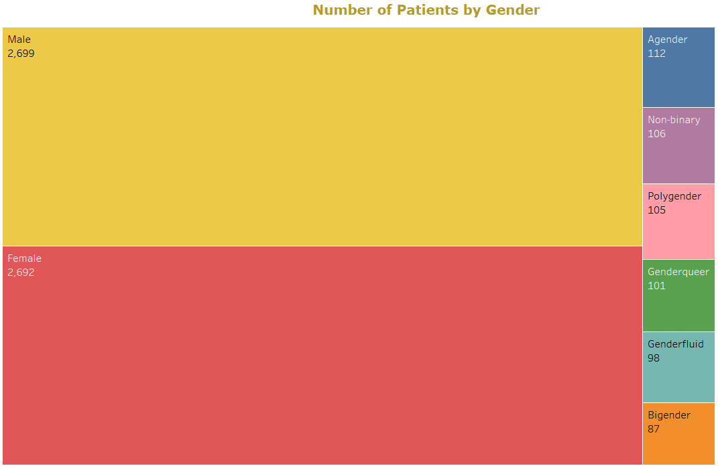
Gender-Based Patient Distribution
🧩 Chart Type: Tree Map
What it Shows:
Each rectangle represents a gender category.
The size of each rectangle reflects the number of patients in that gender.
Colors help differentiate between categories.
🔍 Observations:
Male and Female dominate the distribution with nearly equal counts.
The data includes some patients who do not identify as male or female, such as Agender and Non-binary. This shows that the hospital is welcoming to all kinds of people.

Slide 5
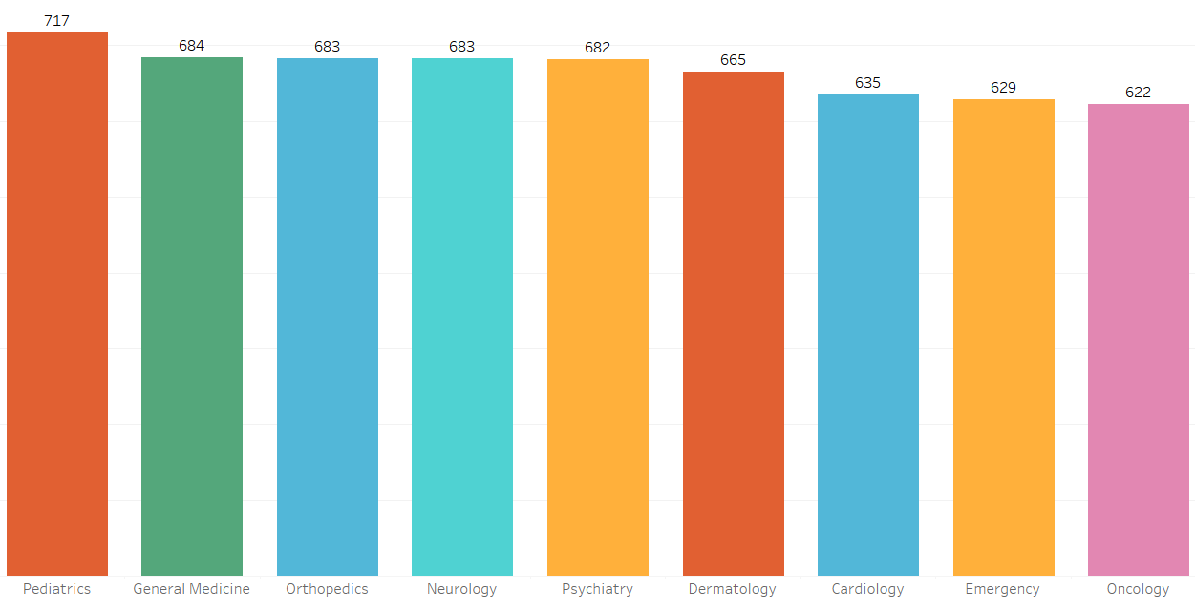
Top Departments by Patient Volume
📌 Chart Overview:
This bar chart shows the number of unique patients across different sample departments. Each bar represents a department, and the height shows the total number of patients.
✅ Key Insights:
Pediatrics has the most number of patients (717), showing that many people need child healthcare.
General Medicine (684), Orthopedics (683), and Neurology (683) also have many patients. These are important departments for regular health issues.
Oncology (cancer care) has the fewest patients (622), maybe because it deals with special or serious cases.
Overall, the number of patients in each department is quite similar, showing the hospital services are well-balanced.
📌 Interpretation:
This visualization helps stakeholders:
Identify which departments are most in demand.
Allocate resources and staff effectively.
Plan department-specific strategies for better patient flow and experience.

Slide 6
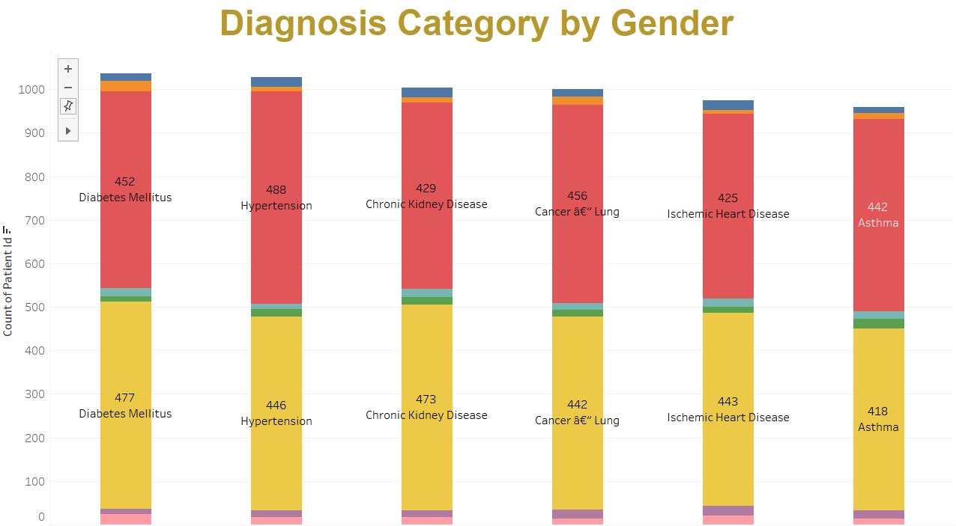
Diagnosis Category by Gender
🔍 Overview:
This stacked bar chart shows the distribution of patients across various diagnosis categories, broken down by gender
📌 Insights:
Diabetes and High Blood Pressure are the most common diseases for all genders.
Female patients (shown in yellow) make up a large part of all disease groups.
Some diseases are more common in one gender—for example, more females have Diabetes and Kidney Disease.
Lung Cancer and Heart Disease affect men and women in similar numbers.
📈 Purpose:
This visual helps to:
Find out if some diseases affect one gender more than others.
Use this information to plan health programs or awareness activities for specific genders.

Slide 7
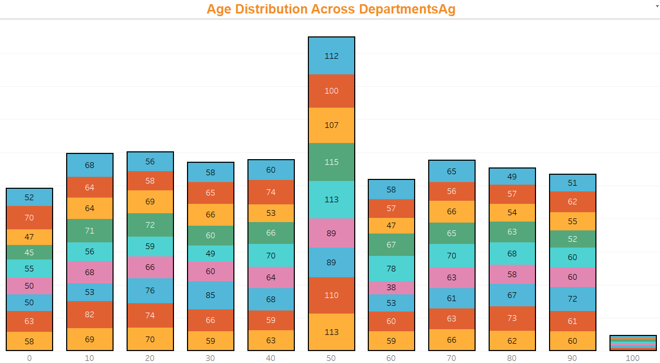
Age Distribution Across Departments
📌 Objective:
To analyze how patient ages are distributed across different hospital departments.
🔍 Insights:
The highest number of patients are in the 50-60 age group.
Departments like Cardiology, General Medicine, and Orthopedics mostly treat middle-aged and older patients.
Pediatrics mainly treats patients in the 0-10 age group.
Some departments treat patients of all ages, while others focus on specific age groups.
✅ Conclusion:
This chart gives a clear view of patients' age and the departments they visit. It shows which age groups are treated by each department, helping in planning resources and focusing on the right services.

Slide 8
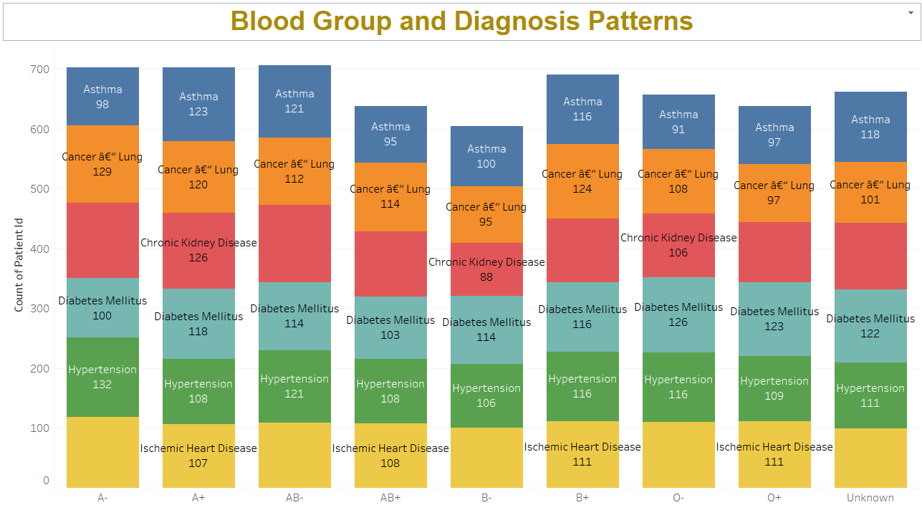
Blood Group and Diagnosis Patterns
📌 Objective:
To analyze the distribution of key health conditions across different blood groups to identify any potential patterns or correlations.
📌 Key Insights:
A+ and AB+ blood groups have the highest number of Asthma and Chronic Kidney Disease cases.
Lung Cancer is found in all blood groups, with a slight increase in A+ and B+.
Hypertension and Diabetes Mellitus are common across all blood types.
Ischemic Heart Disease is evenly spread, with slightly higher numbers in B+ and O+ blood groups.
🧠 Interpretation:
There are no extreme outliers, but conditions like Asthma and Chronic Kidney Disease are more common in A+ and AB+ blood groups. This could help in providing personalized care or monitoring risks based on blood type.

Slide 9
HealthCare Data Insights – Patient Trends & Outcomes
📌 Objective:
  To understand patient trends by analyzing top health conditions, department workload, age and gender distribution, and treatment patterns. This helps in planning resources and improving healthcare services.
📌 Key Insights:
Top Diagnoses:
  Diabetes (1,036)
  Hypertension (1,027)
  Chronic Kidney Disease (1,003)
  Asthma (959)
  Heart Disease (975)
Department Trends:
  Highest patient count in Pediatrics (717)
  Highest billing in General Medicine ($56.57L)
Age Group with Highest Patients: 50 years (948 patients)
Gender Balance: Male and Female patients are nearly equal
Patient Flow Trend: Steady distribution across all quarters
📊 Dashboard Highlights:
👥 Total Patients: 6,000
👨‍⚕️ Male Patients: 2,699
👩‍⚕️ Female Patients: 2,692
👶 Average Age: 49.81 years
🕒 Average Length of Stay: 63.41 days
💰 Average Treatment Cost: $49,959

Slide 10
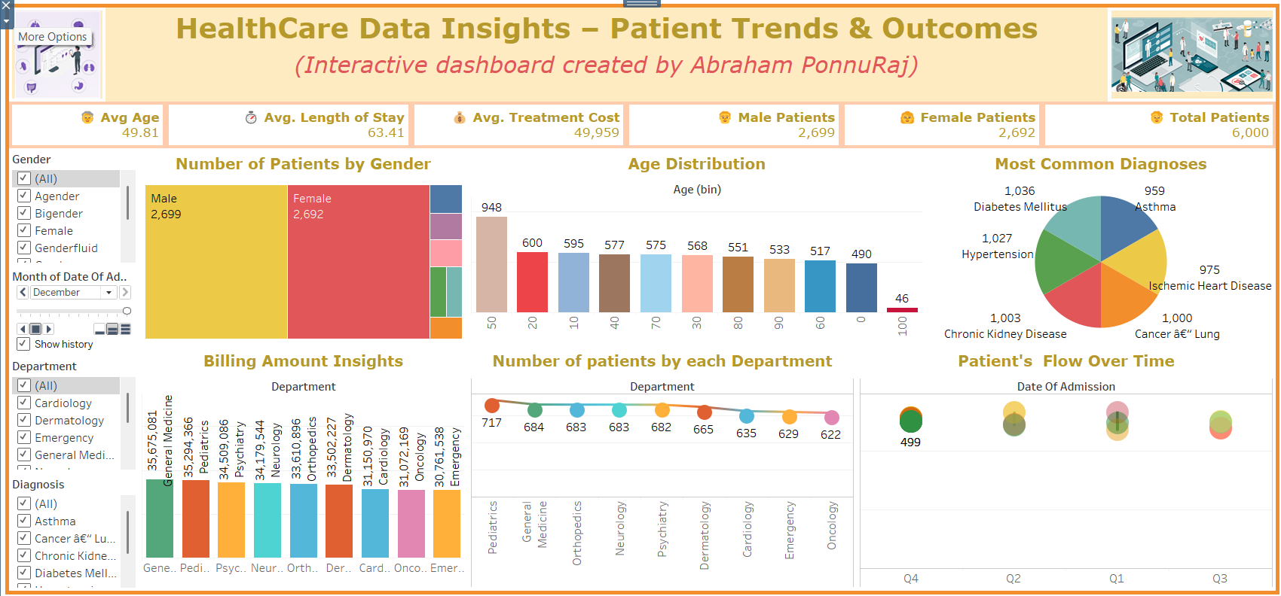

Slide 11
Storytelling Summary & Key Takeaways
📊 Dataset Overview:
This analysis is based on a dataset of 6,000 AI-generated patient records. It looks at patterns in patient demographics, diagnoses, departmental efficiency, and treatment costs, using simulated data.
📊 Data Highlights
Total Patients: 6,000
Average Age: 49.81 years
Average Length of Stay: 63.41 days
Average Treatment Cost: $49,959
Gender Split:
  Male: 2,699
  Female: 2,692
Top Diagnoses:
  Diabetes – 1,036 cases
  Hypertension – 1,027 cases
  Chronic Kidney Disease – 1,003 cases
  Lung Cancer – 1,000 cases
  Heart Disease – 975 cases
  Asthma – 959 cases
Departments with Highest Impact:
  Highest Billing: General Medicine – $56.57 million
  Most Patients: Pediatrics – 717 patients
Age Insights:
  Peak age group: 50 years – 948 patients
Patient Flow: Even distribution across Q1–Q4
✅ Conclusion
The dashboard shows an equal number of male and female patients, many cases of chronic diseases, and heavy use of resources in General Medicine. To manage costs, management need to plan carefully, especially for departments and age groups with high patient numbers.

Slide 12
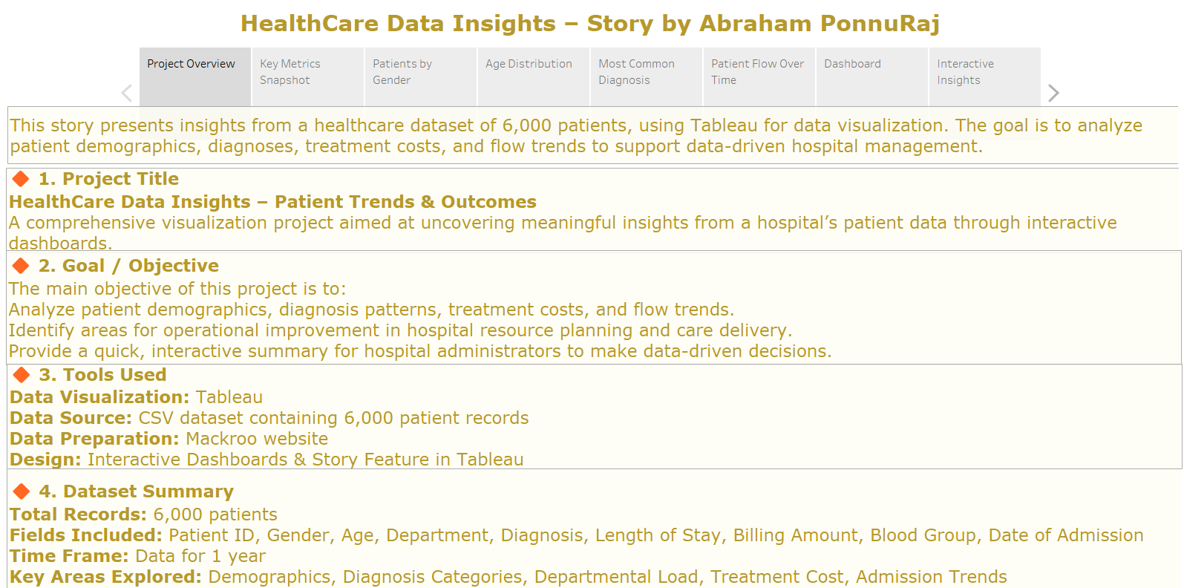

Slide 13
Thank you.

