Slide 1
Third-Party Services Dashboard
Gmail
GitHub
Notion
Linear
Todoist
Jira
Claude Code + MCP: Gmail, GitHub, Notion, Linear, Todoist and Jira
Abraham Gabay · Joel Aserraf · Marco Foununu · AI Homework 3
github.com/abrahamaiproject-bit/Ai-Homework3-Abraham
Notes:
Project overview: Claude Code connected to four services through MCP servers, data exported locally, searched in a local dashboard. Worked alone; Linear is the extra service.

Slide 2
How the project works
1
2
3
4
Connect
Seed test data
Export locally
Search
›
›
›
Official MCP servers for GitHub, Notion, Linear, Todoist and Jira in .mcp.json; Gmail through Google's Gmail MCP server
Throwaway accounts with 10+ items per service about a fictional startup, Lumen Freight
A project skill downloads every item to dataExports/ as one JSON file each, per localStorageFormats.md
A local Python dashboard reads dataExports/ and searches all six services at once

Slide 3
Team and extra services
AG
JA
MF
Abraham Gabay
Joel Aserraf
Marco Foununu
Extra service: Linear
Extra service: Todoist
Extra service: Jira
GitHub repo setup
Gmail, GitHub and Notion connections and test data
Demo video
localStorageFormats.md
Export skill (.claude/skills)
Dashboard website
Screenshots and presentation
We worked together on one shared computer and one set of test accounts, helping each other throughout.

Slide 4
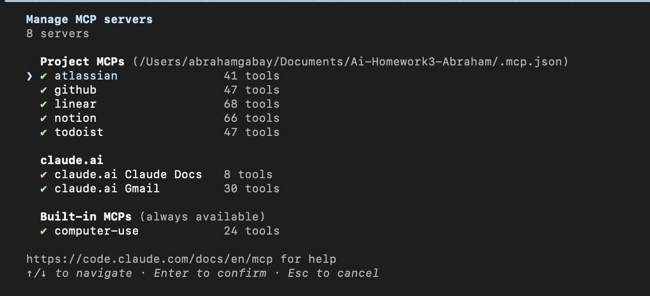
Every service connected through MCP
GitHub, Notion, Linear, Todoist, Jira
Vendor-hosted official MCP servers, saved in .mcp.json. GitHub's token comes from an environment variable; the others sign in with OAuth in the browser.
Gmail
Google's official Gmail MCP server (gmailmcp.googleapis.com), reached through the claude.ai Gmail connector. Google's preview program blocks custom OAuth clients for personal Gmail accounts.
No passwords or keys are in the repo.

Slide 5
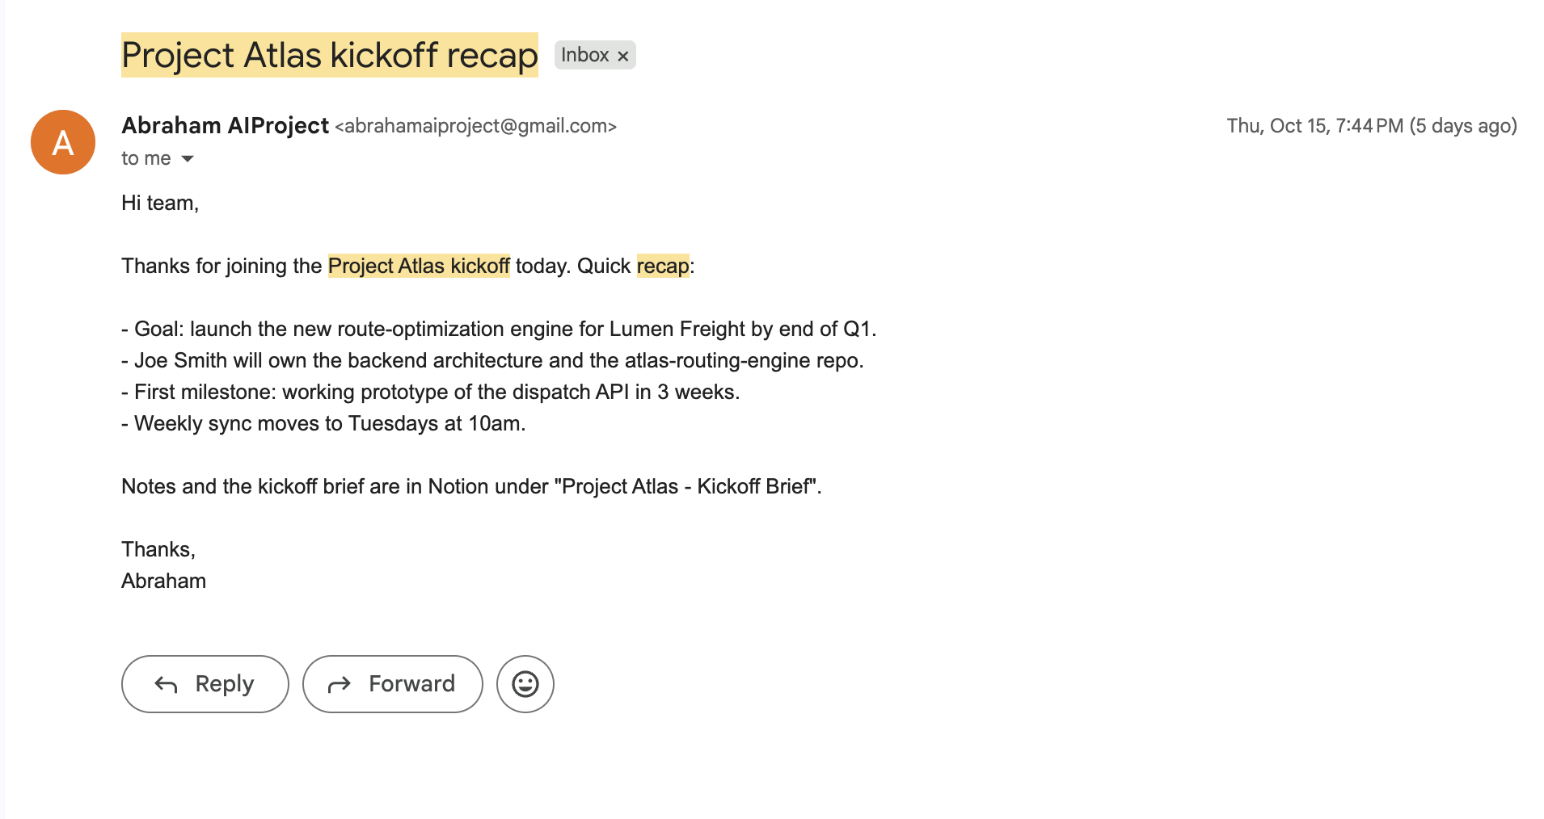
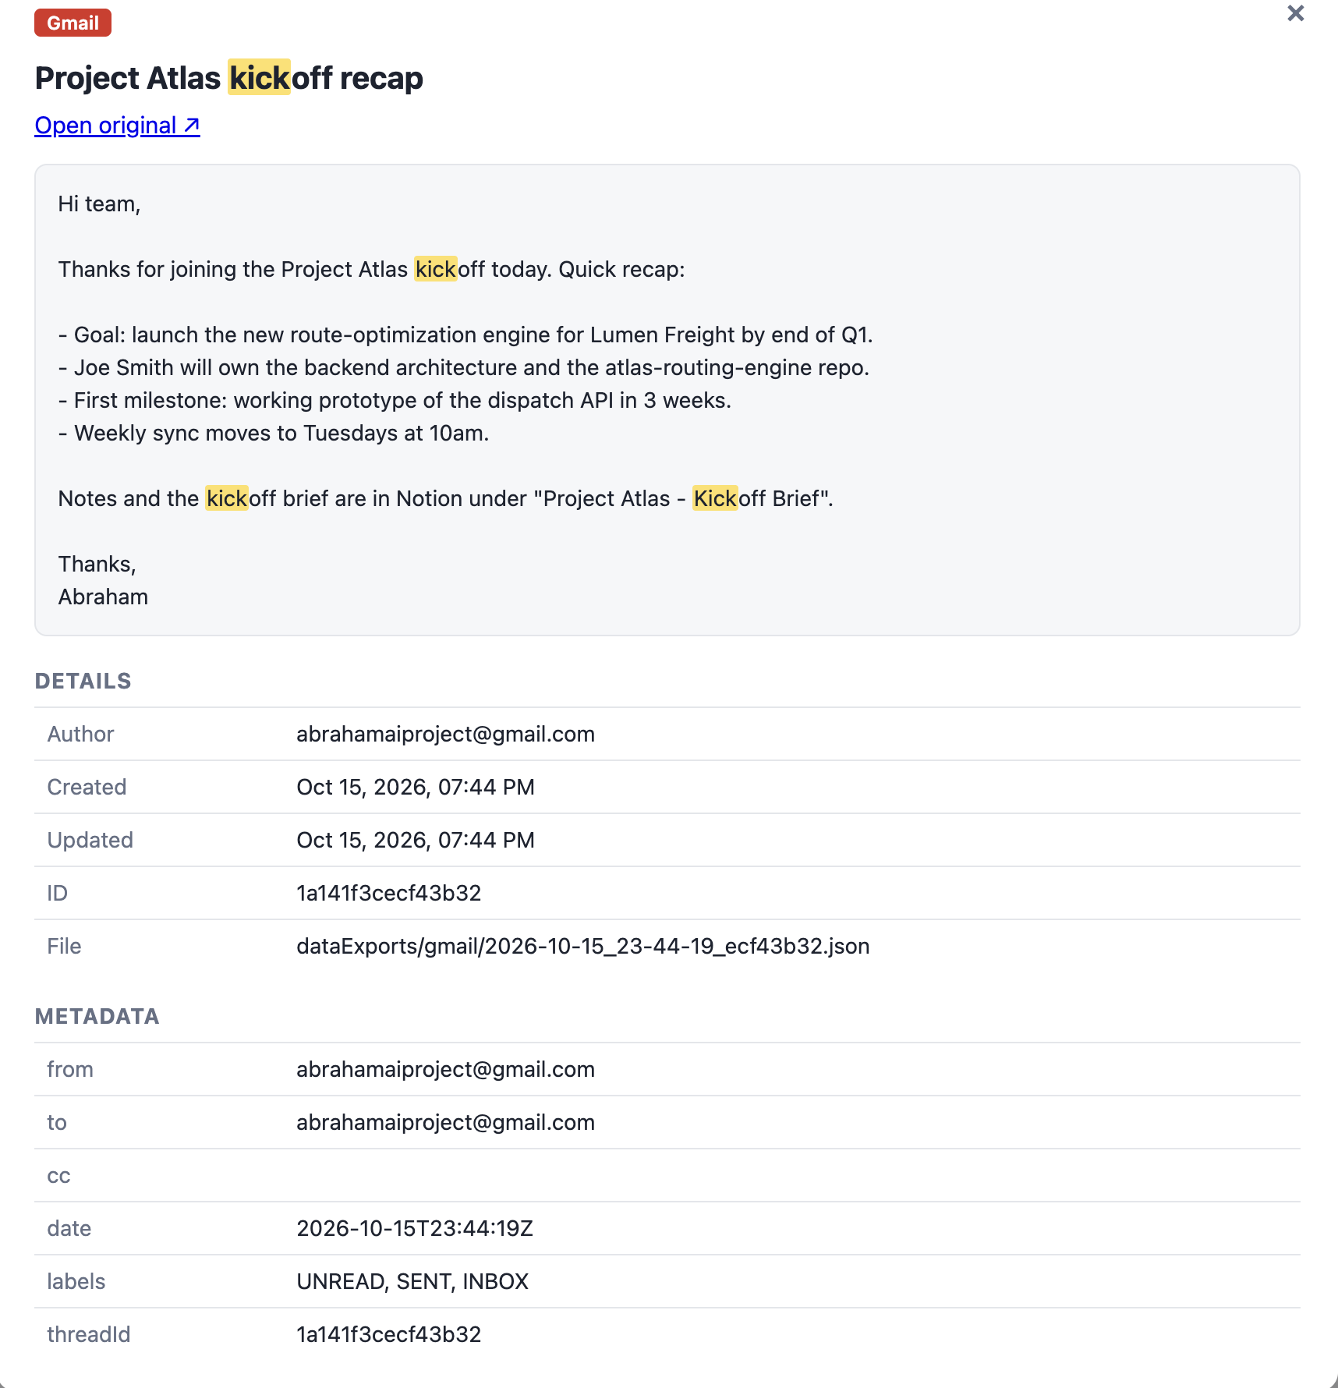
Gmail: original vs dashboard
Original in Gmail
In the dashboard
Item: Email “Project Atlas kickoff recap”
Saved as: dataExports/gmail/2026-10-15_23-44-19_ecf43b32.json
Notes:
Left: the Gmail test item in the real service. Right: the same item read from the local JSON export in the dashboard.

Slide 6
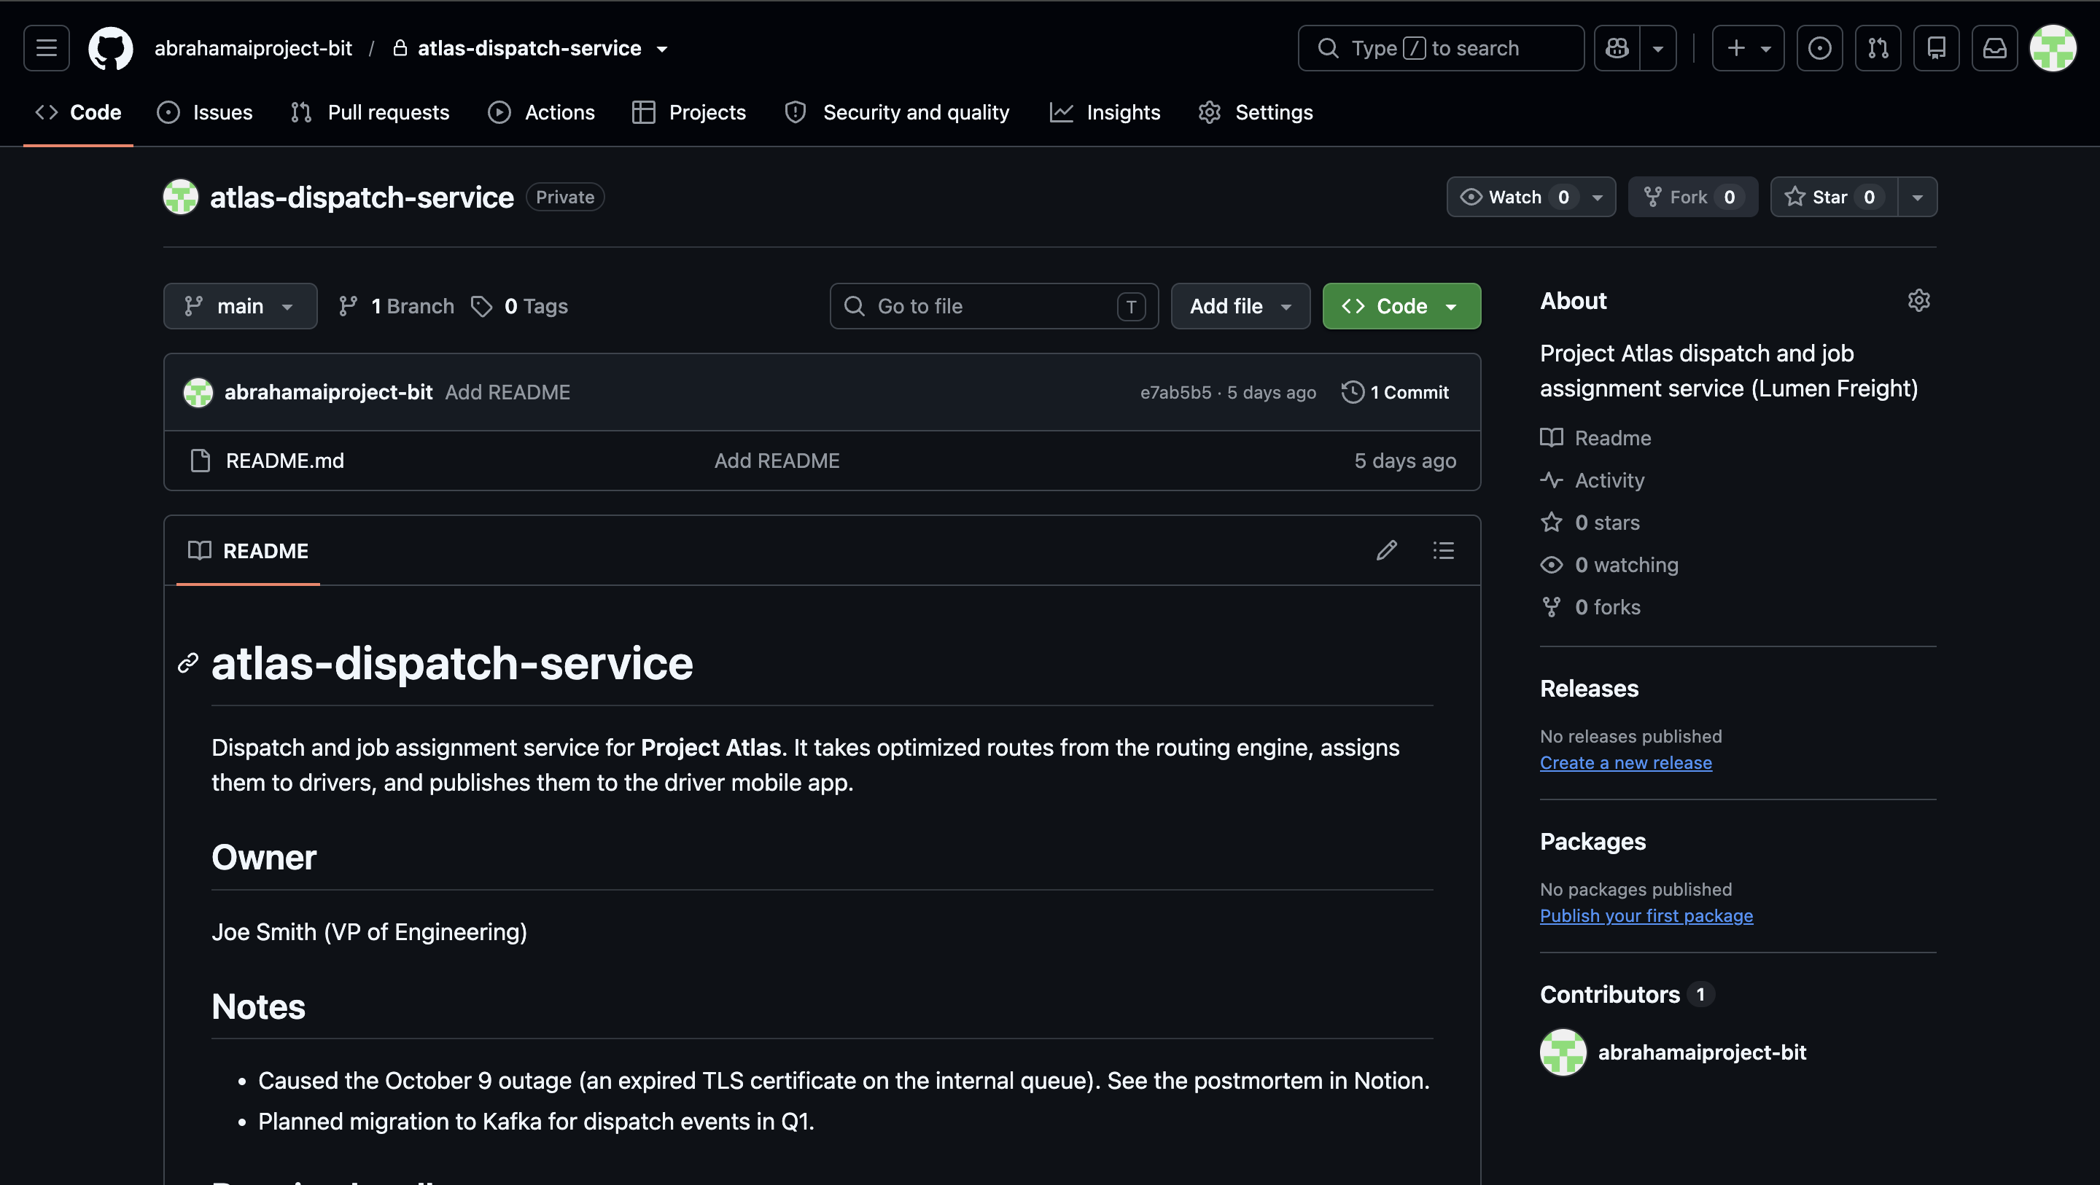
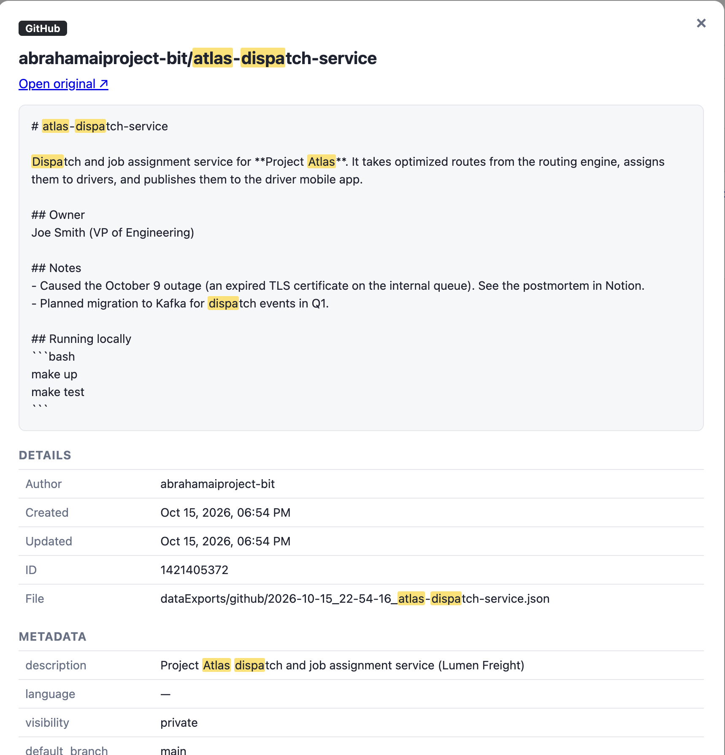
GitHub: original vs dashboard
Original in GitHub
In the dashboard
Notes:
Left: the GitHub test item in the real service. Right: the same item read from the local JSON export in the dashboard.

Slide 7
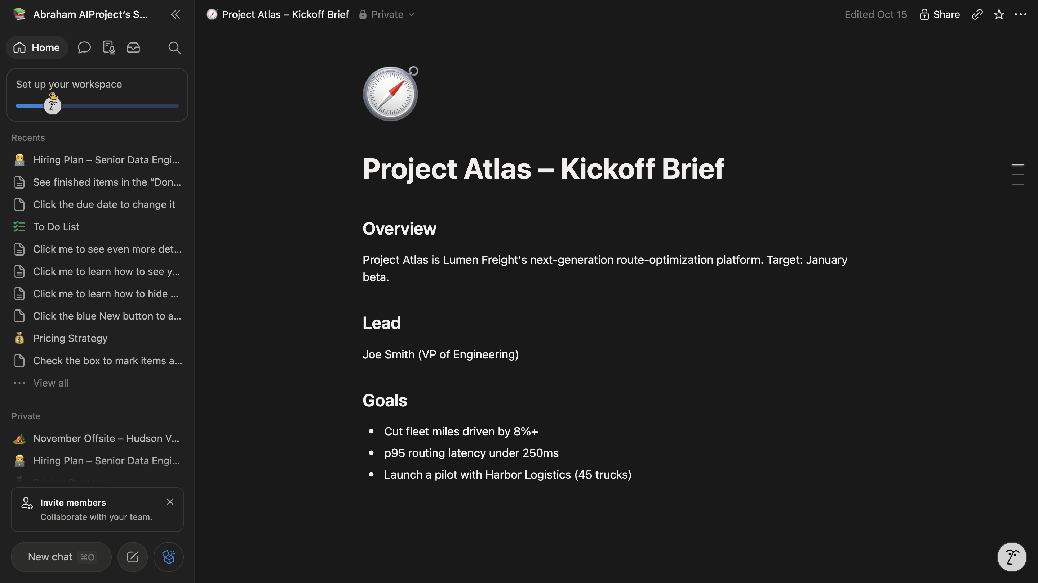
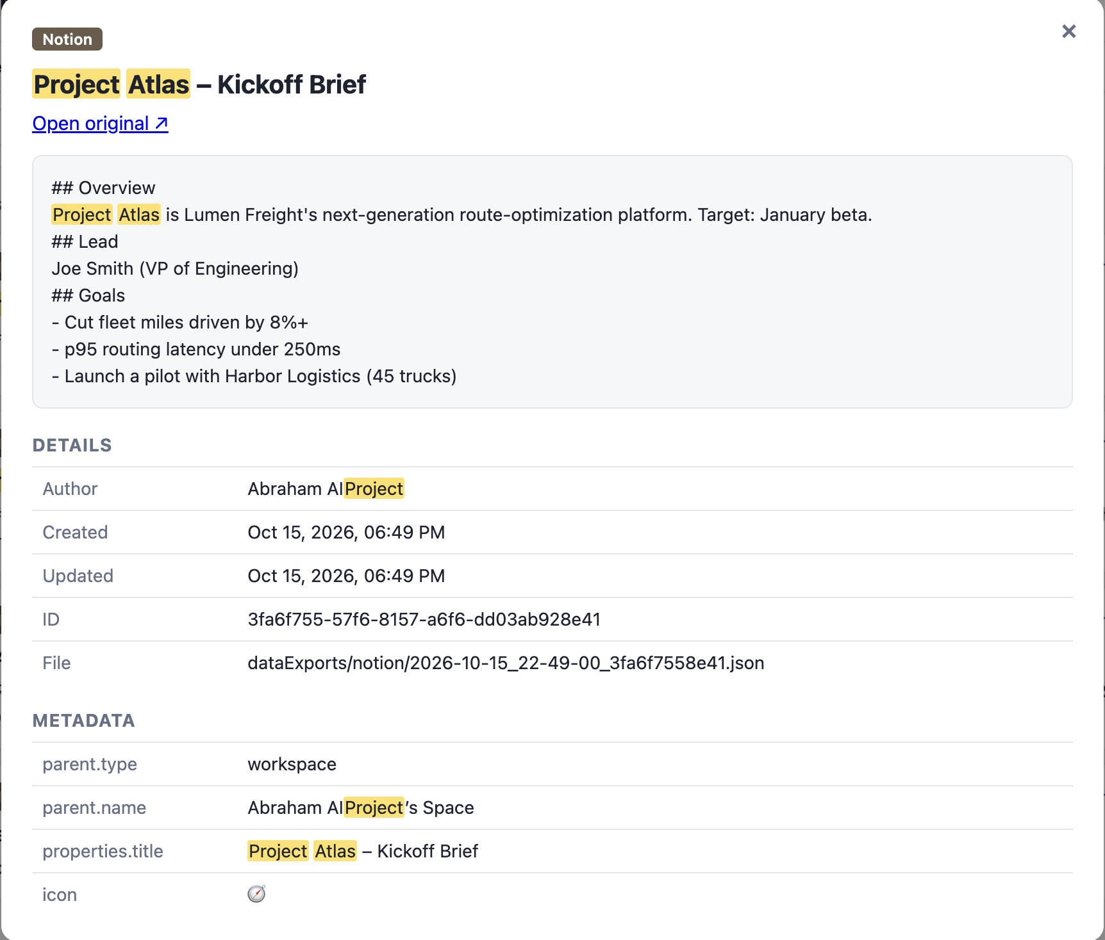
Notion: original vs dashboard
Original in Notion
In the dashboard
Item: Page “Project Atlas – Kickoff Brief”
Saved as: dataExports/notion/2026-10-15_22-49-00_3fa6f7558e41.json
Notes:
Left: the Notion test item in the real service. Right: the same item read from the local JSON export in the dashboard.

Slide 8
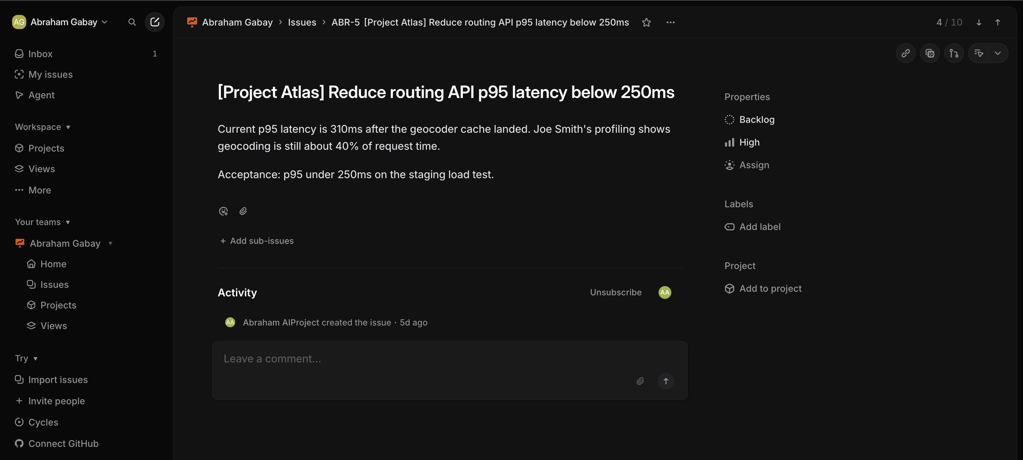
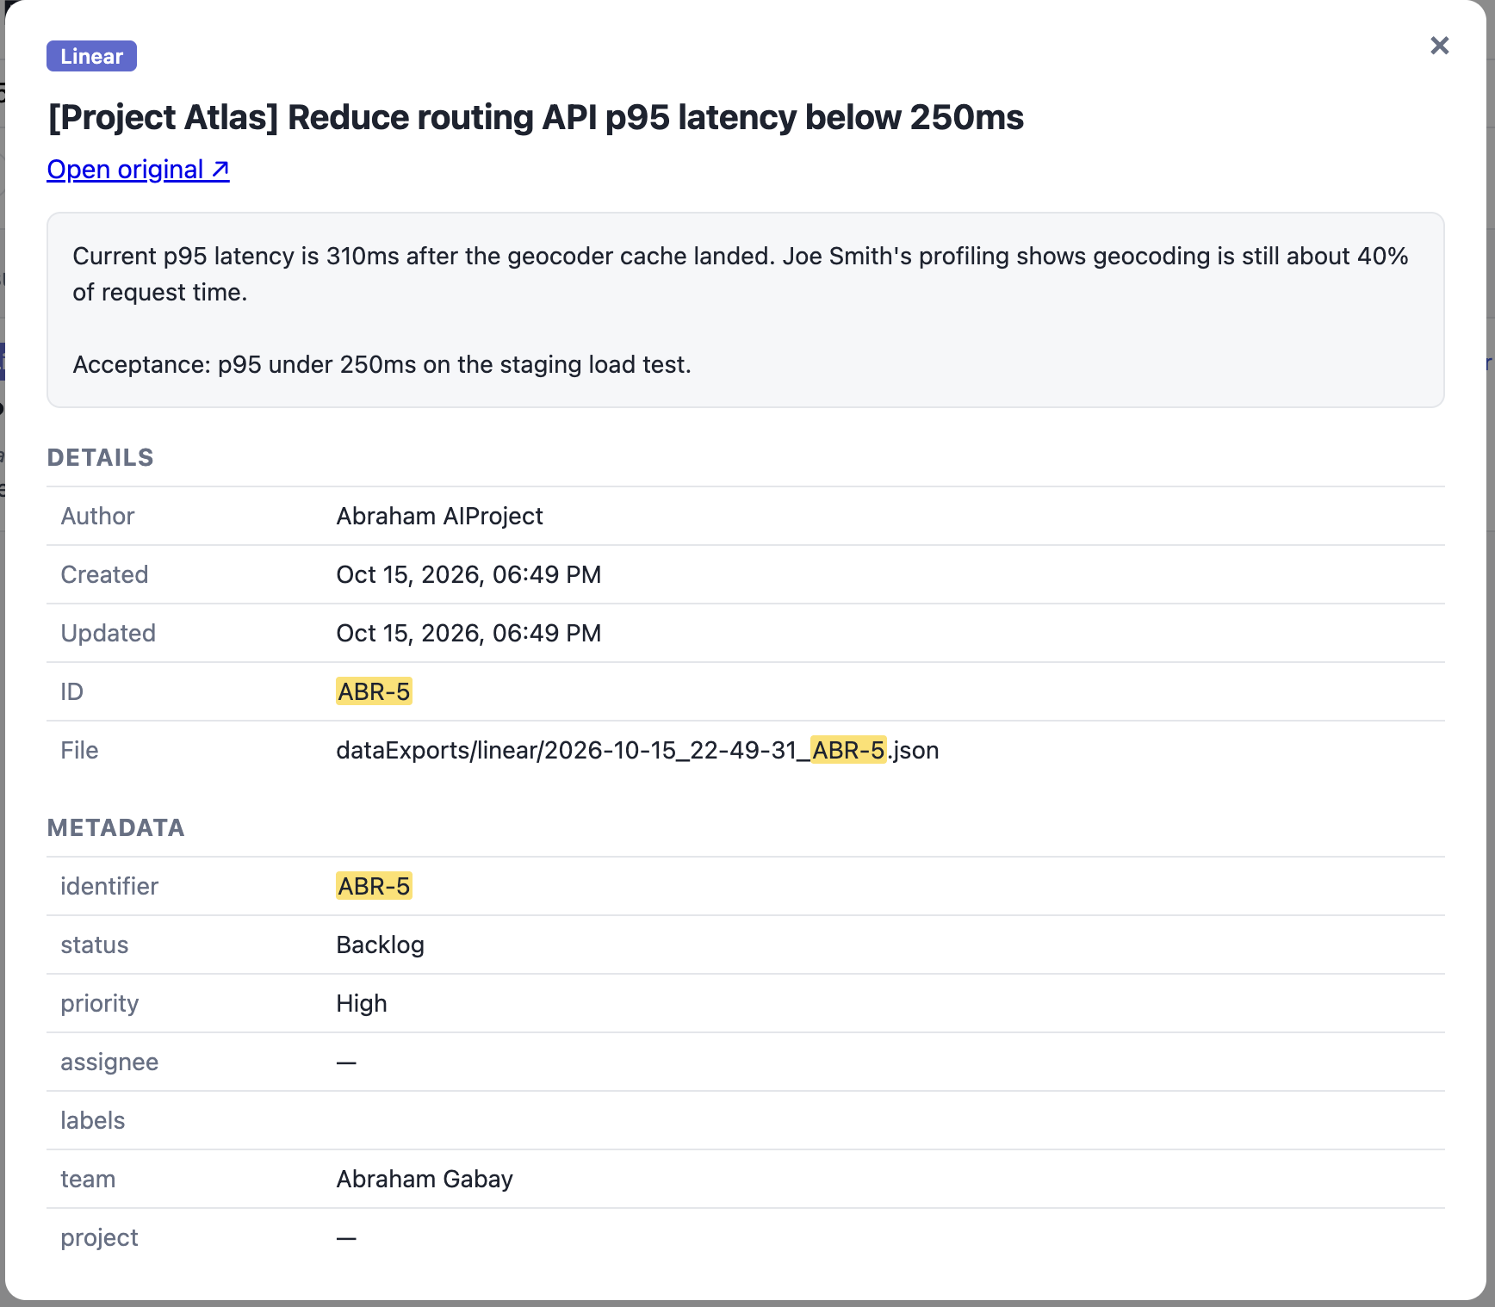
Linear: original vs dashboard
Original in Linear
In the dashboard
Item: Issue ABR-5 “Reduce routing API p95 latency below 250ms”
Saved as: dataExports/linear/2026-10-15_22-49-31_ABR-5.json
Notes:
Left: the Linear test item in the real service. Right: the same item read from the local JSON export in the dashboard.

Slide 9
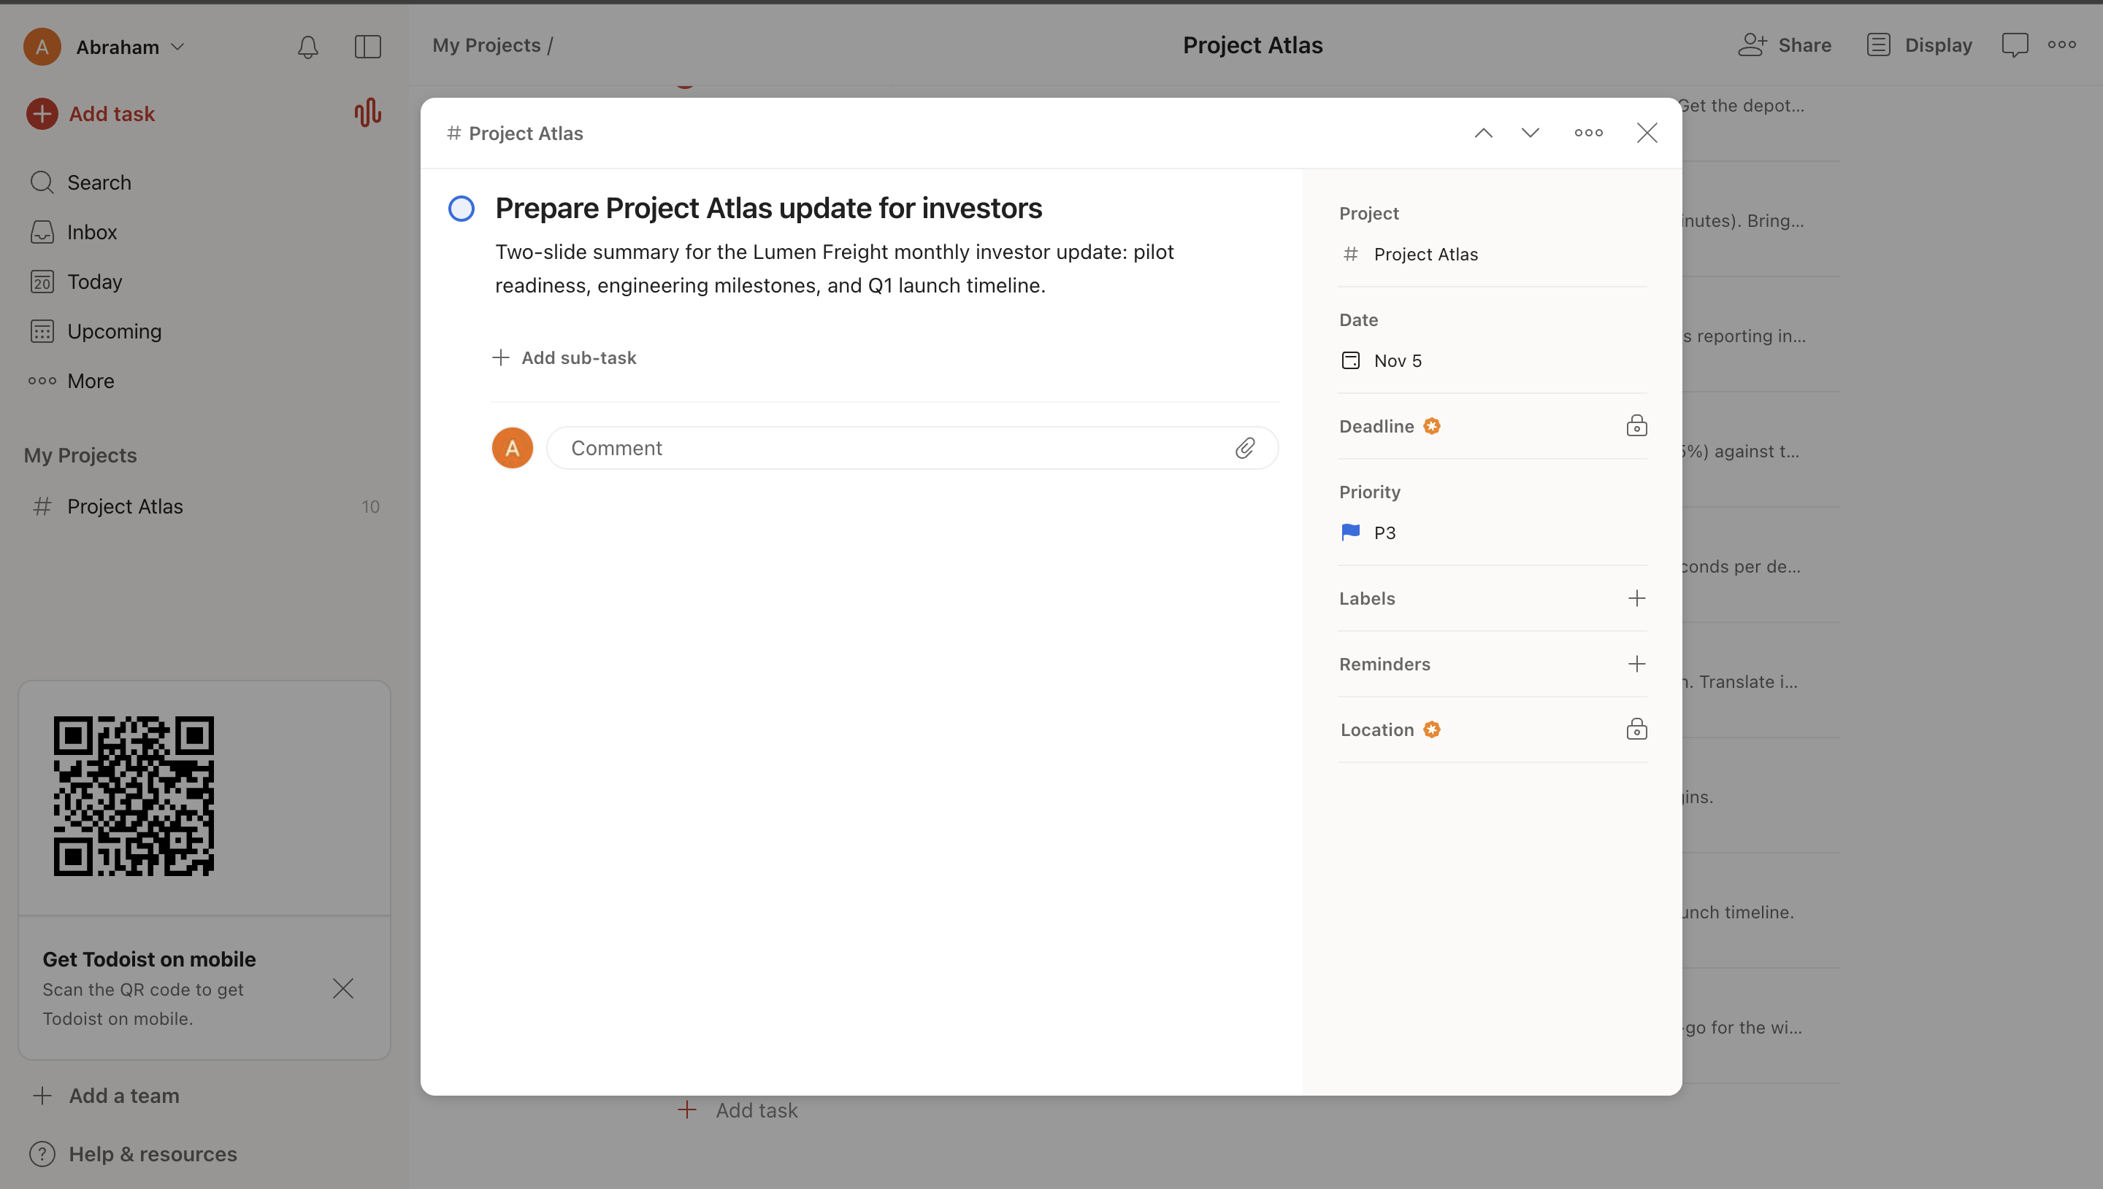
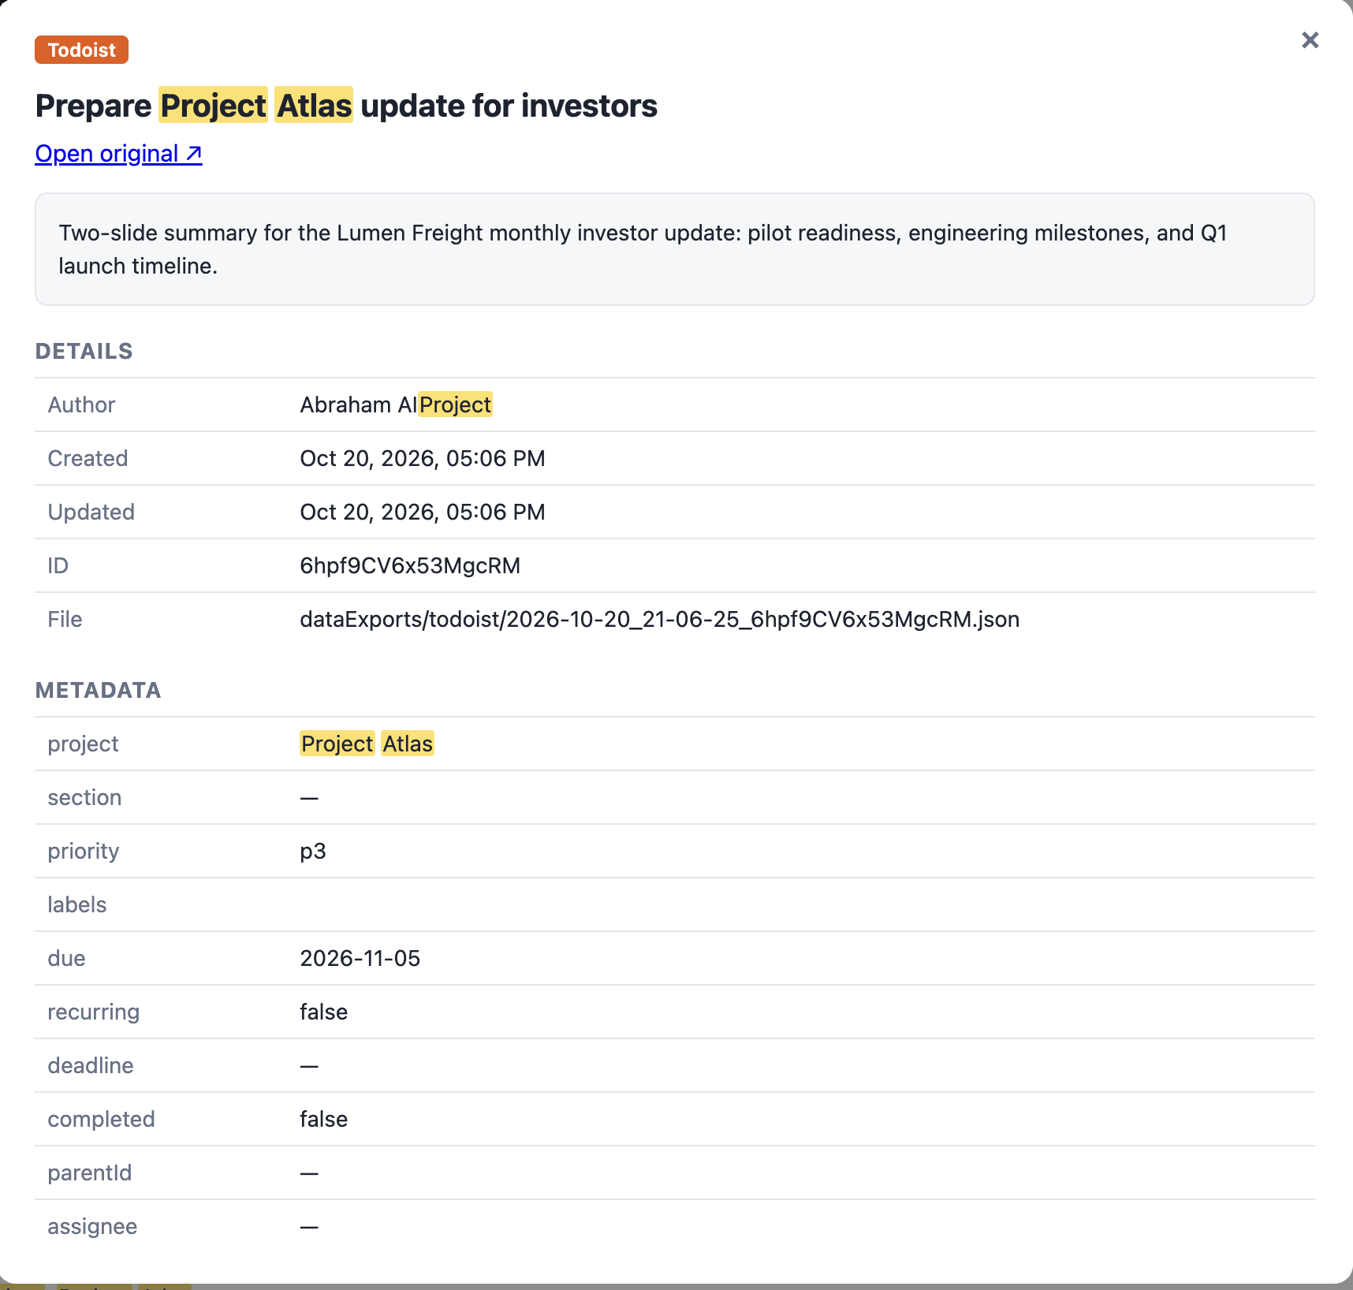
Todoist: original vs dashboard
Original in Todoist
In the dashboard
Notes:
Left: the Todoist test item in the real service. Right: the same item read from the local JSON export in the dashboard.

Slide 10
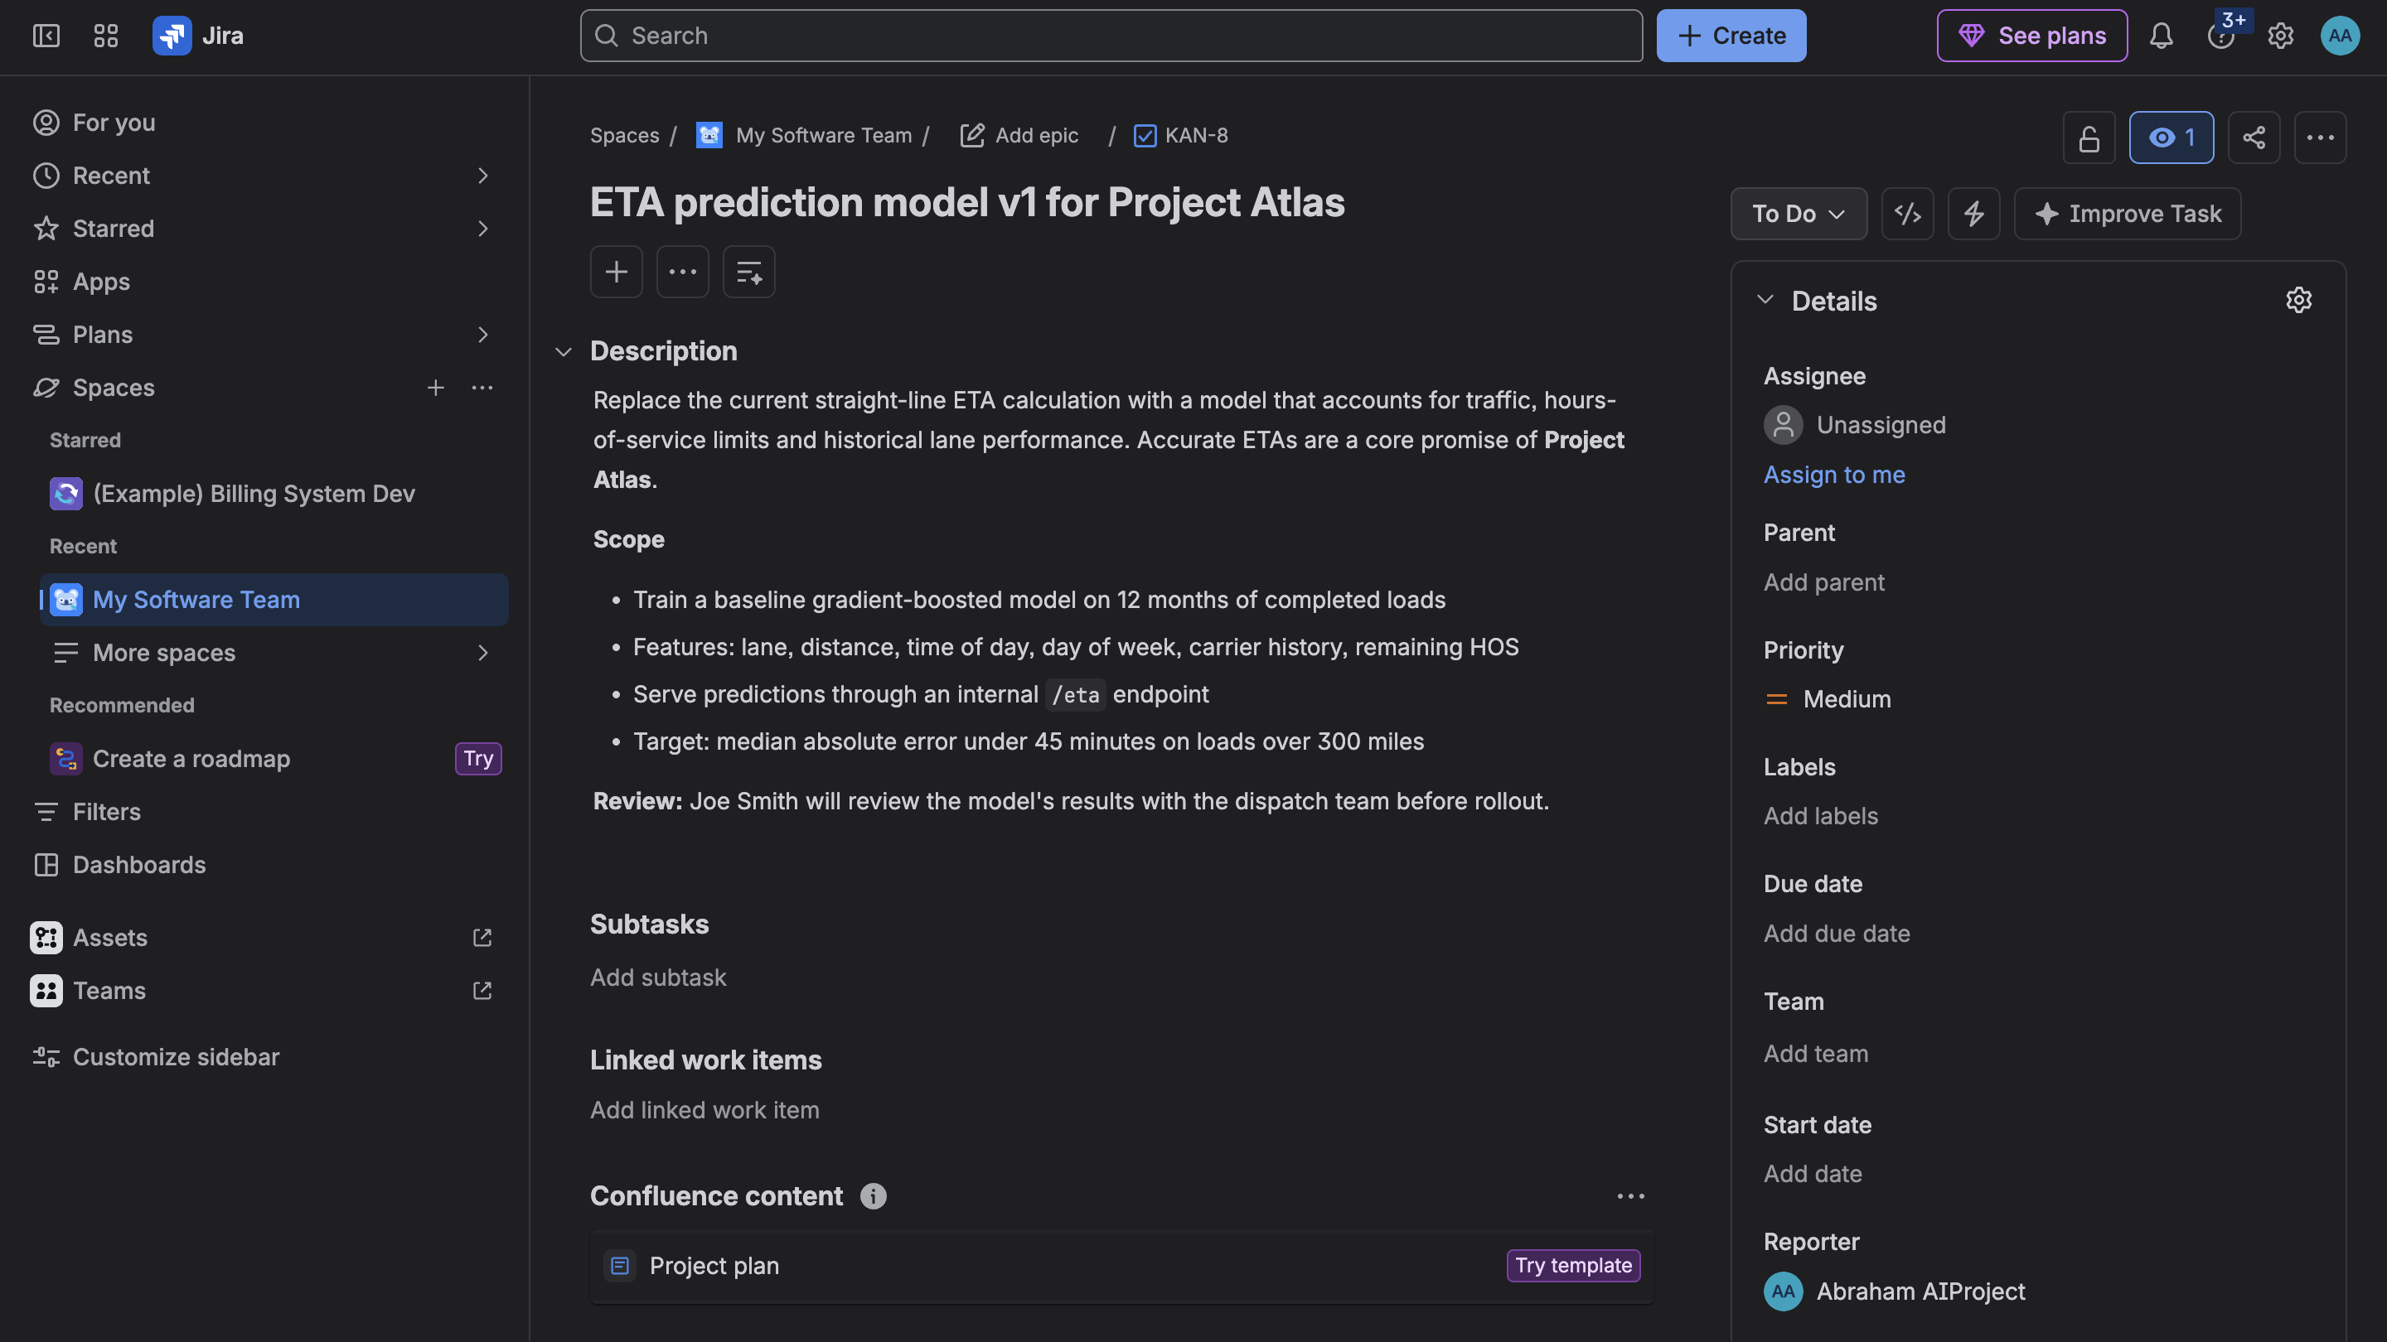
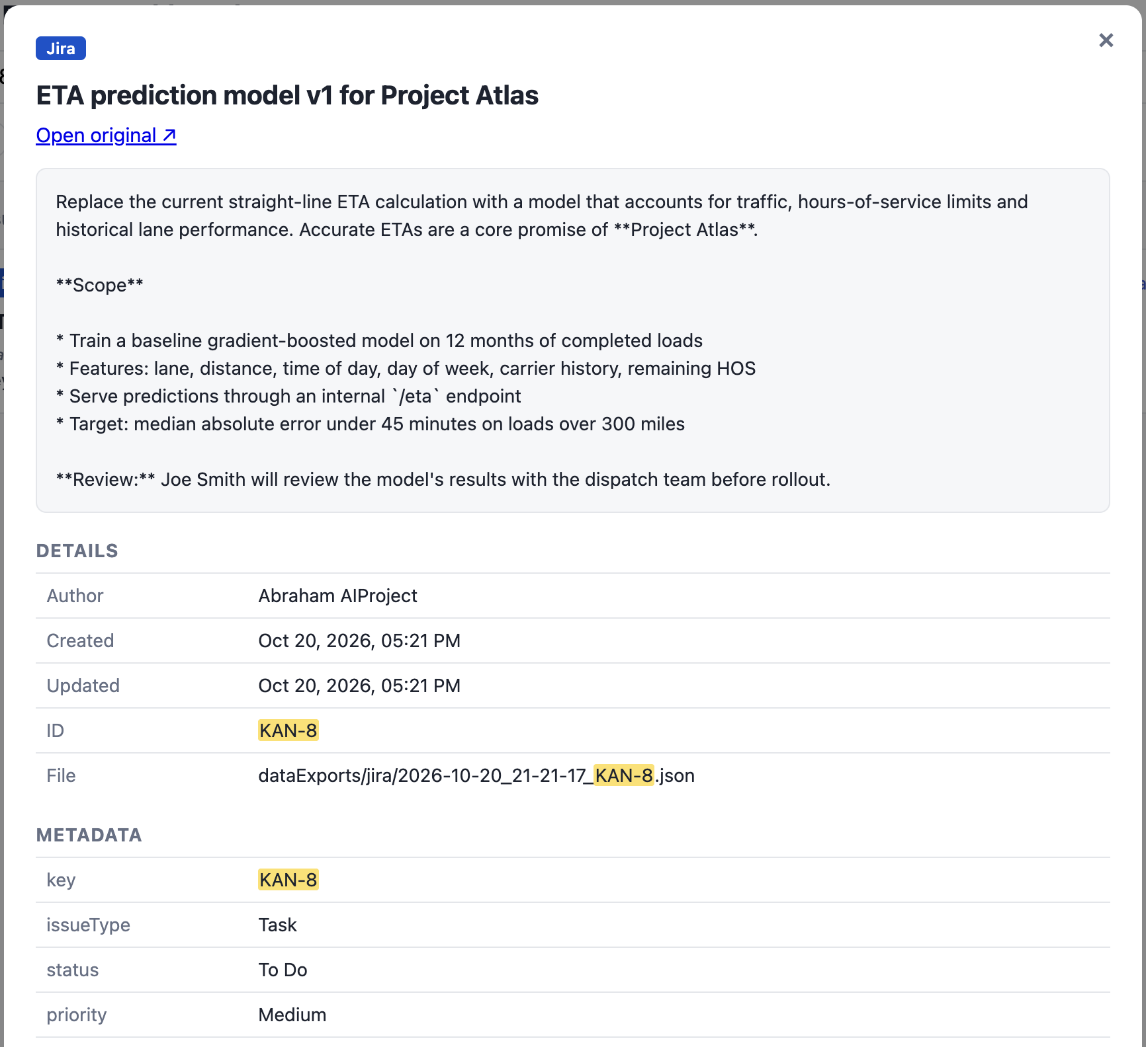
Jira: original vs dashboard
Original in Jira
In the dashboard
Item: Issue KAN-8 “ETA prediction model v1 for Project Atlas”
Saved as: dataExports/jira/2026-10-20_21-21-17_KAN-8.json
Notes:
Left: the Jira test item in the real service. Right: the same item read from the local JSON export in the dashboard.

Slide 11
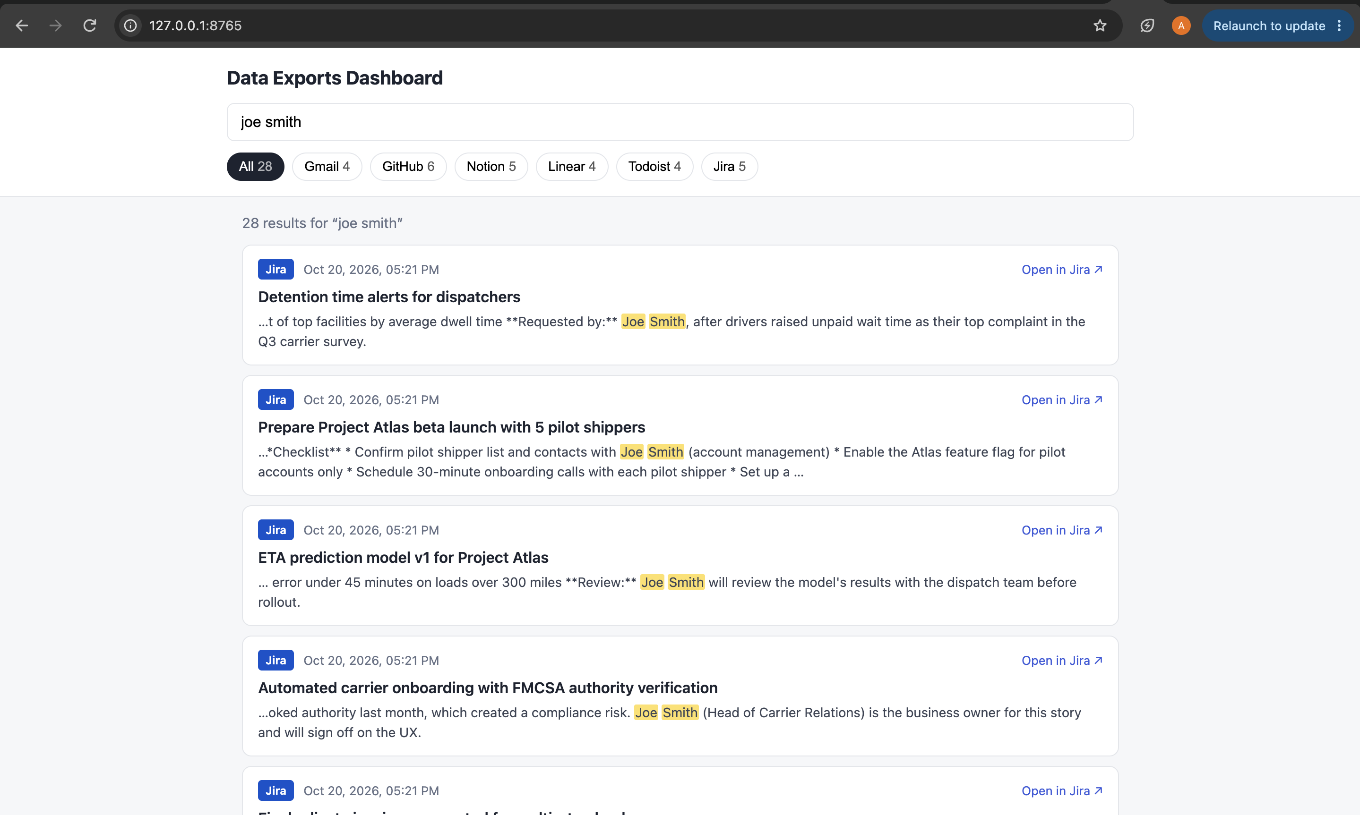
One search across every service
28
results for “joe smith”
6
services in one dashboard
102
items searchable offline

Slide 12
A documented format and a reusable skill
localStorageFormats.md
.claude/skills/export-service-data
One sub-folder per service in dataExports/
One JSON file per item: <UTC time>_<short id>.json
Shared fields: service, id, title, body, author, created, updated, url
Service-specific details in a metadata object (email from/to/labels, repo README, issue status/priority…)
Tells Claude how to download from each service and store it exactly per the format doc
Skips items already on disk by comparing ids
Tested in a fresh conversation: skipped the 25 existing items and saved only new ones
Gmail: 24
GitHub: 11
Notion: 20
Linear: 14
Todoist: 10
Jira: 23

Slide 13
Everything is in one public repo
dataExports/ · .claude/skills/ · .mcp.json · dashboard/ with its README
localStorageFormats.md · root README.md · this presentation and the demo video
github.com/abrahamaiproject-bit/Ai-Homework3-Abraham

