Slide 1
WELCOME

Slide 2
Session 1
4-6 PM GMT @Rohith - Session Lead (9:30-11:30 PM IST) Post 7PM IST everyday

Slide 3
Checklist
Joined Community
Access to Nanodegree Material, timeline
Zoom Invite
Session Lead: @Rohith - Session Lead

Slide 4
Session Lead
Managing weekly Connect sessions with students according to Udacity guidelines
Being present at every Connect session over Zoom, helping students introduce themselves, organizing students in groups and keeping track of time
Explaining concepts of the Nanodegree program to your group of students when needed
Solving questions raised by students during the Connect session
Communicating with students on Slack
Weekly check-in with all students on their progress

Slide 5
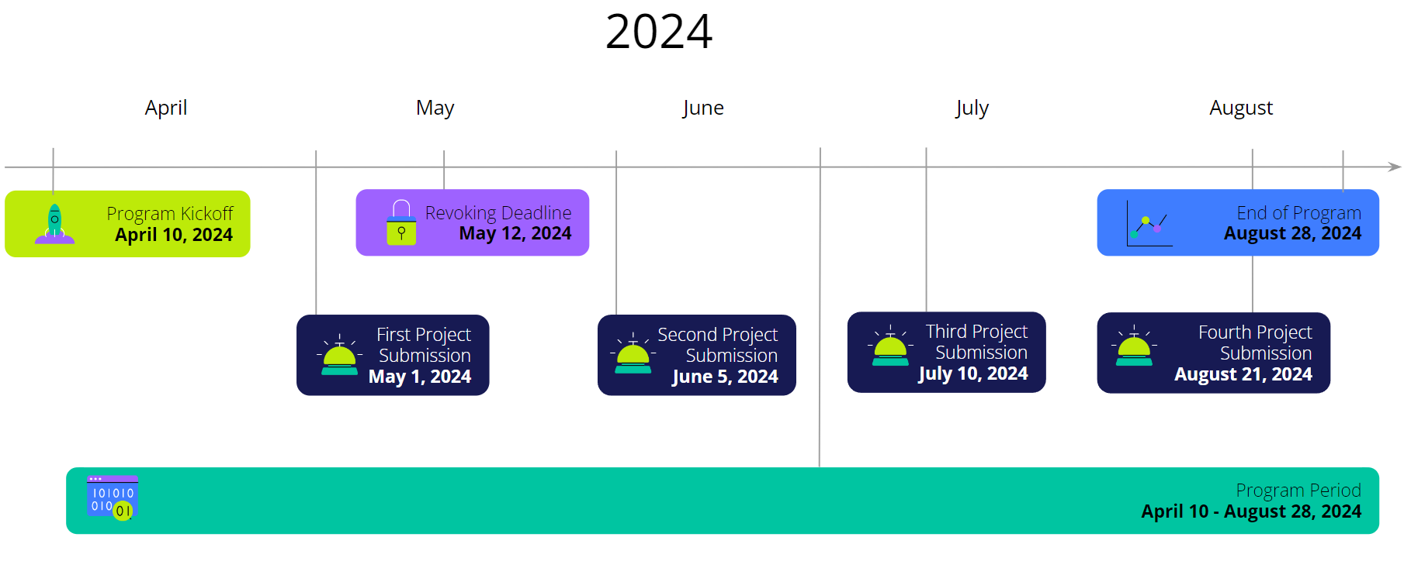

Slide 6
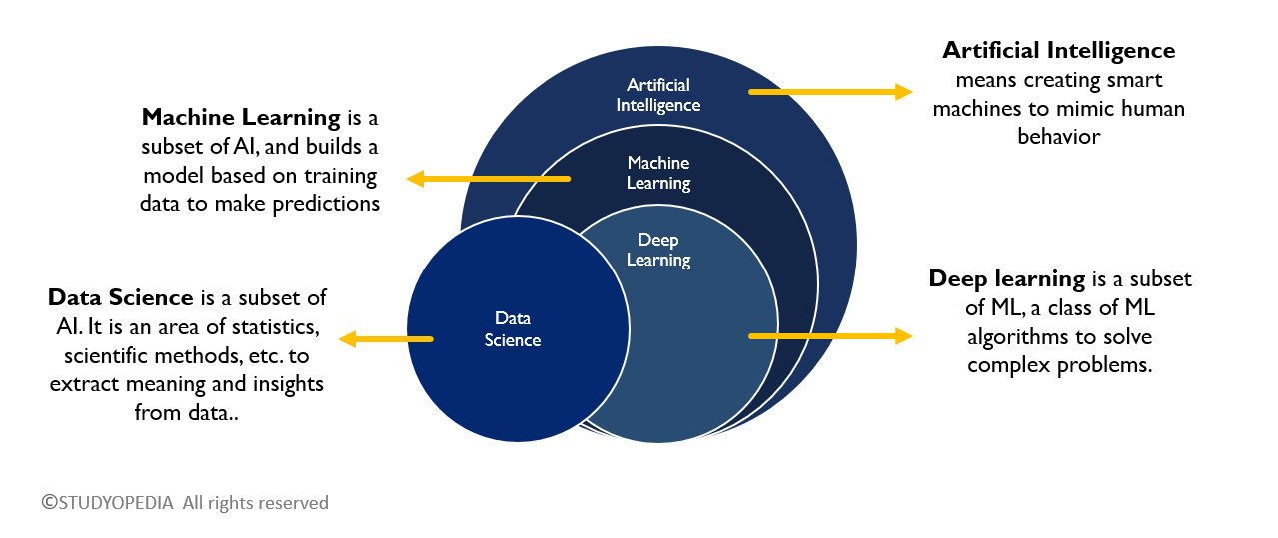
Deep Learning

Slide 7
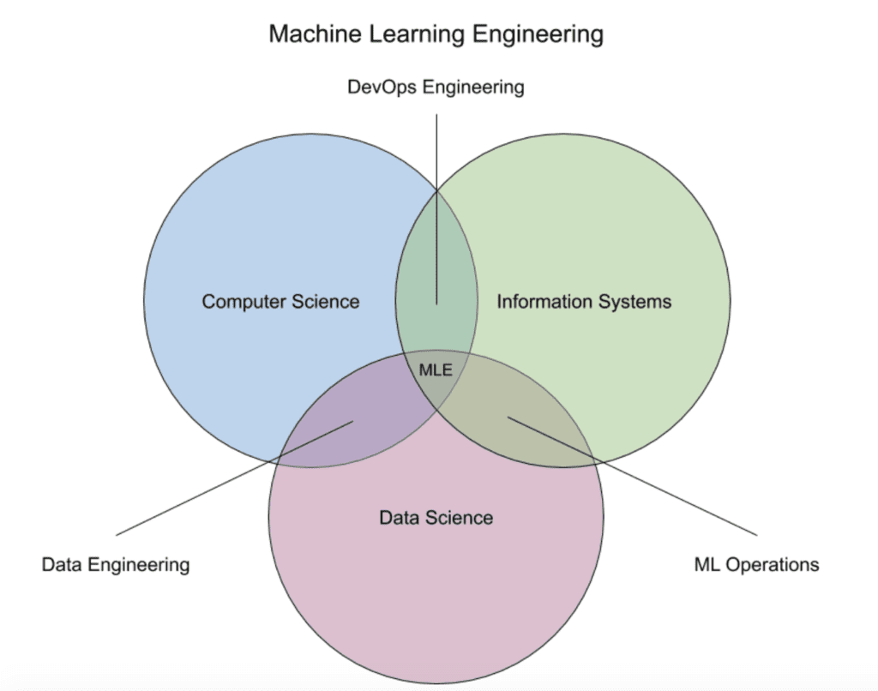
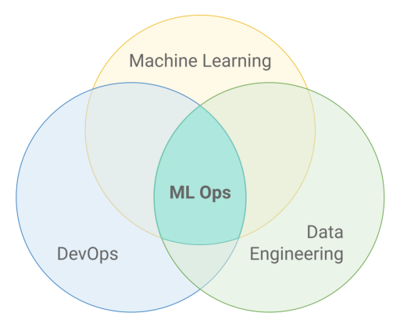
ML Engineer …………… -> ML Ops

Slide 8
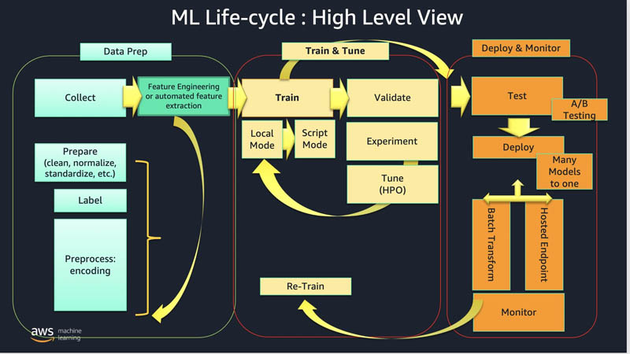

Slide 9
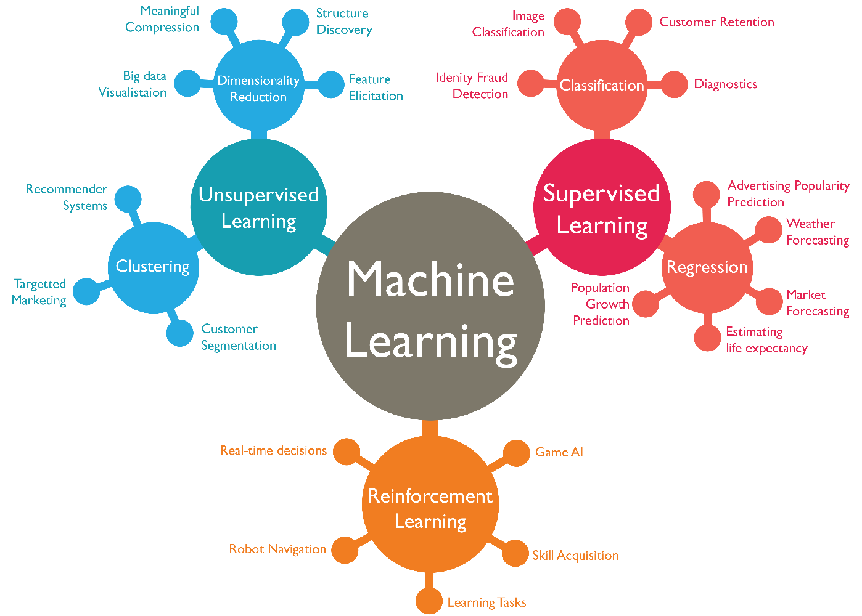

Slide 10
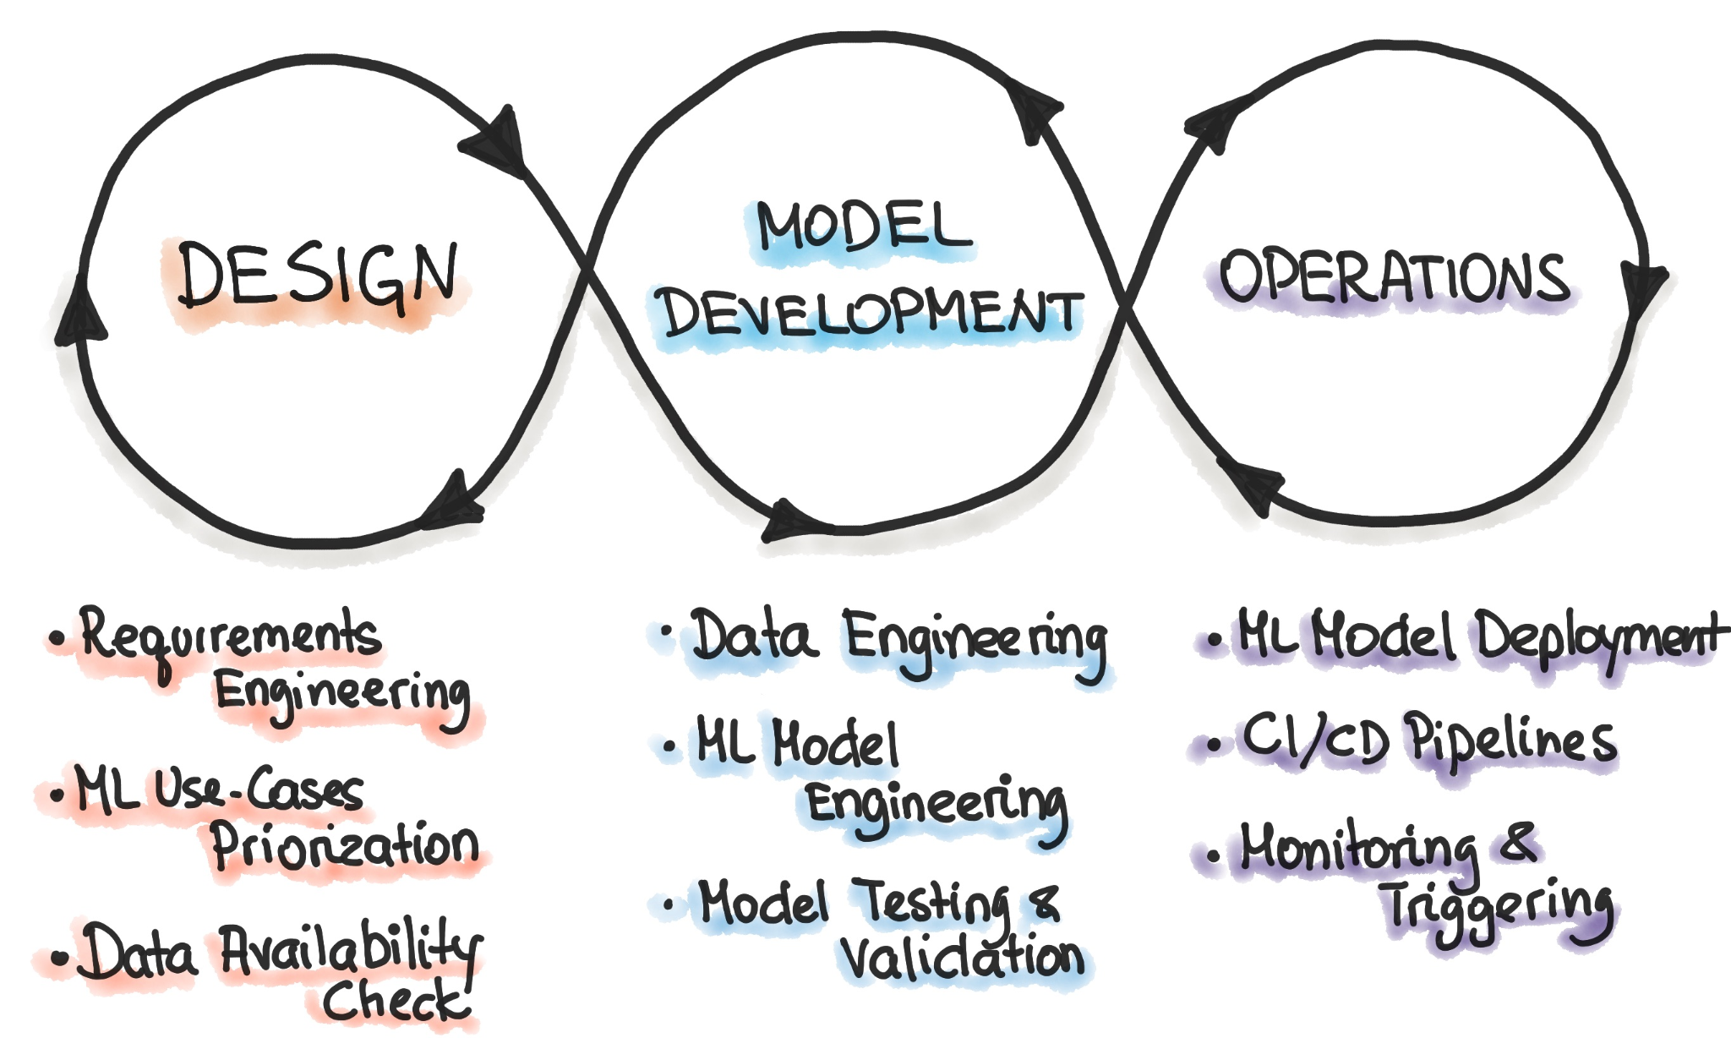
Need for MLOps

Slide 11
Course
Introduction to ML + Predict Bike Sharing Project
Introduction to Deep Learning + Handwritten Digits Classifier with PyTorch
CNN + Landmark Classification & Tagging for Social media
Developing your first ML Workflow + Amazon Sagemaker

Slide 12
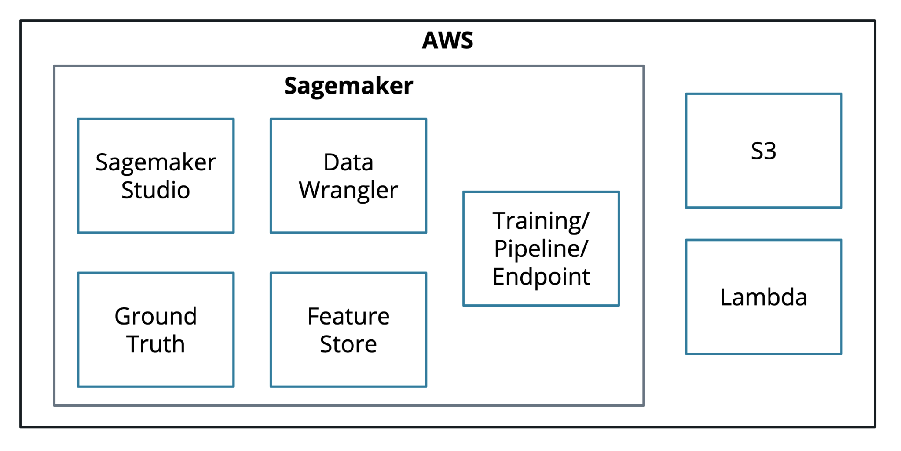
Environment
Programming Language: Python
Development: Jupyter, Sagemaker, Auto Gluon
Cloud Computing power: AWS
Deployment: Sagemaker.

Slide 13
Important
Revoking date: May 12, 2024
Submit the 1st project!
At Least complete the topics that fall under Project 1
Make sure you shutdown the instances (AWS).
Udacity allocated budget worth $25.

Slide 14
Quick References
Approach any ML problem
PyTorch

