Slide 1
Session 4
Calculus - Explicit, Implicit, Total Differentiation, Chain Rule, Relating it with ML

Slide 2
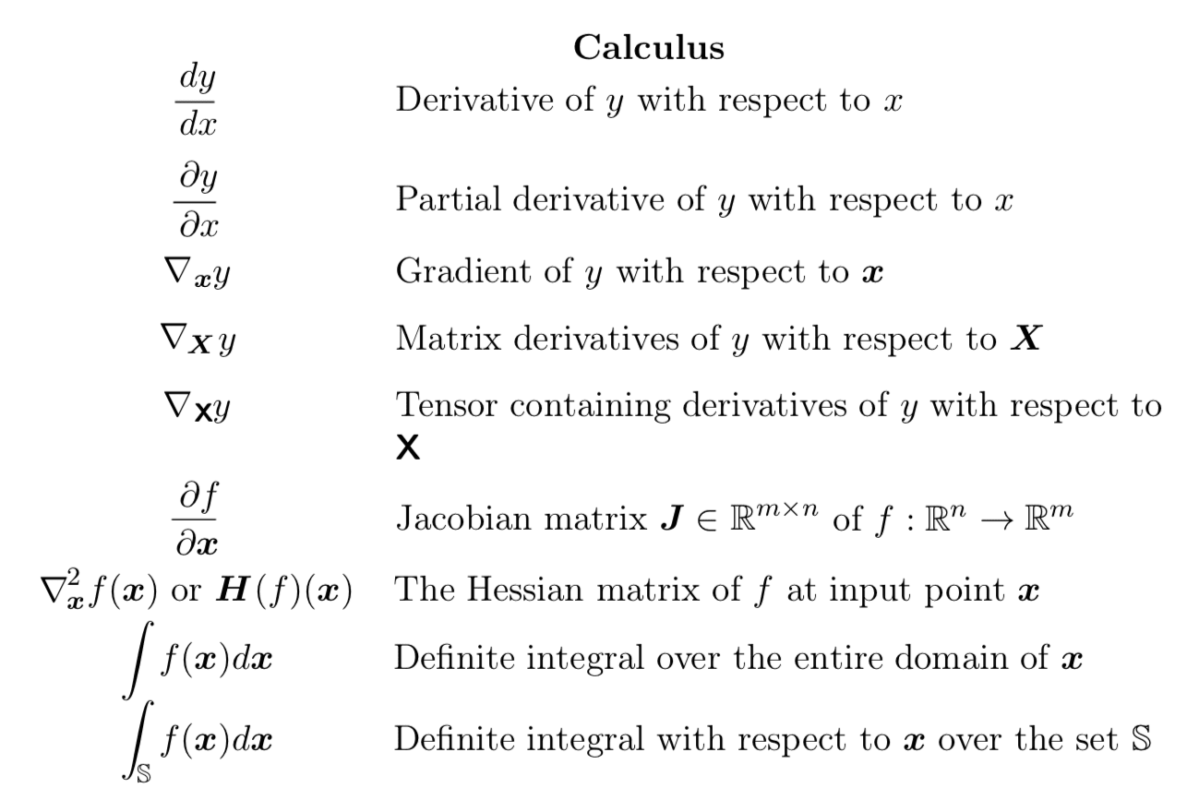
Notation

Slide 3
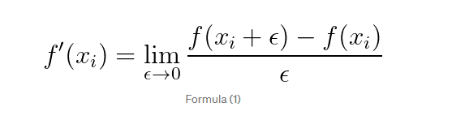
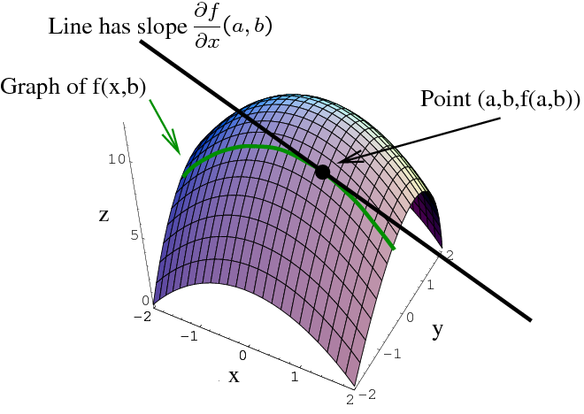
Limits and Differentiation

Slide 4
Need for MultiVariable Calculus
What if variation of single variable is in-sufficient for us ?
Functions could be one of the following (mostly)
R -> R
R^{N} -> R
R^{N} -> R^{M}
^{Image Derivative}

Slide 5
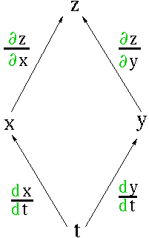
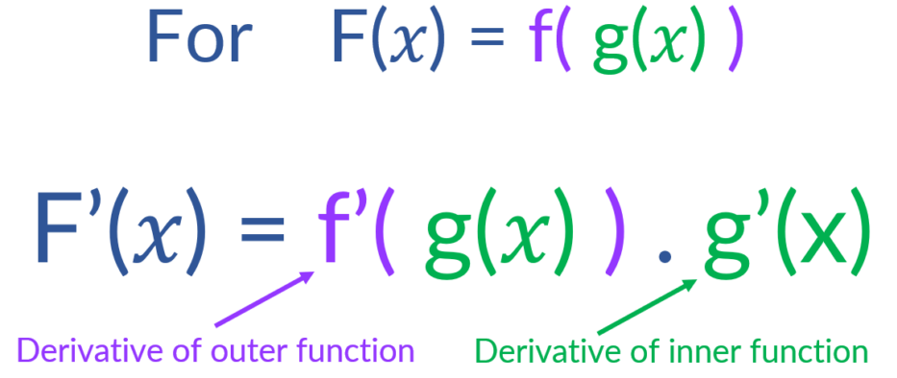

Slide 6
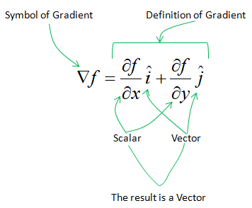
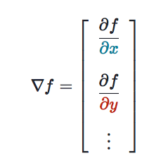
Gradient

Slide 7
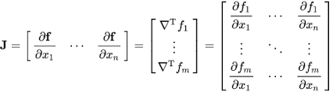
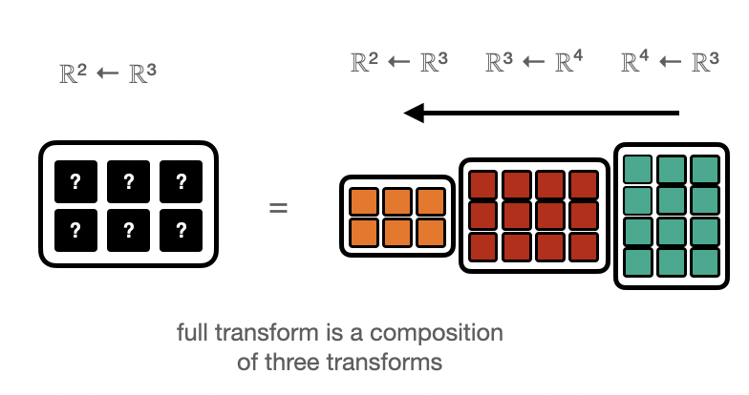
Relation with ML. How can we reach from R³ to R²

Slide 8
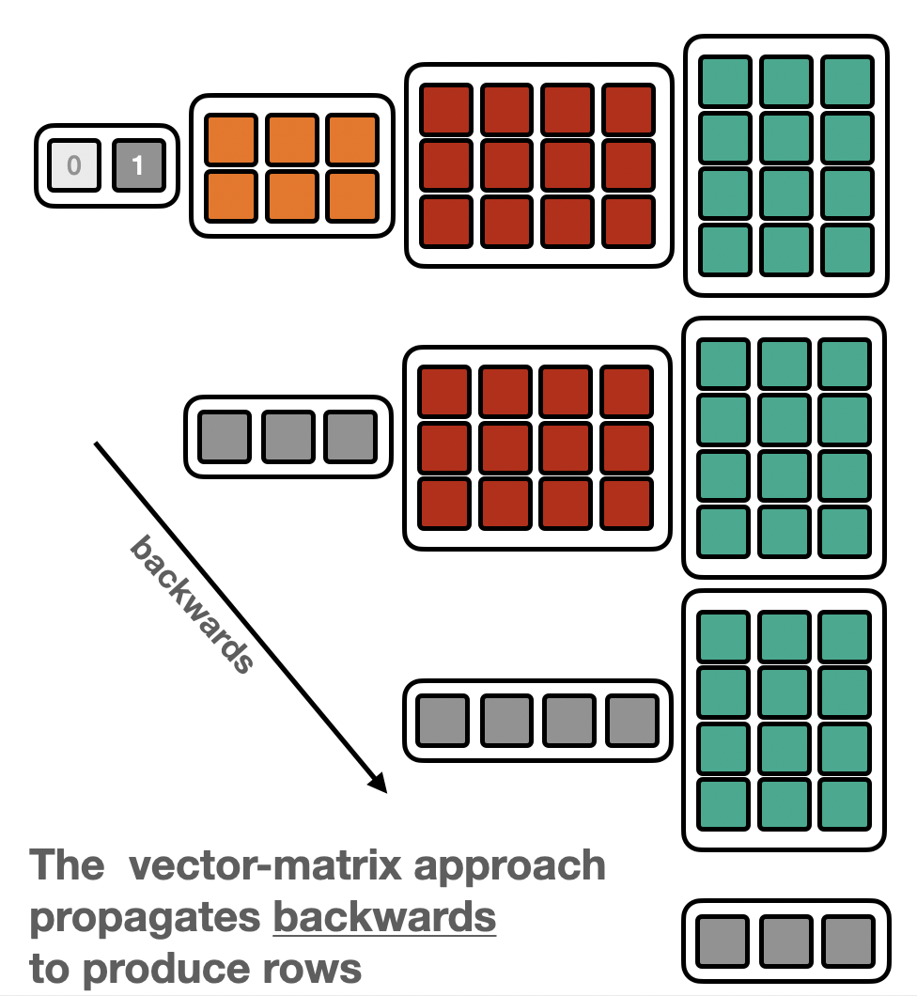
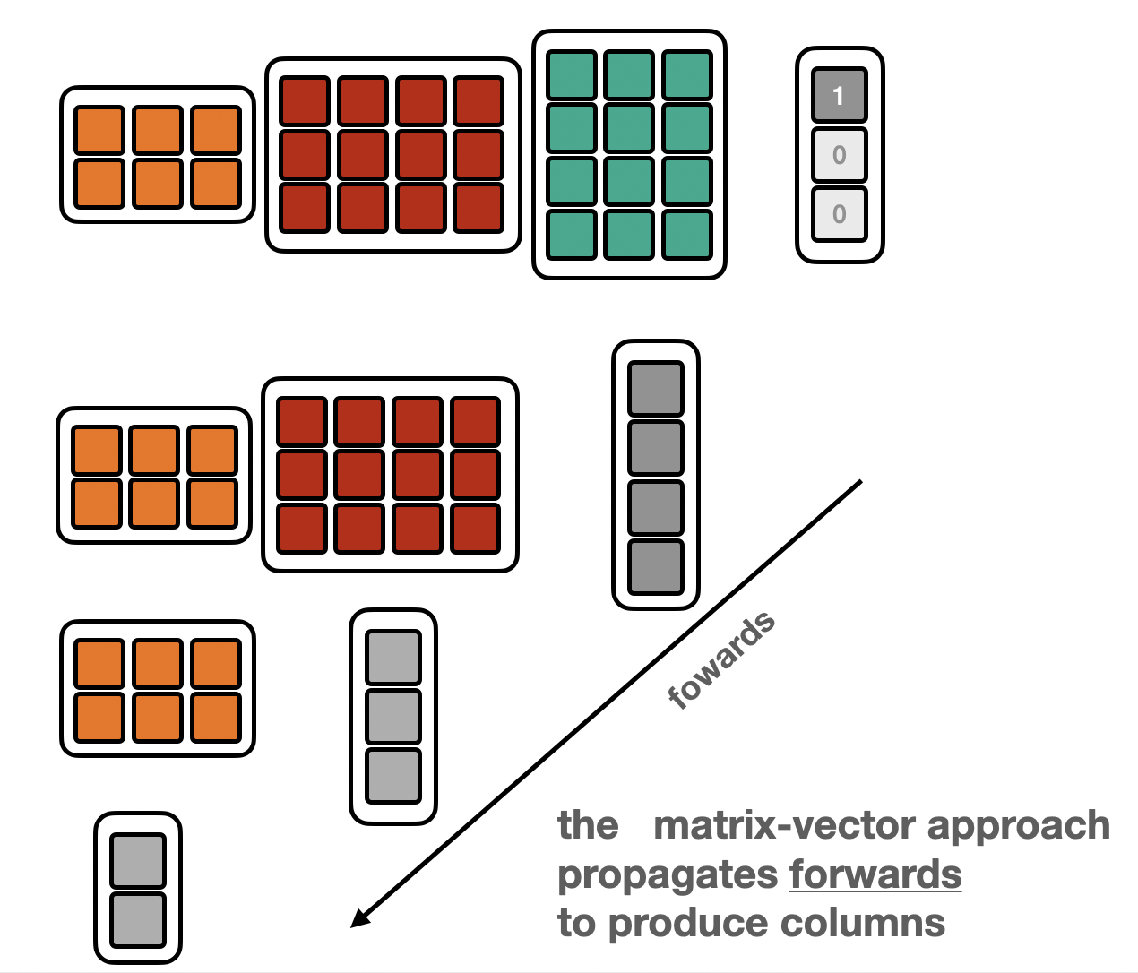
How do I approach this?

Slide 9
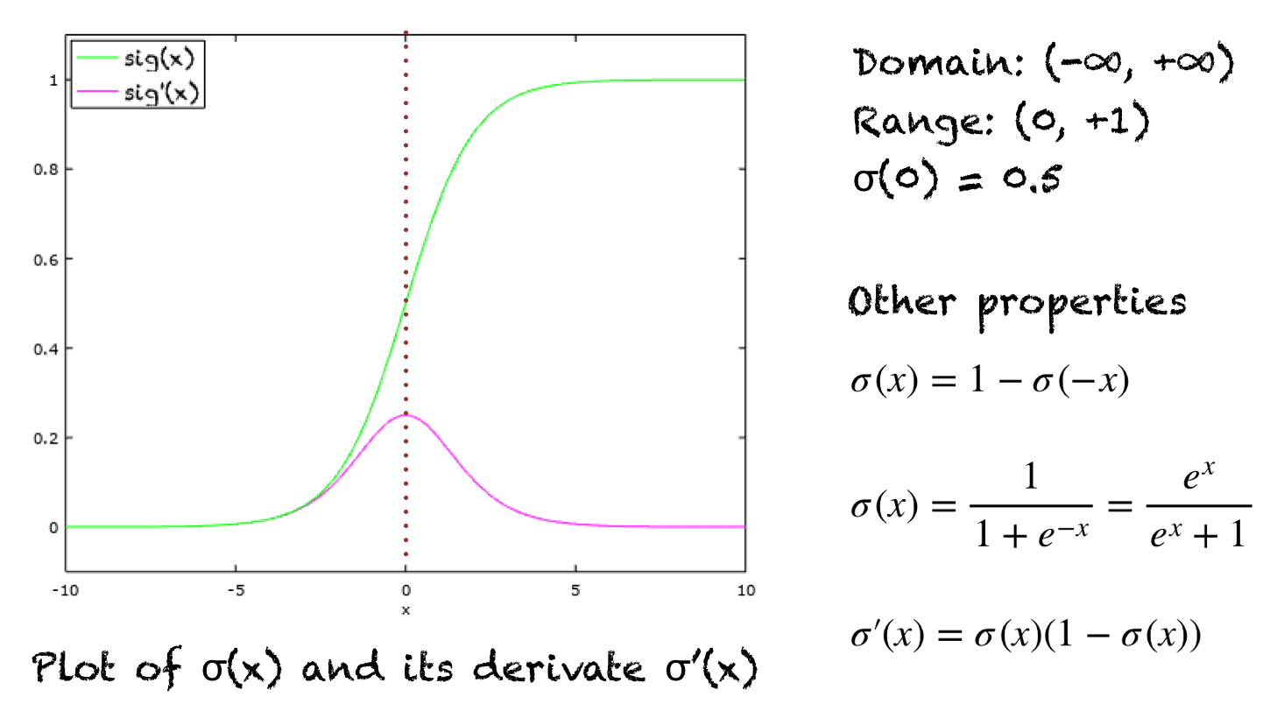

Slide 10
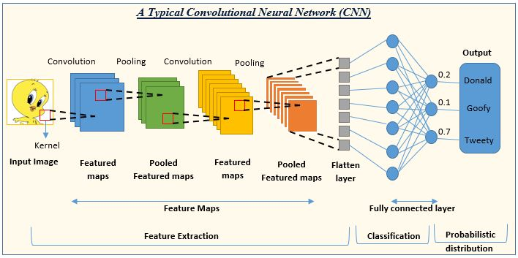
Typical CNN

Slide 11
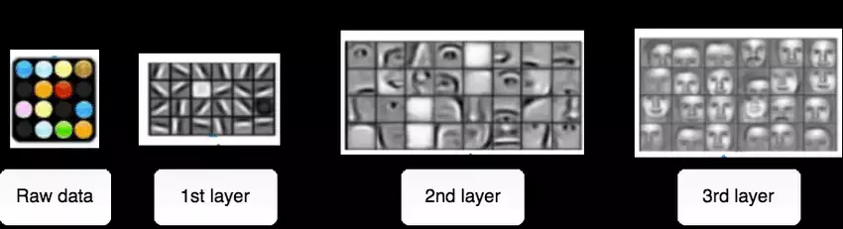
Crux!
Each layer of nodes trains on the output (feature set) produced by the previous layer.
So, nodes in each successive layer can recognize more complex, detailed features – visual representations of what the image depicts.
Such a “hierarchy of increasing complexity and abstraction” is known as feature hierarchy. (Yes! We need to build this feature hierarchy to make robust predictions)

Slide 12
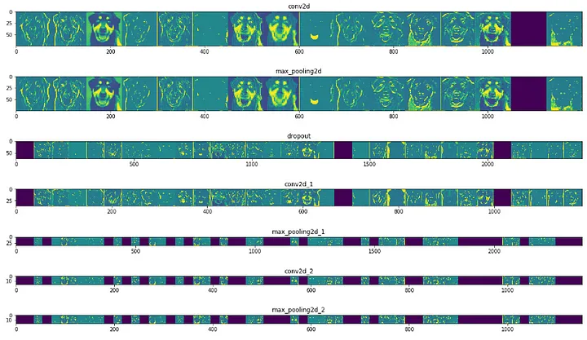
Sample gradient map

Slide 13
