Slide 1
Session 6
PyTorch API Hierarchy | CNN | Implementation!! | Project -2

Slide 2
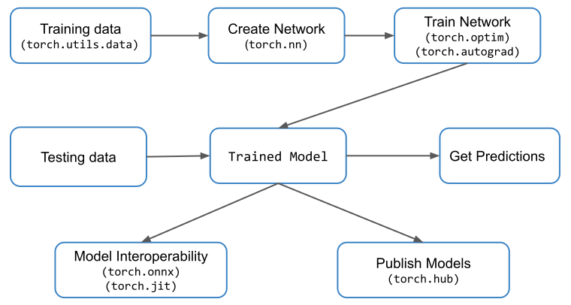

Slide 3
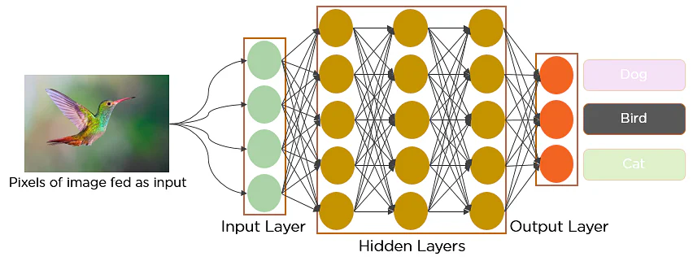

Slide 4
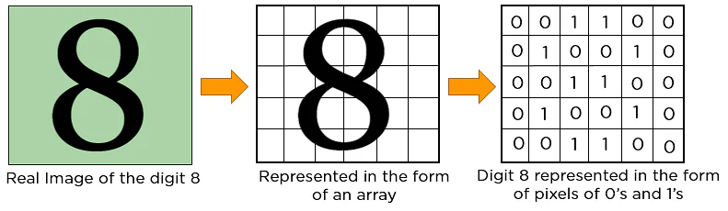
Okay, Let’s understand Images

Slide 5
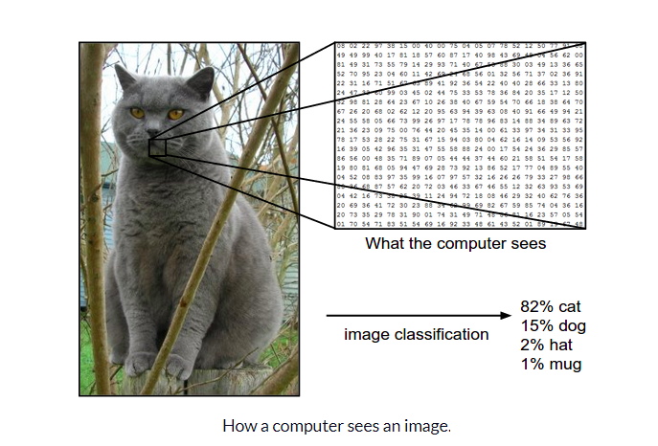

Slide 6
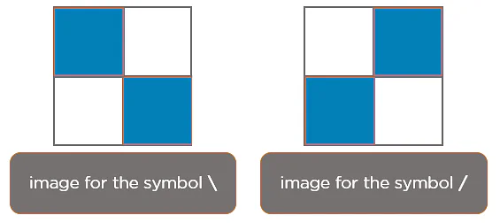
CNN - Images

Slide 7
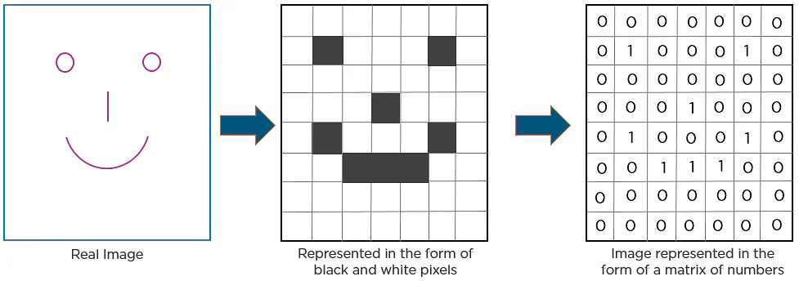
Images - Edges are very IMP!!

Slide 8
Let’s Understand in Depth
https://setosa.io/ev/image-kernels/
https://poloclub.github.io/cnn-explainer/
https://cs231n.github.io/convolutional-networks/
Interactive CNN - 2D
Interactive DNN - Images
Always Remember: Total number of channels in the image MUST match with the total number of channels in the filter.

Slide 9
CNN In Action!

Slide 10
Convolution Math!
Convolutional Layers have a moving filter also called as the weight matrix. The filter slides over the input image (convolution operation) to produce a feature map.
Weight matrix and Input Image multiply (dot product) and summed to produce the feature map.
Ex: (18 x 1 + 54 x 0 + 51 x 1) + (55 x 0 + 121 x 1 + 75 x 0) + (35 x 1 + 24 x 0 + 204 x 1)

Slide 11
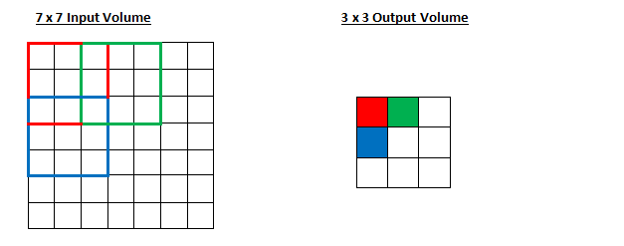
Stride
Stride decide how our weight matrix should move in the input, i.e jumping one step or two.
In the example, we can see The weight matrix move by two places.

Slide 12
Padding
The edge pixels or the number in the input matrix are less used compared to the inside pixels/numbers.
So their contribution is less to form the output.
In order to make them equal, we use padding. Padding is of two types “SAME”, “VALID”.
In SAME padding we add extra zeros to the edges of the input matrix.
Whereas in VALID padding we don’t add any extra rows or columns.

Slide 13
Formula
A Quick Question:
Image of size 7x7x3 is being convolved with 10 kernels(filter) of size 3x3x3. Assume there is no padding. And the Stride is 1. Please comment on the total number of feature maps and the size of each feature map
Formula to get the shape of feature maps;
W - F + 2P
1
s

Slide 14
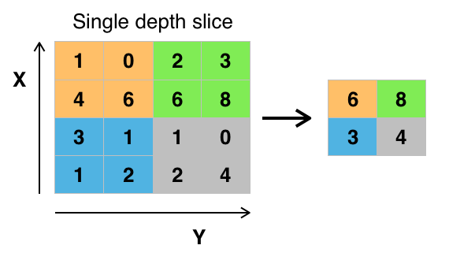
Max Pooling
We move a window across a 2D input space, where the maximum value within that window is the output.
It is also called as downsampling layer because it reduces the number of parameters within the model.

Slide 15
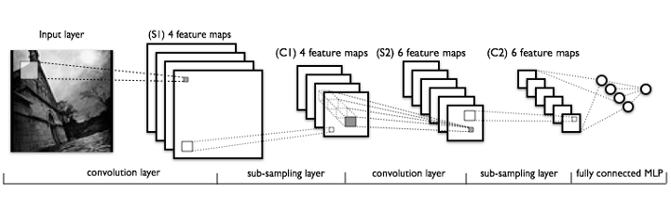
Typical CNN Network

Slide 16
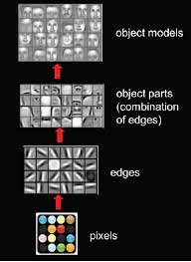
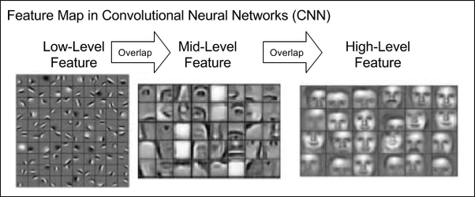
Features in CNN

Slide 17
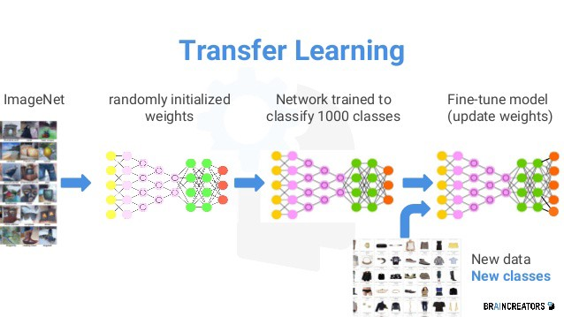
Transfer Learning

Slide 18
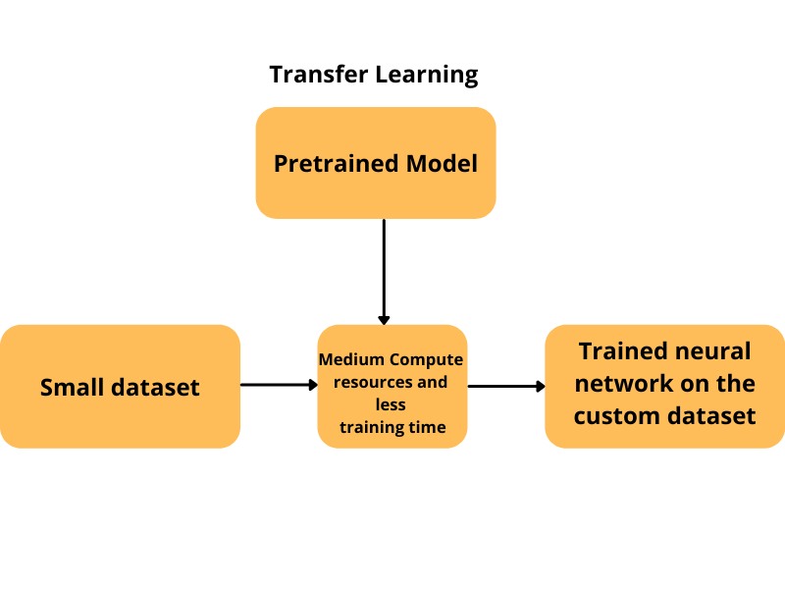

Slide 19
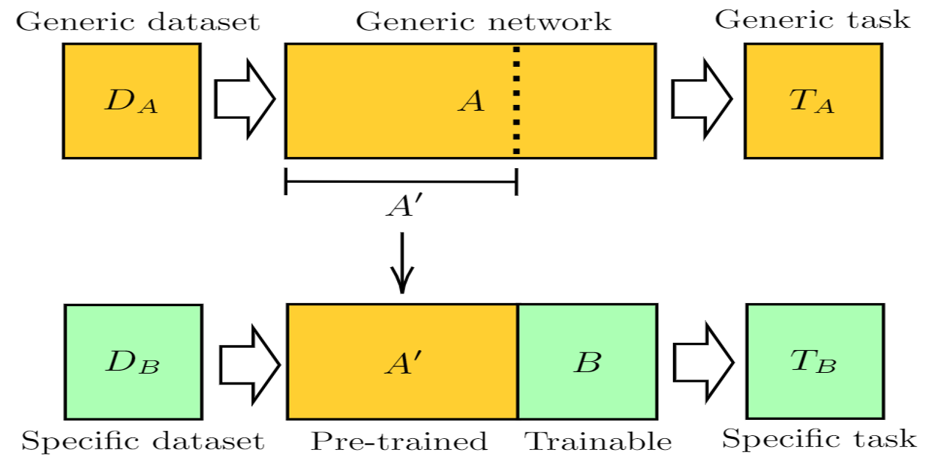
How do they do it?

Slide 20
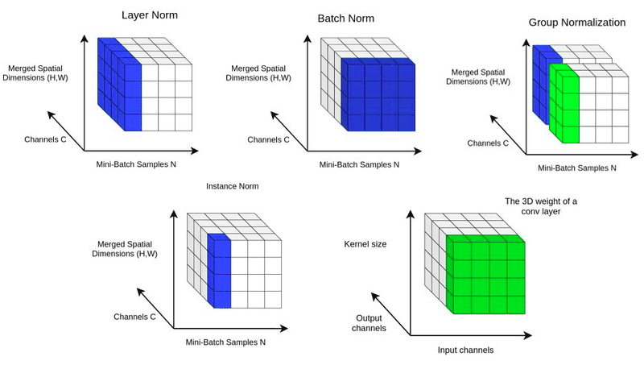
Normalization:

