Slide 1
Session 7
Autoencoders

Slide 2
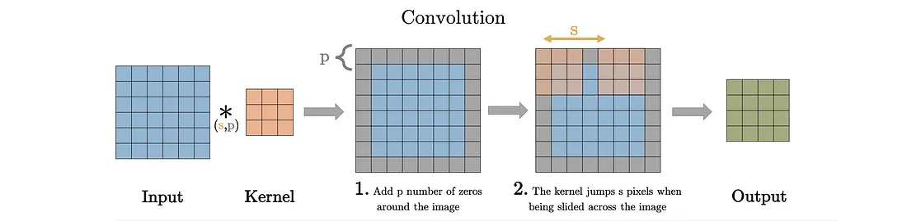
Conv

Slide 3
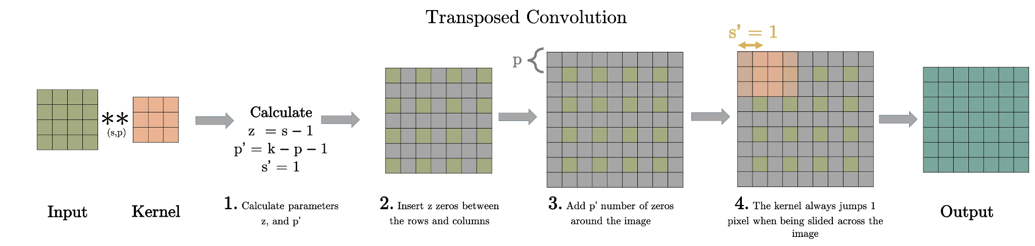
Transposed Conv
A transposed convolutional layer, on the other hand, is usually carried out for upsampling i.e. to generate an output feature map that has a spatial dimension greater than that of the input feature map.

Slide 4
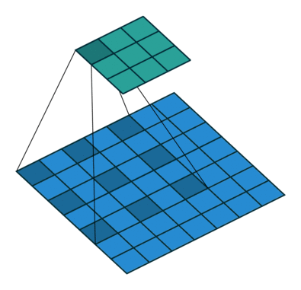
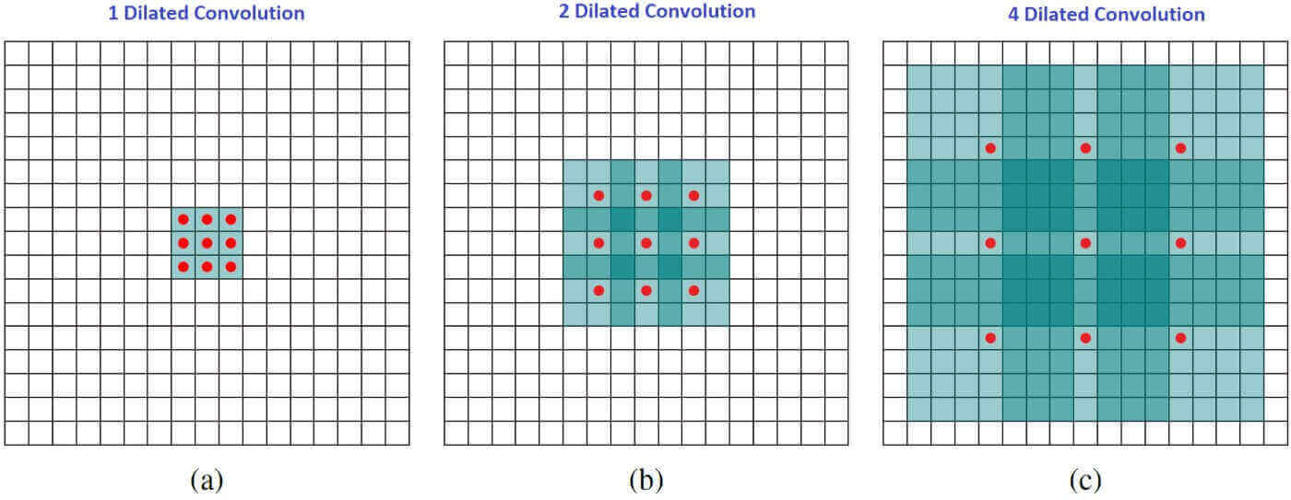
Dilated Conv

Slide 5
Dilated convolution, also known as Atrous Convolution or convolution with holes, first came into light by the paper "Semantic Image Segmentation with Deep Convolutional Nets and Fully Connected CRFs".
The idea behind dilated convolution is to "inflate" the kernel which in turn skips some of the points.

Slide 6
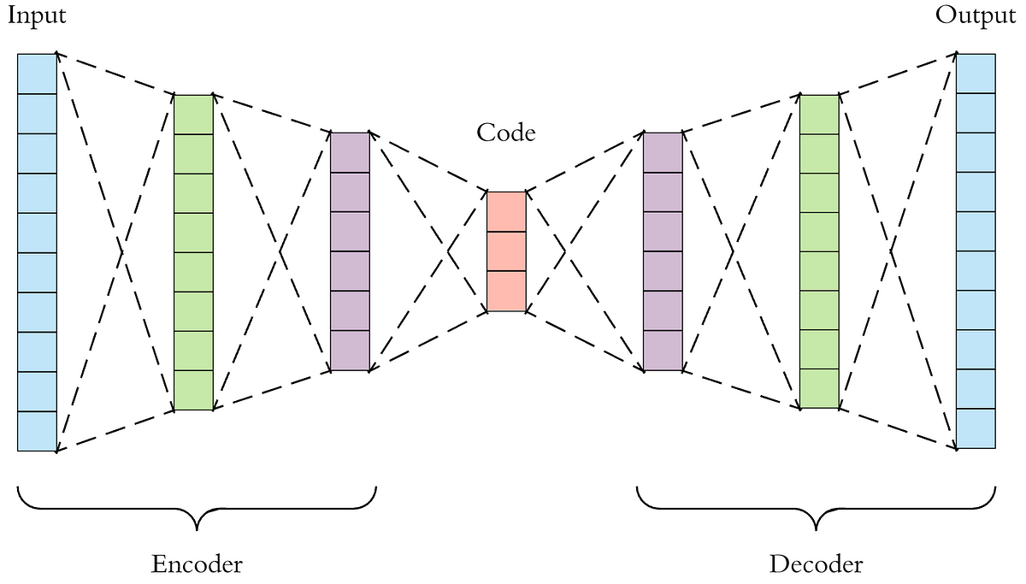
Autoencoders

Slide 7
Autoencoders are a specific type of feedforward neural networks where the input is the same as the output.
They compress the input into a lower-dimensional code and then reconstruct the output from this representation.
The code is a compact “summary” or “compression” of the input, also called the latent-space representation.

Slide 8
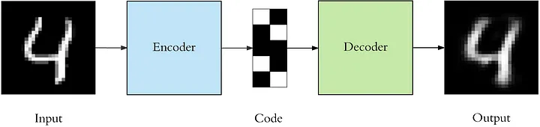

Slide 9
Imp: Denoising Autoencoders
Keeping the code layer small forced our autoencoder to learn an intelligent representation of the data.
There is another way to force the autoencoder to learn useful features, which is adding random noise to its inputs and making it recover the original noise-free data.
This way the autoencoder can’t simply copy the input to its output because the input also contains random noise.
We are asking it to subtract the noise and produce the underlying meaningful data. This is called a denoising autoencoder.

Slide 10
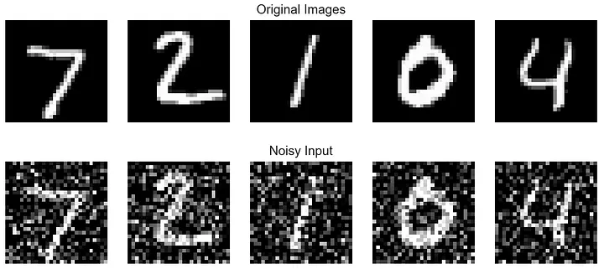
Input data for denoising autoencoders

Slide 11
