Slide 1

Health Data Science Project Employment turnover prediction in Debre Markos University using comparative Supervised Machine learning Algorithms
Presentation
by
Abraham Keffale
(Clinical Nurse ,HO ,MSc student in Health Data Science)
Debre Markos
August 2024

Slide 2
Outline
Introduction
Problem Statement
Rationale of Choosing the topic
Significance of the study
Conceptual framework
Objectives
Methods and Materials
Result
Discussion
Conclusion
Recommendation
Acknowledgment
Reference

Slide 3
Introduction
• Debre Markos University faces challenges related to staff dropout.
• The study aims to predict staff dropout using various machine learning models and see trends.
• The importance of predicting dropout is to enhance staff retention strategies.

Slide 4
Problem Statement
• High staff turnover at Debre Markos University impacts the institution's performance.
• There is a need to understand the underlying reasons and predict future dropouts.
• Traditional methods are insufficient for accurate predictions.

Slide 5
Rationale of Choosing the Topic
High Staff Turnover
Limitations of Traditional Methods
Machine Learning as a Solution
Shift to Data-Driven Decision Making
Research Gap
Institutional Benefits

Slide 6
Significance of the Study
Targeted Interventions
Operational Stability
Impact on Education Quality
Data-Driven Decision-Making
Contribution to Literature
Policy Implications
Reputation Enhancement

Slide 7
Conceptual Frame work

Slide 8
Objectives
General Objective
to predict staff dropout at Debre Markos University using machine learning techniques
Specific Objectives
To determine the key demographic, job-related, and organizational factors that influence staff turnover
To Extract actionable insights from model predictions to inform strategic decision-making and develop targeted retention strategies

Slide 9
Methods and Materials
• Data Collection: HR records from Debre Markos University.
• Data Preprocessing: Handling missing values, feature selection.
• Model Selection: Logistic Regression, Decision Tree, Random Forest, etc.
• Model Evaluation: Accuracy, Precision, Recall, F1-Score.

Slide 10
Data Collection
Source: HR records of Debre Markos University
Ethical Compliance
Variable Identification
Data Format is exported excel file

Slide 11
Data Preprocessing
Data Cleaning
Data Transformation
Feature Engineering
Excel and Power BI ,and Python for data cleaning and preparation.

Slide 12
Machine Learning Models
Logistic Regression: For binary classification.
Decision Tree: For non-linear relationships.
Random Forest: Ensemble method for better accuracy.
Naive Bayes: Probabilistic model.
SVM: Support Vector Machine for optimal hyperplane.
KNN: K-Nearest Neighbors for classification.

Slide 13
Model Evaluation Metrics
Accuracy: Proportion of correct predictions.
Precision: True positives over predicted positives.
Recall: True positives over actual positives.
F1-Score: Harmonic mean of Precision and Recall.
ROC curve

Slide 14
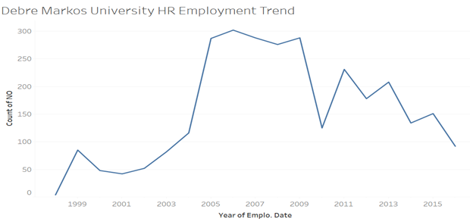
Result 1.Descriptive Statistics

Slide 15
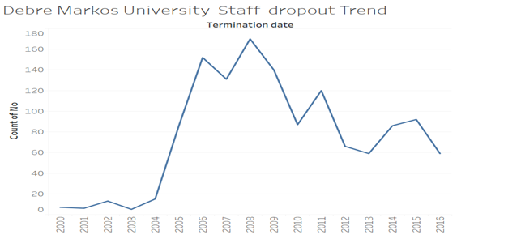

Slide 16
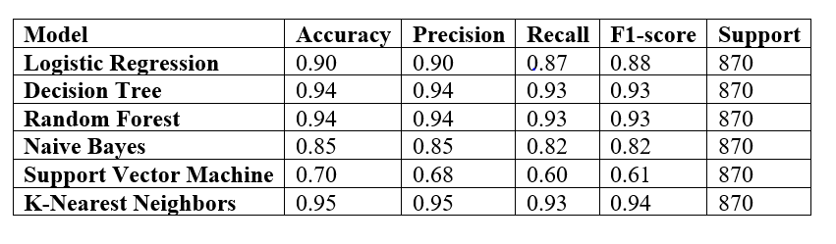
2.Model performance

Slide 17
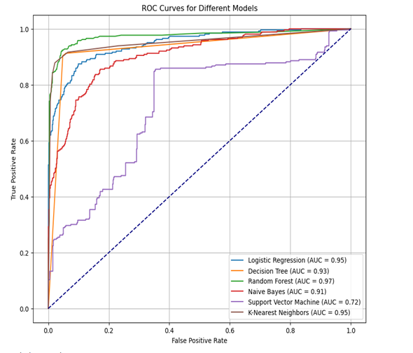
Roc curve

Slide 18
Best Performing Model
• Model Selected: KNN
• Reasons for Selection: High accuracy, robustness against overfitting
• Implications: Reliable predictions for HR decision-making

Slide 19
Discussion
• Interpretation of Results: Insights gained from model performance.
• Practical Implications: How the findings can be applied in the university's HR strategy.
• Limitations: Challenges faced during the study and limitations of the models.

Slide 20
Conclusion
• Summary of Key Findings: Brief overview of what was discovered.
• Contribution to Knowledge: How this study adds to existing research.

Slide 21
Recommendation and Future Work
• Explore additional machine learning models.
• Incorporate more comprehensive data sources.
• Longitudinal study to track dropout trends over time.

Slide 22
Acknowledgment

Slide 23
References
1. Kaya Ç, ŞİMŞEk M. Prediction of Employee Turnover with Imbalance Dataset Using Machine Learning Methods. International Journal of Advanced Natural Sciences and Engineering Researches. 2023;7(9):12-6.
2. Mazarei SM, pouramini J. Predicting employee turnover using tree-based ensemble ‎learning algorithms ‎. Signal and Data Processing. 2023;20(3):73-86.
3. Alemayehu BZ, . Academic staff flight from Ethiopian public universities: Causes and possible solutionsDepartment of Management, Arba Minch University, Arba Minch, Ethiopia. 2019.
4. Tesfaye A. The Relationship between Job Satisfaction and Turnover Intentions among Faculty Members in Ethiopian Higher Education Institutions. Indonesian Psychological Research. 2023;5.
5. Punnoose R, Ajit P, editors. Prediction of Employee Turnover in Organizations using Machine Learning Algorithms A case for Extreme Gradient Boosting2016.
6. Shankar S, Vyas R, Tewari V. Applying machine learning algorithms to determine and predict the reasons and models for employee turnover. International Journal of Information Technology and Management. 2024;23(1):48-63.
7. Yin Q. Comparison of Machine Learning Models for Employee Turnover Prediction.Applied and Computational Engineering,8,228-232. . (2023).
8. Zhao Y, Hryniewicki M, Cheng F, Fu B, Zhu X. Employee Turnover Prediction with Machine Learning: A Reliable Approach2018.
9. Park J, Feng Y, Jeong SP. Developing an advanced prediction model for new employee turnover intention utilizing machine learning techniques. Sci Rep. 2024;14(1):1221.
10. Mohbey K. Employee's Attrition Prediction Using Machine Learning Approaches. 2020. p. 121-8.
11. Veglio V, Romanello R, Pedersen T. Employee turnover in multinational corporations: a supervised machine learning approach. Review of Managerial Science. 2024.
12. Liao C, editor Employee turnover prediction using machine learning models. International Conference on Mechatronics Engineering and Artificial Intelligence (MEAI 2022); 2023 February 01, 2023.
13. Chowdhury A, Malakar S, Seal D, Goswami S. Understanding Employee Attrition Using Machine Learning Techniques. 2022. p. 101-9.

