Slide 1
abraham.2
File created on: 04-07-2022 15:38:31

Slide 2


Slide 3
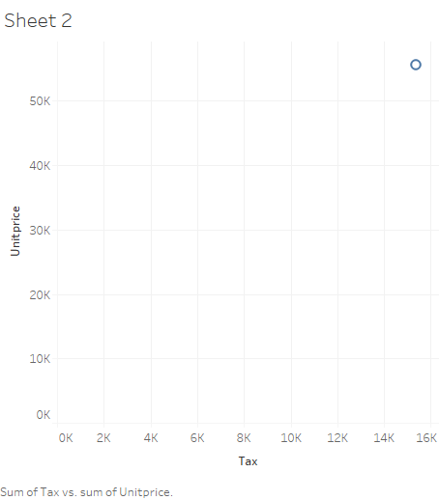

Slide 5


Slide 6
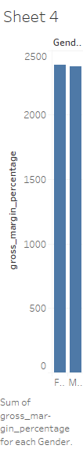

Slide 7


Slide 9
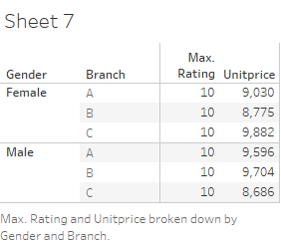

Slide 10
