Slide 1
CSCI 6030: Frontend Web Application Development
Version Control, Git, and GitHub

Slide 2

Version Control and Git
Version control, also known as source control, is the practice of tracking and managing changes to software code
Version control systems are software tools that help software teams manage changes to source code over time
The code for a project, app or software component is typically organized in a folder structure or "file tree"
Git is a popular version control system. It is used for:
Tracking code changes
Tracking who made changes
Coding collaboration
Image source: https://git-scm.com/

Slide 3

Git and GitHub
Git is not the same as GitHub.
GitHub makes tools that use Git.
GitHub is the largest host of source code in the world, and has been owned by Microsoft since 2018.
You can download Git for free from the following website: https://www.git-scm.com/
You can create a free account on GitHub and also download the software package from: https://github.com/
Image sources: https://git-scm.com/; https://github.com/

Slide 4
GitHub Setup and Basic Git Commands
Easiest way to configure GitHub in your computer is to setup their Software Package and log in
Check Git version:
git --version
Configure User:
git config --global user.name "John"
git config --global user.email "John@google.com"
Navigate to project folder
mkdir project_folder
cd project_folder
Initialize Git
git init

Slide 5
GitHub Setup and Basic Git Commands
Easiest way to configure GitHub in your computer is to setup their Software Package and log in
Check Git version:
git --version
Configure User:
git config --global user.name "John"
git config --global user.email "John@google.com"
Navigate to project folder
mkdir project_folder
cd project_folder
Initialize Git
git init

Slide 6
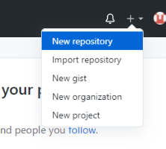
Basic Git Commands
You can create New Repository in your GitHub account
Configure the repository to be public or private
Add readme and gitignore file
The readme file should explain the details of your project
The gitignore file lists the files and directories that Git should ignore storing/keeping track of

Slide 7
Pushing local change to Remote Repo
Add remote connection/origin
Syntax: git remote add origin URL
Example: git remote add origin https://github.com/john/hello-world.git
Check local status
git status
Stage all changes
git add –all
Commit changes
Syntax: git commit –m “commit message”
Example: git commit –m “Added index file”
Push changes
git push origin

Slide 8
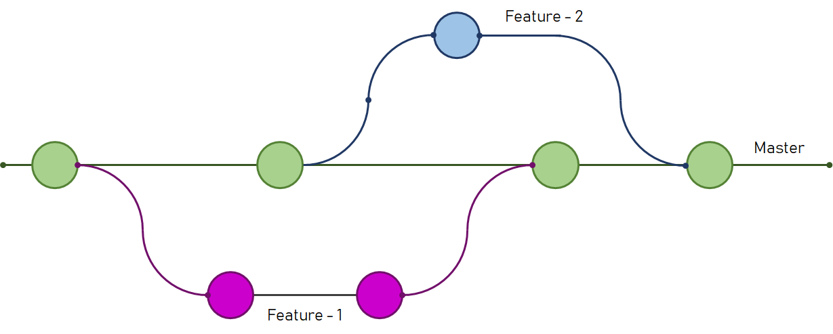
Git Branches
Branches allow you to work on different parts of a project without impacting the main branch.
When the work is complete, a branch can be merged with the main project.
You can even switch between branches and work on different projects without them interfering with each other.

Slide 9
Git Branches
List branches:
git branch
Create new branch
git branch <branch_name>
Example: git branch feature/homepage
Switch branch
git checkout <branch_name>
Example: git checkout feature/homepage
Create and switch
git checkout –b <branch_name>
Example: git checkout –b feature/homepage

Slide 10
Git Branches
Delete branch:
git branch -d <branch_name>
‘-d’ means deleting the branch only if the branch is pushed and merged with the remote branch
Force delete:
git branch -D <branch_name>
‘-D’ means deleting forcefully without checking whether the branch is pushed or not
Remove remote branch
git push origin --delete <branch_name>

Slide 11
Git Branches
Delete branch:
git branch -d <branch_name>
‘-d’ means deleting the branch only if the branch is pushed and merged with the remote branch
Force delete:
git branch -D <branch_name>
‘-D’ means deleting forcefully without checking whether the branch is pushed or not
Remove remote branch
git push origin --delete <branch_name>

Slide 12
Common Git Commands
git init initializes your local directory as a new git repository. You must run this before you can commit any of your work.
git status shows the current status of your repo. It will show you if you have any work that is unstaged, what branch you are on, how many commits you are ahead of the master remote on github, and other useful things.
git diff shows you the changes in your unstaged code.
git remote -v shows you all the remotes for your repo. The v stands for verbose, which shows you the URL of the repository on github, if any, that your local repository is pointing to rather than just the name of the remote repo.
git add . takes all unstaged work and stages it, making it ready to be committed. You can also specify a particular file to stage with git add file-path/name-of-file
git commit -m "write commit message here" commits all staged work. It’s important to write a brief, clear commit message so you know what each commit is for. “Final commit” is not the commit message you’re looking for exactly 100% of the time.
Sources: https://frontend.turing.edu/lessons/module-1/git-commands.html

Slide 13
Common Git Commands
git commit -m "commit message" commits all staged work. It’s important to write a brief, clear commit message so you know what each commit is for. “Final commit” is not the commit message you’re looking for exactly 100% of the time.
git pull once you’ve committed all your local work and running git status shows that you have nothing to commit, you pull down any changes from your remote. By default, this will pull from the origin remote’s master branch. To be specific about which remote and branch to pull from, you can use: git pull name-of-remote name-of-branch
git push pushes your local changes up to your remote. By default, this will push to the origin remote’s master branch. Like pull, you can push to a specific remote and branch with: git push name-of-remote name-of-branch. This is useful if you are using branches and pull requests. If you get an error message, it’s probably because you haven’t pushed your local branch up to github yet. Try git push -u name-of-remote name-of-branch.
git branch shows you all your local branches and indicates which branch you are currently on.
git checkout -b name-of-new-branch makes a new branch and switches to that branch.
Sources: https://frontend.turing.edu/lessons/module-1/git-commands.html

Slide 14
Common Git Commands
git merge name-of-branch will merge the specified branch into the branch you are currently on.
git branch -d name-of-branch-to-delete deletes the specified branch
git log will show you the full list of commits and authors for your repo
history will show you your past git commands
git stash stashes any unstaged changes in your repository. They will not be present in your codebase, but they are not deleted.
git stash pop gives you back the last staged changes you stashed
git blame file-path/name-of-file shows you line-by-line who wrote the code in the specified file. Useful when you have a question about how something works and want to figure out who to ask, and also great source of shame when you realize you wrote the chunk of code you’ve been swearing at for the last hour.
Sources: https://frontend.turing.edu/lessons/module-1/git-commands.html

Slide 15
Commands & Tutorials
Detailed tutorials and list of commands:
https://git-scm.com/docs
https://www.w3schools.com/git/default.asp
https://www.atlassian.com/git/glossary#commands
https://frontend.turing.edu/lessons/module-1/git-commands.html
Image sources: https://git-scm.com/; https://github.com/

Slide 16
Task 6: GitHub Repository Due: Friday, February 7, 2025
Create and setup your GitHub account
Create a new repository for class assignments
Either create a public repository or
Collaborate with https://github.com/aum-web-app
Pull the repository to your local machine
Create a branch for Task 5: Calculator assignment
Checkout to the newly created branch
Copy Task 5: Calculator files in your local repository
Stage all changes
Push changes to remote with appropriate commit message
Make pull request and accept merge request
Submit your repository URL and commit ID (of Task 5 merge) in Canvas
Checkout to the master branch

Slide 17

JavaScript with HTML

Slide 18
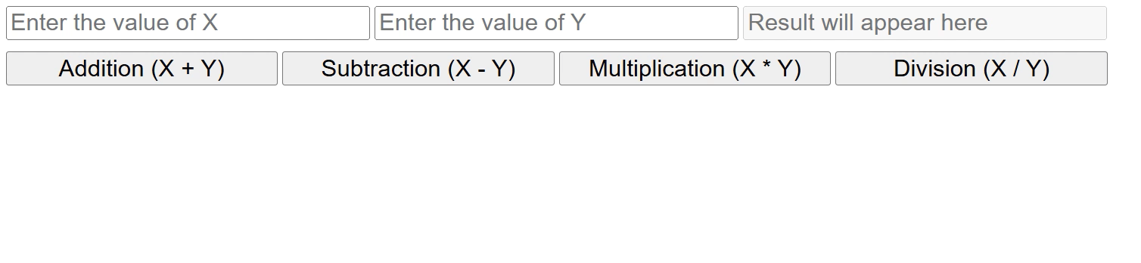
Calculator with JS
Here, we used different arithmetic operations in JS
function add(){
let x = parseInt(document.getElementById("num1").value);
let y = parseInt(document.getElementById("num2").value);
let result = x + y;
document.getElementById("res").value = result;
}

Slide 19
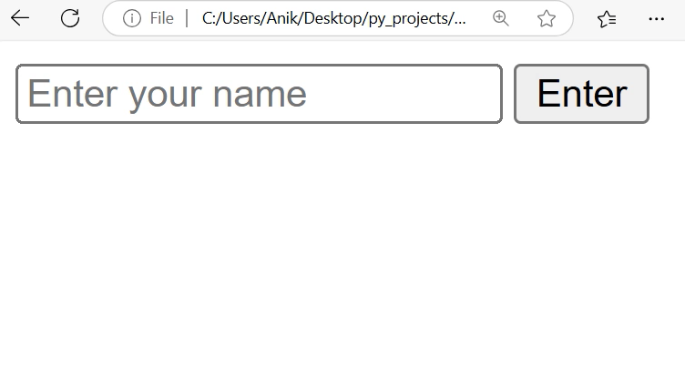
Events
HTML events are "things" that happen to HTML elements
An HTML event can be something the browser does, or something a user does
JavaScript can "react" on these events
Here are some examples of HTML events:
An HTML web page has finished loading
An HTML input field was changed
An HTML button was clicked

Slide 20
Events
HTML allows event handler attributes, with JavaScript code, to be added
JavaScript code is often several lines long. It is more common to see event attributes calling functions
Syntax: <element event="some JavaScript">
Example: <button onclick="greet();">Click Me!</button>

Slide 21
Which event are we using here?

Slide 22

Which event are we using here?

Slide 23
Event Examples
Event | Description
onchange | An HTML element has been changed
onclick | The user clicks an HTML element
onmouseover | The user moves the mouse over an HTML element
onmouseout | The user moves the mouse away from an HTML element
onkeydown | The user pushes a keyboard key
onload | The browser has finished loading the page

Slide 24
JavaScript Arithmetic Operators
Operator | Description
+ | Addition
- | Subtraction
* | Multiplication
** | Exponentiation
/ | Division
% | Modulus (Division Remainder)
++ | Increment
-- | Decrement

Slide 25
JavaScript Assignment Operators
Operator | Example | Same As
= | x = y | x = y
+= | x += y | x = x + y
-= | x -= y | x = x - y
*= | x *= y | x = x * y
/= | x /= y | x = x / y
%= | x %= y | x = x % y
**= | x **= y | x = x ** y

Slide 26
Bitwise Assignment Operators
Operator | Example | Same As
&= | x &= y | x = x & y
^= | x ^= y | x = x ^ y
|= | x |= y | x = x | y

Slide 27
Logical Assignment Operators
Operator | Example | Same As
&&= | x &&= y | x = x && (x = y)
||= | x ||= y | x = x || (x = y)
??= | x ??= y | x = x ?? (x = y)

Slide 28
JavaScript Data Types
// Numbers:
let length = 13;
let weight = 127.5;
// Strings:
let color = "Green";
let lastName = "Cavil";
// Booleans
let x = true;
let y = false;
// Object:
const person = {firstname:"John", lastname:"Doe"};
// Array object:
const cars = ["Saab", "Volvo", "BMW"];
// Date object:
const date = new Date("2022-03-25");
JavaScript has 8 Datatypes
String
Number
Bigint
Boolean
Undefined
Null
Symbol
Object
A JavaScript variable can hold any type of data.

Slide 29
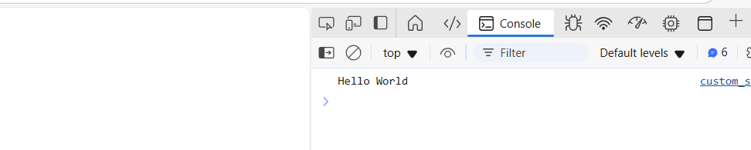
Console Output – Let’s Code
// JS Code
console.log("Hello World")
<!DOCTYPE html>
<html>
<head>
<script src="custom_script.js"></script>
</head>
<body>
<div id="demo_div"></div>
</body>
</html>
Custom_script.js
Index.html
Output in Console

Slide 30
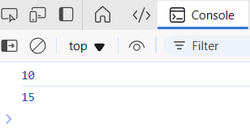
Console Output – Let’s Code
// Example of assignment operation let x = 10;
console.log(x);
// Example of addition operation let y = x + 5;
console.log(y);
<!DOCTYPE html>
<html>
<head>
<script src="custom_script.js"></script>
</head>
<body>
<div id="demo_div"></div>
</body>
</html>
Custom_script.js
Index.html
Output in Console

Slide 31
Strings
JavaScript strings are primitive and immutable
All string methods produce a new string without altering the original string
Strings are for storing text, written with quotes
Examples:
let carName1 = "Volvo XC60"; // Double quotes
let carName2 = 'Volvo XC60'; // Single quotes
Strings created with single or double quotes work the same with no difference
The length of a string can be accessed by using the built-in length property
let canLength = carName1.length;

Slide 32
String Concatenation
In JavaScript, strings can be concatenated using the plus sign
Example:
let merged = "Hello" + "World";
let s1 = "Hello";
let s2 = "world";
let merged = "Hello" + "World";

Slide 33
String Methods
String length
String charAt()
String charCodeAt()
String at()
String [ ]
String slice()
String substring()
String substr()
String toUpperCase()
String toLowerCase()
String concat()
String trim()
String trimStart()
String trimEnd()
String padStart()
String padEnd()
String repeat()
String replace()
String replaceAll()
String split()

Slide 34


String Method Examples
let text = "Hello world";
let text_length = text.length;
console.log("Length of text: " + text_length);
let text = "Hello world";
let loc_w = text.indexOf("w");
console.log("Index of 'w': " + loc_w);

Slide 35
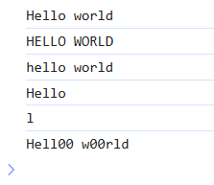
String Methods – More Examples
let text = "Hello world";
console.log(text);
console.log(text.toUpperCase());
console.log(text.toLowerCase());
console.log(text.substring(0, 5));
console.log(text.charAt(3));
console.log(text.replaceAll('o', '00'));

Slide 36
Escape Characters
What if we need to store a quote within a string in JS?
We can use a backslash escape character
Example:
let text= 'It\'s alright.';
Code | Result | Description
\' | ' | Single quote
\" | " | Double quote
\\ | \ | Backslash

Slide 37
Escape Characters in JS
Code | Result
\b | Backspace
\f | Form Feed
\n | New Line
\r | Carriage Return
\t | Horizontal Tabulator
\v | Vertical Tabulator

